Slide 1

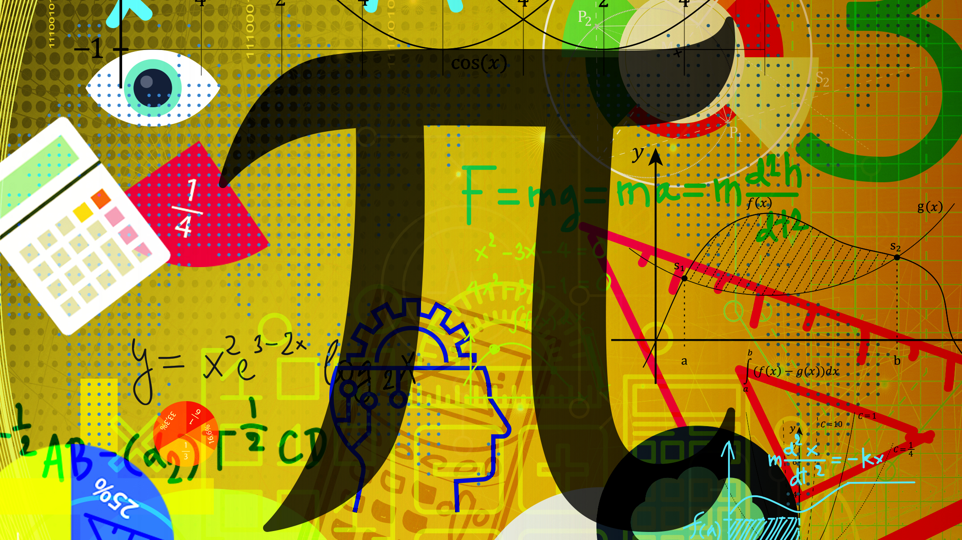
Mathematics
N6

Slide 2
Module 1: Differentiation
INTRODUCTION
Differentiation is one of the most important fundamental concepts to understand in mathematics. It allows us to find the rate of change of one variable with respect to another variable.
www.futuremanagers.com

Slide 3
Module 1: Differentiation (continued)
PARTIAL DIFFERENTIATION
The partial derivative of a function of several variables is the derivative with respect to one of the variables, while the other variables are held constant.
Partial derivatives are themselves functions of the variables concerned and as such, they can also be differentiated.
www.futuremanagers.com

Slide 4
Module 1: Differentiation (continued)
DIFFERENTIATION OF PARAMETRIC EQUATIONS
Parametric equations are a number of equations that take into account several different independent variables or parameters in order to express coordinate points. This is done to define complex geometric objects such as surfaces and curves.
www.futuremanagers.com

Slide 5

Module 2: Integration techniques
INTEGRATION BY PARTS
Every integration rule corresponds to a differentiation rule. Integration by parts is no different. This rule corresponds to the product rule of differentiation:
$$\frac{d}{dx}\left[f\left(x\right)g\left(x\right)\right]=f^{′}\left(x\right)g\left(x\right)+f\left(x\right)g^{′}\left(x\right)$$
$$\int{\left[f^{′}\left(x\right)g\left(x\right)+f\left(x\right)g^{′}\left(x\right)\right]=f\left(x\right)g(x)}$$
www.futuremanagers.com

Slide 6
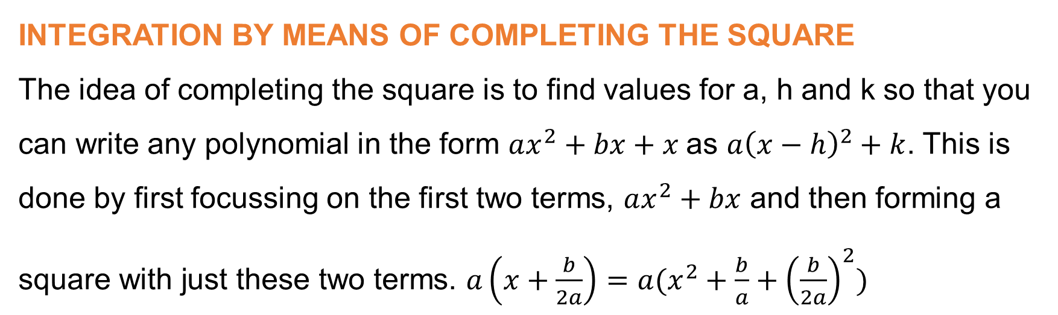
Module 2: Integration techniques (continued)
INTEGRATION BY MEANS OF COMPLETING THE SQUARE
The idea of completing the square is to find values for a, h and k so that you can write any polynomial in the form $ax^{2}+bx+x$as $a{\left(x−h\right)}^{2}+k$. This is done by first focussing on the first two terms, $ax^{2}+bx$ and then forming a square with just these two terms. $a\left(x+\frac{b}{2a}\right)=a(x^{2}+\frac{b}{a}+{\left(\frac{b}{2a}\right)}^{2})$
www.futuremanagers.com

Slide 7
Module 3: Partial fractions
INTRODUCTION
Partial fractions is a method used to break apart fractions containing polynomials. Partial-fraction decomposition is the process of starting with the simplified answer and taking it back apart or decomposing it into its initial polynomial fractions.
www.futuremanagers.com

Slide 8

Module 3: Partial fractions (continued)
THE RULES FOR DECOMPOSING INTO PARTIAL FRACTIONS
The numerator of the given functions must be of a lower degree than that of the denominator.
Factorise the denominator into its irreducible factors.
A linear factor $ax+b$ results in a partial fraction of the form $\frac{A}{ax+b}$
A linear factor repeated has partial fractions $\frac{A}{ax+b}+\frac{B}{{\left(ax+b\right)}^{2}}+…+\frac{G}{{\left(ax+b\right)}^{n}}$
An irreducible quadratic factor $\left(ax^{2}+bx+c\right)$ gives fraction $Ax+\frac{B}{ax^{2}+bx+c}$
www.futuremanagers.com

Slide 9
Module 4: Differential equations
INTRODUCTION
A differential equation is an equation that involves the derivatives of one or more functions. These equations can be used to model very complex systems and they are an important aspect of calculus.
www.futuremanagers.com

Slide 10
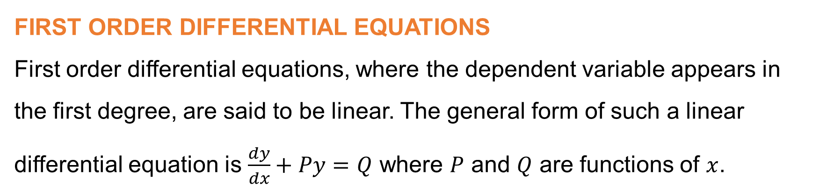
Module 4: Differential equations (continued)
FIRST ORDER DIFFERENTIAL EQUATIONS
First order differential equations, where the dependent variable appears in the first degree, are said to be linear. The general form of such a linear differential equation is $\frac{dy}{dx}+Py=Q$ where $P$ and $Q$ are functions of $x$.
www.futuremanagers.com

Slide 11
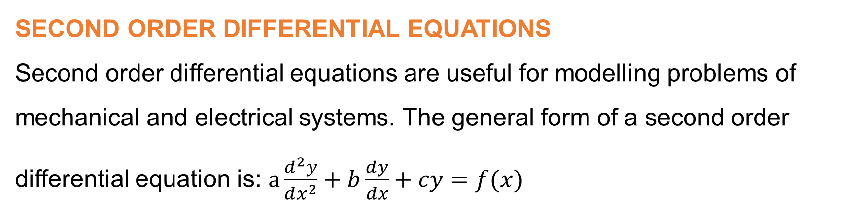
Module 4: Differential equations (continued)
SECOND ORDER DIFFERENTIAL EQUATIONS
Second order differential equations are useful for modelling problems of mechanical and electrical systems. The general form of a second order differential equation is: $a\frac{d^{2}y}{dx^{2}}+b\frac{dy}{dx}+cy=f(x)$
www.futuremanagers.com

Slide 12
Module 4: Differential equations (continued)
NON-HOMOGENOUS DIFFERENTIAL EQUATIONS
Non-homogeneous equations are the same as homogeneous differential equations, except they can have terms involving only x (and constants) on the right side.
www.futuremanagers.com

Slide 13
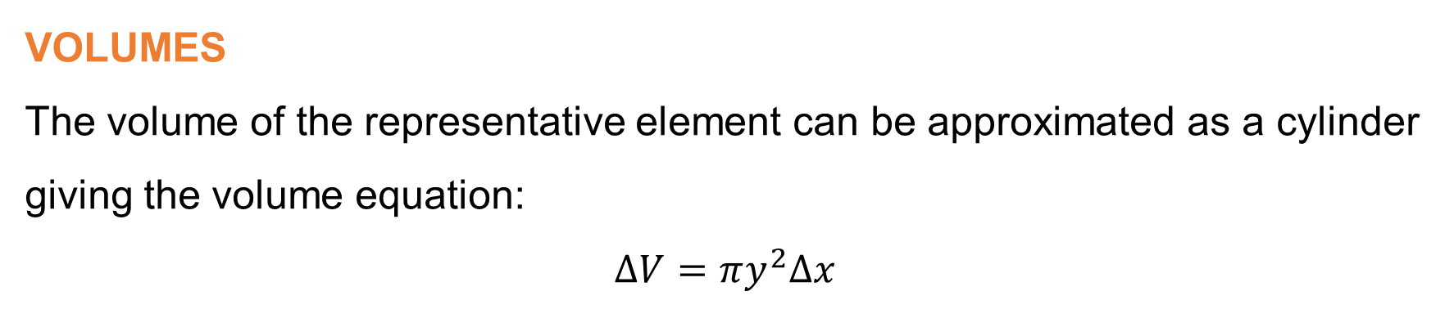
Module 5: Applications of the definite integral
VOLUMES
The volume of the representative element can be approximated as a cylinder giving the volume equation:
$$ΔV=πy^{2}Δx$$
www.futuremanagers.com

Slide 14
Module 5: Applications of the definite integral (continued)
CENTROIDS
The geometric centre of an object; the arithmetic mean position of all points in a shape. The centroid of any shape can be found using x- and y coordinates on a cartesian plane.
www.futuremanagers.com

Slide 15
Module 5: Applications of the definite integral (continued)
CENTRES OF GRAVITY
The centre of gravity is the average location of the weight of an object. Also known as the centre of mass (when the gravitational field is uniform across the object).
www.futuremanagers.com

Slide 16
Module 5: Applications of the definite integral (continued)
SECOND MOMENT OF AREA
The second moment of area is a geometrical property of a specific area which describes how all the points of the area are distributed with regard to a particular axis. This concept helps to determine the resistance of an object to bending along a certain axis. This is extremely important in structural engineering and helps to identify how and where beams will bend when subjected to a load.
www.futuremanagers.com

Slide 17
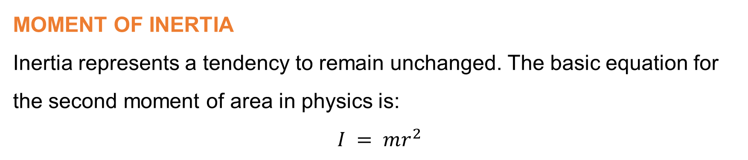
Module 5: Applications of the definite integral (continued)
MOMENT OF INERTIA
Inertia represents a tendency to remain unchanged. The basic equation for the second moment of area in physics is:
$$I = mr^{2}$$
www.futuremanagers.com

Slide 18
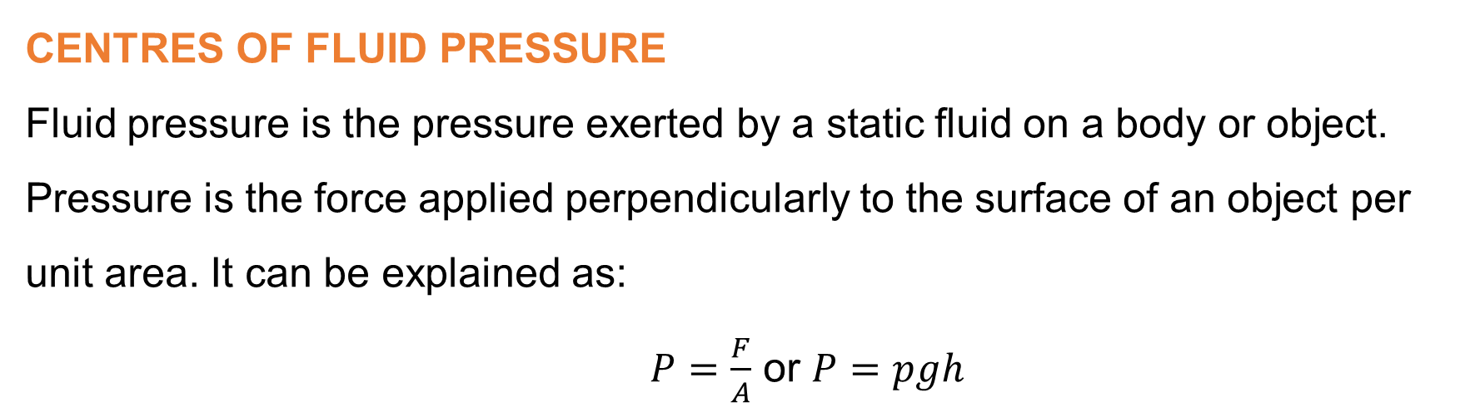
Module 5: Applications of the definite integral (continued)
CENTRES OF FLUID PRESSURE
Fluid pressure is the pressure exerted by a static fluid on a body or object. Pressure is the force applied perpendicularly to the surface of an object per unit area. It can be explained as:
$P=\frac{F}{A}$ or $P=pgh$
www.futuremanagers.com

Slide 19

Module 6: Applications where differentiation and integration techniques are combined
LENGTH OF NON-PARAMETRIC CURVES
The arc length can be determined for continuous and derivative functions over a given range. The non-parametric functions are functions of one another. For non parametric functions, the formula used to determine the length is the same as the general formula:
$$L=\int_{b}^{a}{\sqrt{1+{\left(\frac{dy}{dx}\right)}^{2}dx}}$$
www.futuremanagers.com

Slide 20
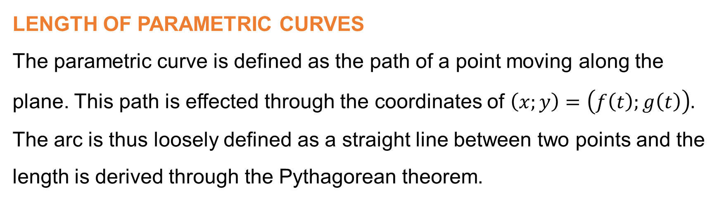
Module 6: Applications where differentiation and
integration techniques are combined (continued)
LENGTH OF PARAMETRIC CURVES
The parametric curve is defined as the path of a point moving along the plane. This path is effected through the coordinates of $\left(x;y\right)=\left(f\left(t\right);g\left(t\right)\right).$ The arc is thus loosely defined as a straight line between two points and the length is derived through the Pythagorean theorem.
www.futuremanagers.com

Slide 21
Module 6: Applications where differentiation and
integration techniques are combined (continued)
SURFACES OF REVOLUTION
A surface of revolution is formed when a curve is rotated about a line. Using integration and differentiation techniques, it is possible to determine the area of such curve.
www.futuremanagers.com

