Slide 1

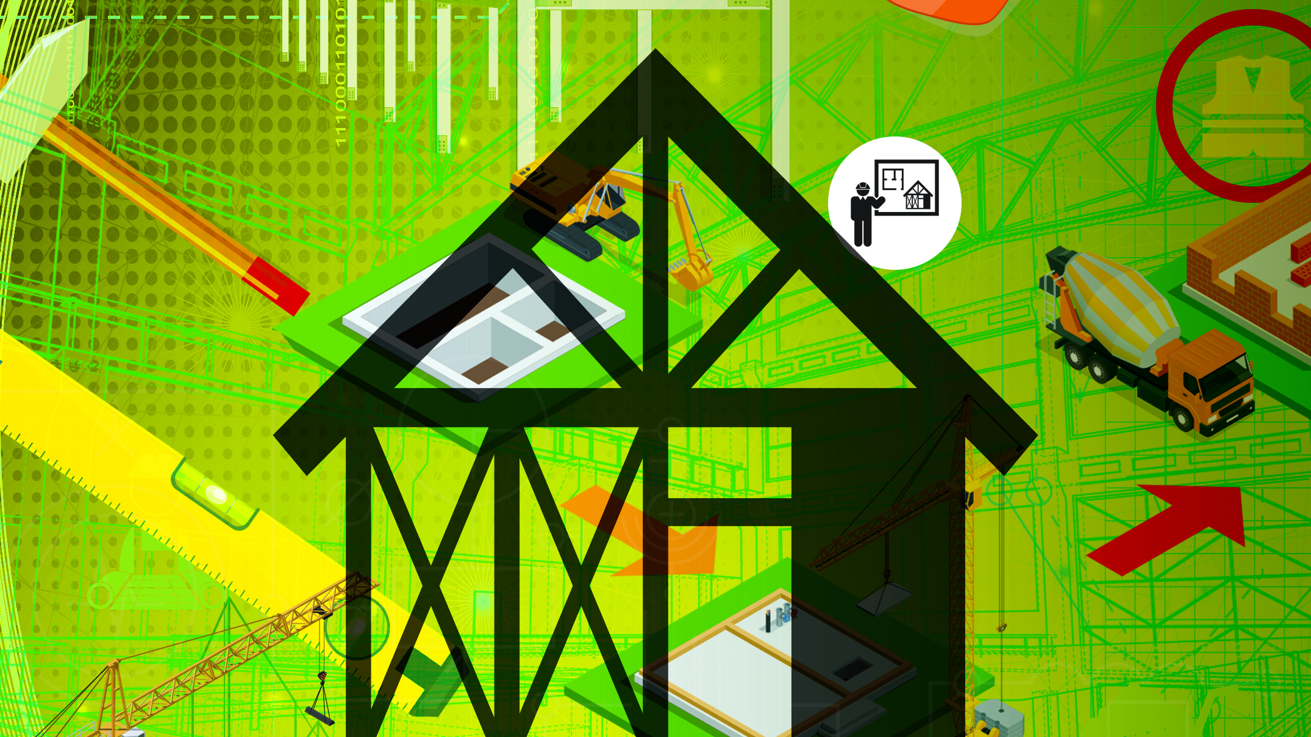
Building and Structural Construction
N6

Slide 2
Module 1: Concrete
CONCRETE MATERIALS
Concrete is one of the most used materials in most types of buildings structures. Concrete is a composite material composed of fine and coarse aggregate bonded together with a fluid cement that hardens over time. Concrete is produced by mixing aggregate and cement. The addition of enough water allows the mixture to set and gain strength. Concrete gains strength over time, as long it is given the time to cure.
www.futuremanagers.com

Slide 3
Module 1: Concrete (continued)
CONCRETE MATERIALS: SAND
The most suitable sands are natural sands or sand that is manufactured (crushed rock). Pit sand tends to have particles of clay that could interfere with the proper strength of the concrete. Pit sand should be properly washed to remove any excess clay. These sands should contain at least 5% fineness. Too much fineness can cause a reduction in the strength in the concrete.
www.futuremanagers.com

Slide 4
Module 1: Concrete (continued)
CONCRETE MATERIALS: STONE
The stones that are used must be hard and strong as well as durable, with a smooth surface. It must be free of any type of impurities, such as clay, salt, roots and earth. Stone aggregate makes the mixture less fluid and thus more stable. It reduces shrinking and deformation.
www.futuremanagers.com

Slide 5
Module 1: Concrete (continued)
CONCRETE MATERIALS: CEMENT
Cement is produced by firing a mixture of limestone and clay in a kiln. The mixture is then ground to a fine powder with a small amount of gypsum. Portland cement is a hydraulic, which means it requires water to turn into cement.
www.futuremanagers.com

Slide 6
Module 1: Concrete (continued)
CONCRETE MATERIALS: WATER
When water is added to the dry mixture, a chemical reaction takes place known as hydration. Water turns the cement into a paste, which together with the sand fills the gaps between the stone, turning the concrete into a solid mass.
www.futuremanagers.com

Slide 7
Module 1: Concrete (continued)
CONCRETE TESTING
The purpose of the slump test is to determine the workability of a concrete mix. The test is performed on site where the concrete is cast. Only fresh concrete from either the mixing machine or ready-mixed concrete trucks must be used for the slump test.
www.futuremanagers.com

Slide 8
Module 1: Concrete (continued)
REINFORCED CONCRETE BEAM DESIGN
Simply supported refers to two reactions with a reinforced concrete (RC) beam resting on the reactions at both sides. An example of this would be a RC lintel over an entrance lobby or garage door opening(s).
www.futuremanagers.com

Slide 9
Module 1: Concrete (continued)
ONE-WAY OR UNIDIRECTIONAL REINFORCED CONCRETE SLABS
Reinforced concrete slabs are essentially used as floors. The slabs are supported by reinforced concrete columns or beams or both. Slabs can either be described as one-way or two-way slabs. The span of a one- way slab is taken as the shortest distance between the two supports.
www.futuremanagers.com

Slide 10
Module 1: Concrete (continued)
T-BEAMS (FLANGED) OF REINFORCED CONCRETE
T-beams and L-beams form one unit when put together. The beam is incorporated within the first floor slab and is cast monolithically. This type of construction consists of the beams, which are constructed first. The formwork to the beams is stopped to accommodate the slab decking plates and to allow for the beam reinforcement to be within the slab.
www.futuremanagers.com

Slide 11
Module 1: Concrete (continued)
L-BEAMS (FLANGED) OF REINFORCED CONCRETE
L-beams forms the perimeter of the slab. The outside formwork is, constructed to the top of the slab. The calculations are very similar to that of the T-beam. Some of the formulae changes due to the nature of the shape of the L-beam.
www.futuremanagers.com

Slide 12
Module 1: Concrete (continued)
REINFORCED CONCRETE COLUMN DESIGN
Reinforced concrete columns are vertical structural members that support the load from the beams and slabs to the base and are primarily classified as compression members. The loads are subjected through the centre of the column and are known as axial loads.
www.futuremanagers.com

Slide 13
Module 1: Concrete (continued)
REINFORCED CONCRETE STAIRCASES
The purpose of a staircase is to allow for the vertical movement between floors.
Staircases are cast monolithically; therefore, the two parts form one singular unit. When we design a staircase, we consider the two parts; namely the slab (waist) and the steps (triangular parts).
www.futuremanagers.com

Slide 14
Module 2: The bending schedule
STRUCTURAL DETAILING: THE BENDING SCHEDULE
The bending schedule is an itemised list of all the reinforcement required for single concrete elements. Civil engineers design the reinforcement, complete the reinforcement layout plan and section drawings as well as the bending schedule.
www.futuremanagers.com

Slide 15
Module 3: Iron and steel
MATERIALS: CUPOLA
A cupola furnace is a vertical tubular furnace used for melting cast iron, bronze and other alloying elements. The cupola furnace is a shaft melting furnace. It is filled with fuel (called coke), metal charge (pig iron, circulation material, scrap steel) and slag-forming additives (limestone) from the top.
www.futuremanagers.com

Slide 16
Module 3: Iron and steel (continued)
MATERIALS: OPEN-HEARTH FURNACE
An open-hearth furnace is used for making steel. The steel is placed on a shallow hearth and flames of burning gas and hot air play over it. The furnace is an enclosed chamber in which heat is produced to heat buildings, destroy refuse, smelt or refine ores.
www.futuremanagers.com

Slide 17
Module 3: Iron and steel (continued)
MATERIALS: THE BESSEMER CONVERTER
The Bessemer steel process was invented by the British inventor Sir Henry Bessemer. The primary method was to produce high-quality steel by shooting air into molten steel. This would in turn burn off carbon and other impurities.
www.futuremanagers.com

Slide 18
Module 3: Iron and steel (continued)
MATERIALS: THE ELECTRIC FURNACE
The electric furnace is a furnace that heats charged materials using an electric arc. Therefore, such a furnace can also be referred to as an ‘electric-arc furnace’.
www.futuremanagers.com

Slide 19
Module 3: Iron and steel (continued)
MATERIALS: NON-FERROUS METALS
All metals are generally classified as either ferrous metals or non-ferrous metals. Ferrous metals have a high carbon content, which makes them vulnerable to rust when exposed to the elements. Non-ferrous metals are alloys or metals that do not contain any iron and therefore do not rust.
www.futuremanagers.com

Slide 20
Module 3: Iron and steel (continued)
BINDING JOINTS
The joints between the top booms (rafters) and bottom booms (tie beams) of a typical steel roof truss are all half-lap joints. Butt joints are used to join the tie beam. This occurs where the span of the building is greater than the longest single length of the steel angle. A rafter and internal strut are connected by bolting the rafter and strut to a gusset plate connecter.
www.futuremanagers.com

Slide 21
Module 3: Iron and steel (continued)
CANTILEVERS AND FULL-FRAME STRUCTURES
Steel roof frames have become very popular in industrial buildings and houses for simple reason that it is light in construction. The trusses can be spanned further apart and are constructed by using steel angles joined to the truss members by means of shaped gusset plates. The joints are held together by means of bolts. For smaller trusses, the joints are mainly welded.
www.futuremanagers.com

Slide 22
Module 3: Iron and steel (continued)
TIE BEAMS AND RAFTERS
Struts are very different compared to ties. Where a tie is under tension, struts are compression members. Together, these two types stabilise the frame. The design of struts follows a similar pattern to that of steel columns, which are also under compression.
www.futuremanagers.com

Slide 23
Module 3: Iron and steel (continued)
WELDING CONNECTIONS
Welding is the art of joining metals by pressure after heating it to a plastic or semi-molten state or by the metals by fusion alone. There are numerous types of welding, of which gas and electric welding are the most popular.
www.futuremanagers.com

Slide 24
Module 3: Iron and steel (continued)
STEEL COLUMNS
Steel columns form an important role in the construction of structural steel. It is as important as the reinforced concrete column is in the building construction. They both act as compression members. Steel column are used extensively in the erection of steel structures such as warehouses and factories, as well as any type of building structure.
www.futuremanagers.com

Slide 25
Module 3: Iron and steel (continued)
ECCENTRIC-LOADED BEAM CONNECTIONS
A concentric load is one that acts in the centre of a column. Eccentric loads acts off-centre or away from the centre of a column, usually in a straight line across. Eccentric loads are generally found attached to steel columns at the perimeter of a workshop or large warehouses where flat boom cranes transport heavy loads across the length of the building.
www.futuremanagers.com

