Slide 1


Industrial Electronics
N1

Slide 2

Module 1 – Introduction to Electronics
UNITS OF MEASUREMENT AND PREFIXES
It it important to have a solid background and knowledge of the units of measurement in this field of study. This is related to quantities such as:
Length. E.g. metres (m)
Area. E.g. square metres ($m^{2}$)
Time. E.g. seconds (s)
Electromotive forces: Volts (V)
Frequency: Hertz (Hz)
www.futuremanagers.com

Slide 3
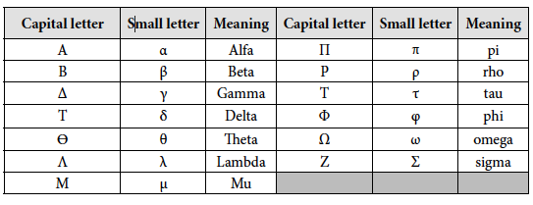
Module 1 – Introduction to Electronics (continued)
GREEK ALPHABET
It is important that you become familiar with the letters of the Greek alphabet in use, such as the following:
www.futuremanagers.com

Slide 4
Module 1 – Introduction to Electronics (continued)
THE MULTI-METER
A multi-meter, which can be analogue or digital, has the capability to
measure current, voltage and resistance by merely changing to the quantity we would like to measure.
www.futuremanagers.com

Slide 5
Module 2 – Basic Atomic Theory
INTRODUCTION
In order to understand the operation of Electronic components and devices it is imperative that we need to have a thorough understanding of basic atomic theory.
www.futuremanagers.com

Slide 6
Module 2 – Basic Atomic Theory (continued)
THE STRUCTURE OF MATTER
Matter may be defined as anything that has mass and that occupies space and can be composed of elementary substances that are found in nature.
Matter can be divided into the following groups:
Solids;
Liquids;
Gasses; and
Plasma.
www.futuremanagers.com

Slide 7
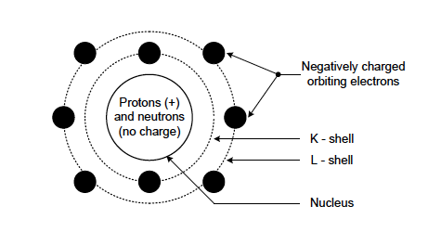
Module 2 – Basic Atomic Theory (continued)
ATOMS
An atom may be defined as the smallest part of an element that can participate in a normal chemical reaction. All atoms consist of minute particles of electrical charges arranged in a set pattern and consist of:
Electrons;
Protons; and
Neutrons.
www.futuremanagers.com

Slide 8
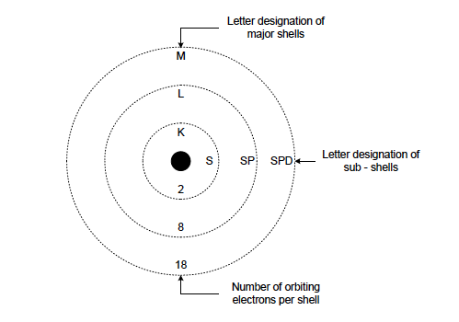
Module 2 – Basic Atomic Theory (continued)
ENERGY SHELLS
In the diagram, the centre circle represents the nucleus consisting of the protons and neutrons and the outer circle or circles indicates the shells for the orbiting electrons.
www.futuremanagers.com

Slide 9
Module 2 – Basic Atomic Theory (continued)
VALENCY
The number of electrons in the outer shell of an atom, called the valence shell, will determine the valency of that element. Valency is an indication of the ability of an atom to gain or lose electrons and will determine the electrical properties of that element.
www.futuremanagers.com

Slide 10
Module 2 – Basic Atomic Theory (continued)
POSITIVE- AND NEGATIVE CHARGES
An atom that has valence electrons will always strive to become stable and in doing so will either lose or gain electrons. When an atom gains an electron the atom becomes negatively charged since it has a surplus of electrons and when an atom loses an electron it will become positively charged since it will have a deficit of electrons.
www.futuremanagers.com

Slide 11
Module 2 – Basic Atomic Theory (continued)
CONDUCTION
Movement of electrons or conduction can and will take place in any given conducting material, in a desired direction, should a source of power be applied across such material. The conduction process can be by either hole flow (transfer) or electron motion or by both.
www.futuremanagers.com

Slide 12
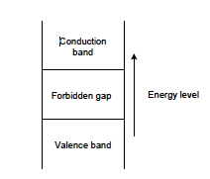
Module 2 – Basic Atomic Theory (continued)
ENERGY BANDS
In any given material, conducting or insulating, there are two distinct energy bands in which electrons may exist, namely the conduction band and the valence band but they will be separated by the forbidden gap.
www.futuremanagers.com

Slide 13
Module 3 – Conductors and Insulators
CONDUCTING MATERIALS
All conducting materials are normally metallic and/or alloys of metals and are classified according to the conductivity of that particular material. Silver, for example, is the best conductor but is very expensive. Copper is used more often as it is versatile and affordable.
www.futuremanagers.com

Slide 14
Module 3 – Conductors and Insulators (continued)
ALLOYS
There are materials that may be combined chemically so as to give specific properties and this combination is termed an alloy. Examples of alloys include:
Brass;
Bronze;
Soft solder; and
Carbon.
www.futuremanagers.com

Slide 15
Module 3 – Conductors and Insulators (continued)
INSULATING MATERIALS
An insulator may be defined as an element that will not allow an electrical current to flow since there are no free electrons in those elements. Materials commonly used in the electrical industry include:
Pure rubber;
Cotton;
Paper; and
Mica.
www.futuremanagers.com

Slide 16
Module 3 – Conductors and Insulators (continued)
CLASSFICATION OF INSULATING MATERIALS
All insulating materials used in electrical engineering and industries today are classified according to the temperature they can withstand.
www.futuremanagers.com

Slide 17
Module 4 – Resistors
INTRODUCTION
All conducting materials will have an opposition to the flow of an electrical current and that this phenomenon is termed resistance of that specific material. A resistor is an electronic component, which offers opposition to the flow of an electric current.
www.futuremanagers.com

Slide 18
Module 4 – Resistors (continued)
DETERMINING RESISTANCE
Resistance can be determined by means of
Colour coding in which selected colours are assigned with a specific numerical value and by merely looking at the colour code and the value of that particular resistor is determined, and
Measurement in which an instrument is used to measure the quantities of current, voltage and resistance by selecting the suitable quantity and scale of the variable to be measured.
www.futuremanagers.com

Slide 19
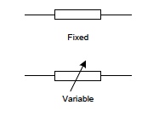
Module 4 – Resistors (continued)
TYPES OF RESISTORS
Resistors are divided into two main categories namely:
Fixed-types; and
Variable- or adjustable types.
www.futuremanagers.com

Slide 20
Module 4 – Resistors (continued)
FACTORS INFLUENCING RESISTANCE
The resistance of all materials are dependant upon the following four factors:
The resistivity of the material;
The length of the material;
The cross-sectional area of the conductor; and
The temperature.
www.futuremanagers.com

Slide 21
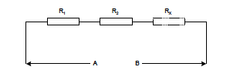
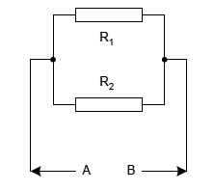
Module 4 – Resistors (continued)
ARRANGEMENT OF RESISTORS
Resistors may be arranged in any way so as to give any desired result as we require it to give. They can be arranged in:
Series, and
Parallel
www.futuremanagers.com

Slide 22
Module 5 – Capacitors
INTRODUCTION
Capacitors are extensively used in electronic circuits for coupling, filter networks, tuned circuits and by-passing circuits. A capacitor is a component that will be able to store an electrostatic charge and its unit of measurement is the Farad.
www.futuremanagers.com

Slide 23
Module 5 – Capacitors (continued)
FACTORS THAT INFLUENCE CAPACITANCE
There are three main factors that influence the capacity of a capacitor:
Dielectric constant;
Cross-sectional area of plates; and
Distance between the plates.
www.futuremanagers.com

Slide 24
Module 5 – Capacitors (continued)
TYPES OF CAPACITORS
There are several types of capacitors such as:
Air capacitors;
Mica capacitors;
Paper capacitors;
Ceramic capacitors;
Aluminium electrolytic capacitors; and
Tantalum electrolytic capacitors.
www.futuremanagers.com

Slide 25
Module 5 – Capacitors (continued)
TESTING OF CAPACITORS
When testing capacitors, they be removed from the circuit and discharged and only then can the testing commence.
There are two types of faults that can occur in a capacitor and each one will be treated individually:
A short-circuited capacitor; and
A leaky capacitor.
www.futuremanagers.com

Slide 26

Module 5 – Capacitors (continued)
CHARGING AND DISCHARGING OF A CAPACITOR
It takes a period of time for a capacitor to charge up to the supply potential. This period of time is termed the time constant of the capacitor. This time will never exceed five time constants and it mathematically given by:
$$τ=R×C$$
Where $τ$ = time,
R = value of resistance, and
C = value of capacitor.
www.futuremanagers.com

Slide 27
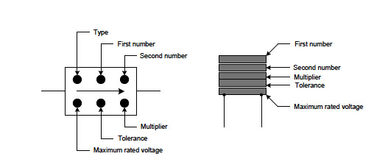
Module 5 – Capacitors (continued)
COLOUR CODING OF CAPACITORS
This International colour coding concept for capacitors can be illustrated:
www.futuremanagers.com

Slide 28
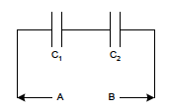
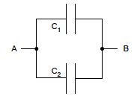
Module 5 – Capacitors (continued)
ARRANGEMENT OF CAPACITORS
Capacitors can be arranged in:
Series, and
Parallel
www.futuremanagers.com

Slide 29

Module 5 – Capacitors (continued)
REACTANCE OF A CAPACITOR
The capacitive reactance is the opposition that will be offered by a capacitor to an alternating quantity. This capacitive can be calculated:
$$X_{c}=\frac{1}{2×π×f×C}$$
Where $X_{c}$ = Capacitive reactance,
f = frequency, and
C = the value of capacitor.
www.futuremanagers.com

Slide 30
Module 6 – Inductors
FACTORS INFLUENCING INDUCTANCE
An inductor is so manufactured that it will produce a specific amount of inductance and is dependant upon the following factors:
The number of turns in the inductor;
The cross-sectional area of the core;
The permeability, ability to conduct magnetic flux, of the core material; and
The length of the inductor.
www.futuremanagers.com

Slide 31
Module 6 – Inductors (continued)
PERMEABILITY
The permeability of any material is derived from the fact that the electrons orbiting an atom aids the magnetic flux set up by the current flowing in the inductor.
www.futuremanagers.com

Slide 32

Module 6 – Inductors (continued)
RELATIVE PERMEABILITY
Relative permeability indicates the ease with which core atoms line up with a magnetic field. This is mathematically defined as:
$$μ_{r}=\frac{μ}{μo}$$
Where $μ_{r}$ = relative permeability,
$μ$ = permeability of a specific material, and
$μo$ = relative permeability of a vacuum.
www.futuremanagers.com

Slide 33
Module 6 – Inductors (continued)
TESTING OF INDUCTORS
The testing of inductors can also be accomplished using a multi-meter. It
is important that the inductor be removed from the circuit before testing commences.
www.futuremanagers.com

Slide 34
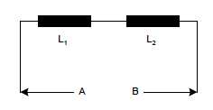
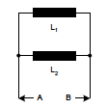
Module 6 – Inductors (continued)
INDUCTOR ARRANGEMENTS
Inductors can be arranged in:
Series
Parallel
www.futuremanagers.com

Slide 35

Module 6 – Inductors (continued)
REACTANCE OF AN INDUCTOR
The inductive reactance is the opposition that will be offered by an inductor to an alternating quantity. This inductive reactance can be calculated:
$$X_{L}=2×π×f×L$$
Where $X_{L}$ = Inductive reactance,
f = frequency of alternating supply, and
L = value of inductor.
www.futuremanagers.com

Slide 36
Module 7 – Magnetism
INTRODUCTION
Magnetism can be defined as an effect naturally created by certain magnetic
materials.
www.futuremanagers.com

Slide 37
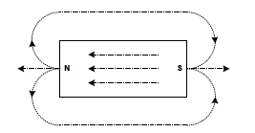
Module 7 – Magnetism (continued)
NATURAL MAGNETS
The North-pole of the magnet will always be attracted by the North-pole
of the earth. A similar action will take place for materials which are attracted by a magnet. Between these poles, lines of magnetic flux will exist which will exert a magnetic force.
www.futuremanagers.com

Slide 38

Module 7 – Magnetism (continued)
LAW OF MAGNETISM
The poles of a magnet have a definite relationship towards one another - unlike poles will always attract one another no matter what shape or size.
www.futuremanagers.com

Slide 39
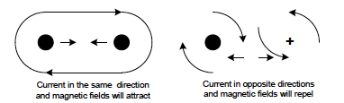
Module 7 – Magnetism (continued)
CURRENT AND MAGNETISM
Conductors will follow the same rules as permanent magnets in that attraction and/or repulsion of these magnetic fields can take place.
www.futuremanagers.com

Slide 40
Module 7 – Magnetism (continued)
ELECTROMAGNETS
The strength of the magnetism produced by a coil through which an electric current is flowing is dependant upon the following factors:
The number of turns in the coil;
The magnitude of the current flowing through the coil;
The type of core material; and
The ratio of the coil diameter to its length.
www.futuremanagers.com

Slide 41
Module 7 – Magnetism (continued)
MAGNETIC INDUCTION
It is possible to manufacture a magnet. This is done by using materials with magnetic qualities. If one takes an un-magnetised object into close proximity of a permanent magnet, the molecules will be aligned in the same fashion as that of the magnet creating a North- and South-pole on the same ends as that of the permanent magnet.
www.futuremanagers.com

Slide 42
Module 7 – Magnetism (continued)
ELECTROMAGNETIC INDUCTION
Should a permanent magnet be brought in close proximity of a length of wire or passed through a coil, the magnetic flux produced by the magnet will cut across the wire and induce a voltage into the wire, which will cause a current to flow in the wire.
www.futuremanagers.com

Slide 43
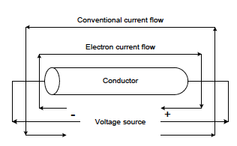
Module 8 – Direct Current Theory
CURRENT FLOW
There is:
Conventional current flow; and
Electron current flow.
www.futuremanagers.com

Slide 44
Module 8 – Direct Current Theory (continued)
OHM’S LAW
The current flowing in a network is directly proportional to the applied voltage and inversely proportional to the resistance of that network.
www.futuremanagers.com

Slide 45
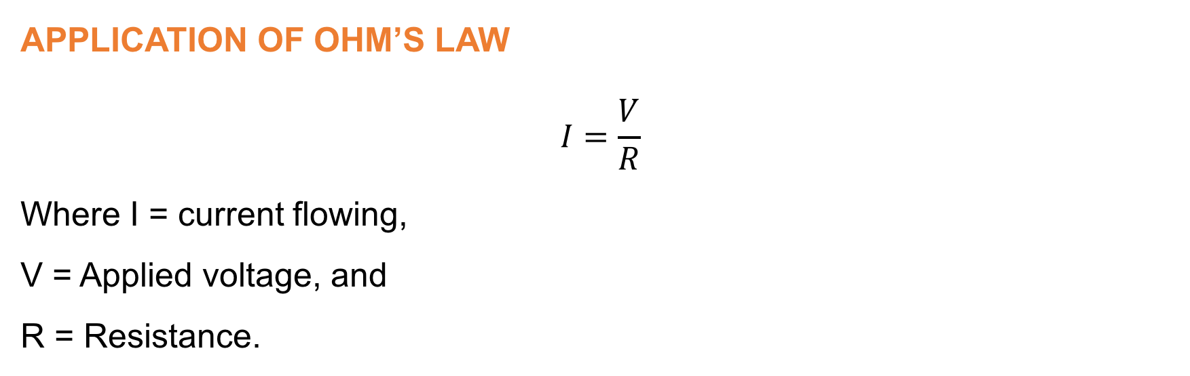
Module 8 – Direct Current Theory (continued)
APPLICATION OF OHM’S LAW
$$I=\frac{V}{R}$$
Where I = current flowing,
V = Applied voltage, and
R = Resistance.
www.futuremanagers.com

Slide 46

Module 8 – Direct Current Theory (continued)
JOULE’S LAW
The heat produced by the current and is directly proportional to the square of the current, the resistance and the time.
$$Q=I^{2}×R×t$$
Where Q = amount of heat generated,
I = current magnitude,
R = resistance of element, and
t = time duration of current-flow.
www.futuremanagers.com

Slide 47
Module 9 – Sources of Electricity (Direct Current)
INTRODUCTION
Electricity may be produced by:
Chemical reaction - cells or batteries;
Magnetism - generators;
Friction - static electricity;
Pressure - crystals;
Light - photo-conductive devices; and
Heat - thermocouples.
www.futuremanagers.com

Slide 48
Module 9 – Sources of Electricity (Direct Current) (continued)
PRIMARY CELLS
A primary cell may be described as a device that will generate an electrical potential which will then be capable of delivering an electric current for as long as the chemicals used in the process are active.
www.futuremanagers.com

Slide 49
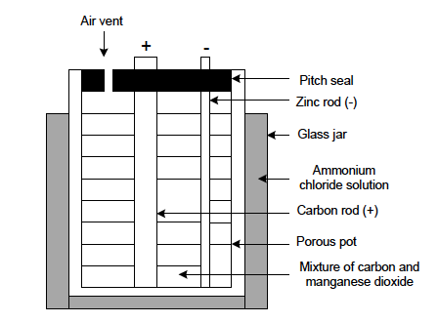
Module 9 – Sources of Electricity (Direct Current) (continued)
THE LECLANCHÉ WET CELL
This cell is not suited for application of a steady current over long periods of time but is best suited for the application of intermittent current at different intervals. Typical values for this type of cell are 1, 5 volt.
www.futuremanagers.com

Slide 50
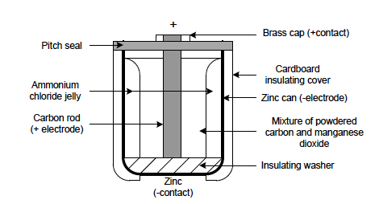
Module 9 – Sources of Electricity (Direct Current) (continued)
THE LECLANCHÉ DRY CELL
These cells can deliver an emf of about 1, 5 volt. Primary cells suffer
from a phenomenon termed polarisation and this leads to the rapid reduction of emf.
www.futuremanagers.com

Slide 51
Module 9 – Sources of Electricity (Direct Current) (continued)
ADVANTAGES AND DISADVANTAGES OF PRIMARY CELLS
Advantages:
Relatively inexpensive;
Easy to install;
Physically small;
Readily available; and
Various sizes available.
Disadvantages:
Cannot be recharged;
Provide only small currents;
Become polarised when delivering a constant current; and
A relatively short lifespan.
www.futuremanagers.com

Slide 52
Module 9 – Sources of Electricity (Direct Current) (continued)
SECONDARY CELLS
A secondary cell may be described as a device that will generate an electrical potential and also store such electrical potential and later release such energy by chemical reaction and such energy can be replaced by charging the cell again.
www.futuremanagers.com

Slide 53
Module 9 – Sources of Electricity (Direct Current) (continued)
CARE AND MAINTENANCE OF LEAD-ACID BATTERIES
Batteries should always be firmly mounted, correctly connected and the terminals are kept clean and tight.
Terminals should be covered by protective grease to prevent corrosion.
During charging, the filler caps should be removed.
• Before commencement of the charging process make sure that the electrolyte in the battery just covers the plates. Never top up with sulphuric acid.
www.futuremanagers.com

Slide 54
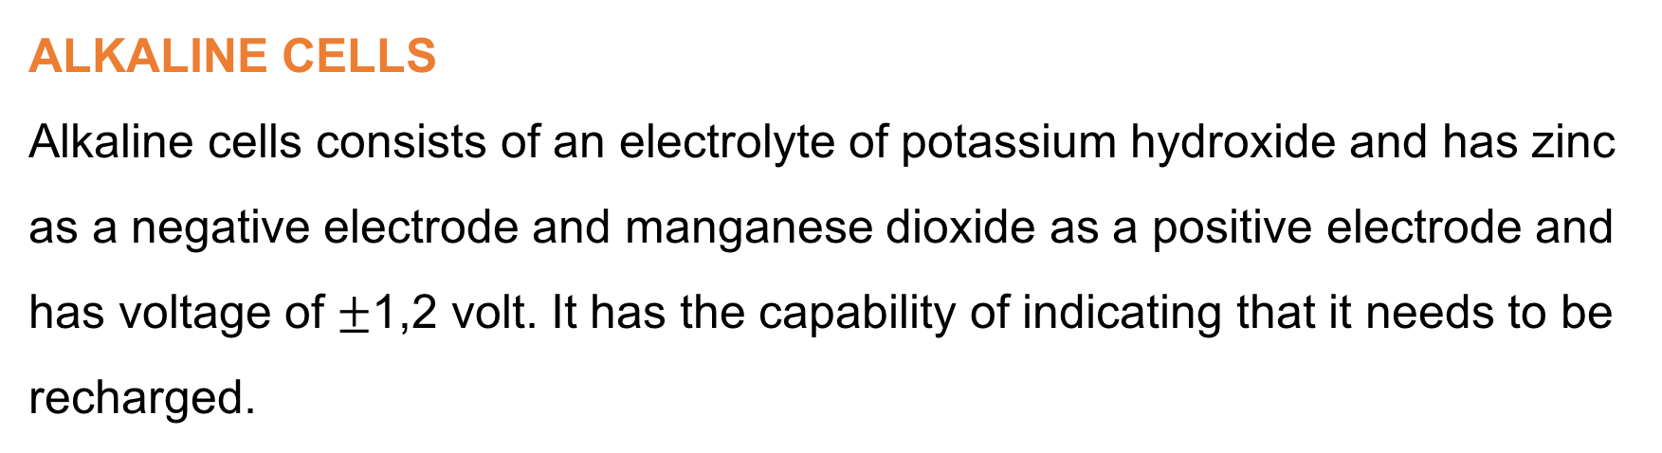
Module 9 – Sources of Electricity (Direct Current) (continued)
ALKALINE CELLS
Alkaline cells consists of an electrolyte of potassium hydroxide and has zinc as a negative electrode and manganese dioxide as a positive electrode and has voltage of $±$1,2 volt. It has the capability of indicating that it needs to be recharged.
www.futuremanagers.com

Slide 55
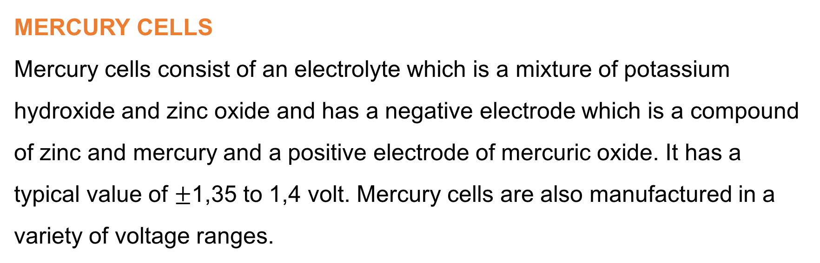
Module 9 – Sources of Electricity (Direct Current) (continued)
MERCURY CELLS
Mercury cells consist of an electrolyte which is a mixture of potassium hydroxide and zinc oxide and has a negative electrode which is a compound of zinc and mercury and a positive electrode of mercuric oxide. It has a typical value of $±$1,35 to 1,4 volt. Mercury cells are also manufactured in a variety of voltage ranges.
www.futuremanagers.com

Slide 56
Module 9 – Sources of Electricity (Direct Current) (continued)
NICKEL-CADMIUM CELLS
Nickel-cadmium cells consist of an electrolyte which is a mixture of potassium hydroxide and has a negative electrode of nickel hydroxide and a positive electrode of cadmium oxide. It has a typical value of 1,25 volt. Nickel-cadmium cells are however also manufactured in a variety of voltage ranges.
www.futuremanagers.com

Slide 57
Module 9 – Sources of Electricity (Direct Current) (continued)
ADVANTAGES AND DISADVANTAGES OF SECONDAY CELLS
Advantages:
They are rechargeable.
Provide a higher current.
They have a longer lifespan and can be used repeatedly.
Disadvantages:
Must be recharged slowly.
More expensive.
Needs proper care.
Must be kept in upright position.
www.futuremanagers.com

Slide 58
Module 9 – Sources of Electricity (Direct Current) (continued)
OTHER SOURCES OF VOLTAGE DEVELOPMENT
Developing a voltage can happen through:
Pressure,
Temperature, and
Photo-voltaic cells.
www.futuremanagers.com

Slide 59
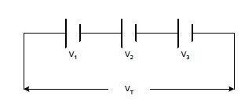
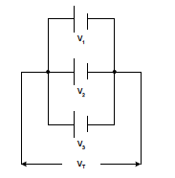
Module 9 – Sources of Electricity (Direct Current) (continued)
GROUPING OF CELLS ARRANGEMENTS
Cells can be arranged in:
Series
Parallel
www.futuremanagers.com

Slide 60
Module 9 – Sources of Electricity (Direct Current) (continued)
INTERNAL RESISTANCE, EMF AND PD
Internal resistance is that opposition that a cell or battery will offer to the flow of an electric current.
Pd is defined as that value that will be measured when the cell is delivering a
current and is also referred to as the full-load voltage and emf is also referred to as the no-load voltage and no current is being produced.
www.futuremanagers.com

Slide 61
Module 10 – Transformers
THE OPERATION OF A TRANSFORMER
When two inductors are placed in close proximity to one another
and one of the inductors are supplied with a voltage form a voltage source, a magnetic field will be set up in that inductor and that magnetic field will cut across the windings of the other inductor thereby inducing a voltage in that inductor which will produce a current to flow in that inductor.
www.futuremanagers.com

Slide 62
Module 10 – Transformers (continued)
THE CONSTRUCTION OF A TRANSFORMER
Transformers may be constructed in one of two ways:
The core-type transformer; and
The shell-type transformer.
www.futuremanagers.com

Slide 63
Module 10 – Transformers (continued)
TYPES OF TRANSFORMERS
The following types of transformers are most commonly found in the electric- and electronic industry:
Step-up transformers;
Auto-transformers; and
Centre-tap transformers.
www.futuremanagers.com

Slide 64


Module 10 – Transformers (continued)
THE TRANSFOMER EQUATION
The ratios between the different variables are given by the following mathematical expression:
$$\frac{V_{p}}{V_{s}}=\frac{N_{p}}{N_{s}}=\frac{I_{s}}{I_{p}}$$
Where $V_{p}$ = primary voltage;
$V_{s}$ = secondary voltage;
$N_{p}$ = number of primary windings;
$N_{s}$ = number of secondary windings;
$I_{s}$ = secondary current; and
$I_{p}$ = primary current.
www.futuremanagers.com

Slide 65
Module 10 – Transformers (continued)
TRANSFORMER DEFECTS AND TESTING
All transformers suffer mainly from the following defects:
Burnt-out windings caused by excessive current which causes too much heat dissipation;
Electrical short-circuits between the primary and secondary windings;
Windings may become short-circuited to the core of the transformer; and
Short-circuits between adjacent windings which will change the ratio of the transformer.
www.futuremanagers.com

Slide 66
Module 11 – Measuring Instruments
INTRODUCTION
A measuring instrument may be defined as a device suitable for determining the value or magnitude of an unknown quantity and is normally associated with electronic and/or electrical operating principles.
www.futuremanagers.com

Slide 67
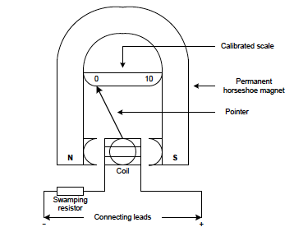
Module 11 – Measuring Instruments (continued)
THE MOVING COIL METER
A moving coil instrument consists of a coil suspended in a magnetic field produced by a permanent horseshoe magnet. It is suspended in such a manner that it can freely move about or rotate in this created magnetic field.
www.futuremanagers.com

Slide 68
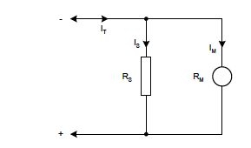
Module 11 – Measuring Instruments (continued)
THE DC-AMPEREMETER
The conductor which is used to manufacture the moving coil of a dc-amperemeter has a very low resistance and has a very small cross-sectional area which results in low current measuring capabilities.
www.futuremanagers.com

Slide 69
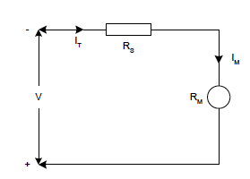
Module 11 – Measuring Instruments (continued)
THE DC-VOLTMETER
The conductor which is used to manufacture the moving coil of a dc-voltmeter has a very high resistance and has a large cross-sectional area which results in low voltage measuring capabilities
www.futuremanagers.com

Slide 70
Module 11 – Measuring Instruments (continued)
DIGITAL MEASURING INSTRUMENTS
These are instruments that provides a digital display of the quantity being measured and will in most instances also give an indication of the polarity being measured.
www.futuremanagers.com

Slide 71
Module 12 – Alternating Current (ac) Theory
ALTERNATING CURRENT (SINGLE-PHASE)
An alternating quantity may be defined as a voltage and/or current that continually changes its direction in that is moves in one direction for a given time period and then moves in the opposite direction for a given time period.
www.futuremanagers.com

Slide 72
Module 12 – Alternating Current (ac) Theory (continued)
GENERATION OF A SINGLE-PHASE ALTERNATING QUANTITY
An alternating quantity can be generated by making use of magnetism. A current and subsequent voltage are produced in a conductor when moved through an established magnetic field and the magnitude thereof will be dependant on the velocity of the movement as well as the strength of the magnetic field present.
www.futuremanagers.com

Slide 73
Module 12 – Alternating Current (ac) Theory (continued)
ADVANTAGES OF AN ALTERNATING QUANTITY
An alternating quantity can be increased or decreased as required for purposes of transmission over distances.
Alternating quantity generators have a big capacity.
Alternating quantity generators require less maintenance compared to direct quantity generators.
Alternating quantity generators are less expensive in comparison to direct quantity generators
www.futuremanagers.com

Slide 74
Module 12 – Alternating Current (ac) Theory (continued)
OTHER TYPES OF WAVEFORMS
Square waves: Can either be positive going or negative going and are mainly used in computer circuitry as well as logic circuits since it will either be on or off.
Sawtooth waves: Mainly used in oscilloscope time-base circuits in order to deflect the electron beam across the oscilloscope screen.
www.futuremanagers.com

Slide 75
Module 13 – Semi-conductor Theory and Diodes
INTRODUCTION
As the name semi-conductor suggests, it is not a very good conductor and something needs to be done in order to improve on its conducting capabilities. This process of improvement in conducting capabilities is termed doping but can be best explained by considering the elements (Germanium and Silicon) as a crystal lattice structure.
www.futuremanagers.com

Slide 76
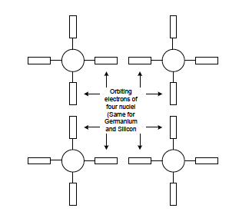
Module 13 – Semi-conductor Theory and Diodes (continued)
CRYSTAL LATTICE STRUCTURES
This type of crystal lattice structure is found in all crystalline elements. Germanium and silicon in its pure form is also known as an intrinsic material and does not have very good conducting properties.
www.futuremanagers.com

Slide 77
Module 13 – Semi-conductor Theory and Diodes (continued)
DONOR DOPING
Donor doping is a mixing process that will generate a free (extra) electron in the conduction band of the atom as well as crystal lattice structure.
www.futuremanagers.com

Slide 78
Module 13 – Semi-conductor Theory and Diodes (continued)
ACCEPTOR DOPING
Acceptor doping is a mixing process that will generate a hole in the conduction band of the atom as well as crystal lattice structure.
www.futuremanagers.com

Slide 79
Module 13 – Semi-conductor Theory and Diodes (continued)
THE PN-JUNCTION
A PN-junction is formed when a P-type material and an N-type material is joined together. This joining together is not an electrical junction but is a junction which is achieved through a manufacturing process in which electrons and holes are uniformly distributed in the two types of material provided they have been doped to the same extent.
www.futuremanagers.com

Slide 80
Module 13 – Semi-conductor Theory and Diodes (continued)
THE DIODE AND CHARACTERISTIC CURVE
A diode may be defined a single PN-junction two terminal device which will offer a low resistance when forward biased and a high resistance when reverse biased.
www.futuremanagers.com

Slide 81
Module 13 – Semi-conductor Theory and Diodes (continued)
TESTING A DIODE
The testing of a diode is based on the conditions of forward- and reverse-bias of the diode. Should the negative terminal of the multi-meter be connected to the cathode of the diode and the positive terminal of the multi meter be connected to the anode of the diode the diode will be forward biased and the resistance value will have a low value.
www.futuremanagers.com

Slide 82
Module 13 – Semi-conductor Theory and Diodes (continued)
DIODE APPICATIONS
Diodes have many applications such as:
A rectifier:
  A half-wave rectifier;
  A full-wave rectifier; and
  A full-wave rectifier with bridge circuit-four diodes.
www.futuremanagers.com

Slide 83
Module 14 – Transistors
INTRODUCTION
The transistor is a three-terminal two-junction semi-conductor component and is commonly referred to as a ‘junction transistor’ but it must be noted that there are also other types of transistors available.
www.futuremanagers.com

Slide 84
Module 14 – Transistors (continued)
THE TRANSISTOR
The junction transistor consists of two types of extrinsic or doped semi-conductor material. It has three terminals and one type of doped material (N-or P-type) sandwiched between two types of the other type of doped material (N-or P-type). This arrangement provides us with the opportunity of obtaining two types of transistors namely an NPN- or PNP-transistor.
www.futuremanagers.com

Slide 85
Module 14 – Transistors (continued)
OPERATING REGIONS OF A TRANSISTOR
The cut-off region is that region where the emitter-base as well as the collector-base junctions is reverse biased.
The active region is that region where the emitter-base junction is forward biased and the collector-base junction is reverse biased.
The saturation region is that region where the emitter-base as well as the collector-base junctions is forward biased.
www.futuremanagers.com

Slide 86
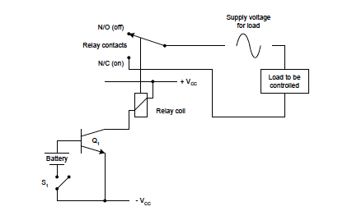
Module 14 – Transistors (continued)
THE TRANSISTOR AS A SWITCH
A transistor can be utilised as an electronic switch as seen in the following diagram:
www.futuremanagers.com

Slide 87
Module 14 – Transistors (continued)
THE TRANSISTOR AS AN AMPLIFIER
The three configurations or modes of amplifier operation are:
Common emitter;
Common base; and
Common collector (emitter follower).
www.futuremanagers.com

Slide 88
Module 14 – Transistors (continued)
TESTING OF TRANSISTORS
There are several tests that can be done on a transistor:
Open-circuit and short-circuit test;
Identification of the base terminal;
Identification of the type of terminal;
Identification of emitter and collector.
www.futuremanagers.com

