Slide 1


Fitting and Machining
N1

Slide 2
Module 1: Occupational safety
INTRODUCTION
Accidents can usually be avoided as they are mostly caused by unsafe, unplanned actions by people doing things for which they are either not trained or are not capable of doing properly. Unsafe actions by workers are the major causes of accidents.
www.futuremanagers.com

Slide 3
Module 1: Occupational safety (continued)
REGULATIONS RELATING TO RESPONSIBLE PERSONS (C1)
Although everyone in a workshop must practice safety and safety is everybody’s responsibility, the OHS Act (Occupational Health and Safety Act, No. 85 of 1993) makes the person in charge of machinery, ultimately responsible for safety.
www.futuremanagers.com

Slide 4
Module 1: Occupational safety (continued)
OBEDIENCE OF WORKERS (C2)
All registered companies have a code of conduct that must be adhered to by all to ensure safe and efficient working conditions for all, with no exceptions.
It must be clear that it is the duty of the worker to keep up to date regarding all such rules.
There must be zero tolerance regarding the application of all such rules.
All reasonable instructions must be carried out to the letter.
www.futuremanagers.com

Slide 5
Module 1: Occupational safety (continued)
REPORTABLE TO PERSONS IN CHARGE (C3)
The worker must be aware of whom to report to and must report:
Maintenance requirements of machines or equipment so that the flow of production is not interrupted.
Progress on work in operation.
Problems encountered in the manufacturing process.
Material and equipment requirements.
Accidents immediately.
www.futuremanagers.com

Slide 6
Module 1: Occupational safety (continued)
REPORTABLE MACHINE FAILURES (C8)
Machine failures cause hold-ups in production at often inconvenient times, which lead to costly ‘down time’ that can be avoided.
Timely reporting and well-planned maintenance can reduce production loss.
Unreported mechanical failures can lead to accidents and injury of co workers.
All machinery must be in top condition at all times to ensure optimum use.
www.futuremanagers.com

Slide 7
Module 1: Occupational safety (continued)
ILLUMINATION OF MACHINERY (C10)
Machinery and workspaces should be adequately illuminated. There must be adequate illumination (lighting) in the workplace. The glare in any workplace must be reduced to a level that does not impair vision. The lighting on rotating machinery must not cause a stroboscopic (flashing) effect. Artificial light, if it is used, must not shine in a machine operator’s eyes. Lights and lamps must be kept clean and maintained.
www.futuremanagers.com

Slide 8
Module 1: Occupational safety (continued)
LOOSE OUTER CLOTHING (C19)
Loose-fitting clothing that flaps about, has unfastened sleeves, or has attached untied belts or attachments can get caught even when the worker just passes close by stationary objects, let alone moving machines or rotating shafts.
www.futuremanagers.com

Slide 9
Module 1: Occupational safety (continued)
GENERAL MACHINERY PROTECTION (C22)
The working area around all machines must be clearly indicated.
All moving parts on all machines must be covered by rigidly constructed guards.
If access to a machine is necessary, the guard must be able to hinge or slide open while the machine automatically switches off.
No machine may be operated if any of the guards are missing or broken.
www.futuremanagers.com

Slide 10
Module 1: Occupational safety (continued)
REVOLVING MACHINERY (C23)
Make sure that shafts, pulleys, wheels, gears, couplings, collars, clutches and friction drums are fenced. Similarly, set screws, keys and bolts on revolving shafts, couplings, collars, friction drums, clutches, wheels, pulleys and gears should be countersunk, enclosed, or otherwise guarded. Never use a damaged pulley.
www.futuremanagers.com

Slide 11
Module 1: Occupational safety (continued)
STARTING AND STOPPING OF MACHINERY (C27)
All machinery must be fitted with an efficient stopping and starting device. This device must be accessible for easy engaging. Never start a machine while another person is repairing, cleaning, oiling or adjusting, or even just dangerously close to it. Machines with foot-operated pedals should have either an automatic locking device to stop the pedal from being accidentally pressed or a stirrup guard over the pedal with only enough space for the operator’s foot.
www.futuremanagers.com

Slide 12
Module 1: Occupational safety (continued)
ACCIDENT PREVENTION IN THE WORKSHOP
The working area must be thoroughly inspected to ensure that all working conditions are up to standard.
The area where the work is taking place must be cordoned off.
A solid screen must be erected around workers who are welding, grinding,
chipping or plasma cutting.
Workers must wear all the regulation protective gear.
www.futuremanagers.com

Slide 13
Module 1: Occupational safety (continued)
GENERAL WORKSHOP SAFETY
All workers must be totally drug & alcohol free when on duty in a workshop.
No fooling about or running is allowed in a workshop.
Workers must concentrate fully on their work and not be distracted.
Working areas must be in good condition at all times and not under construction.
Sufficient ventilation.
www.futuremanagers.com

Slide 14
Module 2: Metals and plastics
INTRODUCTION
Metals play such an important part in our everyday living that it is difficult to imagine life without them. Many people use metal cutlery to eat food that was prepared in metal pots and pans on metal cookers or stoves. Tap water flows through metal pipes. Many people ride metal bicycles, travel in motorcars, buses and trains to schools, shops and places of work. Many houses in informal settlements and in rural areas are constructed using metal sheets.
www.futuremanagers.com

Slide 15
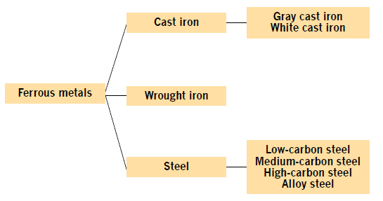
Module 2: Metals and plastics (continued)
METALS
Metals are divided into two groups. Pure metals are obtained from ore and contain no foreign matter. Alloys are obtained by mixing two or more metals.
www.futuremanagers.com

Slide 16
Module 2: Metals and plastics (continued)
PROPERTIES OF METALS
Such as:
Strength;
Elasticity;
Plasticity;
Ductility;
Malleability; and
Brittleness.
www.futuremanagers.com

Slide 17
Module 2: Metals and plastics (continued)
TYPES OF METALS
Ferrous Metals.
Low-carbon steel (mild steel).
Medium-carbon steel.
High-carbon steel.
www.futuremanagers.com

Slide 18
Module 2: Metals and plastics (continued)
FERROUS ALLOYS
Chromium;
Vanadium;
Titanium;
Manganese;
Nickel;
Tungsten; and
Molybdenum.
www.futuremanagers.com

Slide 19
Module 2: Metals and plastics (continued)
NON-FERROUS METALS
Copper;
Tin;
Zinc;
Aluminum; and
Antimony.
www.futuremanagers.com

Slide 20
Module 2: Metals and plastics (continued)
NON-FERROUS ALLOYS
Brass;
Bronze;
Phosphor bronze;
White metal; and
Duralumin.
www.futuremanagers.com

Slide 21
Module 2: Metals and plastics (continued)
IDENTIFICATION OF METALS
All metals are normally marked or colour-coded on the ends. The disadvantage of this form of identification is that the marking is often lost. If the marking is cut off & the piece of metal is separated from its proper storage rack, it is very difficult to determine the carbon content and alloy group. This is why it is important to return unused material to its proper storage rack. It makes sense to start cutting from the unmarked end and leave the marked end intact.
www.futuremanagers.com

Slide 22
Module 2: Metals and plastics (continued)
HEAT TREATMENT
Heat treatment is the heating and cooling of metals (under controlled conditions) in their solid state so as to change their properties. All metals have a crystalline grain structure while in their solid state and the kind of grain structure determines their properties. The size of grains in steel depends upon a number of factors, of which the main one is the furnace treatment the steel has received.
www.futuremanagers.com

Slide 23
Module 2: Metals and plastics (continued)
TEMPERATURE INDICATING AND CONTROL EQUIPMENT
Modern heat-treatment methods for industry require accurate measurement and temperature control. The estimation of temperature by colour has long since been discarded. The thermocouple operates on the principle that whenever two wires of dissimilar metals are joined together at one end and heated, an electromotive force (EMF) is generated at the welded end. The other end is connected to a pyrometer.
www.futuremanagers.com

Slide 24
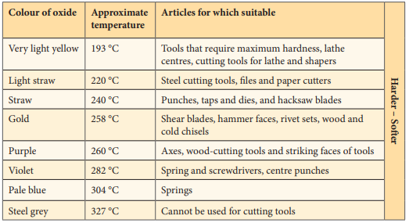
Module 2: Metals and plastics (continued)
TEMPERATURE COLOURS
www.futuremanagers.com

Slide 25
Module 2: Metals and plastics (continued)
QUENCHING MEDIA
The cooling rate of a workpiece depends on many factors. The size, composition and the initial temperature of the part and final properties desired are the deciding factors in the selection of a quenching medium. It is important in liquid quenching baths that either the quenching medium or the steel being quenched should be agitated. The vapour that forms around the part being quenched acts as an insulator and slows down the cooling rate. This can result in incomplete or spotty hardening of the parts.
www.futuremanagers.com

Slide 26
Module 2: Metals and plastics (continued)
COMPOSITES
There is an ever-growing number of synthetic materials available. These materials become plastic above certain temperatures and, while plastic, they can be squeezed into dies and moulds to give them the required shape, which is retained on cooling. These materials hardly ever show signs of plastic properties in their finished state. Such composites are:
Thermo Plastics.
Thermosetting Plastics.
www.futuremanagers.com

Slide 27
Module 3: Hand tools
INTRODUCTION
Hand tools are used for doing jobs that you cannot do using machines or automation. You can use hand tools for adjusting, dismantling and assembling various components (parts), as well as final finishings such as sawing, filing and changing the shape of a material.
www.futuremanagers.com

Slide 28
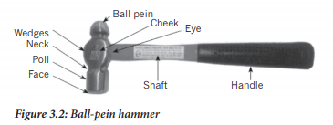
Module 3: Hand tools (continued)
HAMMERS
www.futuremanagers.com

Slide 29
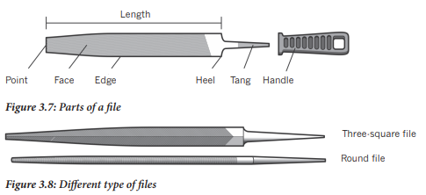
Module 3: Hand tools (continued)
FILES
www.futuremanagers.com

Slide 30

Module 3: Hand tools (continued)
FILES
Chisels are used for shearing, cutting, chipping and removing metal that cannot be removed conveniently by a machine. They are commonly made of octagonal-shaped tool steel. This steel is often called chisel steel. The length of the chisel, its selection and shape depend on the particular work for which it is needed.
www.futuremanagers.com

Slide 31
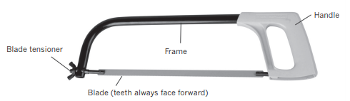
Module 3: Hand tools (continued)
HACKSAW
A hacksaw consists of a frame, handle and renewable blade. There are also two blade-holders and a wing nut. A hacksaw is used to cut metals and composites.
www.futuremanagers.com

Slide 32

Module 3: Hand tools (continued)
PUNCHES
Centre punches are used to enlarge the pop mark on a surface where a hole has to be drilled. They are made of tool steel and the included angle should be 90°. This punch mark acts as a guide for the drill and ensures accurate, easy drilling.
www.futuremanagers.com

Slide 33
Module 3: Hand tools (continued)
SCREWDRIVERS
A screwdriver consists of a handle, normally made of wood or plastic, and a blade with a tip shaped to fit a screw slot. Plastic handles are moulded around the end of the shank. The shank can be round or square, and made of silver steel or cast steel. It is hardened and tempered at the tips.
www.futuremanagers.com

Slide 34
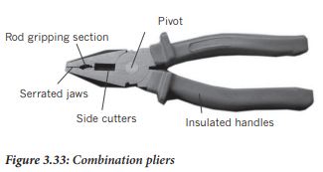
Module 3: Hand tools (continued)
Pliers
Pliers are manufactured in many shapes, each for a specific purpose. They are made of cast steel; their jaws are hardened and tempered.
www.futuremanagers.com

Slide 35
Module 3: Hand tools (continued)
SPANNERS
The majority of spanners is forged from carbon steel or chrome vanadium steel. Ensure that the spanner is the correct one for the particular bolt head or nut. The tool should fit over the bolt head or nut with the minimum of free play. You need to know the type of bolt or nut before you can choose the correct spanner, for example, whether it is a metric or SAE measurement.
www.futuremanagers.com

Slide 36
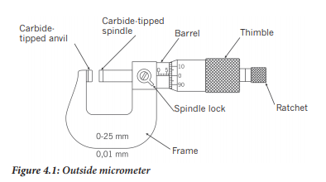
Module 4: Measuring Instruments
OUTSIDE MICROMETER
www.futuremanagers.com

Slide 37
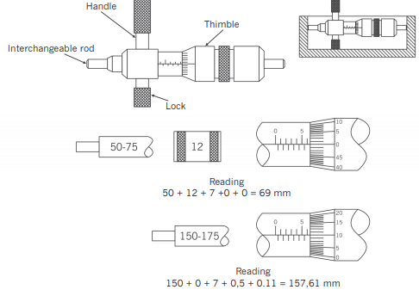
Module 4: Measuring instruments (continued)
THE INSIDE MICROMETER
www.futuremanagers.com

Slide 38
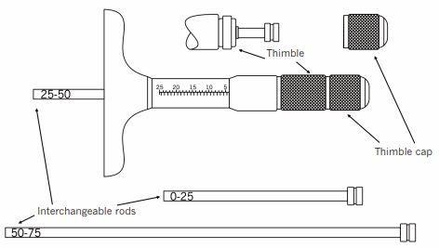
Module 4: Measuring instruments (continued)
THE DEPTH MICROMETER
www.futuremanagers.com

Slide 39
Module 4: Measuring instruments (continued)
THE VERNIER CALIPER
The vernier caliper is the most versatile and useful of all the measuring instruments we will be discussing. Firstly, vernier calipers can measure from 0 mm to 150 mm on the same instrument (larger verniers are available on request). You can measure outside dimensions, internal dimensions and depths using the same instrument, on the same scale, to the same degree of accuracy. The vernier can measure to one two hundredths of a mm or 0,02 mm.
www.futuremanagers.com

Slide 40
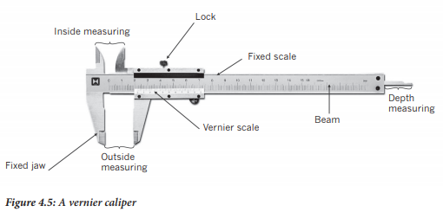
Module 4: Measuring instruments (continued)
THE VERNIER CALIPER
www.futuremanagers.com

Slide 41
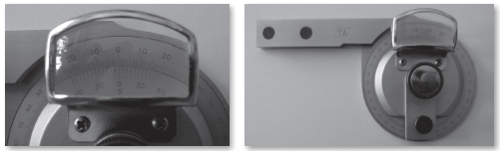
Module 4: Measuring instruments (continued)
VERNIER PROTRACTOR
To measure angles accurately (to within 5 minutes or one twelfth of a degree), one can make use of a vernier protractor.
www.futuremanagers.com

Slide 42
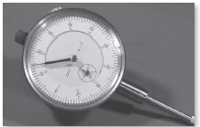
Module 4: Measuring instruments (continued)
DIAL TEST INDICATOR
The dial test indicator is very useful for checking run-out on brake discs, crank shafts, side-shafts, prop-shafts and other components that are subject to stresses, extreme temperature changes, etc.
www.futuremanagers.com

Slide 43
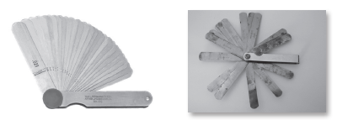
Module 4: Measuring instruments (continued)
FEELER GAUGE
Some gaps are just too small to fit normal measuring instruments, like a vernier, micrometer or ruler, into them, making it necessary to use a feeler gauge.
www.futuremanagers.com

Slide 44
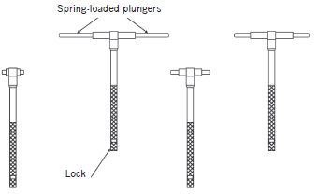
Module 4: Measuring instruments (continued)
TELESCROPIC GAUGES
Telescopic gauges are usually used in conjunction with an outside micrometer or vernier caliper because there are no measuring scales on telescopic gauges.
www.futuremanagers.com

Slide 45
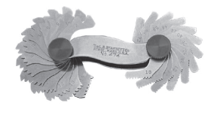
Module 4: Measuring instruments (continued)
TELESCROPIC GAUGES
The gauge looks like a piece of a hacksaw blade. The teeth are fitted to the thread. The gauge blades normally move up in half-millimetres in pitch size in the case of metric threads.
www.futuremanagers.com

Slide 46
Module 5: Marking off
INTRODUCTION
Marking off may be defined as scribing or scratching lines on metals, castings or similar work. These working lines, arches and centre lines are indicated on the blue-print or drawing of the project or artifact to be manufactured. Marking off is a very important operation and accuracy is vital. This is the stage that determines the success of the project. The marked lines assist the artisan in setting up the workpiece in his machine and guide him when machining takes place.
www.futuremanagers.com

Slide 47
Module 5: Marking off (continued)
DIVIDERS
Dividers are made from high-quality tool steel. The two straight legs are made from flat stock and can be the firm or spring-joint type, the fulcrum nut is hardened, and the large bearing surface on the legs helps to prevent side deflection.
www.futuremanagers.com

Slide 48
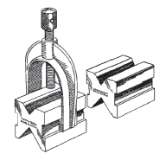
Module 5: Marking off (continued)
V-BLOCKS
V-blocks are used to support round workpieces on the table for marking off purposes, as well as for machining. V-blocks are made in pairs with a V angle of 90°. High quality V-blocks are provided with a clearance slot at the bottom of the vee.
www.futuremanagers.com

Slide 49
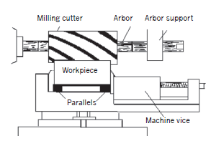
Module 5: Marking off (continued)
PARALLELS
Parallels are used to support non-cylindrical workpieces on the marking off table or for setting up workpieces in the machines. They are manufactured in identical pairs and should not be separated.
www.futuremanagers.com

Slide 50
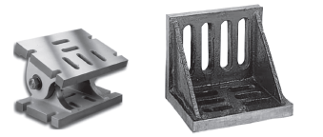
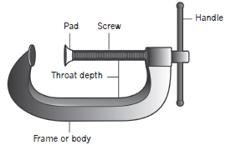
Module 5: Marking off (continued)
ANGLE PLATES
Angle plates are made of cast iron and the two faces are accurately machined at right (90°) angles to each other. They used to support workpieces in a vertical position, at right angles for marking off on the marking off table or in layout of work.
www.futuremanagers.com

Slide 51
Module 6: Screw threads
INTRODUCTION
A screw thread is a ridge running around the outside of a bolt or stud and is either cut into or rolled onto a shaft at a helical angle which will determine the pitch of the thread. The main functions of threads are to either fasten two or more parts together or to transmit movement.
www.futuremanagers.com

Slide 52
Module 6: Screw threads (continued)
METRIC THREADS
Metric threads are by far the most commonly used in South Africa today. Before 1971, the imperial system was in place in South Africa, Britain and the United States of America. South Africa is the only one of the three that went metric. South Africa joined Germany, France and most European and Scandinavian countries as well as Japan and China in using the metric system.
www.futuremanagers.com

Slide 53
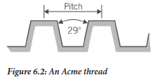
Module 6: Screw threads (continued)
THE ACME THREAD
An Acme thread is basically a square thread with the flanks at a 14½° angle, just enough to stop it from seizing up should there be any shaft sag or twist.
www.futuremanagers.com

Slide 54
Module 6: Screw threads (continued)
BRITISH STANDARD WHITWORTH THREADS (BSW)
The BSW screw thread was extensively used in South Africa before 1971 with the result that many older machines and motor vehicles today still have this thread on their nuts and bolts. The result is that we need to be equipped with the necessary tools and spares to service and repair them. Cutting a BSW thread on a lathe is no problem as most lathes are equipped with the necessary speeds and feeds to cut almost any screw pitch. Stocks and dies as well as taps are available to cut BSW threads.
www.futuremanagers.com

Slide 55
Module 6: Screw threads (continued)
THE BUTTRESS THREAD
The buttress thread is also known as a trapezium thread. It is less well known than the other threads already mentioned. The buttress thread is found on woodworking vices, screw jacks, aircraft propeller hub locking devices, the breech locking device on a field gun or cannon and other mechanisms where a large load must be supported in one direction only.
www.futuremanagers.com

Slide 56
Module 7: Reamers
PARALLEL REAMERS
Reamers are cutting tools used to enlarge the diameter of a hole to a very accurate size. You get parallel hand and machine reamers, both adjustable and fixed reamers. These include:
Hand Reamers; and
Machine Reamers.
www.futuremanagers.com

Slide 57
Module 7: Reamers (continued)
TAPER REAMERS
Taper reamers are in most respects the same as the reamers described above, except that they are tapered and available in most standard sizes and tapers. These reamers are especially designed to cut the inside of a given hole to a predetermined degree of taper to suit, for example, a tapered pin as is used in many drive units, on the lathe lead screw or table feeds on milling machines.
www.futuremanagers.com

Slide 58
Module 7: Reamers (continued)
EXPANDING REAMERS
Expanding reamers are usually equipped with their cutting edges running at a helix angle to the main body of the reamer, not parallel as is the case with parallel reamers. At the front end of this type of reamer, there is an adjusting screw which, when tightened clockwise, causes the reamer to expand in diameter and then enables it to cut a larger internal diameter. Expanding reamers are available in sizes that increase by one millimetre.
www.futuremanagers.com

Slide 59
Module 7: Reamers (continued)
ADJUSTABLE REAMERS
An adjustable reamer is very different from an expanding reamer in both construction and appearance. Firstly, the cutting blades run parallel to the shank of the reamer and then they fit into neat-fitting, tapered slots. The blades are tapered and can be moved along by screw collars that push the blades up the slope of the taper towards the rear of the reamer, where a second collar has to be backed off the required distance to allow the movement.
www.futuremanagers.com

Slide 60
Module 7: Reamers (continued)
THE HAND REAMING PROCESS
The first step is to drill a hole fractionally smaller than the required finished size. Secondly, you chose a suitable reamer for the job, let’s say a hand, adjustable reamer. Thirdly, make sure the workpiece is firmly clamped in position. Take a suitable size tap wrench & lock it onto the square end of the reamer. Put cutting paste on the lower end of the reamer, insert the reamer into the hole and carefully turn it clockwise. Should it become hard to turn, reduce the amount of downward pressure. This should make it easier to turn.
www.futuremanagers.com

Slide 61
Module 7: Reamers (continued)
MACHINE REAMING
When machine reaming, whether it is in the lathe or on a drill press, the principle is the same: clamp the workpiece in the chuck or vice; select the correct reamer for the job; use cutting paste; fit a suitable length tap wrench; use a centre to make sure the reamer is lined up; select a very low, slow gear; make sure you wear safety gloves and then turn on the machine with a suitable feed engaged. You will be holding the tap wrench in your hands, which enables you to gauge the pressure on the reamer.
www.futuremanagers.com

Slide 62
Module 7: Reamers (continued)
HAND TAPS, STOCKS AND DIES, AND REAMERS
Internal screw threads need to be cut using taps, whether they are of the hand or machine type. The tapered tap has a smaller diameter at the front edge or bottom than at the trailing or upper edge. The crest diameter of the tap at the lower edge is slightly less than the diameter of the hole into which it is to be inserted. The shank of the tap has a number of grooves called flutes, cut from top to bottom into the tap, creating the cutting edges.
www.futuremanagers.com

Slide 63
Module 7: Reamers (continued)
EXTERNAL SCREW THREADS
There are numerous ways of cutting external threads, one of which is using a set of stocks and dies. The stock is the part that holds the die in position and gives you leverage to rotate the die clockwise, causing the cutting action. Dies are made of high-quality tool steel and have the appropriate thread inside their bores. The thread inside the die nut tapers from a larger diameter at the start to the required, standard size at the top end..
www.futuremanagers.com

Slide 64
Module 7: Reamers (continued)
DETERMINING TAPPING DRILL SIZES
The size of the drill you use to make the hole you are going to tap is crucial to the successful outcome of the procedure. Should you select a drill that is too big, there will be too little material left for a full depth thread. If, on the other hand, you drill a hole that is not big enough, the tap will not go in and should you force it in, it will probably jam and refuse to go all the way.
www.futuremanagers.com

Slide 65
Module 7: Reamers (continued)
FAULT-FINDING AND CORRECTION
The most common fault when tapping or reaming a hole is that the tap or reamer goes skew. The result is usually that the tap or reamer becomes harder and harder to turn; if it is only slightly skew or in a thin plate, the result is either a skew hole or a thread that leaves the bolt at an undesirable angle. One way to prevent this situation, is to use an engineer’s square at the start of the operation; and again as soon as the cutting process begins. Applying more pressure to correct the reamer, turning clockwise until correct.
www.futuremanagers.com

Slide 66
Module 8: Fasteners
SEMI-PERMANENT JOINING APPLICATIONS
Semi-permanent joining applications refer to methods used to join different objects together, securely but not necessarily permanently. There are numerous ways of joining engineering materials together, but we will deal with only the following: bolts, studs, and nuts, locking devices, and split pins. After learning about these fasteners, you will learn how to use some of them.
www.futuremanagers.com

Slide 67

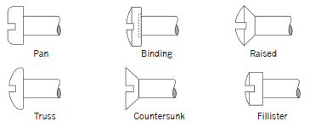
Module 8: Fasteners (continued)
BOLTS AND MACHINE SCREWS
Bolts
Screws
www.futuremanagers.com

Slide 68
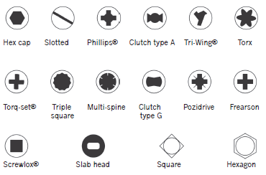
Module 8: Fasteners (continued)
DRIVER CONFIGURATIONS
www.futuremanagers.com

Slide 69
Module 8: Fasteners (continued)
BODY
The body of a bolt is divided into the thread and the shank. The shank is the unthreaded part between the head and the thread. The thread on a bolt or screw can be divided into various categories; most bolts have only a partial thread, while machine screws usually have a full thread.
www.futuremanagers.com

Slide 70
Module 8: Fasteners (continued)
SET SCREWS
These screws cut or form threads when they are driven or turned into the proper size hole, thus they eliminate tapping, riveting and soldering. They are sometimes called ‘thread-forming’ or ‘self-tapping screws’.
www.futuremanagers.com

Slide 71
Module 8: Fasteners (continued)
POSITIVE LOCKING DEVICES
These devices tighten nuts very securely and can be divided into four main
Categories:
Slotted nuts;
Crown nuts;
Tab washers; and
Lock Plate.
www.futuremanagers.com

Slide 72
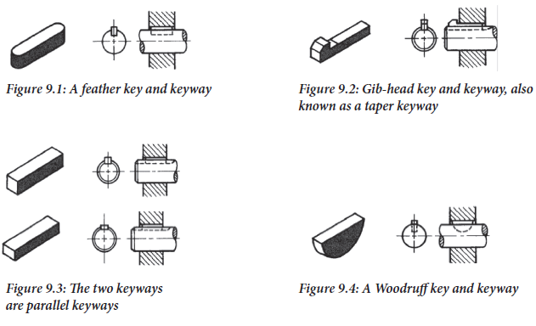
Module 9: Keys and keyways
KEY PROFILES
www.futuremanagers.com

Slide 73
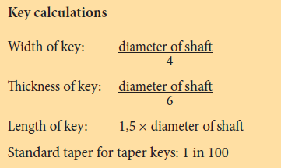
Module 9: Keys and keyways (continued)
KEY CALCULATIONS
www.futuremanagers.com

Slide 74
Module 9: Keys and keyways (continued)
WHERE AND WHEN KEY AND KEYWAYS ARE USED
On motor vehicles, you will find that Woodruff keys are commonly used on
smaller, lighter components.
On heavy machines where shock is also a factor, like the main pulley on a
guillotine, a big tapered Gib-head key is likely to be found.
Feather and rectangular keys are commonly found on feed shafts of milling and drilling machines.
Electric-motor drives on washing machines and other household equipment.
www.futuremanagers.com

Slide 75
Module 10: Grinding machines
INTRODUCTION
Grinding is one of the most accurate and basic machining methods. A grinding machine differs from other machines in that it uses a tool made from emery, carborundum, Cornish silica, diamond dust or similar materials. The grinding wheel, made up of tiny cutting points, cuts with the entire surface area that comes into contact with the material being ground.
www.futuremanagers.com

Slide 76
Module 10: Grinding machines (continued)
SAFETY RULES
Only use a machine once the guards have been correctly fitted.
Check that there is no oil or grease on the floor around the machine.
Check tool rest is not more than 3mm from the grinding wheel’s surface.
When starting the machine, do not stand in front of the wheel. Before you start grinding, let the machine idle for a few seconds.
If the wheel is running unevenly, dress it with an emery wheel dresser.
Grind only on the face of a straight grinding wheel and never on the side.
www.futuremanagers.com

Slide 77
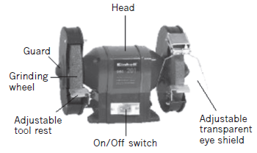
Module 10: Grinding machines (continued)
BENCH GRINDING MACHINE
A bench grinding machine can grind the cutting edge of tools square and sharp, remove burrs from the anvil ends of cold chisels, repair screwdrivers, drill bits and the point of punches, sharpen scissors and polish metalwork.
www.futuremanagers.com

Slide 78
Module 10: Grinding machines (continued)
PEDESTAL GRINDING MACHINE
A pedestal grinding machine is a machine tool that gets its name from the pedestal that supports the motor and abrasive grinding wheels. This grinding machine is used for general purpose, off-hand grinding where the workpiece is handheld and applied rapidly to the rotating abrasive wheel. One of the primary functions of the pedestal grinder is the shaping and sharpening of tool bits and drill bits in the machine workshop. Pedestal grinding machines are often modified for use with rotary wire wheels or buffing wheels.
www.futuremanagers.com

Slide 79
Module 10: Grinding machines (continued)
ANGLE GRINDING MACHINE
• The same safety precautions that apply regarding the other types of grinders are applicable to an angle grinder.
• The safety guard must be in place before you can start the grinding process.
• Protective shields must be placed around the object being ground to protect people passing by.
• Use the correct grinding wheel for the job.
www.futuremanagers.com

Slide 80
Module 10: Grinding machines (continued)
GRINDING WHEELS
Grinding wheels are not natural stones, but grains of abrasive material bonded together at high temperature. The grain size determines whether the wheel will be fine, medium or coarse. The grade of the wheel refers to the hardness of the bond. Hard grade wheels are used or grinding soft materials, whereas soft grade wheels allow the abrasive material to fall away easily and are used to grind hard materials.
www.futuremanagers.com

Slide 81
Module 10: Grinding machines (continued)
BONDS
The bonding materials define the type of finish produced.
The size of the abrasive grains in grinding wheels varies widely. The actual size of the abrasive particles is called grit or grain size.
Structure refers to the pores. These are air spaces or voids between the abrasive grains and posts of bond in which they are embedded.
The grade is the hardness of the wheel and indicates the strength or holding power of the bond which holds the abrasive grains in place.
www.futuremanagers.com

Slide 82
Module 10: Grinding machines (continued)
TESTING GRINDING WHEEL FOR DAMAGE
Flawed or imperfect grinding wheels are unsafe and must not be mounted. A cracked or damaged wheel may break while being used and may result in injury and even death.
www.futuremanagers.com

Slide 83
Module 10: Grinding machines (continued)
GRINDING WHEEL OPERATIONS
Sharpening Chisels;
Sharpening Punch; and
Sharpening Screwdrivers.
www.futuremanagers.com

Slide 84
Module 10: Grinding machines (continued)
SURFACE GRINDING MACHINE
Surface grinding is the precision grinding of a planed surface. While all grinding, strictly speaking, is surface grinding, the term is commonly used to describe the grinding of flat surfaces. Many parts formerly milled, planed or hand scraped, are now precision ground.
www.futuremanagers.com

Slide 85
Module 11: Drilling machines
INTRODUCTION
Machinists need to be able to use several types of complex and powerful drilling machines such as:
Sensitive Drill Presses;
Upright Drill Presses;
Radial Drilling Machines; and
Portable Electric Drilling Machine.
www.futuremanagers.com

Slide 86
Module 11: Drilling machines (continued)
DRILLS
The most commonly used tool of a drilling machine is the twist drill. Twist drills have either straight or tapered shanks. A twist drill is divided into three principal parts: the point, the body and the shank. To ensure good work, it is important that the correct cutting speed is used and this will depend on the metal being drilled and on the type of drill used.
www.futuremanagers.com

Slide 87
Module 11: Drilling machines (continued)
DRILLING PROCESSES
There are various drilling processes to accommodate the heads or fastening devices:
Countersinking;
Counterboring;
Spot-facing; and
Pilot drill.
www.futuremanagers.com

Slide 88
Module 11: Drilling machines (continued)
CLAMPING METHODS
Never hold a workpiece on the drilling machine or any other machine using only your hand. A serious injury can result if you do this. You never know when the lips of a drill are about to break through the underside of the workpiece. When this happens, the workpiece is snatched from the hand. It may cause serious injury. It is important that the workpiece be held securely while it is machined.
www.futuremanagers.com

Slide 89
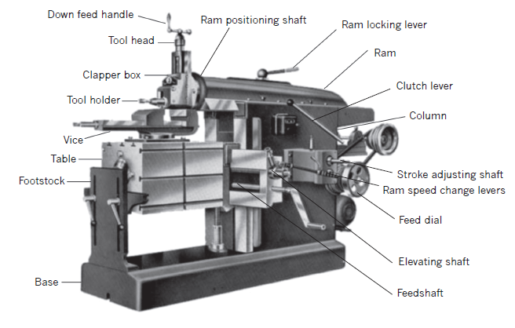
Module 12: The shaping machine
THE SHAPING MACHINE AND SAFETY
This machine is very useful but dangerous in the hands of an inexperienced
operator.
www.futuremanagers.com

Slide 90
Module 12: The shaping machine (continued)
IDENTIFICATION OF COMPONENTS AND THEIR USES
The base, the foundation of the main frame. Bolted to the floor.
Ram slides back and forth, can be locked with lever.
Clapper box and tool holder mounted on front of ram.
Machine Table is adjustable.
Tool head can be adjusted using crank handle.
Clutch lever initiates or stops movement of the ram.
Operator normally stand on the right-hand side of the machine.
www.futuremanagers.com

Slide 91
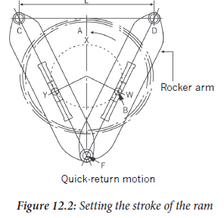
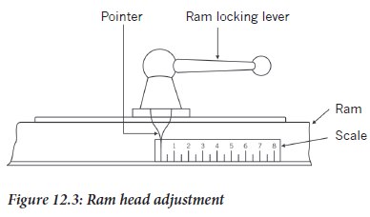
Module 12: The shaping machine (continued)
SETTING LENGTH OF RAM STROKE
www.futuremanagers.com

Slide 92
Module 12: The shaping machine (continued)
RAISING AND LOWERING OF THE MACHINE TABLE
When you want to lower or raise the machine table, you must first release the locking device on the table support at the base of the table and then release the table slide tensioners on either side. Fit the crank arm to the lower of the two table adjustment shafts, and wind it clockwise to raise the machine table or anticlockwise to lower the machine table. Once you are happy with the table height, remember to nip up the table slide tension screws and reset the table support at the base of the table.
www.futuremanagers.com

Slide 93
Module 12: The shaping machine (continued)
SETTING UP AND CLAMPING DOWN THE WORKPIECE
A machine vice is often mounted on the machine table and workpieces can be firmly held in the vice while they are being machined. Angle plates and jigs are bolted to the machine table using bolts and threaded blocks especially machined to fit into the T-slots in the machine table. The workpiece is then bolted to the angle plate directly or partially with other clamps and bolts fastened to the machine table. Workpieces can be set up directly on the machine table and then clamped down with clamps and bolts.
www.futuremanagers.com

Slide 94
Module 13: Machine cutting tools
SHAPING MACHINE TOOLS
Roughing tools with a course feed are usually used first when a large amount of material must be removed from a workpiece. A roughing tool is as wide as possible to spread the load of a big, wide cut over as large an area as possible. The cutting angles will vary depending on the type of material that is to be cut. For cutting steel, a sharp cutting-edge angle with a reasonably small leading relief angle of between 5° to 8° is used to ensure as much support as possible on the leading edge.
www.futuremanagers.com

Slide 95
Module 13: Machine cutting tools (continued)
GROOVING TOOLS FOR THE SHAPING MACHINE
To cut an internal keyway, a boring bar, as thick in diameter as possible, with a high-speed steel tool that has been ground to the dimensions of the keyway required, is used. In the case of internal work, as this is, the clapper box is fastened down so that it does not rise on the return stroke as it should on external work. The feed operation is manual only. The crank handle mounted on top of the tool head is turned anticlockwise, quickly manually, at the end of the return stroke.
www.futuremanagers.com

Slide 96
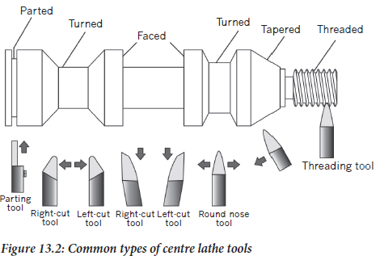
Module 13: Machine cutting tools (continued)
LATHE TOOLS
www.futuremanagers.com

Slide 97
Module 13: Machine cutting tools (continued)
ROUGHING TOOLS
Roughing tools for a centre lathe vary according to the material they are required to cut. In most cases, the tools used are of robust construction, usually with tungsten tips due to their extreme resistance to heat and their exceptional hardness allowing higher cutting speeds and feeds. Tungsten-tipped tools are available with removable tips that are usually not re-sharpened when blunt or chipped, but thrown away. A new tip can be fitted in seconds. For rough cutting on steel, knife-edged tools are commonly used.
www.futuremanagers.com

Slide 98
Module 13: Machine cutting tools (continued)
PARTING TOOLS
The leading edge is angled together with the various relief angles to suit the type of metal to be cut. Most parting tools are ground with the leading edge angled slightly so that the left front edge protrudes ahead of the right side, or the other way round, depending on whether the part being made is on the left or the right side of the parting tool, as a burr is left on the waste side. This pattern spreads the load over a greater area and only cuts right through on one side, which saves energy and time.
www.futuremanagers.com

Slide 99
Module 13: Machine cutting tools (continued)
GROOVING TOOLS
Grooves cut on a lathe are mostly symmetrical and circular around the circumference of a round bar, shaft or axle, as a screw thread would be. The grooves can be straight or cut at a helical angle, giving it a lead and thus able to feed a belt or other material running on the edge where the grooved area is towards one or the other direction.
www.futuremanagers.com

Slide 100
Module 13: Machine cutting tools (continued)
FINISHING TOOLS
Most finishing tools are designed to take light cuts. They can thus be honed after grinding to the required shape so as to ensure the best, finest finish possible. Finishing tools, unlike roughing tools, have less aggressive cutting angles and have more rounded leading edges. High-speed steel tools are commonly used for finishing tools but tungsten steel-tipped, with or without replaceable tip tools can be ordered especially formed for high-speed finishing.
www.futuremanagers.com

Slide 101
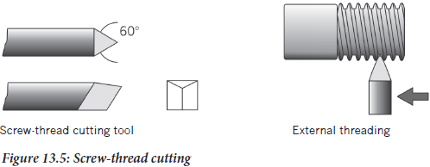
Module 13: Machine cutting tools (continued)
THREAD CUTTING TOOLS
Metric thread-cutting tools are ground to a 60° point that must extend further
than the full depth of the thread. On a tool ground to cut a right-hand thread,
the tool will be fed from right to left and will thus have a higher left, leading edge.
www.futuremanagers.com

Slide 102
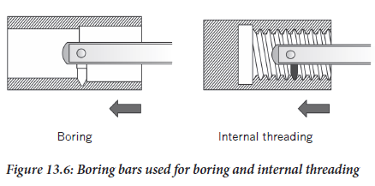
Module 13: Machine cutting tools (continued)
BORING BARS
Internal turning on a centre lathe is done using boring bars. Boring bars are
obtainable in any size, length, diameter and made to carry an unlimited variety of tool sizes and shapes.
www.futuremanagers.com

Slide 103
Module 14: The centre lathe
INTRODUCTION
The centre lathe produces a cutting action by rotating the workpiece against the cutting edge of the tool. As the cutting tool is moved lengthwise and crosswise to the axis of the workpiece, the shape of the workpiece is generated. The shape produced is basically cylindrical. The lathe is designed to hold and rotate the workpiece, and to hold and control the movement of the tool. If you understand these two fundamentals, you will find it easy to learn the parts and functions of the centre lathe.
www.futuremanagers.com

Slide 104
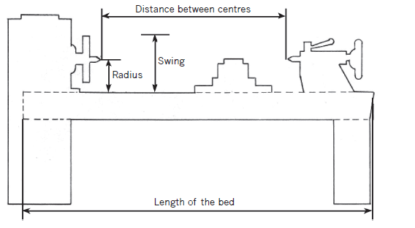
Module 14: The centre lathe (continued)
LATHE SIZE AND CAPACITY
www.futuremanagers.com

Slide 105
Module 14: The centre lathe (continued)
MAIN COMPONENTS
This consists of the following:
The headstock; tailstock; lathe carriage; cross slide; compound slide; feed shaft; leadscrew; driving plate and dogs; and the chucks.
www.futuremanagers.com

Slide 106
Module 14: The centre lathe (continued)
THE GEARBOX
Lathes are equipped with a gearbox for driving the spindle on which the chuck is mounted and another to drive the feeds and leadscrew. The gearbox that drives the spindle is mounted above the one for the feeds, in the headstock on the left-hand side of the lathe. On the front of the gearbox, there are a number of gear shifters facing the operator and within easy reach for convenient gear changing. There is usually a fairly wide selection of gear ratios.
www.futuremanagers.com

Slide 107
Module 14: The centre lathe (continued)
CENTRES
One of the first operations done to a workpiece is often drilling a hole using a
centre drill in the right-hand end of the workpiece. This is usually done to add
stability to the right-hand end of the workpiece that is furthest away from the
support of the chuck. In the case of a pipe, it is not necessary to drill a hole before fitting one of the available centres, but it is very necessary to use a centre when machining objects like long pipes.
www.futuremanagers.com

Slide 108
Module 14: The centre lathe (continued)
SCREW-CUTTING
Screw-cutting is one of the main functions of a centre lathe. A centre lathe is one of the few machines that can cut almost any screw thread, at any angle and at any given pitch, which can be set without changing any machine components. There is more than one method of cutting a screw thread on a centre lathe. The decision on which method to use usually rests with the turner themself.
www.futuremanagers.com

Slide 109
Module 14: The centre lathe (continued)
RIGHT-HAND TURNING
On most centre lathes, you have the option of either allowing the chuck to turn towards you, which is selected by pushing the clutch lever downwards, or away from you by raising the clutch lever upwards. Should you choose the second option, the cutting tools must be turned over with the cutting edge pointing downwards. This method is only used under special conditions and can reduce chatter and build-up of cuttings. In either situation, you can choose to cut right by setting the feed accordingly.
www.futuremanagers.com

Slide 110
Module 14: The centre lathe (continued)
FACING
Facing from the outside in is more convenient since heavier cuts can be taken. When facing from the centre out, a right-hand turning tool in a left-hand tool holder is the best arrangement; but when facing from the outside to the centre, a left-hand tool in a right-hand or straight tool holder can be used. The point (tip) of the cutting tool should be set to the dead centre.
www.futuremanagers.com

Slide 111
Module 14: The centre lathe (continued)
TAPER TURNING ON A CENTRE LATHE
There are three common methods of taper turning on a centre lathe:
The compound slide method;
The setting over of the tailstock method; and
The method using a taper-turning attachment.
www.futuremanagers.com

Slide 112
Module 14: The centre lathe (continued)
BORING AND DRILLING
Drilling and boring go hand-in-hand as you need to drill a hole before you bore it out to size. When drilling a hole in the lathe, start off by using a centre drill then follow it up with the drill size of the hole needed. Both the centre drill and the normal drill bits of up to a diameter of 15 mm are held in a Jacobs chuck, after which taper shank drills are used.
www.futuremanagers.com

Slide 113
Module 14: The centre lathe (continued)
COMPUTER NUMERICAL CONTROL LATHE
In conventional machine tools, the slides are moved laterally on their slide ways by the machinist, either manually or by automatic feed mechanism. The machinist must also execute other actions needed for machining a work piece, e.g. starting / stopping the turning of the spindle, changing feed rates or rotational speed, turning on the cutting fluid, etc. The machinist must exercise judgement and make decisions repeatedly when manufacturing mass-produced similar parts.
www.futuremanagers.com

Slide 114
Module 15: Milling machines
INTRODUCTION
The vertical milling machine is a relatively new development in comparison to
the horizontal milling machine. The first vertical milling machine appeared in the 1860s. The vertical milling machine was a development more closely related to the drill press than to the horizontal spindle milling machine. The basic difference between the drill press and the early vertical milling machine is that the spindle assembly, pulleys and all, was moved vertically.
www.futuremanagers.com

Slide 115
Module 15: Milling machines (continued)
MAJOR PARTS, CONTROLS AND FUNCTIONS
These parts consist of:
The base and column; knee; saddle; machine table; machine table trips; spindle; overarm and arbor support; arbor; and chucks.
www.futuremanagers.com

Slide 116
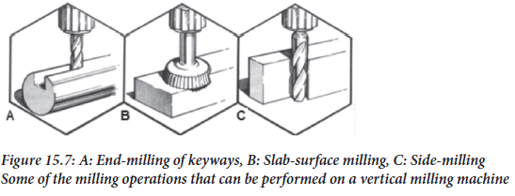
Module 15: Milling machines (continued)
MILLING CUTTERS
A great variety of cutters is available and of these a number are made for direct mounting in the spindle nose, for mounting on stub arbors or for holding in special chucks of cutters.
www.futuremanagers.com

