Slide 1

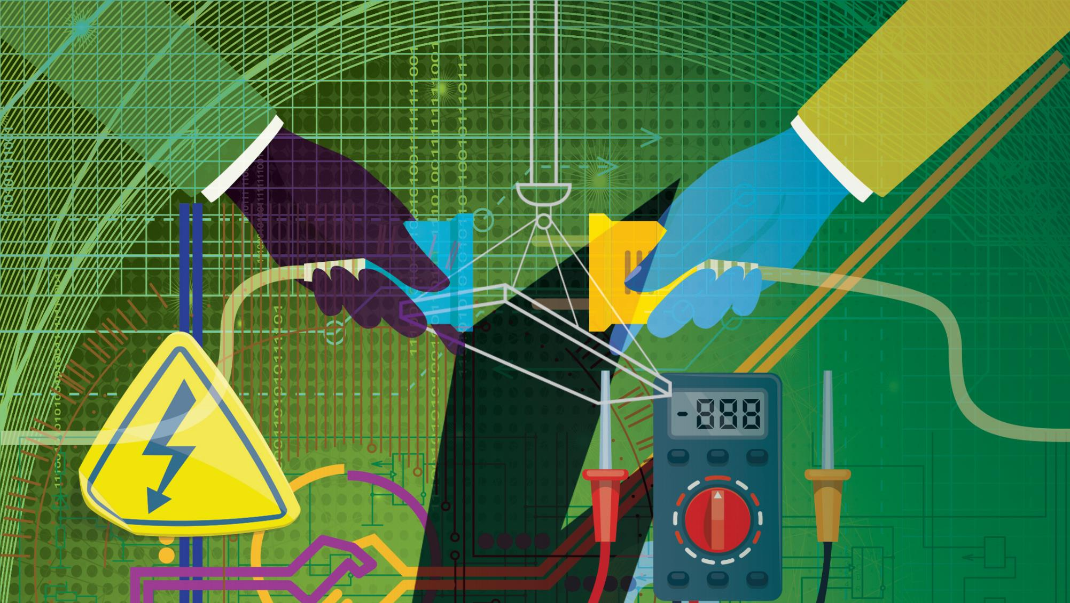
Electrical Trade Theory
N1

Slide 2
Chapter 1: Safety and basic hand tools
SAFETY
Safety is everyone’s responsibility, but accidents are mainly caused by:
carelessness;
ignorance; and
inexperience.
www.futuremanagers.com

Slide 3
Chapter 1: Safety and basic hand tools (continued)
ENVIRONMENTAL
Employers must provide and maintain a safe and health and safety risk-free working environment and employees must obey all health and safety rules.
Includes housekeeping, colour-coding, safety signs, machine guarding, and grinders and ladders.
www.futuremanagers.com

Slide 4

Chapter 1: Safety and basic hand tools (continued)
FIRES
Many fires are electrically related. Open flames, faulty electrical apparatus, carelessness and burning cigarette butts carelessly discarded, are major causes of fires.
www.futuremanagers.com

Slide 5
Chapter 1: Safety and basic hand tools (continued)
BASIC HAND TOOLS
Flat screwdriver Philips screwdriver Combination pliers Long-nose pliers Side cutter (diagonal cutter) Crimping tool | Cable knife Hacksaw Bending spring (for PVC conduit) Draw tape
www.futuremanagers.com

Slide 6
Chapter 2: Electrical circuits
THE ATOM
a) Three-dimensional representation (difficult) b) Two-dimensional representation (easy)
www.futuremanagers.com

Slide 7
Chapter 2: Electrical circuits (continued)
SIMPLE CIRCUIT
For an electric current to flow, an electric
circuit must exist:
an electrical power device
an electric appliance or device
two lengths of insulated conductor connecting the device to the power supply.
www.futuremanagers.com

Slide 8

Chapter 2: Electrical circuits (continued)
OHM’S LAW
The current flowing in an electrical circuit is proportional to the applied voltage and inversely proportional to the resistance of the circuit.
$I=\frac{V}{R}$ where I = current in ampere (A)
V = potential difference in volt (V)
R = resistance in ohm (Ω).
www.futuremanagers.com

Slide 9

Chapter 2: Electrical circuits (continued)
HEATING EFFECT OF AN ELECTRIC CURRENT
Joule’s law states that heat generated in an electric circuit is proportional to:
the square of the current ($I^{2}$)
the resistance of the circuit ($R$)
the time during which the current flows ($t$).
$Q=I^{2}Rt$ where $Q$ = heat energy generated in joule
$I$ = current in ampere
$R$ = resistance in ohm
$t$ = time in seconds (s).
www.futuremanagers.com

Slide 10
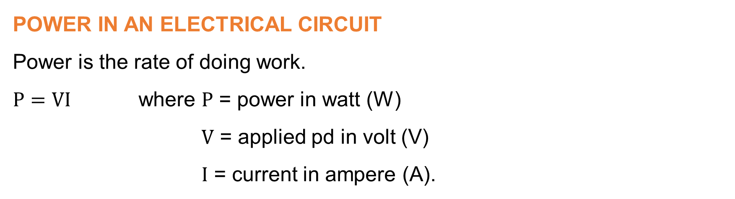
Chapter 2: Electrical circuits (continued)
POWER IN AN ELECTRICAL CIRCUIT
Power is the rate of doing work.
$P=VI$ where $P$ = power in watt (W)
$V$ = applied pd in volt (V)
$I$ = current in ampere (A).
www.futuremanagers.com

Slide 11
Chapter 2: Electrical circuits (continued)
GROUPING OF RESISTORS
Resistors can be grouped in:
Series
Parallel
Series-parallel
www.futuremanagers.com

Slide 12
Chapter 2: Electrical circuits (continued)
FACTORS INFLUENCING THE RESISTANCE OF A CONDUCTOR
The resistance of a conductor depends on four factors:
The type of material of the conductor;
The length of the conductor;
The cross-sectional area of the conductor; and
The temperature of the conductor.
www.futuremanagers.com

Slide 13

Chapter 2: Electrical circuits (continued)
TEMPERATURE COEFFICIENT OF RESISTANCE
Temperature coefficient of resistance is the increase in unit resistance of a substance, per unit rise in temperature from 0°C.
$R_{t}=R_{0}+⍺_{0}t$ where${ R}_{t}$= resistance at temperature $t$
$t$ = temperature in °C
$R_{0}$ = resistance at 0°C
$⍺_{0}$ = temperature coefficient of resistance at 0°C
www.futuremanagers.com

Slide 14
Chapter 2: Electrical circuits (continued)
CELLS
The internal resistance of a cell causes an internal volt drop to take place when there is a current flowing. This causes the terminal voltage to drop. The internal volt drop is proportional to the load current.
www.futuremanagers.com

Slide 15
Chapter 2: Electrical circuits (continued)
GROUPING OF CELLS
Cells can be grouped in:
Series
Parallel
Series-Parallel
combination
www.futuremanagers.com

Slide 16
Chapter 3: Magnetism and transformers
MAGNETISM
There are three types of magnets:
Natural magnets;
Permanent magnets; and
Electromagnets.
www.futuremanagers.com

Slide 17
Chapter 3: Magnetism and transformers (continued)
TRANSFORMERS
Standard transformers are used to step a voltage up or down with a corresponding decrease or increase in current.
Transformers have several advantages:
Their construction is simple;
Their efficiency at full load is high, ± 97%;
Because they have no moving parts, their operation is silent; and
They require little care and maintenance.
www.futuremanagers.com

Slide 18
Chapter 3: Magnetism and transformers (continued)
COOLING OF TRANSFORMERS
Cooling may be classified in two main groups:
Open-air cooling; and
Oil cooling which is made of three components:
The oil tank;
Expansion; and
Breather
www.futuremanagers.com

Slide 19
Chapter 3: Magnetism and transformers (continued)
PRINCIPLE OF OPERATION OF A TRANSFORMER
The coils are electrically separate and insulated from one another.
The coils are magnetically coupled by means of a laminated iron core.
An ideal transformer is assumed to have no losses.
www.futuremanagers.com

Slide 20
Chapter 3: Magnetism and transformers (continued)
AUTO-TRANSFORMERS
In an auto-transformer, the primary and secondary windings are connected electrically as well as magnetically.
They are used for voltage regulation on transmission lines, reduced voltage starting of three-phase motors and high voltage starting of discharge lamps.
www.futuremanagers.com

Slide 21
Chapter 4: Alternating current
ELECTROMAGNETIC INDUCTION
An electro-magnetic field (emf) is induced when a conductor goes through a magnetic field.
Faraday’s first law of electromagnetic induction states:
An emf is induced in an electric circuit whenever there is a change in the magnetic flux linking with the circuit.
Faraday’s second law of electromagnetic induction:
The magnitude of the induced emf is proportional to the rate of change of flux linking with the circuit.
www.futuremanagers.com

Slide 22
Chapter 4: Alternating current (continued)
SINGLE-PHASE ALTERNATING CURRENT
For domestic use such as in appliances, swimming pool motors and lighting.
Simple AC alternator
Waveform of induced emf
www.futuremanagers.com

Slide 23
Chapter 4: Alternating current (continued)
THREE-PHASE ALTERNATING CURRENT
Large consumers of electricity use three-phase ac power because:
Three-phase power is cheaper to generate and transmit.
Three-phase motors are more efficient and can be constructed in large sizes.
Simple three-phase alternator and three-phase waveform
www.futuremanagers.com

Slide 24
Chapter 5: Batteries and direct current sources
PRIMARY CELLS
The Leclanché dry cell is the most often used primary cell, especially in the case of portable appliances such as torches and radios.
Leclanché dry cell
www.futuremanagers.com

Slide 25
Chapter 5: Batteries and direct current sources (continued)
MINIATURE CELLS
To meet the requirements of miniaturisation (such as for guided missiles, hearing aids, pacemakers, calculators and wrist watches) ‘button’ cells such as the mercury oxide, silver oxide and other similar primary cells were developed.
Silver oxide cell
www.futuremanagers.com

Slide 26
Chapter 5: Batteries and direct current sources (continued)
LEAD-ACID CELL (SECONDARY CELLS)
The most often used secondary cell is the lead-acid cell as used in motor
vehicles.
www.futuremanagers.com

Slide 27
Chapter 5: Batteries and direct current sources (continued)
CHOICE OF CELLS
Certain factors may have to be considered when selecting cells, such as:
The voltage required by the load;
The current delivering capacity (the load current) that is required;
The duration of current flow;
The life expectancy of the cell;
Whether or not a rechargeable cell is required; and
The shelf (storage) life of the cell.
www.futuremanagers.com

Slide 28
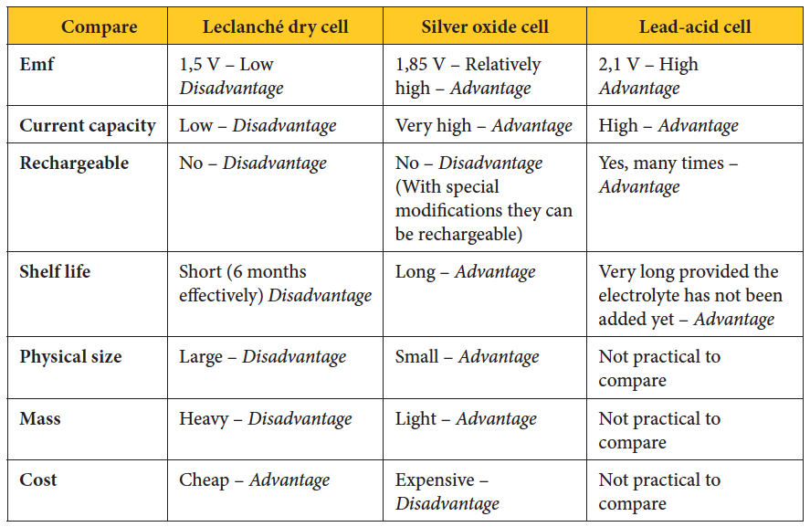
Chapter 5: Batteries and direct current sources (continued)
COMPARISON OF CELLS
www.futuremanagers.com

Slide 29
Chapter 5: Batteries and direct current sources (continued)
DIRECT CURRENT GENERATOR
In order to generate direct current, the two slip-rings of the alternator can be replaced by one ring which is split into two halves and insulated from each other.
Simple dc generator
www.futuremanagers.com

Slide 30
Chapter 5: Batteries and direct current sources (continued)
METHODS OF PRODUCING ELECTRICITY
Including primary and secondary cells and generators, electricity can be produced in the following ways:
Chemical reaction;
Electro-magnetic induction;
Solar energy conversion;
Heat; and
Friction.
www.futuremanagers.com

Slide 31
Chapter 6: Measuring instruments
VOLTMETERS AND AMMETERS
An ammeter measures the current (or a known fraction of it), and a voltmeter measures the current proportional to the voltage.
Fundamentally, both instruments are the same.
www.futuremanagers.com

Slide 32
Chapter 6: Measuring instruments (continued)
MOVING IRON METER
There are two types of moving iron meters:
Attraction type
Repulsion type
www.futuremanagers.com

Slide 33
Chapter 6: Measuring instruments (continued)
MOVING COIL METER (PERMANENT MAGNET TYPE)
The right-hand side of the coil experiences a downward force and the left-hand side, an upward force. This causes the coil to move in a clockwise direction. The larger the current through the coil, the stronger the magnetic field and the larger the deflecting torque.
www.futuremanagers.com

Slide 34
Chapter 6: Measuring instruments (continued)
INSULATION RESISTANCE TESTER (“MEGGER”)
The lower the resistance, the greater the current through the deflecting coil and the greater the force will be tending to line the flux of the deflecting coil with that of the main flux.
www.futuremanagers.com

Slide 35
Chapter 6: Measuring instruments (continued)
CONNECTION OF INSTRUMENTS
For low voltage and low current circuits, instruments such as voltmeters and
ammeters are connected directly.
In order to extend the range of instruments and to enable them to measure higher voltages and currents, series and shunt resistors (for both ac and dc circuits) and instrument transformers for higher ac voltages and currents can be used.
www.futuremanagers.com

Slide 36
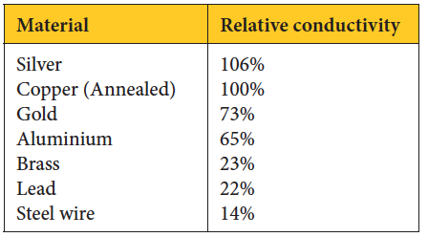
Chapter 7: Conductors, Cables, and wireways
CONDUCTORS MATERIALS
Some materials are better conductors than others, seen in the table below:
www.futuremanagers.com

Slide 37
Chapter 7: Conductors, Cables, and wireways (continued)
INSULATORS
The main function of insulating materials is to support and/or electrically separate conductors in order to prevent the flow of an electric current where a potential difference exists between two or more points.
www.futuremanagers.com

Slide 38
Chapter 7: Conductors, Cables, and wireways (continued)
ARMOURED CABLES
Different types of armored cables include:
PVC insulated steel wire armoured cables;
Paper-insulated armoured cables; and
Cross-linked polyethylene (XLPE) cables.
PVC wire armoured cable
Paper-insulated, armoured cables
www.futuremanagers.com

Slide 39
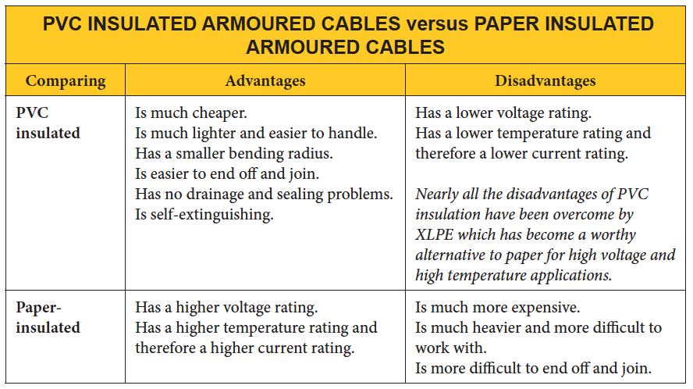
Chapter 7: Conductors, Cables, and wireways (continued)
COMPARISONS OF PAPER AND PLASTIC INSULATED ARMOURED CABLES
www.futuremanagers.com

Slide 40
Chapter 7: Conductors, Cables, and wireways (continued)
WIREWAYS
A wireway is used to house conductors, cables and busbars.
It can be defined as a tray, any enclosed casing such as conduit, sleeving, ducting, trunking system and the like that is used to contain conductors or cables.
www.futuremanagers.com

Slide 41
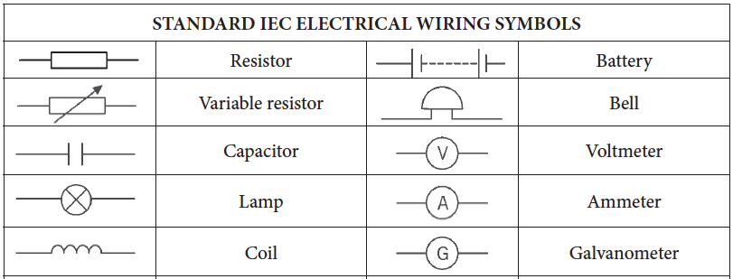
Chapter 8: Wiring of premises
STANDARD IEC ELECTRICAL WIRING SYMBOLS
Symbols are used to represent wiring, components and apparatus in circuit
diagrams.
www.futuremanagers.com

Slide 42
Chapter 8: Wiring of premises (continued)
APPLIANCES
Appliances can be divided into three groups:
Fixed appliances;
Portable appliances; and
Stationary appliances.
www.futuremanagers.com

Slide 43
Chapter 8: Wiring of premises (continued)
COMPONENTS
The things to look out for which could identify an object as being an electrical component, are protruding wires, protruding contact pins, protruding terminals and contacts, contact sockets and connection screws.
www.futuremanagers.com

Slide 44
Chapter 8: Wiring of premises (continued)
DISTRIBUTION BOARDS
A distribution board is an enclosure that contains electrical equipment for the distribution or control of electrical power from one or more incoming circuits to one or more outgoing circuits.
www.futuremanagers.com

Slide 45
Chapter 8: Wiring of premises (continued)
WIRING OF SUB-CIRCUITS
All circuits are wired in parallel so that the full supply voltage will be applied across appliances or apparatus when they are switched on.
Different sub-circuits include:
Bell sub-circuit;
Socket outlet (plug) sub-circuit;
Geyser sub-circuit;
Lighting sub-circuit;
Two-way switching;
Intermediate switching;
Stove sub-circuit;
Simmerstat (energy regulator) switch;
Three-heat switching; and
Oven thermostat switch.
www.futuremanagers.com

Slide 46
Chapter 8: Wiring of premises (continued)
PROTECTION
The fundamental principles that form the basis of the South African National Standard (SANS) 10142 are primarily to ensure the safety of persons, livestock and property against electrical hazards.
www.futuremanagers.com

Slide 47
Chapter 8: Wiring of premises (continued)
EARTH LEAKAGE PROTECTION
The purpose of an earth leakage unit is to detect an earth fault current and to automatically disconnect an installation or circuit from the supply.
In order to test the effectiveness of the earth leakage protection offered, a special test must be carried out.
Test button
www.futuremanagers.com

Slide 48
Chapter 8: Wiring of premises (continued)
OVERHEAD ENTRY TO A DWELLING
Although supplies to dwellings are mostly done by means of underground cables, in some cases aerial (overhead) conductors are used. These are conductors which are supported above the ground and are totally exposed to the open air.
www.futuremanagers.com

Slide 49
Chapter 8: Wiring of premises (continued)
LOAD BALANCING
It is important to attempt to balance the load across the three phases when a three-phase transformer supplies single-phase load. This will ensure that the efficiency of the three-phase supply transformer is at its best.
www.futuremanagers.com

Slide 50
Chapter 8: Wiring of premises (continued)
LIGHTNING ARRESTORS
A lightning arrestor is a device designed to protect an installation from transient (momentary) voltage surges caused by lightning.
www.futuremanagers.com

Slide 51
Chapter 8: Wiring of premises (continued)
PREPAID METERING
Prepaid metering is a system whereby a consumer purchases electrical energy in advance. A special meter is installed in the consumer’s house or flat.
Magnetic card prepaid energy meter
www.futuremanagers.com

Slide 52
Chapter 8: Wiring of premises (continued)
ENERGY CONTROL UNITS
An energy control unit is used to shed a non-essential load such as a geyser or underfloor heating during high demand periods.
www.futuremanagers.com

Slide 53
Chapter 9: Testing
TESTING AND INSPECTION
Before a Certificate of Compliance (CoC) may be issued, inspection and testing must be carried by an authorised person. A test report must also be issued.
It is important to pay attention to the protection offered by the earth leakage device, earthing and bonding, especially of roofs, gutters and downpipes.
www.futuremanagers.com

Slide 54
Chapter 9: Testing (continued)
INSULATION RESISTANCE TEST BETWEEN CONDUCTORS AND EARTH
This test is carried out with an insulation resistance tester.
One lead of the approved tester is connected to the earth terminal in the distribution board and the other lead to the busbar bridged with the neutral bar.
Test between earth and the conductors that connect the consumer’s main switch to the supplier’s metering equipment.
Insulation resistance test
www.futuremanagers.com

Slide 55
Chapter 9: Testing (continued)
INSULATION RESISTANCE TEST BETWEEN CONDUCTORS
This test is also carried out with an insulation resistance tester.
One lead of the approved tester is connected to the earth terminal in the distribution board and the other lead to the busbar bridged with the neutral bar.
The test is carried out between the conductors connect the consumer’s main switch to the supplier’s metering equipment.
Insulation resistance test
www.futuremanagers.com

Slide 56
Chapter 9: Testing (continued)
EARTH AND BONDING CONTINUITY TEST
Test the continuity of the bonding between the consumer’s earth terminal and all exposed conductive parts.
Earth and bonding continuity tests
www.futuremanagers.com

Slide 57
Chapter 9: Testing (continued)
POLARITY TEST
If a single-pole switch is connected in the neutral conductor, the operation of the appliance will still be controlled as usual but it will be very dangerous.
A test must therefore be carried out to ensure that the requirements of SANS 10142 have been met.
Polarity tests
www.futuremanagers.com

Slide 58
Chapter 9: Testing (continued)
TESTING THE CONTINUITY OF CONDUCTORS
A continuity test of with an ohmmeter can be carried out as follows:
The main disconnector must be open (off).
Disconnect all appliances and fluorescent lamp fittings.
Remove all incandescent lamps (globes).
Close the sub-circuit circuit breakers.
Bridge the busbar and neutral bar
Close all light switches.
Test between live and neutral contacts at lighting points and socket outlets.
www.futuremanagers.com

Slide 59
Chapter 9: Testing (continued)
EARTH LEAKAGE PROTECTION TEST
The effectiveness of the earth leakage protection of the installation is tested by simulating an earth fault between each phase conductor and earth at various outlet points in the installation.
Earth leakage tester
www.futuremanagers.com

Slide 60
Chapter 10: Electronics
COLOUR CODING OF RESISTORS
Resistors sometimes have a colour-coding in the form of three to four coloured rings dots. The rings are closer to one end than the other. The code begins with the rings or dots closest to the end.
The first two coloured rings represent numbers.
The third ring is an indication of how many zeros are to be added after the first two numbers.
The fourth ring is an indication of the tolerance allowed. If no fourth ring has been painted, it means that the tolerance is 20%.
www.futuremanagers.com

Slide 61
Chapter 10: Electronics (continued)
SEMICONDUCTORS
Semiconductors are materials which are neither good conductors nor good insulators.
A semiconductor may act either as a conductor or as an insulator depending on various physical influences. Common semiconductor materials are germanium and silicon.
www.futuremanagers.com

Slide 62
Chapter 10: Electronics (continued)
CAPACITORS
A capacitor is a device comprising two conductors, known as plates, separated by an insulating material known as a dielectric. Common dielectric materials are mica, air, waxed paper and plastic films.
Variable air capacitor
Rolled foil capacitor
www.futuremanagers.com

