Slide 1

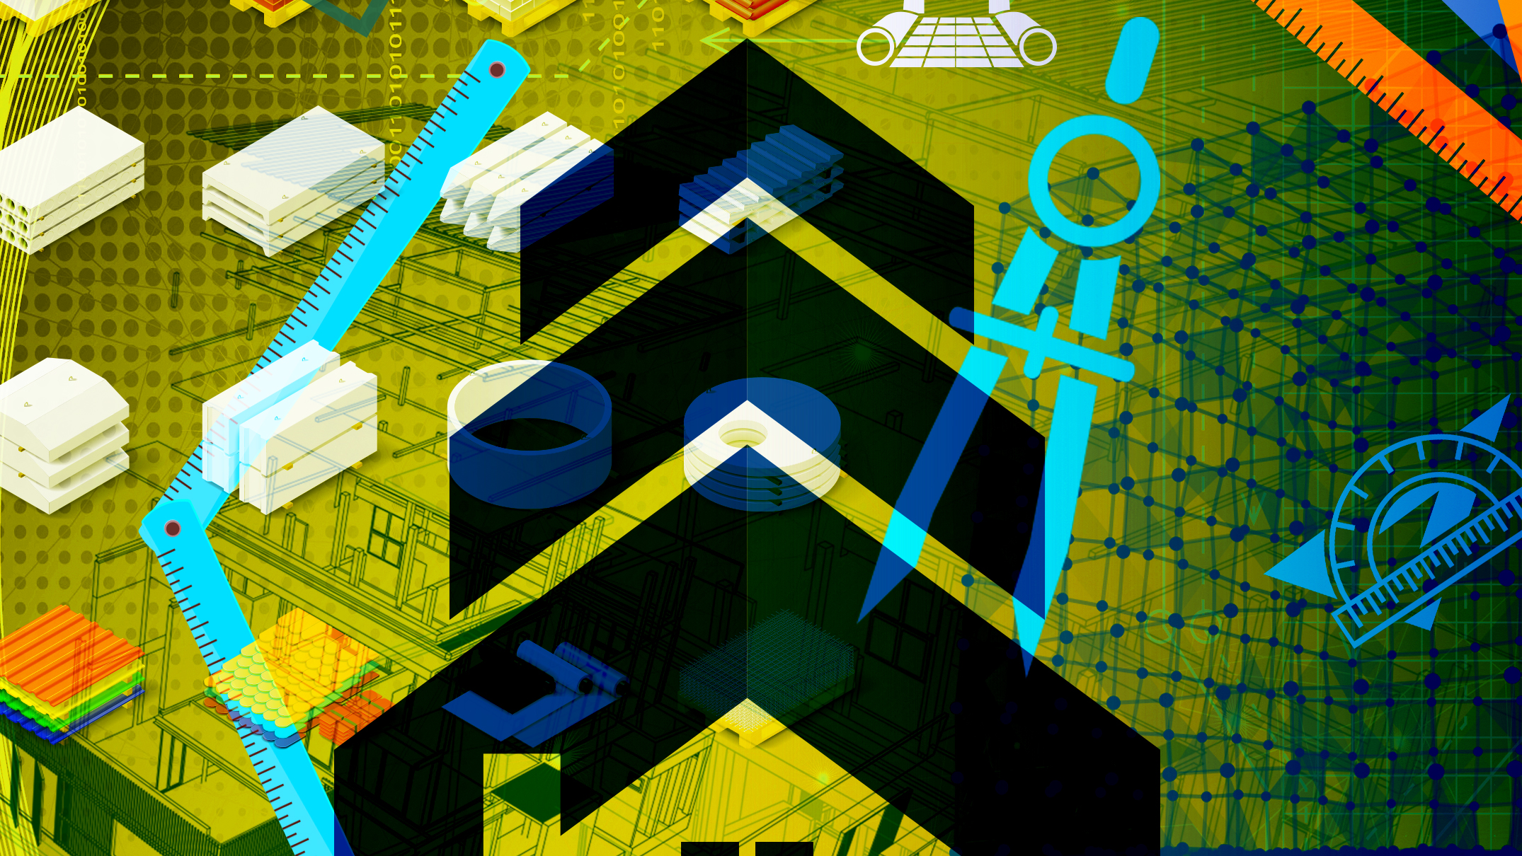
Building Science
N1

Slide 2
Module 1: Measurements
INTRODUCTION
Individuals were responsible for production long before industrial operations where a person was responsible for making and assembling a product alone and that person needed only to adhere his own particular system of measurement. However, machines took over and the need for standardisation of measurement grew. The metric system is now used chiefly by most industrialised nations of the world.
www.futuremanagers.com

Slide 3
Module 1: Measurements (continued)
MEASURING INSTRUMENTS
The following instruments are used to measure either length, volume, mass, weight or gravity:
Ruler;
Measuring tape;
Scale;
Micrometers;
Protractor;
Burette;
Pipette; and
Measuring flask; etc
www.futuremanagers.com

Slide 4
Module 1: Measurements (continued)
HISTORY OF THE SYTÊME INTERNATIONALE OF UNITS
The creation of the decimal metric system during the French Revolution and the subsequent use of two platinum rods representing a meter (and now stored in vaults in Paris and New York), is really the first step in the development of the present SI system.
www.futuremanagers.com

Slide 5
Module 1: Measurements (continued)
LENGTH
Length can be measured in micro meters, millimeters, centimeters, decimeters, meters, decameters, hectometers and kilometers.
www.futuremanagers.com

Slide 6

Module 1: Measurements (continued)
AREA
When area needs to be calculated, it must be done in square metres. The Si unit for this is m².
Square and rectangle: Area = $Length ×breadth$
Triangle: Area = $\frac{1}{2}breadth ×height$
Circles: Area = ${πr}^{2}$
www.futuremanagers.com

Slide 7
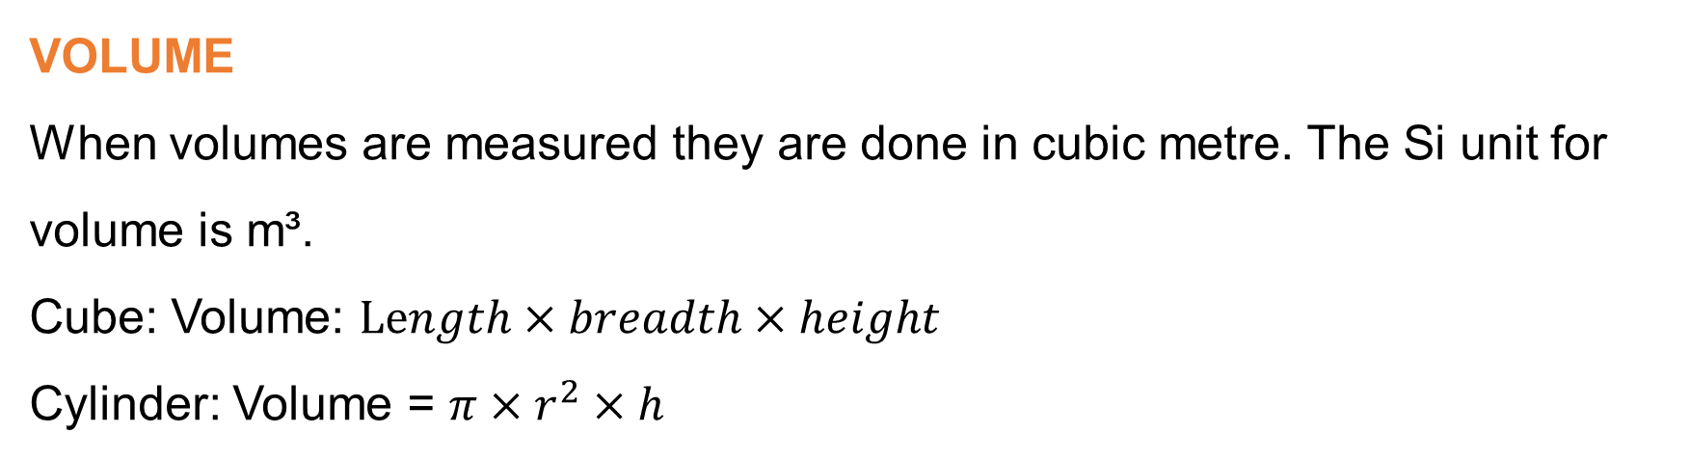
TRIA
Module 1: Measurements (continued)
VOLUME
When volumes are measured they are done in cubic metre. The Si unit for volume is m³.
Cube: Volume: $Length×breadth×height$
Cylinder: Volume = ${π×r}^{2}×h$
www.futuremanagers.com

Slide 8
TRIA
Module 1: Measurements (continued)
THE DIFFERENCE BETWEEN MASS AND WEIGHT
Everything we see around us, everything we can touch or feel, is classified under the heading of matter. The state of matter is “solid”, “liquid” or a “gas”.
The weight of a body depends on the pull of gravity of the earth. By measuring the pull of gravity on a body, you measure its weight. A device used for measuring the pull of gravity is called a scale or a weighing machine.
www.futuremanagers.com

Slide 9
TRIA
Module 1: Measurements (continued)
MASS
Mass is the amount of matter in a body. The mass of an object is the quantity of matter it contains and is measured in grams (g) and Kilograms (kg).
www.futuremanagers.com

Slide 10
Module 2: Timber
INTRODUCTION
Trees provide timber for the building industry. Structurally timber is a very useful material. It is easy to work with and can be made into any shape. It is used in building, flooring, fences, furniture etc. Timber is used in construction for a variety of applications such as making durable solid wood furniture and built-in cupboards as well as roof structures.
www.futuremanagers.com

Slide 11
TRIA
Module 2: Timber (continued)
THE STRUCTURE OF A TREE
The roots;
The trunk;
The crown.
www.futuremanagers.com

Slide 12
TRIA
Module 2: Timber (continued)
THE ROOTS
The roots are found under the soil and have two main functions.
To anchor the tree.
Absorb water from the soil.
The water contains mineral salts which grows cells at the tips of the roots and forms root fibre during the growth process. This makes it possible for the roots to grow deeper into the soil.
www.futuremanagers.com

Slide 13
TRIA
Module 2: Timber (continued)
THE TRUNK
This part produces the wood and provides support to the crown. The water that is taken up by the roots moves through the sapwood to the leaves. From here the water with processed food moves through the inner bark to feed the roots.
www.futuremanagers.com

Slide 14
TRIA
Module 2: Timber (continued)
THE CROWN
The crown consist of branches, leaves and seeds. Water and dissolved minerals are carried to the leaves by fibres and tracheids in the sapwood. Large quantities of water evaporate from the leaves and the water remaining in the leaves dissolves carbon dioxide from the atmosphere. Food is produced from water in the leaves with the help of sunlight, carbon dioxide and minerals. This process is called photosynthesis. Oxygen is released by the process and let out into the atmosphere by the leaves during daytime.
www.futuremanagers.com

Slide 15
TRIA
Module 2: Timber (continued)
STRUCTURE OF TIMBER
Timber consists of many small cells, which are joined together to form a whole. These cells consist of different forms (square, round and elongated). Timber is classified into two main groups namely soft wood and hardwood.
www.futuremanagers.com

Slide 16
TRIA
Module 2: Timber (continued)
SOFTWOOD
Soft wood consist of a simple structure with only two main cell types. The trachyte is the main component and the most important cell type. The parenchyma cell is the second type.
www.futuremanagers.com

Slide 17
TRIA
Module 2: Timber (continued)
HARDWOOD
Hardwood consist of fibres similar to trachytes but are shorter and pointed sharply and are seldom arranged in radial rows. Trachea or pores are another cell type that are found in hardwood and never in soft wood. These cells are wide and interlinked to form a channel for transporting sap from the roots to the leaves. Parenchyma cells are also found in hardwood.
www.futuremanagers.com

Slide 18
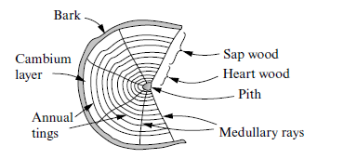
TRIA
Module 2: Timber (continued)
THE TREE TRUNK
The following parts are important when looking at a cross section of a tree trunk:
www.futuremanagers.com

Slide 19
TRIA
Module 2: Timber (continued)
BARK
The bark protects the entire trunk. It is cork-like and consists of a number of pores and cells. As the tree grows new bark is formed whilst the old bark dries and falls off.
www.futuremanagers.com

Slide 20
TRIA
Module 2: Timber (continued)
CAMBIUM LAYER
This is a thin layer that surrounds the sapwood. New wood and bark are formed in this layer. The cambium is inactive in winter time.
www.futuremanagers.com

Slide 21
TRIA
Module 2: Timber (continued)
ANNUAL RING
Trees grow faster during spring and summer than in autumn and winter. Rings are formed and are called annual growth rings. One ring represents one growth year.
www.futuremanagers.com

Slide 22
TRIA
Module 2: Timber (continued)
SAPWOOD
Sapwood is the more newly formed wood and is found more towards the outside side of a tree below the cambium layer. This wood contains enormous amounts of nutrients and sap. This part of the tree trunk will produces a less valuable timber than heartwood.
www.futuremanagers.com

Slide 23
TRIA
Module 2: Timber (continued)
HEARTWOOD
The inner core of the tree is formed by heartwood. It is still alive but the growth has ceased and is therefore free of sap. This is the most valuable timber, durable and resistant to insect attacks.
www.futuremanagers.com

Slide 24
TRIA
Module 2: Timber (continued)
PITH
The pith is the central part of the tree. As the tree grows older this part dies and becomes rotten. The pith is always dark in colour.
www.futuremanagers.com

Slide 25
TRIA
Module 2: Timber (continued)
MEDULLARY RAYS
Thin layers of fibre stretch from the pith to the cambium layer. Medullary rays are nested randomly throughout the trunk. The purpose of these rays is to transport nutrients to the inner part of the trunk.
www.futuremanagers.com

Slide 26
TRIA
Module 2: Timber (continued)
SEASONING OF TIMBER
Drying helps to distress timber to avoid warping when it is sawn and processed. There are two common drying methods:
Natural drying, and
Artificial drying (kiln drying).
www.futuremanagers.com

Slide 27
TRIA
Module 2: Timber (continued)
REASONS FOR SEASONING TIMBER
Seasoned timber is stronger, more stable & retains its maximum strength.
Easier to work with lighter wood.
Wet timber will warp and split easily, cannot be glued, and can be attacked by insects, fungi and rot.
If furniture is made from wet timber it will be very heavy and will pull apart as the timber dries.
Joints will open as timber dries out.
www.futuremanagers.com

Slide 28
TRIA
Module 2: Timber (continued)
NATURAL SEASONING
Timber is stacked in such a way that air can move freely around every piece of wood. Sunlight can cause shakes in the timber and rain can prolong the drying process. Timber should be protected by a temporary or permanent shed.
www.futuremanagers.com

Slide 29
TRIA
Module 2: Timber (continued)
THE FOLLOWING FACTORS MUST BE CONSIDERED WHEN STACKING THE TIMBER
The timber must be stacked on a level surface above the ground.
The separating battens must be of equal thickness and spaced in parallel piles.
A shelter/shed must be erected over the wood to protect it against the elements.
www.futuremanagers.com

Slide 30
TRIA
Module 2: Timber (continued)
ARTIFICIAL/KILN SEASONING
Kiln seasoning is performed in an airtight room which is fitted with heating coils, fans and steam jets. The timber is stacked on trolleys for easy handling. The room is heated by the heating coils to speed up the evaporation of the moisture from the timber. The air is circulated by the fans while steam is released to control the drying process. Timber can be used as soon as stability is reached.
www.futuremanagers.com

Slide 31
TRIA
Module 2: Timber (continued)
PROGRESSIVE KILN
This kind of kiln process consists of a number of loads moving progressively from the entrance to the exit. The seasoning of the timber gradually intensifies as the charge moves. Loads at various distances from the entrance are at a different drying stage.
www.futuremanagers.com

Slide 32
TRIA
Module 2: Timber (continued)
THE PURPOSE OF PRESERVATIVES
The preservation of timber refers to the process used to prolong the durability of wood, i.e extending its useful life for as long as possible. The method of preservation will depend on the degree of preservation required.
www.futuremanagers.com

Slide 33
TRIA
Module 2: Timber (continued)
WHY TIMBER IS PRESERVED
It is done to provide protection against any type of damage caused by the elements such as rain, sun and natural threats, for example, beetles and termites.
www.futuremanagers.com

Slide 34
TRIA
Module 2: Timber (continued)
PROPERTIES OF A GOOD PRESERVATIVE
Be poisonous enough to kill insects such as termites and beetles, without being harmful to humans.
Resistant to insects and fungi.
Must be affordable, permanent, cheap and easily available.
Be able to strengthen rather than weaken the wood.
Must not corrode metals.
Must easily penetrate the wood.
www.futuremanagers.com

Slide 35
TRIA
Module 2: Timber (continued)
TYPES OF PRESERVATIVES
Preservatives are divided into three main categories:
Coaltar creosote.
Poisonous chemical salts (aqueous solutions of metallic salts).
Organic compounds (solutions of volatile organic solvents).
www.futuremanagers.com

Slide 36
TRIA
Module 2: Timber (continued)
COALTAR CREOSOTES (OILY PRESERVATIVES)
These preservatives are the by-products of processing coal and wood; they are viscous, dark liquids. Coaltar creosote is diluted for the purpose of application and may contain additives, such as wax oil, to enhance its durability. This preservative’s power to protect lies in the phenol, oil and naptthalene that it contains. It contains either coaltar or coaltar distillates and in some cases both. It kills most insects and fungi.
www.futuremanagers.com

Slide 37
TRIA
Module 2: Timber (continued)
POISONOUS SALTS
These preservatives consist of a mixture of organic salts. The most common insecticides and fungicides in this group are magnesium silicofluoride and sodium fluoride, which are applied using a paintbrush. Arsenic compounds also kill fungi and insects. Metallic salts are usually dissolved in water to produce the preservatives. Examples are copper chrome arsenic (CCA), acid cupric chloride and zine chloride.
www.futuremanagers.com

Slide 38
TRIA
Module 2: Timber (continued)
ORGANIC COMPOUNDS DISSOLVED INTO VOLATILE ORGANIC SOLVENTS
Light oils such as naphtha and spirits, are more readily absorbed by wood than water and are therefore, used as solvents to allow toxins such as pentachlorophenol (PCP), copper naphthenate to penetrate the wood. They are applied with a paintbrush, and when oil evaporates the toxins remain in the wood. Solvents are the white spirit, mineral turpentine or light mineral oil (paraffin).
www.futuremanagers.com

Slide 39
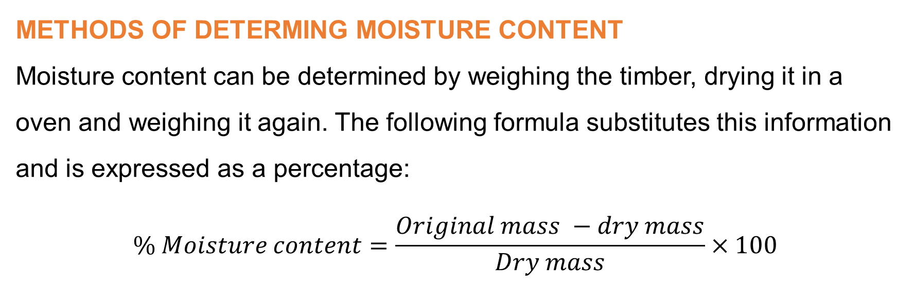
TRIA
Module 2: Timber (continued)
METHODS OF DETERMING MOISTURE CONTENT
Moisture content can be determined by weighing the timber, drying it in a oven and weighing it again. The following formula substitutes this information and is expressed as a percentage:
$$\% Moisture content=\frac{Original mass −dry mass}{Dry mass}×100$$
www.futuremanagers.com

Slide 40
Module 3: Pressure
INTRODUCTION
Pressure is defined as the force applied per unit area. Pressure depends on how many gas molecules hit the wall of the container and what speed they are travelling at. The simplest device for measuring pressure is a barometer.
www.futuremanagers.com

Slide 41
TRIA
Module 3: Pressure (continued)
ATMOSPHERIC PRESSURE
All around us on the earth there are gases which can be seen as air. This air consists of mass and therefore has a pressure effect on the earth. This is called atmospheric pressure.
www.futuremanagers.com

Slide 42
Module 4: Forces
EFFECTS OF A FORCE
If one pushes, for example, exerts force on an object the object moves or tends to move in the direction in which it is pushed.
If you want to stop this moving object, you need to apply a force in the opposite direction of motion to the moving object.
You can also change the direction by applying a force at an angle to the moving object in motion.
www.futuremanagers.com

Slide 43
TRIA
Module 4: Forces (continued)
SCALARS
A scalar is a physical quantity that consists only of magnitude and no direction. Examples of these are area, length, volume, mass, distance, temperature, etc.
www.futuremanagers.com

Slide 44
TRIA
Module 4: Forces (continued)
VECTORS
Vectors are a physical quantity that have a specific magnitude and direction.
www.futuremanagers.com

Slide 45
TRIA
Module 4: Forces (continued)
SYSTEM OF FORCES
This is when a number of forces act upon a body. When a body is at rest, the combined effect of all the forces which it experienced is zero (0). A load placed on a horizontal surface will only remain at rest when the surface
provides Reaction equal to the weight of the load.
www.futuremanagers.com

Slide 46
TRIA
Module 4: Forces (continued)
MAGNITUDE
The magnitude of a vector is drawn to a given scale. Distance for instance, must be presented on a piece of paper to a scale factor. For example, 1cm can represent 1m.
www.futuremanagers.com

Slide 47
Module 5: Parallelogram of forces
WHAT IS PARALLELOGRAM LAW?
When two pulling forces act on a point they can be represented in magnitude and direction by two adjacent sides of a parallelogram, the resultant will be represented in magnitude and direction by the diagonal of the parallelogram from the point on which the forces are acting. The direction and magnitude of the resultant and equilibrium of two forces acting at a point can be determine graphically by making use of a parallelogram. Both these forces must either push towards the point or pull away from the point of application.
www.futuremanagers.com

Slide 48
TRIA
Module 5: Parallelogram of forces (continued)
PARALLELOGRAM
A parallelogram is a quadrilateral with both pairs of opposite sides parallel.
www.futuremanagers.com

Slide 49
TRIA
Module 5: Parallelogram of forces (continued)
RHOMBUS
A rhombus is a parallelogram with all its sides equal in length. It is sometimes called a diamond.
www.futuremanagers.com

Slide 50
TRIA
Module 5: Parallelogram of forces (continued)
RESOLUTION INTO HORIZONTAL & VERTICAL COMPONENTS
If the force is given in size and direction, including the angle which it makes with the horizontal, we can find the components by graphical means. This works the same way that parallelograms work. It can also be solved by means of trigonometry. The force and the two components form a right-angled triangle and we know that the ratio of the opposite side to the hypotenuse is the sine of the angle. The ratio of the adjacent side to the hypotenuse gives the cosine of the angle.
www.futuremanagers.com

Slide 51
Module 6: Triangle of forces
INTRODUCTION
If you want to find the equilibrium of any resultant in a parallelogram of forces, you have to extend the resultant an equal length and add an arrowhead facing in the opposite direction. If you need to move it back to overlap the resultant, we can see that we have a triangle formed by the two forces and the equilibrant, and that the direction of the arrowhead follows the same way.
www.futuremanagers.com

Slide 52
TRIA
Module 6: Triangle of forces (continued)
BOW’S NOTATION
A method of lettering the cells and outside spaces formed by the direction of the stresses in and loads on a framed structure so that these stresses and loads can be traced by similar letters in the vector diagram.
www.futuremanagers.com

Slide 53
Module 7: Polygon of forces
INTRODUCTION
More than three forces acting on a point that is in equilibrium. The vectors of the forces combine to form a polygon and the sides are parallel to the direction of the forces. The length of the sides must be in proportion with the sizes of the forces.
www.futuremanagers.com

Slide 54
TRIA
Module 7: Polygon of forces (continued)
LAW FOR POLYGON OF FORCES
Any number of forces whose lines of action meet at a point can be presented in magnitude and direction by the sides of a polygon, taken into account that they are in equilibrium.
www.futuremanagers.com

Slide 55
Module 8: Simple supported Beams
LINK POLYGON: SIMPLE SUPPORTED BEAMS
A beam is a horizontal or inclined structural member spanning a distance between one or more supports and carrying vertical loads across its longitudinal axis. This can be a joist, purlin, rafter or girder.
www.futuremanagers.com

Slide 56
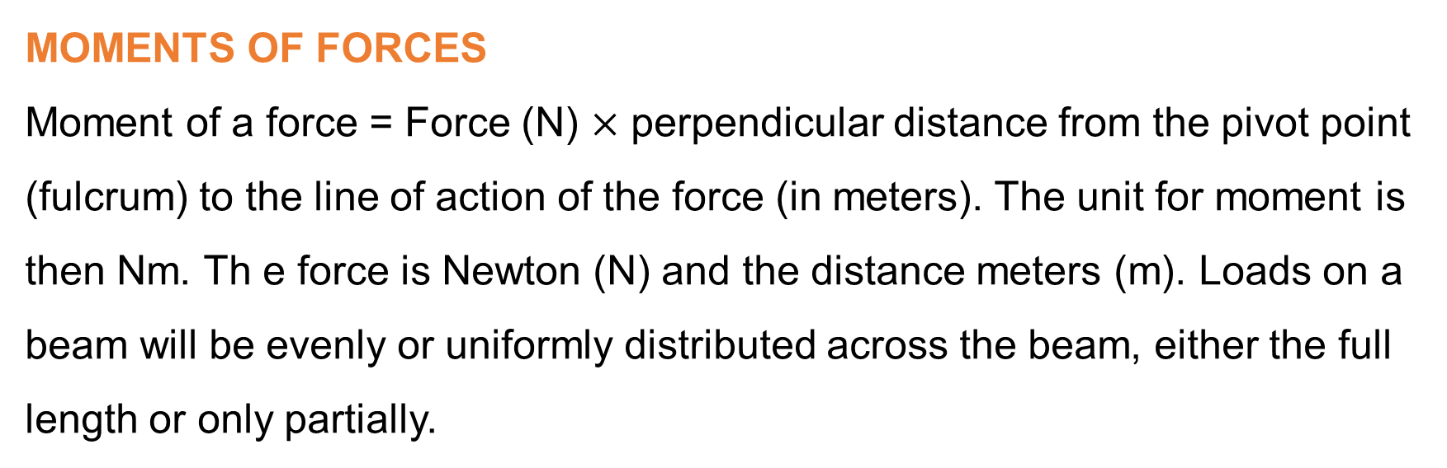
TRIA
Module 8: Simple supported Beams (continued)
MOMENTS OF FORCES
Moment of a force = Force (N) $×$ perpendicular distance from the pivot point
(fulcrum) to the line of action of the force (in meters). The unit for moment is then Nm. Th e force is Newton (N) and the distance meters (m). Loads on a beam will be evenly or uniformly distributed across the beam, either the full length or only partially.
www.futuremanagers.com

Slide 57
Module 9: Concrete
INTRODUCTION
Concrete forms an integral part of the building industry. It is strong, very cheap and can be cast into any design. Concrete can be used to form the structure of any building. It can be used in the casting of beams, columns, slabs and foundations. It can also be used in the manufacturing of pipes, canals and culverts.
www.futuremanagers.com

Slide 58
TRIA
Module 9: Concrete (continued)
COMPOSITION
Concrete is a building material consisting of river sand, stone, cement and water mixed to the correct proportions. The sand is fine aggregate and the tone is through a coarse aggregate. Aggregates are classified by specific sieve sizes. Coarse aggregate are stone not passing through a 4,8 mm sieve and not bigger than 6,4 mm. Fine aggregates are washed river sand or crusher sand.
www.futuremanagers.com

Slide 59
TRIA
Module 9: Concrete (continued)
PROPERTIES OF CEMENT
The water cement ratio should be correct.
The cement aggregate ratio should be correct.
The fine and coarse aggregates must be in the correct proportions.
The mixture must be well mixed and the mixture must be workable.
It must be fully compacted when the concrete is placed.
It must be impermeable. No water must past through it.
It must be well cured.
www.futuremanagers.com

Slide 60
TRIA
Module 9: Concrete (continued)
PROPERTIES OF CONCRETE
Concrete is very strong as it can resist a very high compressive strength.
The tensile strength of concrete is very weak / poor.
To resist tensile stress the concrete must therefore be reinforced with steel.
It can be made watertight and is suitable for roofs, walls and floors.
Maintenance cost of concrete is very low.
Easy to work with (handles easily) and very durable.
www.futuremanagers.com

Slide 61
TRIA
Module 9: Concrete (continued)
FACTORS TO BE CONSIDERED BEFORE MIXING CONCRETE
Always use clean and graded materials.
Avoid joining new concrete to old concrete.
The dry ingredients must be mixed thoroughly before adding the water.
Always measure materials to suit the specific job.
Do not prepare more concrete than can be placed within thirty minutes.
Always have protective material covering on hand in case of inclement (changing) weather.
www.futuremanagers.com

Slide 62
TRIA
Module 9: Concrete (continued)
BULKING OF SAND
Sand consists of small particles and if put together there will always be open spaces between the particles. When sand is mixed with water or come into contact with moisture the water will penetrate the openings or spaces between sand particles and will increase the volume. This increase of sand is called bulking.
www.futuremanagers.com

Slide 63
TRIA
Module 9: Concrete (continued)
EFFECTS CEMENT CAN HAVE ON WORKMEN
Can cause skin and eye irritation.
Can cause skin burns.
Can cause skin to peel away.
The inhalation of cement dust can affect one’s health.
www.futuremanagers.com

Slide 64
TRIA
Module 9: Concrete (continued)
METHODS OF MIXING MATERIALS
The main objective when mixing concrete is to obtain a uniform and close mixture of all the ingredients. The mixture must be such that the various sizes of aggregates are uniformly distributed through the mass. This can be done either by hand or using a machine.
www.futuremanagers.com

Slide 65
TRIA
Module 9: Concrete (continued)
TRANSPORTATION OF CONCRETE
There must be no drying out or contamination of the mix.
Segregation of the mix must be prevented.
The concrete should be tipped vertically and directly over its final position to prevent dispersal of aggregates.
The concrete must be well compacted in its final position.
www.futuremanagers.com

Slide 66
Module 10: Density of materials
INTRODUCTION
Density is used to indicate how close molecules of a substance/material are placed together. If a concrete block is matched with a wooden block of the same size, the concrete block will be much heavier than the wooden block. The reason for this is that the concrete block is more dense than the wooden block of the same size.
www.futuremanagers.com

Slide 67
TRIA
Module 10: Density of materials (continued)
RELATIVE DENSITY
The density of a material compared to the density of water is called relative density. This results in a number without a unit which can be used to determine whether a material is pure and without any other substances. Water’s density will be used as a constant and all the other materials will be compared to it.
www.futuremanagers.com

Slide 68
TRIA
Module 10: Density of materials (continued)
THE PRINCIPLE OF ARCHIMEDES
The principle of Archimedes is used to find the volume of an object with an irregular shape.
www.futuremanagers.com

Slide 69
TRIA
Module 10: Density of materials (continued)
THE DENSITY OF LIQUIDS
A container with known volume is used to find the density of liquids. The mass of the liquid is the difference in the mass between the full and empty container which will be the mass of the liquid. To calculate the density the mass should be divided into the volume. Relative density will be obtained by comparing the mass of the liquid to the mass of the water. A density bottle is used to find the density of liquids.
www.futuremanagers.com

Slide 70
TRIA
Module 10: Density of materials (continued)
THE STRUCTURE OF MATERIALS
The structure of materials is the way the particles are placed. In metals and plastics the particles are placed close together. In concrete in bricks they are not so close and there are spaces between the particles. These materials are formed with the spaces in between. In the joining of concrete and bricks water is used. Some of this water will evaporate with the result of leaving spaces. Materials with these small spaces will be porous.
www.futuremanagers.com

Slide 71
TRIA
Module 10: Density of materials (continued)
POROSITY AND ABSORPTION OF WATER
The amount of pores or voids that are present in a material is called porosity. A material that is porous can absorb a lot of water through its pores. Bricks, concrete and wood are porous and can absorb huge amounts of water.
www.futuremanagers.com

Slide 72
TRIA
Module 10: Density of materials (continued)
REGULATIONS FOR WATERPROOFING
The NHBRC states that any wall including a parapet, chimney, column or pier forming part of a wall shall be constructed in such a way as not to allow water to penetrate to any part of the building where it will affect the health or durability of a building.
www.futuremanagers.com

Slide 73
TRIA
Module 10: Density of materials (continued)
WALLS
A damp proof course not to be installed less than 150 mm above the level of the ground. In the case of a solid wall the course must be extended over the full thickness of the wall including the plaster. Any part of any wall of a room below ground level shall be protected by a vertical waterproof (damp proof) course.
www.futuremanagers.com

Slide 74
TRIA
Module 10: Density of materials (continued)
FLOORS
The entire area between the foundation walls shall be covered by a suitable waterproof (damp proof) membrane which must be not less than 0,25 mm thick and laid on a surface which will not contain any sharp objects. This membrane shall be folded up around the corners and for the full thickness of the slab. Any joint in the membrane shall overlap by not less than 100 mm and be sealed effectively.
www.futuremanagers.com

Slide 75
TRIA
Module 10: Density of materials (continued)
PREVENTION OF DAMPNESS
Most building materials are porous and the moisture that is absorbed can create an enormous problem. Wet walls can cause paint and plaster to peel off. This will create very unhealthy conditions. Impermeable materials are used to prevent moisture penetrating walls.
www.futuremanagers.com

Slide 76
TRIA
Module 10: Density of materials (continued)
MATERIALS USED FOR WATERPROOFING
Glass;
Polythene sheeting;
Malthoid; and
Asphalt.
www.futuremanagers.com

Slide 77
TRIA
Module 10: Density of materials (continued)
PLACING OF DPC
DPC is divided into three categories according to where it is used:
Below ground level to keep damp from the ground out of a building.
Above ground level to keep damp from entering walls by capillary action.
On a parapet wall and windows to keep rainwater out of walls.
www.futuremanagers.com

Slide 78
TRIA
Module 10: Density of materials (continued)
DPC BELOW CONCRETE FLOORS AT GROUND LEVEL
Concrete floors at ground level must always be isolated from the ground by DPC to keep the concrete from absorbing damp from the soil by capillary action. An underfloor DPC usually consists of a heavy-duty PVC membrane of at least 0,25 mm. The membrane is spread out over the hard core filling inside the foundation walls, with the edges folded up to the top level of the concrete. Every seam in the membrane must overlap by 200 mm at both sides and be tightly sealed.
www.futuremanagers.com

