Slide 1
Entrepreneurship & Business Management N5

Slide 2
Module 1 – Personal management
INTRODUCTION
Striking a balance is of vital importance, because success within a business will only become a reality if you are successful within yourself. Your business is only a part of your life. There are other as important roles that you need to fulfil as well.
www.futuremanagers.com

Slide 3
Module 1 – Personal management (continued)
MANAGEMENT AND LEADERSHIP
Leadership is the ability of an individual to obtain the support and action of people to achieve a common goal.
Management is about doing “the things right” while leadership is about doing “the right things”.
www.futuremanagers.com

Slide 4
Module 1 – Personal management (continued)
PERSONAL MANAGEMENT
There are four key areas to bear in mind when making habits for effective personal management:
Physical - Develops a healthy body and mind;
Mental - Stimulates yourself mentally;
Spiritual - Gives you direction and a purpose in life; and
Social and emotional - Socialises; builds relationships.
www.futuremanagers.com

Slide 5
Module 1 – Personal management (continued)
PERSONAL PLANNING
It’s important to be able prioritize and put the first things first when it comes to managing time and schedule. Looking at the goals that one wants to achieve, it is important to understand how much time is needed to dedicate to each goal. This will aid in building the most efficient and successful habits to do one’s best.
www.futuremanagers.com

Slide 6
Module 2 – Management
INTRODUCTION
Management should be seen as a process of directing the resources and efforts of a business towards opportunities to achieve profit. This takes place by planning and organising, and by applying leadership and control.
www.futuremanagers.com

Slide 7
Module 2 – Management (continued)
RESPONSIBILITIES OF MANAGERS
The magnitude of a manager’s responsibilities is closely related to his/her position in a business. There are different levels to consider such as:
Top level - managers at this level accept responsibility for the business as a whole;
Middle - management at this level varies according to the size of a company, but they normally accept responsibility for a specific department of a business; and
Lower level – management at this level entails supervising the workers to get ajob done.
www.futuremanagers.com

Slide 8
Module 2 – Management (continued)
MANAGEMENT ENVIRONMENTS
There are different environments to consider:
Internal environment (business);
Direct external environment; and
Indirect external environment.
www.futuremanagers.com

Slide 9
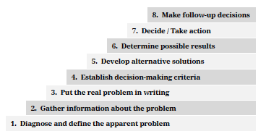
Module 2 – Management (continued)
MANAGERIAL DECISION-MAKING
A strategic planning process includes decisions regarding the future of a business.
Steps in the decision-making process
www.futuremanagers.com

Slide 10
Module 3 – Ethics and social responsibility
INTRODUCTION
Ethics refer to moral principles or a set of values held by an individual or group. Decisions are then taken in accordance with these principles of conduct. Your personal mission statement is another example of such a set of rules: a set of rules that reflects your own beliefs.
www.futuremanagers.com

Slide 11
Module 3 – Ethics and social responsibility (continued)
BUSINESS ETHICS
The business environment is a place where “right” or “wrong” issues can be confusing. A suggested method to come to a decision is to apply the “ethics check”. This includes three questions:
Is it legal?
Is it balanced?
How will it make me feel about myself?
www.futuremanagers.com

Slide 12
Module 3 – Ethics and social responsibility (continued)
ESTABLISHING ETHICAL STANDARDS
There is no single standard for ethical behaviour. It is therefore up to the individual businessperson to establish a code of ethics for his/her own business.
www.futuremanagers.com

Slide 13
Module 3 – Ethics and social responsibility (continued)
SOCIAL RESPONSIBILITY
Social responsibility refers to an obligation that a person has towards other individuals. A business has the following aspects of social responsibilities:
www.futuremanagers.com

Slide 14
Module 4 – Organising your business
INTRODUCTION
The need for organising arises when the business starts to grow and informal arrangements between the small business manager and workers are no longer practical. More work will require a manager to formalise work arrangements. This includes the assigning of tasks to specific individuals.
www.futuremanagers.com

Slide 15
Module 4 – Organising your business (continued)
ORGANISATIONAL STRUCTURE
There are several types of organisational structures:
The bureaucratic organisational structure;
Matrix organisational structure;
Flat organisational structure; and
Departmentation.
www.futuremanagers.com

Slide 16
Module 4 – Organising your business (continued)
DELEGATION
Delegation is the process whereby a manager assigns authority and responsibility to subordinates. The delegation process consists of three different but interrelated phases.
www.futuremanagers.com

Slide 17
Module 5 – Staffing your business
INTRODUCTION
Staffing refers to the formal process of ensuring that a business has a qualified workforce to meet its objectives.
www.futuremanagers.com

Slide 18
Module 5 – Staffing your business (continued)
HUMAN RESOURCES PLANNING
Human resource planning involves having the right number of people with the proper skills in the right place at the right time to perform the various activities in the business.
www.futuremanagers.com

Slide 19
Module 5 – Staffing your business (continued)
TRAINING AND DEVELOPMENT
Training and development of your staff is of vital importance if you want to provide the best possible service to your customers.
Training is generally aimed at upgrading the lower level worker in a business.
The objective of development is more to maintain and improve the effectiveness of managers.
www.futuremanagers.com

Slide 20
Module 5 – Staffing your business (continued)
MOTIVATING THE WORKFORCE
Motivation can be defined as that internal drive or desire that an individual experiences to exert an effort.
Research theories on motivation can be divided into three groups:
People theories;
Job theories; and
Organisational theories.
www.futuremanagers.com

Slide 21
Module 5 – Staffing your business (continued)
COMPENSATION
Remuneration is the compensation that an employee receives for his labour. These salaries must be enough to motivate them to perform well, but low enough for the business to afford them.
www.futuremanagers.com

Slide 22
Module 6 – Labour relations
INTRODUCTION
The relationship between an owner/manager and his or her staff is a vital part in the successful running of any business.
The Labour Relations Act spells out the rights of the different parties and provides a framework to regulate relationships between these parties.
www.futuremanagers.com

Slide 23
Module 6 – Labour relations (continued)
COLLECTIVE BARGAINING
Collective bargaining is an important way of regulating labour relations
and of determining employees’ wages and benefits. Collective bargaining takes place when trade unions and employers negotiate or try to settle disputes on employment issues.
www.futuremanagers.com

Slide 24
Module 6 – Labour relations (continued)
GRIEVANCE PROCEDURE
Every business should have its own grievance procedure, which must be in line with the Labour Relations Act. Employees should be informed about the procedure and must have the freedom to make use of it.
www.futuremanagers.com

Slide 25
Module 7 – Control
INTRODUCTION
Control involves checking to determine whether or not your business is progressing towards its goals, and if not, whether it is taking the required corrective action. There are various sources to maintain control:
www.futuremanagers.com

Slide 26
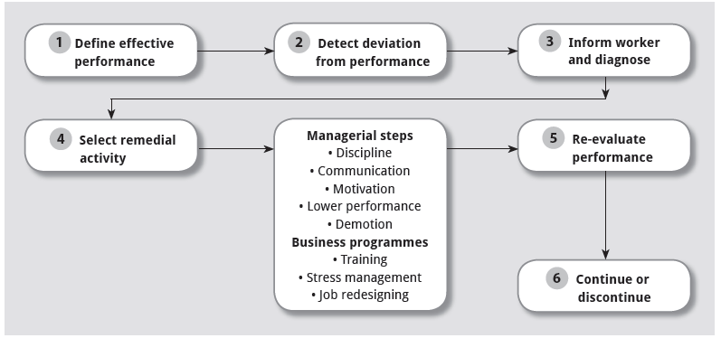
Module 7 – Control (continued)
CONTROL PROCESS
www.futuremanagers.com

Slide 27
Module 7 – Control (continued)
CONTROL METHODS
Control methods can be applied to the performance of employees or to the financial performance of the business.
Financial control methods can include:
Termination of employment;
Budgeting; and
Ratio analysis.
www.futuremanagers.com

Slide 28
Module 7 – Control (continued)
CONTROL OF TECHNOLOGY
Technology implies the use of mechanical, electronic and scientific methods to improve your daily operations. The control process requires up-to-date information. Modern technology can be a great help with this in the form of:
Computers;
Fax machines and email;
Telephones and cellphones; and
Photocopiers.
www.futuremanagers.com

Slide 29
Module 7 – Control (continued)
STOCK CONTROL
Stock control can also be referred to as inventory control. This forms an important part of the overall control function within a business.
Inventories includes:
Raw materials;
Work-in-progress; and
Finished goods.
www.futuremanagers.com

Slide 30
Module 7 – Control (continued)
CREDIT CONTROL
A business’s needs to finance operations involve the possibility of credit. This could be in the form of:
Bank overdraft facility;
Suppliers’ credit;
Hire purchase; and
Leasing.
www.futuremanagers.com

Slide 31
Module 8 – Operations management
INTRODUCTION
Operations management is defined as managing the resources required to produce the products or services provided by a business. It is achieved by making use of various inputs such as raw materials, people, equipment and facilities.
www.futuremanagers.com

Slide 32
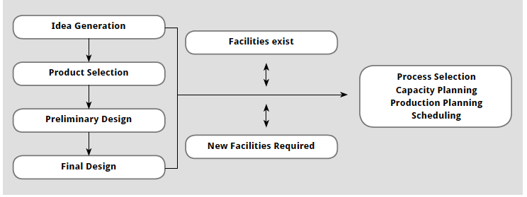
Module 8 – Operations management (continued)
DESIGNING OPERATION SYSTEMS
The product and service design development process.
www.futuremanagers.com

Slide 33
Module 8 – Operations management (continued)
USING OPERATION SYSTEMS
Efficiently managing the operating systems in a business includes:
Operations management control;
Purchasing management; and
Inventory control.
www.futuremanagers.com

Slide 34
Module 8 – Operations management (continued)
MANAGING PRODUCTIVITY
Productivity is the relationship between inputs and inputs. The higher the output in comparison with input the more productive the business is. Factors influencing productivity are:
Management;
Employees
Raw materials;
Market conditions; and operations.
www.futuremanagers.com

Slide 35
Module 8 – Operations management (continued)
MANAGING QUALITY
The basic requirements of a quality control system include the need to:
Define what is to be measured;
Determine the unit of measurement;
Establish the desired level;
Perform the measurement and compare it with the desired level; and
Accept or reject the lot, or take the necessary steps to change the process.
www.futuremanagers.com

