Slide 1


Mechanotechnics
N4

Slide 2
Module 1: Organisation and layout of a workshop
WORKSHOP LAYOUT
A good workshop should be properly planned because it becomes permanent. Tools should be available from a centralised facility, workshop store or in the worker’s dedicated toolbox and all tools should be in their specific storage compartments to avoid clutter. In an ideal workshop layout, there should be a labelled waste bin next to each workstation or equipment, depending on the type of waste the machine will produce.
www.futuremanagers.com

Slide 3
Module 1: Organisation and layout of a workshop (continued)
TYPES OF PRODUCTION
Production is the process of converting raw materials into finished goods. The most common types of production are:
Mass production;.
Batch production; and
Individual production.
www.futuremanagers.com

Slide 4
Module 1: Organisation and layout of a workshop (continued)
TYPES OF LAYOUTS
The layout of a workshop supports the type of production. Two main categories are used, namely production layout and process layout. Batch, mass and individual production require one or both the types of layouts to function.
www.futuremanagers.com

Slide 5
Module 1: Organisation and layout of a workshop (continued)
MACHINE LAYOUTS
Machines must be placed taking the interaction with other machines into consideration:
Space must be provided around each machine to allow clear separation for passing traffic, storage of tools and operations;
Machine placement must allow sufficient space for operations; and
Workbenches must be strong enough to support heavy pieces of equipment or materials.
www.futuremanagers.com

Slide 6
Module 1: Organisation and layout of a workshop (continued)
LAYOUT PROCEDURES
The best way to plan the layout is through logical thinking of what is best for your own situation. This means considering factors such as the size, production requirements, machines required to perform the work availability of trained personnel, accessibility to electricity, and lighting arrangements of the facility.
www.futuremanagers.com

Slide 7
Module 2: Calculations: Flat, V- and conveyor belt drives
TYPES OF BELTS
V-belts are designed to improve on the flat belt and are commonly used for power transmission offering traction, speed, bearing load and service life.
Flat belts are used for light duty power transmission and applications, and high performance conveying.
www.futuremanagers.com

Slide 8
Module 2: Calculations: Flat, V- and conveyor belt drives (continued)
V-BELTS
V-belts are used in transmissions where slippage and misalignment is not allowed. They provide traction, velocity and a long service life. The V-shape of the belt mates with the groove on the pulley and the belt cannot slip off because the belt wedges into the groove as the wedge increases.
www.futuremanagers.com

Slide 9
Module 2: Calculations: Flat, V- and conveyor belt drives (continued)
CONVEYOR BELTS
A conveyor belt is a system that consists of two or more pulleys and an endless loop of carrying medium, called the conveyor belt, that rotates around the pulleys. Conveyors are durable and are highly used in heavy industries and mines. They allow high volumes of goods to be moved around at high speeds, thus saving time.
www.futuremanagers.com

Slide 10
Module 3: Metal-cutting machines
TYPES OF CUTTING MACHINES
Shaping machines are used to remove material from metal surfaces.
Drilling machines are used for drilling different sizes of holes in different materials at different depths and speeds.
Milling machines are used to remove material from a workpiece using rotary cutters or bits.
Surface grinders are used when a high-quality finish must be done for accuracy and low surface roughness.
www.futuremanagers.com

Slide 11
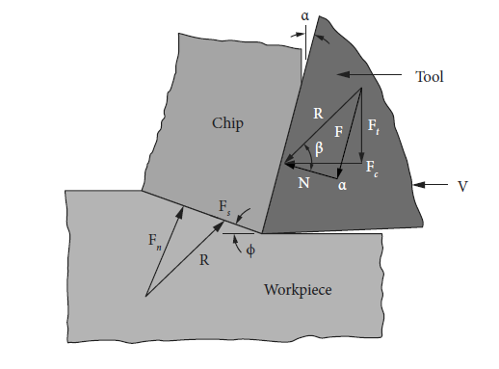
Module 3: Metal-cutting machines (continued)
FORCES ACTING ON CUTTING TOOLS
Forces acting on the cutting tools are important for the design of the mechanical structure of the cutting machines to predict power consumption and to get maximum productivity.
www.futuremanagers.com

Slide 12
Module 3: Metal-cutting machines (continued)
CALCULATIONS FOR CUTTING MACHINES
Machines generally do not operate at 100% efficiency as there are losses of energy which will affect output. In general, operating time can be calculated as follows:
Planned production time + planned shutdown time.
Operating time + downtime losses.
Net operating time + speed losses.
Fully productive time + quality losses.
www.futuremanagers.com

Slide 13
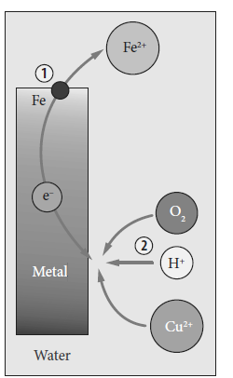
Module 4: Metal protection
CORROSION
Corrosion is the gradual destruction of materials (usually metals) by chemical and/or electrochemical reaction with their environment. It happens slowly over time and can affect many different materials and metals, including ceramics and polymers.
www.futuremanagers.com

Slide 14
Module 4: Metal protection (continued)
CORROSION TESTS
Corrosion tests are important evaluation tools for materials, especially metals that are used for industrial, engineering and consumer purposes. The different types of tests are:
Salt spray test;
Humidity test; and
Sulphur dioxide test.
www.futuremanagers.com

Slide 15
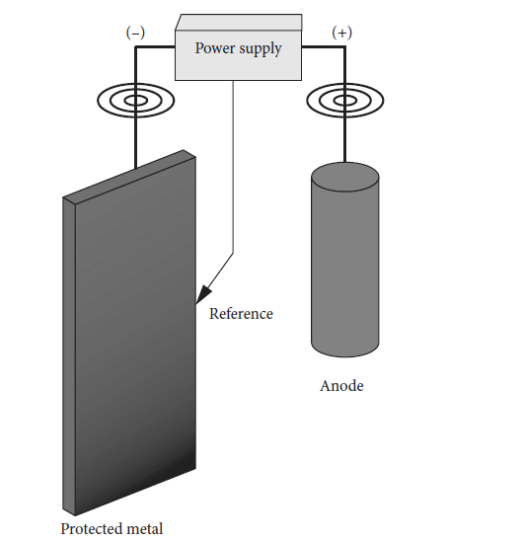
Module 4: Metal protection (continued)
METAL PROTECTION PROCESSES
Two of the most cost-effective ways of preventing corrosion are:
Cathodic protection, which is used to protect metal structures ranging from steel pipes, storage tanks to wind turbines (see figure); and
Phosphating, during which the surface of steel is treated, using metal-phosphate layers that are soluble, porous and absorbent.
www.futuremanagers.com

Slide 16
Module 4: Metal protection (continued)
SURFACE PREPARATION FOR PAINTING
There are three methods of surface preparation:
Mechanical cleaning: : Loose dust and debris is removed by using mechanical methods like sanding and brushing.
Chemically assisted cleaning: Solvents are used to remove oily contaminants through spraying or dipping the materials into the solvents.
Conversion coating: Chemically react with the metal surface to form a more physical surface to improve the bonding of the coatings.
www.futuremanagers.com

Slide 17
Module 4: Metal protection (continued)
PAINTING PROCESSESS
Paints are coatings that are mostly used for protection and for decorative purposes. Industrial painting involves the application of a thin film of paint material. Different forms of painting include:
Air spray painting;
Airless spray painting;
Electrostatic painting;
Dip painting; and
Powder coating.
www.futuremanagers.com

Slide 18
Module 5: Precision measuring of machines parts
MEASURING TAPERS, BALLS, ROLLERS AND SINE BARS
A machine taper is a system in machine tools that is used to secure the tool holder, or the tool.
For setting and calibration, steel balls are used to measure internal tapers.
Making use of measuring rollers, will measure one side of a right angled triangle, while the other side is maintained as a constant.
A sine bar is a device that is used to accurately measure angles or to position work pieces prior to grinding or other machining procedures.
www.futuremanagers.com

Slide 19
Module 5: Precision measuring of machines parts (continued)
MEASURING OF THREADS
The three-wire method is a direct measurement method for measuring threaded components like bolts and screws. It is used to measure the pitch diameter of straight threads. A thread micrometer is a precision measuring tool that is used to measure the diameter and thickness of threads. Slip gauges, precision ground and lapped measuring standards, are used as references for the setting of measuring equipment such as micrometers and sine bars.
www.futuremanagers.com

Slide 20
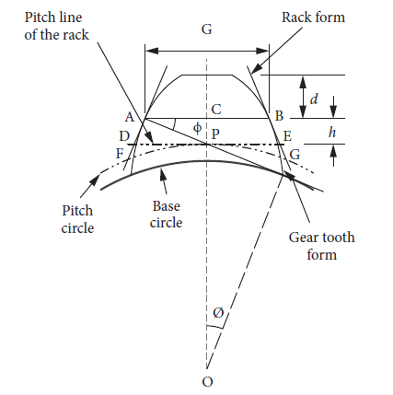
Module 5: Precision measuring of machines parts (continued)
MEASURING GEAR TEETH
The constant chord refers to the imaginary straight line joining the leading and trailing edges. The constant chord of a gear measured where the tooth flanks touch the flanks of the basic rack.
www.futuremanagers.com

Slide 21
Module 6: Bearings
SLIDING OR JOURNAL BEARINGS
Sliding, or journal, bearings refer to bearings where there are no rolling elements present. In the most basic form, a journal bearing is a machined bush with well finished inside and outside diameters, and with no balls or rollers to assist the rotation. The bearing can also be machined with an oil hole or tube to supply lubricating oil.
www.futuremanagers.com

Slide 22
Module 6: Bearings (continued)
ANTI-FRICTION BEARINGS
Anti-friction bearings, or roller bearings, are typical bearings that make use of the rolling action of balls or tapers to prevent friction. The bearings consist of three parts; namely the ball, outer ring, and inner ring. These bearings are also normally used where low to moderate radial and axial loads are present.
www.futuremanagers.com

Slide 23
Module 6: Bearings (continued)
INSTALLATION AND MAINTENANCE OF BEARINGS
Correct bearing installation is very important as incorrect installations can have an extremely negative impact on the bearing.
Bearings should be mounted squarely.
Do not hit bearings with any solid object when installing.
To maintain bearings, ensure that there is regular inspection: Listen, look, and feel to make sure all is running as it should.
www.futuremanagers.com

Slide 24
Module 7: Gear drives
SPUR GEARS
Spur gears are the types of gears that are widely used in most torque transfer systems, like washing machines and dryers. They have straight teeth and are mounted on parallel shafts.
www.futuremanagers.com

Slide 25
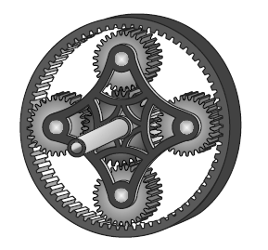
Module 7: Gear drives (continued)
SIMPLE EPICYCLIC GEARING
Epicyclic gear trains consist of two to three gears and are mounted in such a way that the centre of the one gear turns or rotates around the centre of the other gear. These gears are normally called sun gear, planetary gears, and ring gear.
www.futuremanagers.com

Slide 26
Module 8: Hydrostatics in fluid systems
FLUID FLOW HYDRAULICS
Pascal’s law states: “Pressure applied to fluid at any point is transmitted, undiminished throughout the fluid in all directions and act upon every part of the confining vessel at right angles to its interior surfaces and equally upon equal areas”. By making use of the principles of Pascal’s law, we can use hydraulic fluid to transfer energy from one point to another.
www.futuremanagers.com

Slide 27

Module 8: Hydrostatics in fluid systems (continued)
ELEMENTARY CALCULATIONS
Pascal’s law: $ΔP=pg\left(Δh\right)$
Bernoulli’s theorem: $P_{1}+{\left(0,5ρ_{1}\right)}^{2}+ρgh=P_{2}={\left(0,5ρ_{2}\right)}^{2}+ρgh^{2}$
Basic flow rate for fluids through a pipe: $Q=A×v$
Water flowing through single pipes: $P=f×V^{2}×\frac{ρ}{2}×\frac{L}{D}$
Bernoulli's theorem and piping installations: $h_{1}+z_{1}+\frac{v_{1}^{2}}{2g}=h_{2}+z_{2}+\frac{v_{2}^{2}}{2g}$
www.futuremanagers.com

