Slide 1


Building & Structural Surveying
N4

Slide 2
Module 1: General
DEFINTION OF SURVEYING
Surveying may be defined as the art of taking measurements and making field observations that are necessary to determine the position, volumes and areas of all natural and/or man-made features on the earth’s surface and representing the results on a map or plan to a suitable scale.
www.futuremanagers.com

Slide 3
Module 1: General (continued)
PURPOSE OF SURVEYING
The purpose is to prepare survey drawings, such as maps, plans, cross sections or elevation drawings, with profiles which have all the necessary information about natural and manmade features. These are then used by the architect and the engineer to work on the design of the proposed structure. The final plan is then given to the surveyor who ‘sets out’ the work which might be construction projects such as roads, railways, reservoirs and buildings.
www.futuremanagers.com

Slide 4
Module 1: General (continued)
TYPES OF SURVEYING
Different types of surveying include:
Plane surveying;
Topographic survey;
Cadastral surveying;
Engineering surveying; and
Geodetic surveying.
www.futuremanagers.com

Slide 5
Module 1: General (continued)
METHODS (TECHNIQUES) OF SURVEYING
The following are the important methods:
Chain or taping survey;
Levelling;
Traverse survey (transit survey);
Tacheometric survey (Stadia surveying);
Triangulation survey;
Trilateration;
Compass survey;
Plane table survey; and
Photographic survey.
www.futuremanagers.com

Slide 6
Module 1: General (continued)
QUALITIES OF A GOOD SURVEYOR
Must be neat, especially in booking field work.
Must possess initiative and approach each problem with resourcefulness.
Must accept information or results as trustworthy only after verification by an independent check.
Must be reliable and have sound judgement.
Must think clearly without confusion and reason logically without prejudice.
Must be thorough and content with his work.
www.futuremanagers.com

Slide 7
Module 1: General (continued)
DIFFERENCE BETWEEN A BUILDING AND A LAND SURVEYOR
A building surveyor is involved in the survey buildings and structures, for the purpose of drawing plans for renovations or extensions of buildings and to ensure compliance with building regulations.
A land surveyor is involved in surveys for the purpose of developing maps, surveying land and buildings for the purpose of defining property boundaries and national boundaries, setting out and monitoring of roads, bridges, tunnels, large structures and railways.
www.futuremanagers.com

Slide 8
Module 1: General (continued)
FUNCTIONS OF A SURVEYOR
The functions of a surveyor are divided into three areas, namely:
Field work;
Office work; and
Care and adjustment of instruments.
www.futuremanagers.com

Slide 9
Module 1: General (continued)
PURPOSE OF FIELD WORK
It involves measuring distances and angles by handling and using survey instruments correctly.
Record field notes accurately using standard methods.
Details of the survey are located from reference points.
Directions are established.
Required structures and features and gradients are set out.
Relative elevation of points and inaccessible points are determined.
www.futuremanagers.com

Slide 10
Module 1: General (continued)
FIELD BOOK
This is a small book used by a surveyor in the field to record survey data and notes as surveys are carried out. It should contain information such as:
Title page;
Index/index diagram;
Surveyor’s signature/Name;
Field party names;
Job description;
Observations;
Sketches;
Descriptions;
Equipment list; and
Weather information.
www.futuremanagers.com

Slide 11
Module 1: General (continued)
SURVEY FIELD NOTES
Field notes are written notes of the field observations and measurements taken and recorded at the time the field work was done in the field. Due to the fact that other people will be reading the notes, a specific format is used for each type of survey carefully ensuring that the notes are clear and the format used can be easily interpreted by others.
www.futuremanagers.com

Slide 12
Module 1: General (continued)
METHODS OF MEASUREMENT
Horizontal distance: measuring horizontally from one point to another.
Vertical distance: measuring to determine the height of a point.
Horizontal angle: measuring angles by moving the theodolite horizontally, to the left or to the right.
Vertical angle: measuring angle by moving the theodolite up or down.
www.futuremanagers.com

Slide 13
Module 1: General (continued)
FUNDAMENTAL PRINCIPLES OF SURVEYING
The fundamental principle, upon which the various methods of surveying are based, is the determination of the relative positions of points; that is locating the horizontal position of a point with respect to at least two other points that are known.
www.futuremanagers.com

Slide 14
Module 2: Basic Concepts
MAPS
A map is the representation of a large section of the earth’s surface on a small scale with very little detail, onto a horizontal plane surface (sheet of paper). Although a map has a scale, not everything is drawn to scale, some parts on the map are represented by a dot which could represent a town in reality.
www.futuremanagers.com

Slide 15
Module 2: Basic Concepts (continued)
PLANS
A plan is the representation of the surface features of a small section of the earth’s surface drawn to a large scale onto a horizontal plane surface, showing more detail. All the parts on the plan are drawn to the scale indicated. The purpose of plans is to provide the detailed layout of a structure to be built or town layout indicating where residential houses, roads and shops will be.
www.futuremanagers.com

Slide 16
Module 2: Basic Concepts (continued)
ACCURACY OF MAPS
The final form of a map or plan depends upon the purpose for which it is prepared. The scale depends upon the use to which the map or plan will be put. The smaller the scale, the less accurate the map will possibly be, to show the relative distances between two points.
www.futuremanagers.com

Slide 17
Module 2: Basic Concepts (continued)
FACTORS INFLUENCING THE ACCURACY OF THE SURVEY
Control Framework;
Scale;
Speed and cost;
Skill and experience; and
Checks.
www.futuremanagers.com

Slide 18
Module 2: Basic Concepts (continued)
MAP SCALES
The scale to which a map is drawn depends mainly on the use to which the map will be put. The greater the required degree of accuracy, the larger the scale, and certainly the more costly the map will be to produce. Types of scales:
Natural scale;
Engineering scale; and
Divided scale line.
www.futuremanagers.com

Slide 19
Module 2: Basic Concepts (continued)
THE SOUTH AFRICAN CO-ORDINATE SYSTEM
The South African co-ordinate system is based upon the Gauss Conform Projection, also known as the Transverse Mercator Projection. This is an adaptation of the ordinary Mercator projection turned about 90° so that it may be based on any meridian not on the Equator. In South Africa the framework consists of a number of accurately co-ordinated trigonometric beacons covering the whole republic.
www.futuremanagers.com

Slide 20
Module 2: Basic Concepts (continued)
ANGULAR MEASUREMENT
There are 3 types of angular measurement:
Sexagesimal;
Centesimal; and
Radian.
www.futuremanagers.com

Slide 21

Module 3: Areas and Volume
AREAS
When area needs to be calculated, it must be done in square metres. The Si unit for this is m².
Square and rectangle: Area = $Length ×breadth$.
Trapezium: Area = $\frac{a+b}{2}×h$.
Parallelogram: Area = $a×h$.
Triangle: Area = $\frac{1}{2}breadth ×height$.
Circles: Area = ${πr}^{2}$.
www.futuremanagers.com

Slide 22
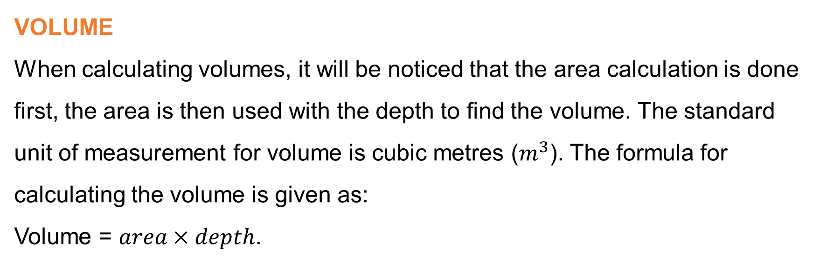
Module 3: Areas and Volume (continued)
VOLUME
When calculating volumes, it will be noticed that the area calculation is done first, the area is then used with the depth to find the volume. The standard unit of measurement for volume is cubic metres ($m^{3}$). The formula for calculating the volume is given as:
Volume = $area×depth$.
www.futuremanagers.com

Slide 23
Module 4: Chain Surveying
DEFINITION
Chain surveying uses a tape or chain as the principal instrument for the accurate of measurement of lengths. It involves the location of points by the measurement of the distance. The chain survey team involves the surveyor and two chain people, one being the leader and the other being the follower. The equipment used includes items for measuring lines, for marking stations or points, and for setting out simple angles.
www.futuremanagers.com

Slide 24
Module 4: Chain Surveying (continued)
LINEAR MEASUREMENT EQUIPMENT
The Chain;
Steel tape;
Synthetic tape; and
Surveyor’s folding ruler.
www.futuremanagers.com

Slide 25
Module 4: Chain Surveying (continued)
MARKING EQUIPMENT
Chain arrows;
Ranging rods; and
Plumb rod.
www.futuremanagers.com

Slide 26
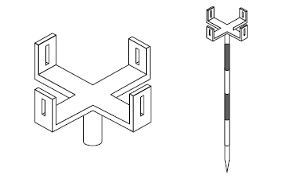
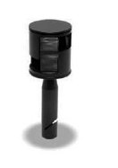
Module 4: Chain Surveying (continued)
EQUIPMENT FOR SETTING OUT SIMPLE ANGLES
Cross staff:
Optical square:
Abney level:
www.futuremanagers.com

Slide 27
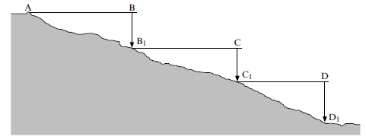
Module 4: Chain Surveying (continued)
STEP CHAIN SURVEYING
Chaining may be done either on a horizontal plane or a sloping plane. When taping is done on a sloping plane, to obtain the horizontal distance of the slope, step chaining is used.
www.futuremanagers.com

Slide 28
Module 4: Chain Surveying (continued)
IMPORTANT FACTORS IN DETERMINING THE SELECTION OF TRIANGLES
Triangle should be well conditioned (situated).
The number of lines should be kept to a minimum.
Lengths of offsets should be as short as possible.
Lines should free from obstruction.
All triangles must be provided with a check.
www.futuremanagers.com

Slide 29
Module 4: Chain Surveying (continued)
OBSTACLES TO CHAINING (TAPING)
Chain lines should be arranged, as far as possible, to avoid obstructions, but there are obstacles that cannot be avoided, even after a careful preliminary survey. There are obstacles, such as a hill, which are obstacles to the line of sight but not to measurement, a pond, building, river or busy main road which are obstacles to measurement but not to sight. There are various methods that are applied to overcome these problems.
www.futuremanagers.com

Slide 30
Module 4: Chain Surveying (continued)
ELECTRONIC DISTANCE MEASUREMENT (EDM)
The EDM is an instrument that measures distance using light and radio waves. The distance is measured by calculating the time difference between a transmitted pulse and a return pulse or the phase difference between a transmitted and a reflected beam of radiation.
www.futuremanagers.com

Slide 31
Module 5: Linear Measurement Corrections
ACCURACY AND PRECISION
“Accuracy” refers to how closely a measurement or observation is, to measuring a “true value,” since measurements and observations are always subject to error. “Precision” refers to how closely repeated measurements or observations come to duplicating measured or observed values.
www.futuremanagers.com

Slide 32
Module 5: Linear Measurement Corrections (continued)
ERRORS AND MISTAKES IN SURVEY MEASUREMENTS
Mistakes: Are avoidable blunders which occur because of carelessness or a temporary mental lapse. They include incorrect readings and booking of observations and the use of erroneous data in calculations.
Constant errors: Are those which have the same magnitude and algebraic sign. The errors can be caused either by the apparatus itself or external circumstances to the apparatus.
www.futuremanagers.com

Slide 33
Module 5: Linear Measurement Corrections (continued)
ERRORS AND MISTAKES IN SURVEY MEASUREMENTS (CONT)
Systematic errors: Are errors which depend, for their magnitude and sign, upon external circumstances such as temperature changes, the slope of land etc., and they tend to produce cumulative effects.
Accidental errors: Are small errors in observation which cannot be detected by the human eye under normal surveying conditions. Accidental errors are human errors not caused by carelessness.
www.futuremanagers.com

Slide 34
Module 5: Linear Measurement Corrections (continued)
TAPING ERROR CORRECTION
Measuring tape manufacturers do not usually guarantee the exact length of tapes; as a result tapes are standardised. Standardisation is a process whereby the standard temperature and tension are determined when the tape is the exact length.
www.futuremanagers.com

Slide 35
Module 6: Levelling
DEFINITION
Levelling is determining the relative elevations or heights of points using a dumpy level or automatic level.
www.futuremanagers.com

Slide 36
Module 6: Levelling (continued)
USE OF LEVELLING
It is used when highways, railroads, canals, sewers etc, are constructed.
Setting out of the elevation construction projects as indicated on the plan.
Heights determined are used to calculate the volume of earthworks and other materials.
Levelling is also used to investigate drainage characteristics of some areas.
www.futuremanagers.com

Slide 37
Module 6: Levelling (continued)
LEVELLING EQUIPMENT
Traveller or boning rod;
Change plate;
Staff bubble;
Tripod stand;
Dumpy level;
Tilting level;
Automatic level; and
Bubble tube.
www.futuremanagers.com

Slide 38
Module 6: Levelling (continued)
TELESCOPE FOCUSING
For accurate work when observing a target, both the cross-hairs of the reticule and the distant target object must be in sharp focus. This is done by focusing on the cross hairs first then the target, by bringing the image of the target object into exactly the same plane as the cross-hairs.
www.futuremanagers.com

Slide 39
Module 6: Levelling (continued)
METHODS OF LEVELLING
There are three methods of levelling:
Differential levelling;
Trigonometric levelling; and
Barometric levelling.
www.futuremanagers.com

Slide 40
Module 6: Levelling (continued)
LEVELLING PROCEDURE (FIRST POSITION OF THE LEVEL)
The level is set up at P where BM may be observed and readings taken at point A, B and C.
The first reading is taken with the staff on a point of known reduced level.
which is the benchmark. The reading is recorded as the back-sight.
The staff is held at A and B, in turn, and recorded as intermediate sights.
A change point is chosen at C owing to the nature of the ground. The reading is taken and recorded as the foresight.
www.futuremanagers.com

Slide 41
Module 6: Levelling (continued)
LEVELLING PROCEDURE (SECOND POSITION OF THE LEVEL)
The staff remains at point C and the level is moved to Q, set up and levelled.
The reading on the staff at C, the change point, is taken and recorded as the BS.
Followed by intermediate sights D, E and F etc. until another change point is required.
www.futuremanagers.com

Slide 42
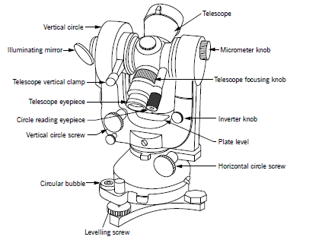
Module 6: Levelling (continued)
THEODOLITE
This instrument is ideal for tacheometric and traverse surveying, but not for differential survey.
www.futuremanagers.com

Slide 43
Module 6: Levelling (continued)
COLLIMATION ERROR
It occurs when the collimation line is not truly horizontal when the instrument is level. It is possible to determine the collimation error and reduce its size using the two peg test.
www.futuremanagers.com

Slide 44
Module 6: Levelling (continued)
HANDS SIGNALS
The distance between the person operating the levelling instrument and the person holding the staff is sometimes huge. With one person being far away from the other, the best way of communication is to use hand signals.
www.futuremanagers.com

Slide 45
Module 7: Compass Surveying
DEFINITION OF COMPASS SURVEYING
Compass surveying is the location of points by measuring compass bearings (angles). It is used to ascertain magnetic north, direction.
www.futuremanagers.com

Slide 46
Module 7: Compass Surveying (continued)
PRINCIPLE OF COMPASS SURVEYING
The principle of surveying is traversing, which consists of a number of connected survey lines. The lengths of the legs are measured with a chain and the directions are measured with an angle measuring instrument. In one of the traverse methods, the angles are measured with a compass, hence the method is called compass traversing.
www.futuremanagers.com

Slide 47
Module 7: Compass Surveying (continued)
MAGNETIC COMPASSES
There are two main types of magnetic compasses used in surveying; the surveyor’s compass and the prismatic compass. The surveyor’s compass is usually the larger and more accurate instrument, and is mostly used on a stand or tripod. The prismatic compass is often a small instrument which is hand-held for observing and thus employed in less accurate work.
www.futuremanagers.com

Slide 48
Module 7: Compass Surveying (continued)
SYSTEMS USED TO EXPRESS BEARINGS
Whole circle bearing (WCB): This is the bearing of a line measured in a clockwise direction from true north towards the line and varies from 0 to 360 degrees.
Quadrantal Bearing (QB): In this system the bearing of a line is measured eastward or westward from north or south whichever is nearer. The directions can be either clockwise or anti clockwise depending upon the position of the line.
www.futuremanagers.com

Slide 49
Module 7: Compass Surveying (continued)
DETERMINATION OF MAGNETIC BEARING AND TRUE BEARING
Magnetic bearing of a line is the bearing of a line measured from the magnetic north. It can be given as a WCB measured from true north or QB, but when calculating the true bearing the QB must be converted to WCB.
True bearing of a line is the horizontal angle between true north and the survey line. It is measured from true north in a clockwise direction. It can be given as a WCB or QB.
www.futuremanagers.com

Slide 50
Module 8: Plane Table Surveying
DEFINITION
Plane table surveying involves the measurement of distance and angles while plotting these observations simultaneously in the field. Although plane table surveying is not as accurate as other methods, but for certain types of work it gives sufficient accuracy. Methods used in plane tabling involve traversing, radiation, intersection and resection.
www.futuremanagers.com

Slide 51
Module 8: Plane Table Surveying (continued)
IMPORTANT POINTS WHEN SETTING UP THE PLANE TABLE
The table should be level when erected and oriented accurately.
The table should be at a workable height.
Keep all the equipment to be used on hand.
Select well defined stations for orientation.
Select stations that are recognised on the map.
Each ray should be easily identified.
Use reference numbers to refer to each ray.
www.futuremanagers.com

Slide 52
Module 8: Plane Table Surveying (continued)
THE USE OF PLANE TABLE SURVEYING
There are uses why tolerable accuracy can obtained:
Production of maps and plans of small areas.
For the preparation of reconnaissance and exploratory survey maps.
Filling details between control points established more accurate by theodolite traverse or triangulation.
When existing maps and plans are reviewed.
For the location of contours.
www.futuremanagers.com

Slide 53
Module 8: Plane Table Surveying (continued)
PLANE TABLE EQUIPMENT
Plane table;
Alidade;
Plane table compass;
Plumbing fork; and
Plane table spirit level.
www.futuremanagers.com

Slide 54
Module 8: Plane Table Surveying (continued)
SETTING UP THE PLANE TABLE
Setting up the plane table consists of the following:
Centring (positioning) the plane table.
Levelling the plane table.
Orienting the plane table.
www.futuremanagers.com

Slide 55
Module 8: Plane Table Surveying (continued)
METHODS INVOLVED IN PLANE TABLING
There are four main methods of surveying with a plane table:
Radiation.
Triangulation (intersection).
Traversing.
Resection.
www.futuremanagers.com

