Slide 1

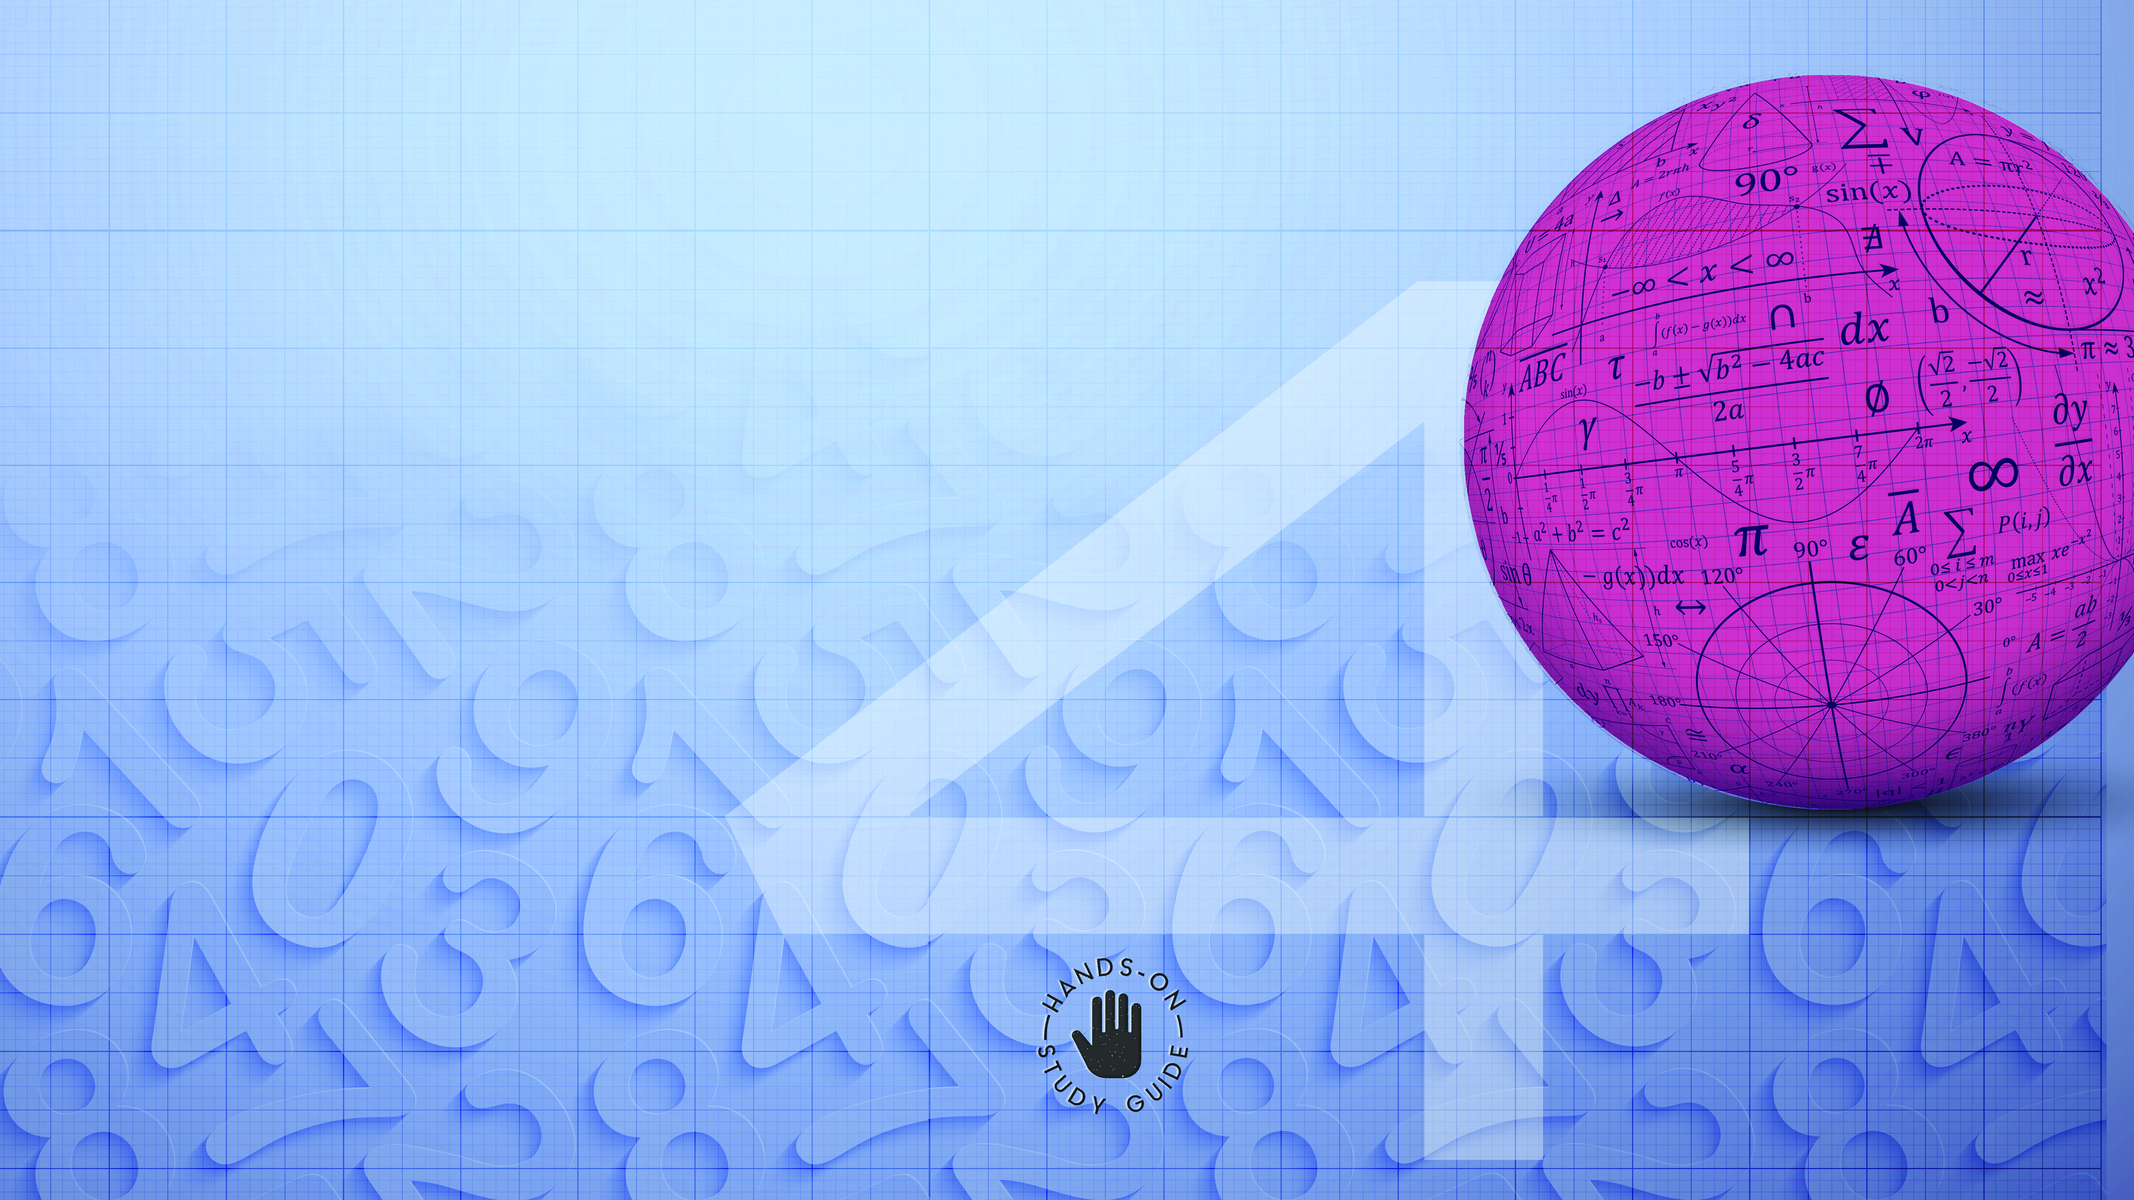
Mathematics
NCV4

Slide 2
Chapter 1: Complex numbers
WORK WITH COMPLEX NUMBERS
The complex number system defines sums of real and imaginary numbers, a + bi, where a and b are real numbers:
the imaginary unit is i
a is called the real part
bi is called the imaginary part.
The real number system (R) together with the imaginary number system form the complex number system.
www.futuremanagers.com

Slide 3
Chapter 1: Complex numbers (continued)
ADDITION, SUBTRACTION, MULTIPLICATION OF COMPLEX NUMBERS
When adding or subtracting terms in algebra, you add or subtract like terms. The same rule applies when you add or subtract complex numbers. To add or subtract complex numbers you can treat i as you would treat a variable.
O multiply: Each part of the first complex number gets multiplied by each part of the second complex number.
www.futuremanagers.com

Slide 4
Chapter 1: Complex numbers (continued)
DE MOIVRE’S THEOREM
De Moivre’s theorem is used to raise complex numbers to powers. This theorem provides a simple way to determine a power of a complex number in polar form.
www.futuremanagers.com

Slide 5
Chapter 1: Complex numbers (continued)
SOLVE PROBLEMS USING COMPLEX NUMBERS
Just as you can have equations with real numbers you can have equations with complex numbers. There are several ways of solving simultaneous equations, the most common being by a combination of substitution (replacing) and elimination (to remove or to get rid of). To solve simultaneous equations, you need to find the values for x and y that will satisfy both equations.
www.futuremanagers.com

Slide 6
Chapter 2: Functions and Algebra
THE REMAINDER AND THE FACTOR THEOREMS
The remainder and factor theorems are used to solve cubic equations and also to draw graphs. The remainder theorem is used to factorise polynomials of the third degree. (The remainder is the amount left over in a division operation when one quantity cannot be divided exactly by another. ) The factor theorem enables us to factorise polynomials of a degree higher than two. The factor theorem is a direct result of the remainder theorem.
www.futuremanagers.com

Slide 7
Chapter 2: Functions and Algebra (continued)
INVERSE GRAPHS OF FUNCTIONS
Relations describe any relationship between the dependent (y) and the independent (x) variables. Functions are special kind of relations. An inverse function is a second relation that reverses the direction of the mapping produced by a first function. For an inverse to exist, the first function must produce a one-to-one correspondence. An inverse function can also be defined as the set of ordered pairs obtained by swapping the x- and y-elements of each ordered number pair in the original function.
www.futuremanagers.com

Slide 8
Chapter 2: Functions and Algebra (continued)
LINEAR PROGRAMMING
Linear programming is used every day by people (for example in businesses and in industrial contexts) who are interested to know the most efficient way of carrying out a task or achieving a goal. Linear programming is the mathematical method used to find the best solution to problems that can be expressed in terms of linear equations, straight-line graphs and linear inequalities. It is used to achieve the best outcome, such as maximum profits or lowest costs and production levels.
www.futuremanagers.com

Slide 9
Chapter 2: Functions and Algebra (continued)
INSTANEOUS RATE OF CHANGE
The derivative tells us the rate of change of one quantity to another at a particular point (instant). This is called the instantaneous rate of change. It has many applications in electricity, economics, population modelling, and so on. When a quantity is always changing in value, such as population, we use calculus (differentiation and integration) to model its behaviour.
www.futuremanagers.com

Slide 10
Chapter 2: Functions and Algebra (continued)
INTEGRATION
This section involves analysing and representing mathematical and contextual situations using integrals, and finding areas under curves using integration rules. Integration is an important concept in mathematics. It is the inverse of differentiation. The term integral may also be called the antiderivative. Integrals and derivatives have numerous applications in science and engineering, for example, to calculate surface areas and to formulate physical laws of electrodynamics.
www.futuremanagers.com

Slide 11
Chapter 3: Space, Shape and Measurement
USE THE CARTESIAN CO-ORDINATE SYSTEM TO DERIVE AND APPLY EQUATIONS
The formulae to find the equation to find the centre of a circle were derived using Pythagoras’ theorem or the distance formula. Often the equation of the circle with centre at (h; k) requires completing the square to write the equation in the standard form.
www.futuremanagers.com

Slide 12
Chapter 3: Space, Shape and Measurement (continued)
THE GEOMETRY OF STRAIGHT LINES
The angle of a straight line is 180°.
For perpendicular lines, adjacent supplementary angles are equal to 180°.
For intersecting lines, adjacent supplementary angles are equal to 180° and vertically opposite angles are equal.
For parallel lines cut by a transversal, corresponding and alternate angles are equal.
www.futuremanagers.com

Slide 13
Chapter 3: Space, Shape and Measurement (continued)
THE GEOMETRY OF TRIANGLES
The sum of the interior angles is 180°.
An equilateral triangle has all sides equal and all angles equal to 60°.
An isosceles triangle has at least two equal sides with base angles equal.
A right-angled triangle has one angle that is a right-angle. The side opposite the right-angle is the hypotenuse. The square of the hypotenuse is equal to the sum of the squares of the other two sides.
The exterior angle of a triangle is equal to the opposite two interior angles.
www.futuremanagers.com

Slide 14

Chapter 3: Space, Shape and Measurement (continued)
THE GEOMETRY OF STRAIGHT LINES
The geometry of straight lines can be defined in terms of angles.
www.futuremanagers.com

Slide 15
Chapter 3: Space, Shape and Measurement (continued)
TYPES OF ANGLES
Type of angle | Description
Acute angle | An angle less than 90°
Right angle | An angle equal to 90°
Obtuse angle | An angle greater than 90°, but smaller than 180°
Straight line | An angle equal to 180°
Reflex angle | An angle greater than 180°
Revolution | An angle equal to 360°
Complementary angles | Sum of angles equals 90°
Supplementary angles | Sum of angles equals 180°
www.futuremanagers.com

Slide 16
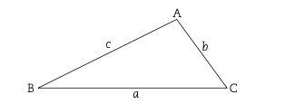
Chapter 3: Space, Shape and Measurement (continued)
GEOMETRY OF TRIANGLES
A triangle is defined as a polygon with three angles and therefore three sides or edges, which are line segments.
www.futuremanagers.com

Slide 17
Chapter 3: Space, Shape and Measurement (continued)
TYPES OF TRIANGLES
Type of triangle | Description
Scalene triangle | Sides are all different lengths and all three angles different
Isosceles triangle | Two equal sides and the angles opposite the sides are also equal
Equilateral triangle | All three sides are equal and each angle measures 60°
Acute-angled triangle | All interior angles are less than 90°
Obtuse-angled triangle | One interior angle is more than 90°
Right-angled triangle | One interior angle is a right angle, that is, 90°
www.futuremanagers.com

Slide 18
Chapter 3: Space, Shape and Measurement (continued)
PROPERTIES OF TRIANGLES
The exterior angle of a triangle is equal to the sum of the two opposite interior angles.
The exterior angle of a triangle is equal to the sum of the two opposite interior angles.
The Theorem of Pythagoras states that in a right-angled triangle the square of the hypotenuse is equal to the sum of the squares of the other two sides.
www.futuremanagers.com

Slide 19
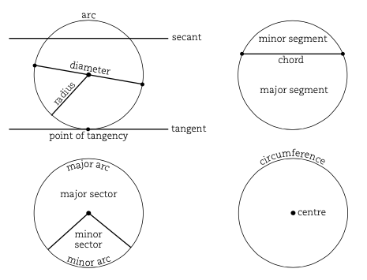
Chapter 3: Space, Shape and Measurement (continued)
CIRCLE TERMS
www.futuremanagers.com

Slide 20
Chapter 3: Space, Shape and Measurement (continued)
MAJOR THEOREMS OF CIRCLES
Theorem 1: If a line is drawn from the centre of a circle to the midpoint of
a chord, that line is perpendicular to the chord. Conversely, if a line is drawn from the centre of the circle perpendicular to the chord, it bisects the chord.
Theorem 2: If an arc subtends an angle at the centre of the circle and at any point on the circumference, the angle at the centre is twice the measure of the angle at the circumference.
www.futuremanagers.com

Slide 21
Chapter 3: Space, Shape and Measurement (continued)
MAJOR THEOREMS OF CIRCLES (CONT)
Theorem 3: If the diameter of a circle subtends an angle at the circumference, the angle subtended is a right angle triangle. Conversely, if an angle subtended by a chord at a point on the circumference is a right angle, the chord is a diameter.
www.futuremanagers.com

Slide 22
Chapter 3: Space, Shape and Measurement (continued)
MAJOR THEOREMS OF CIRCLES (CONT)
Theorem 4: Angles in the same segment of a circle are equal. Conversely, if a straight line subtends equal angles at two points on the same side of the straight line, the two points and the two end points of the straight line are concyclic.
www.futuremanagers.com

Slide 23
Chapter 3: Space, Shape and Measurement (continued)
MAJOR THEOREMS OF CIRCLES (CONT)
Theorem 5: The opposite angles of a cyclic quadrilateral are supplementary. Conversely, if two opposite angles of a quadrilateral are supplementary, then quadrilateral is a cyclic quadrilateral
www.futuremanagers.com

Slide 24
Chapter 3: Space, Shape and Measurement (continued)
MAJOR THEOREMS OF CIRCLES (CONT)
Theorem 6: An exterior angle of a cyclic quadrilateral is equal to the interior opposite angle. Conversely, if an exterior angle of a quadrilateral is equal to the interior opposite angle, the quadrilateral is cyclic.
www.futuremanagers.com

Slide 25
Chapter 3: Space, Shape and Measurement (continued)
MAJOR THEOREMS OF CIRCLES (CONT)
Theorem 7: If a tangent to a circle is drawn, it is perpendicular to the radius at the point of contact. Conversely, if a line is drawn perpendicular to a radius at the point where the radius meets the circle, it is a tangent to the circle.
Theorem 8: If two tangents are drawn from the same point outside a circle, they are equal in length.
www.futuremanagers.com

Slide 26
Chapter 3: Space, Shape and Measurement (continued)
MAJOR THEOREMS OF CIRCLES (CONT)
Theorem 9: The angle between a tangent to a circle and a chord drawn from a point of contact, is equal to an angle in the alternate segment. Conversely, if the angle formed between a line that is drawn through the end point of a chord and the chord, is equal to the angle subtended by the chord in the alternate segment, the line is a tangent to the circle
www.futuremanagers.com

Slide 27
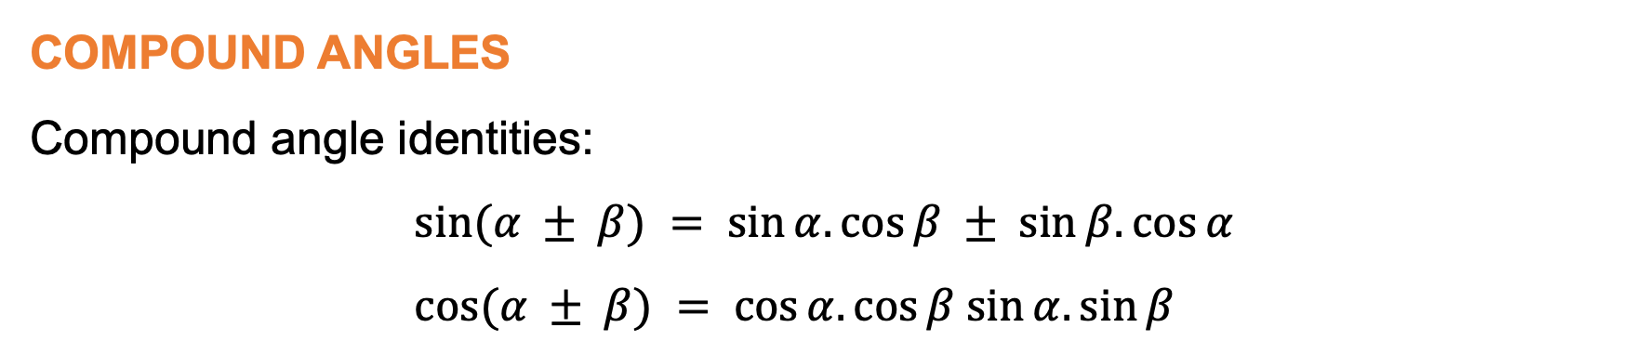
Chapter 3: Space, Shape and Measurement (continued)
COMPOUND ANGLES
Compound angle identities:
$$sin⁡(α ± β) = sin⁡α.cos⁡β ± sin⁡β.cos⁡α \\ cos⁡(α ± β) = cos⁡α.cos⁡β sin⁡α.sin⁡β$$
www.futuremanagers.com

Slide 28

Chapter 3: Space, Shape and Measurement (continued)
COMPOUND ANGLES TO DERIVE CO-FUNCTIONS
Co-functions, that is, (90° − α):
$$cos\left(90° − α\right)= cos 90°.cos α + sin 90°.sin α = 0.cos α + 1.sin α = sin α sin(90°−α) = sin 90°.cos α − sin α.cos 90° = 1.cos α − sin α.0 = cos α$$
$$tan\left(90°− α\right)=\frac{sin\left(90°−α\right)}{\cos\left(90°−α\right) }=\frac{sin90°.cosα − sinα.cos90°}{90°.cosα + sin90°.sinα }=\frac{\left(1.cosα − sinα.0\right)}{0.cosα + 1.sinα }=\frac{cosα}{sinα}$$
www.futuremanagers.com

Slide 29

Chapter 3: Space, Shape and Measurement (continued)
COMPOUND ANGLES TO DERIVE CO-FUNCTIONS (CONT)
Co-functions, that is, (90° + α):
$$sin\left(90° + α\right)= sin 90°.cos α + sin α.cos 90° = 1.cos α + sin α.0 = cos α$$
$$cos⁡(90° + α) = cos⁡90°.cos⁡α − sin⁡90°.sin⁡α = 0.cos⁡α − 1.sin⁡α = −sin⁡α$$
$$tan⁡(90° + α) =\frac{\sin\left(90° + α\right)}{\cos\left(90° + α\right) } =\frac{sin90°.cosα + sinα.cos90°}{cos90°.cosα − sin90°.sinα } =\frac{1.cosα + sinα.0}{0.cosα − 1.sinα } = –\frac{cosα}{sinα}$$
www.futuremanagers.com

Slide 30

Chapter 3: Space, Shape and Measurement (continued)
DOUBLE ANGLE IDENTITIES
From the compound angle identity $sin⁡(α + β) = sin⁡α.cos⁡β + sin⁡β.cos⁡α, sin⁡2α = sin⁡(α + α) = sin⁡α.cos⁡α + sin⁡α.cos⁡α = 2sin⁡α.cos⁡α$
Therefore:
$$sin 2α = 2sin α.cos α$$
www.futuremanagers.com

Slide 31

Chapter 3: Space, Shape and Measurement (continued)
DOUBLE ANGLE IDENTITIES (CONT)
From the compound angle identity$\cos\left(α + β\right)=\cos{α}.\cos{β}−\sin{α}.\sin{β},\cos^{2}{α} = cos⁡(α + α) = cos⁡α.cos⁡α – sin⁡α.sin⁡α = \cos^{2} α – \sin^{2}α$
Therefore:
$$\cos^{2}{α} = \cos^{2} α – \sin^{2} α$$
www.futuremanagers.com

Slide 32
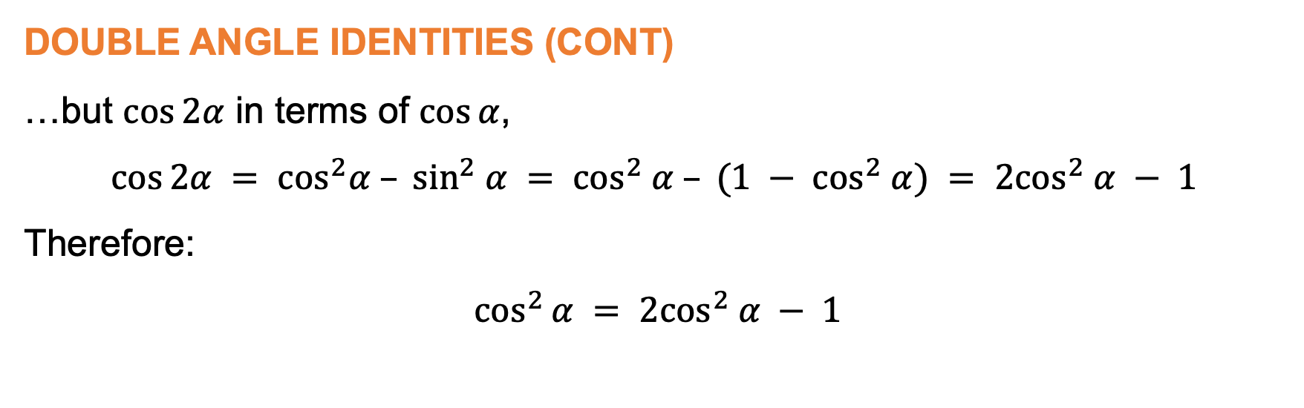
Chapter 3: Space, Shape and Measurement (continued)
DOUBLE ANGLE IDENTITIES (CONT)
…but $cos⁡2α$ in terms of $cos⁡α$,
$$cos⁡2α = \cos^{2}α – \sin^{2} α = \cos^{2} α – (1 − \cos^{2} α) = 2\cos^{2} α − 1$$
Therefore:
$$\cos^{2}{α} = 2\cos^{2} α − 1$$
www.futuremanagers.com

Slide 33

Chapter 3: Space, Shape and Measurement (continued)
DOUBLE ANGLE IDENTITIES (CONT)
…but $\cos^{2}α$ in terms of $sin⁡α$,
$$cos⁡2α = \cos^{2}α – \sin^{2}α = (1 − \sin^{2}α) − \sin^{2}α = 1 – 2\sin^{2} α$$
Therefore:
$$cos⁡2α = 1 – 2\sin^{2}α$$
www.futuremanagers.com

Slide 34
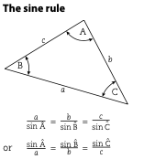
Chapter 3: Space, Shape and Measurement (continued)
THE SINE RULE
The sine and cosine rules are applied to non-right-angled triangles. The sine rule is used for non-right-angled triangles where:
Two sides and one non-included angle are given
Two angles and one side are given
www.futuremanagers.com

Slide 35
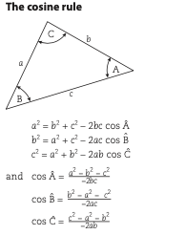
Chapter 3: Space, Shape and Measurement (continued)
THE COSINE RULE
The cosine rule is used for non-right-angled triangles where:
Two sides and one included angle are given.
Three sides are given.
www.futuremanagers.com

Slide 36
Chapter 4: Data Handling
DATA ANALYSIS USING VARIOUS TECHNIQUES
A sample is defined as a subset of items drawn from the population, that represents every possible item.
Graphical representations and numerical summaries that are consistent with the data, and clear and appropriate to the situation and target audience.
A frequency table is the figure that represents the number of times a specific incident occurred.
Bar graphs are a good way of representing discrete data.
www.futuremanagers.com

Slide 37
Chapter 4: Data Handling (continued)
DATA ANALYSIS USING VARIOUS TECHNIQUES (CONT)
A bar graph that comprises two or more components is called a compound bar graph.
The stem and leave plot is similar to a histogram, in that it also presents data in a graphical format.
A histogram is a graphical representation of grouped data in terms frequency.
Frequency polygons are very similar to histograms and can therefore be drawn from histograms.
www.futuremanagers.com

Slide 38
Chapter 4: Data Handling (continued)
DATA ANALYSIS USING VARIOUS TECHNIQUES (CONT)
Pie charts are circular charts divided into sectors. These sectors represent the proportion of the quantities.
Line graphs are used to show how a dependent variable changes in terms of an independent variable.
A broken line graph relates specifically to data in which the independent variable is time.
The box and whisker plot is a representation of the five number summary.
www.futuremanagers.com

Slide 39
Chapter 4: Data Handling (continued)
DATA ANALYSIS USING VARIOUS TECHNIQUES (CONT)
The ogive curve is a graphical representation of the cumulative frequency distribution table (or ogive). The main purpose of the ogive is to answer questions of a more than or less than nature.
www.futuremanagers.com

Slide 40
Chapter 4: Data Handling (continued)
NUMERICAL SUMMARIES OF DATA
Measure of central tendency describes the mean, median and mode.
Measure of dispersion describes the range, quartiles, interquartile range, semi-interquartile range. These measures are rank-sensitive, therefore the data first need to be arranged in ascending order.
www.futuremanagers.com

Slide 41
Chapter 4: Data Handling (continued)
USE VARIANCE AND REGRESSION ANALYSIS TO INTERPOLATE AND EXTRAPOLATE BIVARIATE DATA
A sample variance is described as the measure of dispersion within a set of sample data. The sample variance is defined as the sum of the squared deviations from their mean divided by one less than the number of observations in the data set. A standard deviation is also a measure of the spread or dispersion of a data set. The standard deviation is calculated by taking the square root of the variance.
www.futuremanagers.com

Slide 42
Chapter 4: Data Handling (continued)
PROBABILITY TERMINOLOGY
The sample space, S, is the set of all possible outcomes of an experiment.
An event is any subset of the sample space.
Two events, A and B, are statistically dependent if the one event affects the outcome of the other event.
Two events, A and B, are statistically independent if there is no influence of one event on the other event.
www.futuremanagers.com

Slide 43
Chapter 4: Data Handling (continued)
PROBABILITY TERMINOLOGY (CONT)
Two events, A and B, are mutually exclusive if they cannot both have a successful outcome at the same time.
Two events, A and B, are mutually inclusive if they happen at the same time, that is, successful outcomes at the same time.
www.futuremanagers.com

Slide 44
Chapter 5: Financial Mathematics
HIRE PURCHASE
Hire purchase is a system of purchasing a product where the customer takes possession of the product on payment of a deposit and completes the purchase by paying a series of regular instalments. The customer only becomes the owner of the product once the final instalment has been paid. For a hire purchase loan the interest is computed at a simple interest rate, and it is only applicable to the amount owing.
www.futuremanagers.com

Slide 45
Chapter 5: Financial Mathematics (continued)
INFLATION
Inflation refers to an average percentage increase in the price of goods from year to year. This progressive increase of prices is often brought about by an expansion in demand or autonomous increases in costs. As a result of these average percentage increases from year to year, the compound growth formula will be utilised.
www.futuremanagers.com

