Slide 1

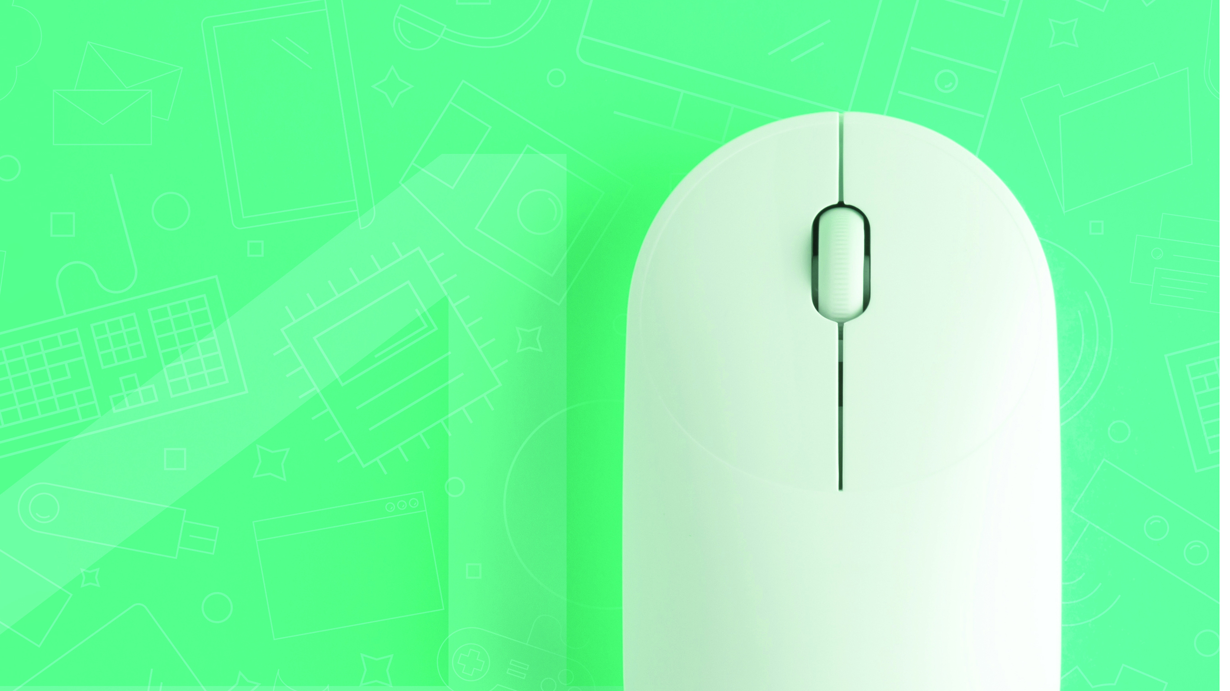
Life Orientation Computer Skills
NCV4

Slide 2
Module 1: Concepts of Information and Communication Technology (ICT)
THE EFFECTS OF ICT IN TERMS OF A SOCIAL COMPUTER ENVIRONMENT
Information and Communication Technology (ICT) refers to the technologies to record, store, process, retrieve, transfer, and receive information electronically in a digital form.
A social network is a platform on the internet that enables everyone to have daily contact with others, to send messages and to share ideas, photos and videos.
www.futuremanagers.com

Slide 3
Module 1: Concepts of Information and Communication Technology (ICT) (continued)
THE IMPACT OF SOCIAL NETWORKS AND MEDIA - POSITIVE
Access to information;
Improved access to education;
Entertainment;
Improved communication;
Increased job opportunities;
Marketing and advertising;
Social networking.
www.futuremanagers.com

Slide 4
Module 1: Concepts of Information and Communication Technology (ICT) (continued)
THE IMPACT OF SOCIAL NETWORKS AND MEDIA - NEGATIVE
Cyberbullying and cyber stalking;
Security risk;
Negative effect on productivity and good manners;
Reduced personal interactions;
Social media causing moral and ethical problems;
FOMO;
Health problems and reduced physical activity.
www.futuremanagers.com

Slide 5
Module 1: Concepts of Information and Communication Technology (ICT) (continued)
PROTOCOLS WHEN USING SOCIAL MEDIA
Be careful what you publish on social media;
Do not trust anybody;
Respect privacy rules;
Use caution when you click on links;
Be cautious about meeting new cyber friends in person;
Be aware of phishing, fraud and scams;
Be sensible when you use a social site.
www.futuremanagers.com

Slide 6
Module 1: Concepts of Information and Communication Technology (ICT) (continued)
PRECAUTIONARY AND SAFETY MEASURES IN A LEGAL COMPUTER ENVIRONMENT
Download from secured websites only;
Use an antivirus and antispyware programs, and a firewall;
File sharing when using public wireless networks;
Block certain content.
www.futuremanagers.com

Slide 7
Module 2: Integrated features of word-processing using Microsoft Word 2016
INTEGRATE FEATURES AND FUNCTIONS
MS Word allows features such as:
Automatic numbering on one level;
Multilevel numbering;
Remove numbering;
Set page margins;
Creating and adding columns;
Spellcheck;
Preview print and print;
Mail Merge;
Creating and saving data source.
www.futuremanagers.com

Slide 8
Module 3: Integrated features of spreadsheets using Microsoft Excel 2016
INTEGRATE AND PRACTISE CREATING AND EDITING DOCUMENTS
Microsoft Excel allows features such as:
Cloud storage;
Templates;
FlashFilling data;
Formatting cells;
Spellcheck, preview and printing;
Basic and advanced calculations.
www.futuremanagers.com

Slide 9
Module 3: Integrated features of spreadsheets using Microsoft Excel 2016 (continued)
CHARTS FOR DIFFERENT CONTEXTS
Charts make data visual. With a chart, spreadsheet data can be transformed to show comparisons, patterns, and trends.
www.futuremanagers.com

Slide 10
Module 4: Basic features of databases Using Microsoft Access 2016
A DATA STRUCTURE AND CAPTURE INFORMATION IN A DATA TABLE
A database is an organised collection of related information or data. A good example of a database is a telephone directory or a business client card filing system. Data is stored in tables in a database. Tables are subject-based lists that contain data arranged in records. Each record (or row) is divided into separate fields (or columns) of information. A record is information about ONE person or product. A database table may contain any number (within the system limitations) of records.
www.futuremanagers.com

Slide 11
Module 4: Basic features of databases Using Microsoft Access 2016 (continued)
CREATE A REPORT BASED ON A TABLE USING BASIC FEATURES
Open the database and table to be used for the creating of a report.
Click Create | Reports group: Report Wizard.
Include all fields except the ID and click Next.
Select the sort order you want for your records.
Select the lay out you want for your report.
www.futuremanagers.com

Slide 12
Module 5 – The internet as communication medium
USE THE INTERNET FOR A VARIETY OF STUDY AND WORK
The world wide web can be used to:
Conduct online job searching;
Complete an online job application and upload a CV;
Register for job alerts;
Analyse a contract;
Analyse job adverts.
www.futuremanagers.com

Slide 13
Module 5 – The internet as communication medium (continued)
EXPLORE AND USE SOCIAL ELECTRONIC MEDIA AND NETWORKS
Take advantage of social media sites such as Facebook, LinkedIn and Twitter to connect with industry leaders and recruiters, and to show off your unique skills and experience. Keep in mind that many employers check the profiles of potential employees. Unsuitable topics on your social profile will hamper a possible appointment.
www.futuremanagers.com

