Slide 1

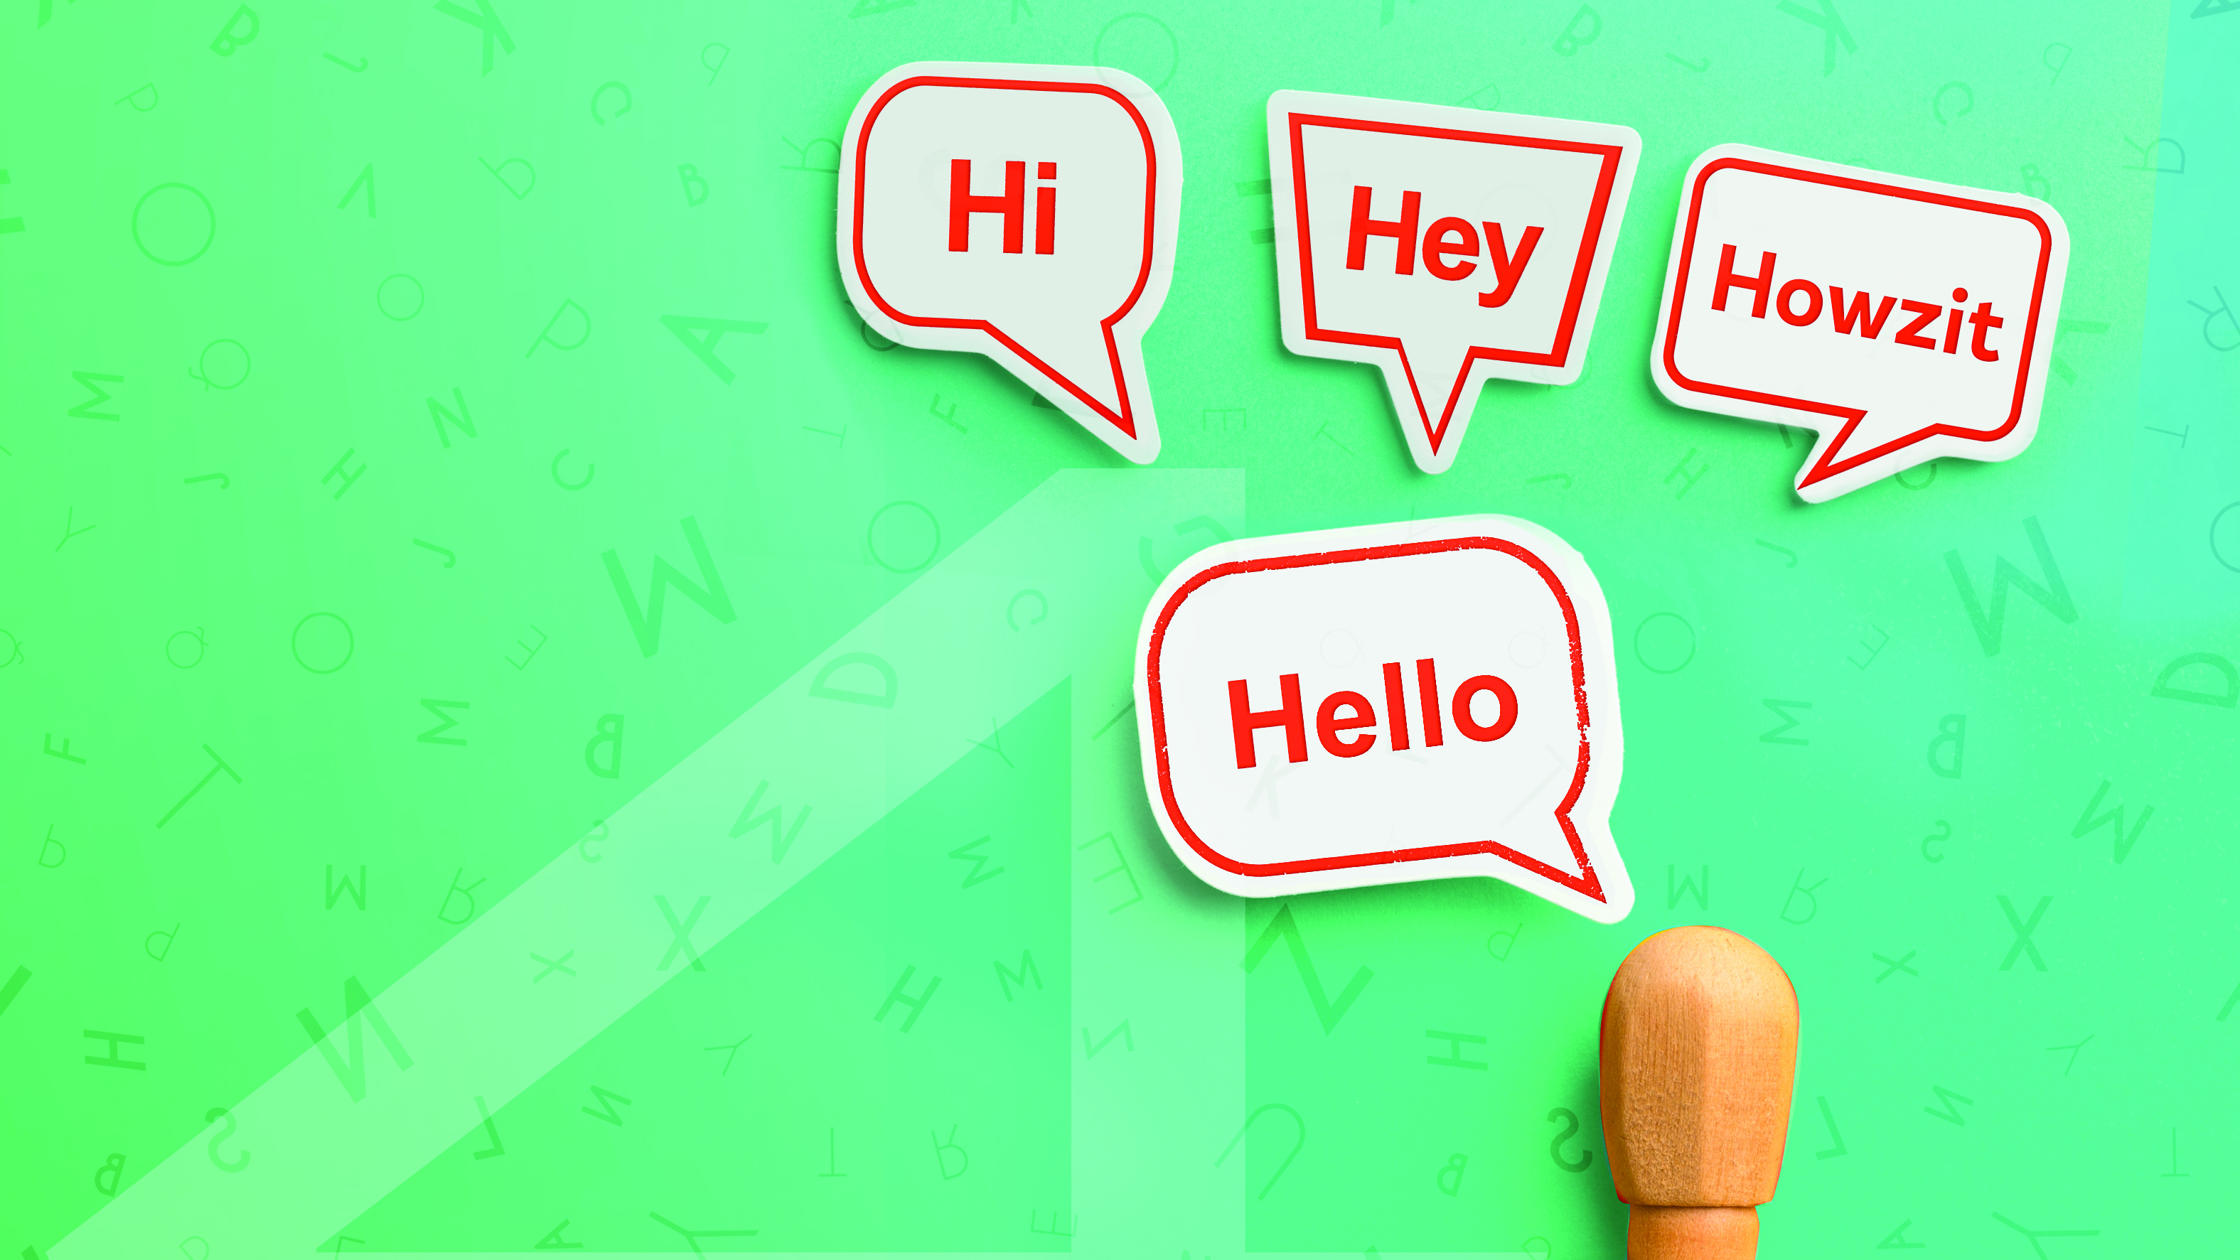
Language
NCV4

Slide 2
Module 1 – Job finder
READING STRATEGIES (REVISION)
The process of active reading for comprehension includes the following:
Pre-reading;
Skimming;
Predicting;
Reading; and
Re-reading.
www.futuremanagers.com

Slide 3
Module 1 – Job finder (continued)
NEWSPAPER COLUMNS
You will find a newspaper column on the inside ‘comment’ and ‘opinion’ pages of a newspaper. It is usually a regular (weekly) contribution by a member of the editorial staff or by a guest columnist, who is normally a well known personality.
www.futuremanagers.com

Slide 4
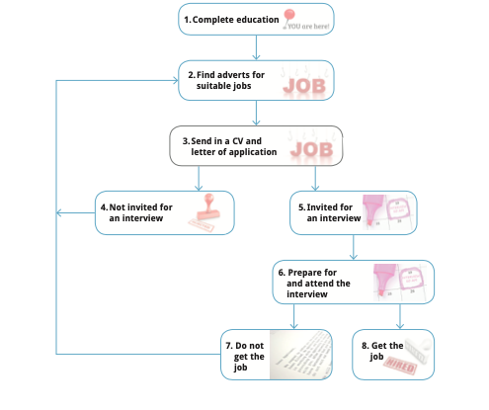
Module 1 – Job finder (continued)
FINDING A JOB
Finding a job is a process which can be followed by the schematic presentation:
www.futuremanagers.com

Slide 5
Module 1 – Job finder (continued)
MAGAZINE ARTICLES
Although magazines are filled with various articles, there are always one or two feature articles in every edition. A feature article aims to inform, to educate and to entertain, similar to a newspaper column.
www.futuremanagers.com

Slide 6
Module 1 – Job finder (continued)
JOB INTERVIEWS
The purpose of a job interview is to exchange information between an applicant and a prospective employer. However, for the applicant here is another purpose as well: to persuade the interviewer that they are the best person for the job.
www.futuremanagers.com

Slide 7
Module 1 – Job finder (continued)
MEDIA INTERVIEWS
In a media interview a journalist interviews a celebrity. The aim of the interview is to reveal information that will be of interest to the reader/viewer/listener. For the celebrity it is an opportunity to get important media coverage and make him or herself even more famous.
www.futuremanagers.com

Slide 8
Module 2 – Handling conflict situations, debating and making speeches
CONFLICT AND CONFLICT RESOLUTION
Conflict is a struggle or clash between individuals; it is caused by different ideas, interests, values, etc. It is not just a disagreement: it is the result of a build-up of disagreements.
Conflict resolution is the process of finding a solution or acceptable compromise in a situation of serious disagreement between two or more parties; it is the act of solving (or fixing) a conflict.
www.futuremanagers.com

Slide 9
Module 2 – Handling conflict situations, debating and making speeches (continued)
ARGUMENT AND DEBATE
Developing an effective argument is all about expressing our opinion in a logical and ordered way. A debate, on the other hand, is formal, controlled argument based on reason and logic (thinking skills).
www.futuremanagers.com

Slide 10
Module 2 – Handling conflict situations, debating and making speeches (continued)
UNPREPARED SPEECH
There are always occasions when you will be expected to speak without having had a chance to prepare. It can be very unnerving to think on your feet in this way, so build confidence by building your vocabulary and preparing thoroughly for your prepared speeches.
www.futuremanagers.com

Slide 11
Module 2 – Handling conflict situations, debating and making speeches (continued)
FORMAL PRESENTATION (REVISION)
When making a formal presentation, make sure you:
Do research and organise your material coherently.
Choose and develop main ideas and support them with examples.
Use an attention-grabbing introduction and a powerful conclusion.
Use appropriate style and register.
Incorporate appropriate visual, audio and/or audio-visual aids.
www.futuremanagers.com

Slide 12
Module 3 – Critical reading and précis
PURPOSE OF A TEXT (REVISION)
The following represents different purposes of different texts:
Purpose | Description
To inform | To give facts about something
To persuade | To present arguments for or against a topic; to influence the reader’s way of thinking; to give an opinion; to advertise
To entertain | To read for pleasure or enjoyment; this can also involve imagination
To instruct | To tell how something should be done through a series of steps
To explain | To tell, show or why something happened, e.g. how something works
To describe | To make the reader see actual events, places or objects clearly
www.futuremanagers.com

Slide 13
Module 3 – Critical reading and précis (continued)
POINT OF VIEW
A text is produced with a purpose and tells us something from a particular point of view which can be either subjective or objective. A point of view is objective if it simply gives factual information about something. A subjective point of view is a personal view or opinion. It’s not based on fact or general knowledge.
www.futuremanagers.com

Slide 14
Module 3 – Critical reading and précis (continued)
SUBJECTIVE (EMOTIVE) LANGUAGE USE (REVISION)
Subjective (emotive) language conveys personal feelings as well as meaning and makes the listener or reader share in them. It is used in creative writing but also when speakers/writers want to persuade you to their point of view.
www.futuremanagers.com

Slide 15
Module 3 – Critical reading and précis (continued)
MEANING
A text always has meaning – whatever its purpose or whatever the point of view from which it is spoken or written. It tells us things and we understand them. Explicit meaning is direct, implicit meaning is indirect. Inference is defined as a conclusion reached on the basis of evidence and reasoning as well as background knowledge. An assumption means to believe something without having any proof that it is true, e.g. to assume that everyone wants peace.
www.futuremanagers.com

Slide 16
Module 3 – Critical reading and précis (continued)
BIAS
Our assumptions can make us biased. This can prevent us from seeing people and events as they really are. Bias is a tendency to favour one person, group, thing or point of view over another, when we are speaking or writing about them. We are 'slanted’ towards them. Bias can be a personal opinion or a more public opinion, such as a news story that only presents facts supporting one point of view.
www.futuremanagers.com

Slide 17
Module 3 – Critical reading and précis (continued)
CRITICAL LANGUAGE AWARENESS
When we understand how language can 'mess with our minds' we become more critically aware and can see when someone is trying to persuade us, or is trying to gain power over us.
www.futuremanagers.com

Slide 18
Module 3 – Critical reading and précis (continued)
PRÉCIS
A précis is a summary of a text written in your own words.
www.futuremanagers.com

Slide 19
Module 4 – Writing with opinion
SYNOPSIS OF DIFFERENT TYPES OF WRITING
There are different types of writing and many of them are quite similar. The goal of our text will dictate the type of writing that we will choose. In order to write an article or persuasive, discursive, argumentative, reflective or critical text, we first have to find out what exactly the text’s main purpose, features and style are.
www.futuremanagers.com

Slide 20
Module 4 – Writing with opinion (continued)
NEWS ARTICLE/MAGAZINE ARTICLE
How to write a newspaper/magazine article:
Have an introduction, body and conclusion.
Provide an accurate summary of events by stating the facts briefly.
Start with the most important facts – the who, what, when, where, why, how and how much.
Give the names and positions of the people involved.
Supply dates, times and contact details where necessary.
www.futuremanagers.com

Slide 21
Module 4 – Writing with opinion (continued)
NEWS ARTICLE/MAGAZINE ARTICLE (CONT)
Give a succinct, but interesting title.
Use mostly objective language as you will be dealing more with facts; and not opinions.
Write in the third person (no ‘I’, ‘we’ or ‘you’).
Use clear, concise language; short sentences and paragraphs.
Use a style that relates to the reader, e.g. an article for teenagers would require an informal style.
www.futuremanagers.com

Slide 22
Module 4 – Writing with opinion (continued)
NEWS ARTICLE/MAGAZINE ARTICLE (CONT)
Include comments, opinions or statements from people involved or experts interviewed - these can be in direct speech.
Write in a fair and unbiased fashion, but add a few rhetorical questions emotive words and images.
www.futuremanagers.com

Slide 23
Module 4 – Writing with opinion (continued)
PERSUASIVE WRITING
Advertising is a very good example of persuasive writing. Business proposals and motivations are also persuasive texts because they present an argument from one side only.
www.futuremanagers.com

Slide 24
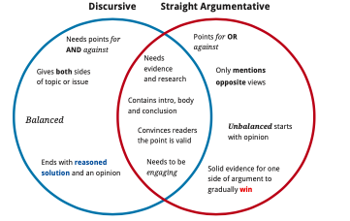
Module 4 – Writing with opinion (continued)
ARGUMENTATIVE WRITING
An argument can be one-sided (as in persuasive writing) or it can give both sides (as in argumentative writing). Argumentative writing can either be discursive or 'straight'.
www.futuremanagers.com

Slide 25
Module 4 – Writing with opinion (continued)
REFLECTIVE WRITING
Reflective writing is normally about a personal experience and a lesson or realisation from it. It is a personal account of what you think and feel during and after that experience. You can express your thoughts or perceptions about a person, event or object. You don’t write to demonstrate your knowledge of a subject, but to reveal a bit about your personality or character.
www.futuremanagers.com

Slide 26
Module 4 – Writing with opinion (continued)
CRITICAL WRITING
Critical writing in the media is usually a review of an arts related work. A critical evaluation should be based on facts, supported by evidence, regardless of whether it is positive or negative. It involves an objective summary – with information about the plot, characters, setting, etc. It also involves your subjective opinion.
www.futuremanagers.com

Slide 27
Module 5 – Viewing multimedia and multimodal texts
MULTIMEDIA AND MULTIMODAL
A text is multimedia or multimodal when it combines two or more of the following ways (modes) of communicating:
Language;
Visual;
Audio;
Gestures; and
Space.
www.futuremanagers.com

Slide 28
Module 5 – Viewing multimedia and multimodal texts (continued)
VISUAL TEXTS
Here are some reasons why visuals are important to communication:
Visuals evoke emotions and we respond easily to them.
Visuals convey information in a way that fully engages the brain and the information is absorbed very quickly.
Visuals decorate a text and make it attractive. The use of visual texts, especially pictures, is a quick and effective method of attracting the attention of a particular target audience.
www.futuremanagers.com

Slide 29
Module 5 – Viewing multimedia and multimodal texts (continued)
PHOTOGRAPHS
Photography can evoke more emotion than the written text and is effective to use in order to make a stronger point.
www.futuremanagers.com

Slide 30
Module 5 – Viewing multimedia and multimodal texts (continued)
ILLUSTRATIONS
Illustrations are pictorial matter that is used to explain or decorate a written text. Illustrations may include graphs, timelines, charts, maps, diagrams, etc. Illustrations can be computer-generated or hand-drawn.
www.futuremanagers.com

Slide 31
Module 5 – Viewing multimedia and multimodal texts (continued)
CARTOONS (REVISION)
Cartoons are funny drawings or sketches (often one to three-panel strips) in newspapers or magazines. They often have a caption and dialogues. The purpose of cartoons is to entertain by providing humorous comment on aspects of everyday life. Many cartoons stay ‘fresh’ for long, while others ‘date’ sooner - they don’t seem funny anymore.
www.futuremanagers.com

Slide 32
Module 5 – Viewing multimedia and multimodal texts (continued)
CARICATURES
Caricatures of celebrities usually appear in entertainment magazines and caricatures of politicians in newspapers. A caricature is a sketch that captures a person’s distinctive features (nose, hair, regular item of clothing, etc.). Certain features could be exaggerated, while the rest are oversimplified.
www.futuremanagers.com

Slide 33
Module 5 – Viewing multimedia and multimodal texts (continued)
TELEVISION ADVERTISEMENTS
Television advertisements are created in a digital electronic medium instead of on paper. Although they are mainly visual, they also use oral and written language and audio – sound effects and music. The use of cinematographic techniques allows objects to be viewed from different angles, bringing the use of space into the communication. Television advertisements are therefore good examples of multimodal communication.
www.futuremanagers.com

Slide 34
Module 5 – Viewing multimedia and multimodal texts (continued)
ANIMATION
Animation is the technique of using a series of still pictures in a rapid sequence to create an illusion of movement.
www.futuremanagers.com

Slide 35
Module 6 – Creative texts: novel and film study
ELEMENTS OF A NOVEL
The basic elements of a novel are:
Setting;
Plot;
Characters;
Conflict; and
Theme.
www.futuremanagers.com

Slide 36
Module 6 – Creative texts: novel and film study (continued)
LITERARY TECHNIQUES IN A NOVEL
The literary techniques of a novel include:
Objective and subjective language;
Imagery and symbolism;
Repetition; and
Irony.
www.futuremanagers.com

Slide 37
Module 7 – Media communication theory
TYPES OF MASS MEDIA
Different types of mass media include:
Print media which refers to the collection of communication media which send out information in the form of the printed word.
Audio-visual which refers to media that we can both hear and see.
Electronic media which refers to Internet-based online forms of news publication which can be accessed by the end user who has the required electronic equipment.
www.futuremanagers.com

Slide 38
Module 7 – Media communication theory (continued)
MANIPULATIVE MEDIA COMMUNICATION
Manipulative media communication is media communication that seeks to control or influence the public cleverly using unprincipled methods. This relies on bias, elements of persuasion, emotive and persuasive language, selective reporting and propaganda techniques.
www.futuremanagers.com

Slide 39
Module 7 – Media communication theory (continued)
IMPACT OF THE MEDIA - LITERACY
Positive | Negative
By interacting with print media and Internet websites we improve our reading ability. | The emphasis in audio-visual media is on easy entertainment. Instead of reading books, newspapers and magazines, we sit passively in front of the ‘box’. Reading skills remain under-developed.
www.futuremanagers.com

Slide 40
Module 7 – Media communication theory (continued)
IMPACT OF THE MEDIA - LEARNING
Positive | Negative
Audio-visual electronic media and colourful print media like special interest magazines are excellent channels for informing and educating. | Because TV is in the home, it is easy to spend hours in front of it. This leaves little time for doing homework and studying.
Electronic media – the Internet – is at the forefront of the ‘knowledge revolution’. Thanks to search engines like Google, it has become possible for us to learn about anything or anyone just by spending a few moments at the computer. It also uses effective multimodal techniques to convey information. | Websites all have links to other related websites and matters of interest. This often leads us to browse – to flit from one item to another – and lose the concentration necessary to really benefit from what we have searched for.
 | Students often copy and paste information from the Internet directly into their projects. This is plagiarism.
www.futuremanagers.com

Slide 41
Module 7 – Media communication theory (continued)
IMPACT OF THE MEDIA – OPINION FORMATION
Positive | Negative
The media keep us informed. Honest reporting presents us with different points of view and we are encouraged to think about the issue and develop our own opinion. | Manipulative reporting and propaganda does not give us the chance to form our own opinions. We are cunningly and indirectly told how to think, what to buy, etc.
www.futuremanagers.com

Slide 42
Module 7 – Media communication theory (continued)
IMPACT OF THE MEDIA – VALUES
Positive | Negative
Advertising informs us of the latest trends in society and new products and services. | Advertising makes us place too much importance on ‘things’. It persuades us to buy things we really do not need.
www.futuremanagers.com

Slide 43
Module 7 – Media communication theory (continued)
IMPACT OF THE MEDIA – RELAXATION
Positive | Negative
TV, DVDs, music videos and Internet videos allow us to escape from work and worries and relax through providing entertainment in the home. | We can become addicted. Entertainment is made so attractive that more time is spent on that than on learning from the media.
 | Other important ways of relaxing, e.g. socialising with friends, playing sport, developing hobbies and reading are pushed to one side.
www.futuremanagers.com

Slide 44
Module 8 – Language Desk
PUNCTUATION
Punctuation can be compared to ‘the traffic signals of language: they tell us to slow down, notice this, take a detour, and stop': Punctuation also ‘prevents misunderstandings between writer and reader'.
www.futuremanagers.com

Slide 45
Module 8 – Language Desk (continued)
DIRECT AND REPORTED (INDIRECT) SPEECH
Direct speech is what somebody actually says. When writing, we always put the actual words spoken into quotation marks (inverted commas). Reported speech is when we report what somebody else has said. We do NOT use quotation marks.
www.futuremanagers.com

Slide 46
Module 8 – Language Desk (continued)
ACTIVE AND PASSIVE VOICE
A verb is in the active voice when the subject of the sentence does something.
A verb is in the passive voice when the subject of the sentence has something done to it by another person, place or thing.
www.futuremanagers.com

