Slide 1

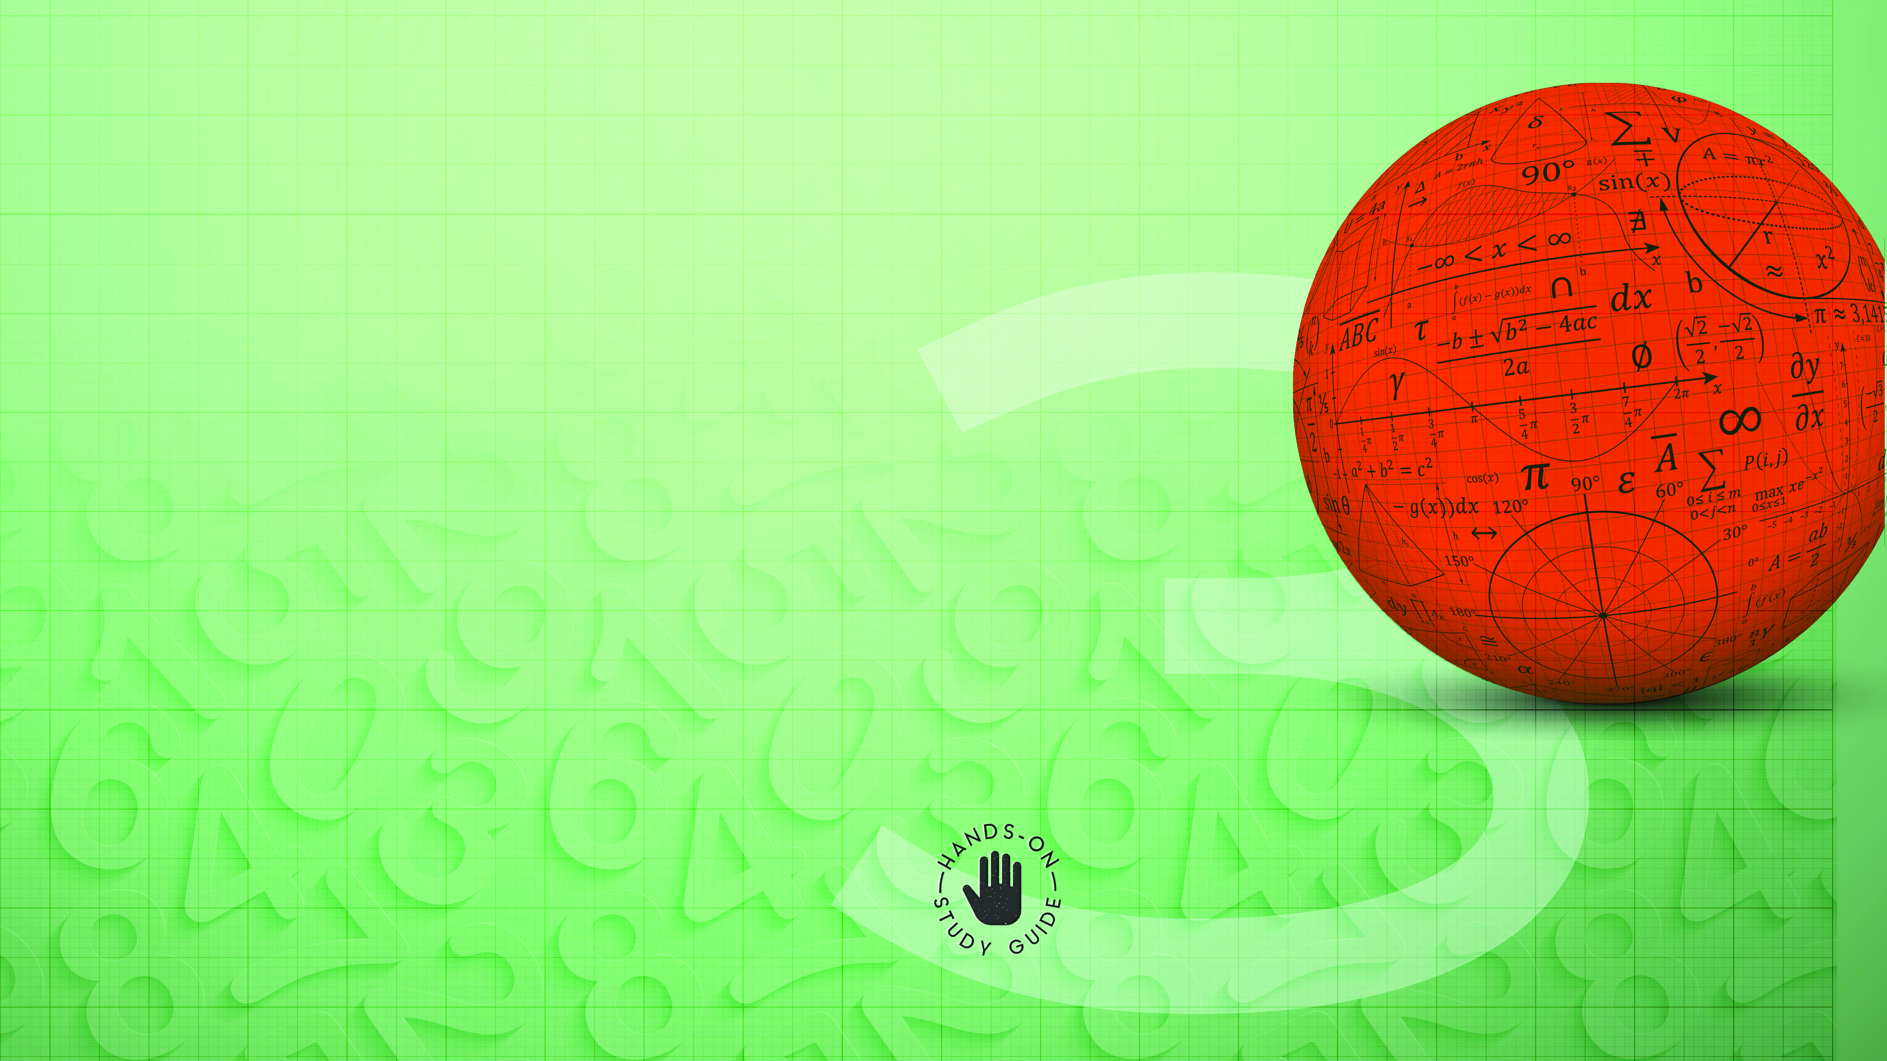
Mathematics
NCV3

Slide 2
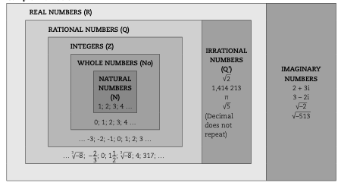
Chapter 1: Complex numbers
COMPLEX NUMBERS IN A FORM APPROPRIATE TO THE CONTEXT
www.futuremanagers.com

Slide 3
Chapter 1: Complex numbers (continued)
PERFORM OPERATIONS ON COMPLEX NUMBERS
Complex numbers can be represented in the complex plane in the same way that integers are represented on a number line and coordinates on a Cartesian plane. An Argand diagram is a graphical representation of complex numbers.
The x-axis is used to plot the real part of the complex number.
The y-axis is used to plot the imaginary part of the complex number.
www.futuremanagers.com

Slide 4
Chapter 1: Complex numbers (continued)
POLAR FORMS OF COMPLEX NUMBERS
We can think of complex numbers as vectors. A vector is something than can be defined by two quantities, namely size and direction.
The polar form is also called modulus-amplitude, modulus-argument or trigonometric form of a complex number. When we write a complex number as a polar form, it can be written in terms of distance or direction.
www.futuremanagers.com

Slide 5
Chapter 1: Complex numbers (continued)
PERFORMING OPERATIONS ON COMPLEX NUMBERS
When we add or subtract terms in algebra, we add or subtract like terms. The same rule applies when we add or subtract complex numbers. The real components and imaginary components are added or subtracted separately. Each part of the first complex number gets multiplied by each part of the second complex number, therefore we use FOIL.
www.futuremanagers.com

Slide 6

Chapter 2: Functions and Algebra
SKETCH GRAPHS
The following types of graphs can be sketched when the variables are given quantities:
$y =ax + q$ - straight line graph
$y =ax^{2} + q$ – parabola
$y =\frac{a}{x} + q$ – rectangular hyperbola
$y =ab^{x} + q$ – exponential graph
www.futuremanagers.com

Slide 7
Chapter 2: Functions and Algebra (continued)
MANIPULATE AND SIMPLIFY ALGEBRAIC EXPRESSIONS
Multiplying/dividing with binomial and trinomial denominators:
Factorise the numerator and the denominator where necessary.
Cancel/divide any factor in the numerator by an identical factor in the denominator.
Cancel/divide any factor in the numerator by an identical factor in the denominator of the other fraction.
Simplify by multiplying the remaining numerators with each other.
Simplify by multiplying the remaining denominators with each other.
www.futuremanagers.com

Slide 8
Chapter 2: Functions and Algebra (continued)
MANIPULATE AND SIMPLIFY ALGEBRAIC EXPRESSIONS (CONT)
Adding or subtracting algebraic fractions with binomial and trinomial denominators:
Factorise the denominators where necessary.
Determine the LCM of the denominators.
Write all the fractions as one fraction with the same denominator.
Simplify the numerator.
www.futuremanagers.com

Slide 9

Chapter 2: Functions and Algebra (continued)
SOLVE ALGEBRAIC EQUATIONS AND INEQUALITIES
For quadratic equations:
To get rid of fractions: Multiply by the LCM (denominators $≠$0)
The perfect square form of a quadratic expression is: $a{\left(x ± p\right)}^{2} ± q$
When solving simultaneous equations find:
(x;y) that will satisfy both the equations
The points of intersection of two graphs.
www.futuremanagers.com

Slide 10
Chapter 2: Functions and Algebra (continued)
LINEAR PROGRAMMING
Linear programming is the mathematical method used to find the ‘best’ solution to problems which can be expressed in terms of linear equations or inequalities. It is used to achieve the best outcome such as maximum profits or lowest costs and production levels. Solutions are normally found by drawing graphs of the inequalities in two variables on a system of axes and then by finding optimum values that satisfy the required conditions.
www.futuremanagers.com

Slide 11
Chapter 2: Functions and Algebra (continued)
INSTANTANEOUS RATE OF CHANGE
Quantities are continually changing thus we need calculus to make sense of all these changes. Calculus is the mathematics of rates of change. The two main branches of calculus are:
Differential calculus: The part of calculus which is concerned with the rate at which a function is changing.
Integration: Which can be described as the part of calculus which is concerned with summing the values of a function over a particular range.
www.futuremanagers.com

Slide 12
Chapter 2: Functions and Algebra (continued)
CALCULATING LIMITS
To calculate simple limits we use direct substitution.
To calculate limits of the indeterminant form (if the denominator is zero) we use the following methods:
Simplification.
Factorisation: Common factor, quadratic trinomial, difference of squares.
Rationalisation of the denominator or numerator.
Division of the numerator and denominator by the highest power of x.
www.futuremanagers.com

Slide 13

Chapter 2: Functions and Algebra (continued)
FIRST/BASIC PRINCIPLES
The gradient of the curve of a function at a point is equal to the gradient of the tangent to the curve at that point.
To find the gradient of a function f(x) at any point (x ; y) , from first principles:
$$\frac{dy}{dx}=f^{′}\left(x\right)=\lim_{h−0}\frac{f\left(x+h\right)−f\left(x\right)}{h};h≠0$$
www.futuremanagers.com

Slide 14
Chapter 3: Space, Shape and Measurement
SURFACE AREA OF TWO- AND THREE-DIMENSIONAL SHAPES
The surface area is defined as the sum of the areas of all surfaces of a geometrical object. The surface area of pyramids, cones and spheres is defined by means of nets. The formulae for pyramids and cones are defined as the sum of the base area and the areas of the lateral faces.
www.futuremanagers.com

Slide 15
Chapter 3: Space, Shape and Measurement (continued)
VOLUME OF TWO- AND THREE-DIMENSIONAL SHAPES
The volume of the three-dimensional objects is defined as the stacking of the base area. The stacking varies throughout the shape, that is, it has non- uniform cross-sections. Volume refers to the amount of solid occupied by a three- dimensional object.
www.futuremanagers.com

Slide 16
Chapter 3: Space, Shape and Measurement (continued)
SURFACE AREA AND VOLUME OF A COMBINATION OF GEOMETRIC OBJECTS
To calculate the surface area of a combination of geometrical objects, you need to focus on the view of the object, that is, side view, top view and bottom view. After the views have been satisfied, can you select the appropriate formulae to calculate the surface area. The volume of a combination of geometrical objects can be calculated by identifying the different objects contributing to the combination.
www.futuremanagers.com

Slide 17
Chapter 3: Space, Shape and Measurement (continued)
USE THE CARTESIAN COORDINATE SYSTEM TO DERIVE AND APPLY EQUATIONS
The equation of a line through two given points can be determined by first calculating the gradient (m) and substituting this into the y = mx + c formula. Then to determine the y-intercept (c), one of the given points must be substituted into the y = mx + c . formula, with m known.
www.futuremanagers.com

Slide 18
Chapter 4: Data Handling
THE FIVE NUMBER SUMMARY
The five number summary represents a summary of the data set. This requires that you need to identify the two extremes of the data set, the upper and lower quartiles as well as the median of the data set. The five values are rank sensitive and therefore the data first has to be arranged in ascending order.
www.futuremanagers.com

Slide 19
Chapter 4: Data Handling (continued)
FENCES, INDICATING AND INTERPRETING OUTLIERS
Fences are used as a method to check for outliers. These fences can be categorised as a lower fence and an upper fence. Any data points which lies below the lower fence and above the upper fence are considered as outliers. To calculate the respective fences, we need to calculate the lower quartile, the upper quartile and the inter-quartile range. A fence is not only used to identify outliers but can also define an upper inside value and lower inside value.
www.futuremanagers.com

Slide 20
Chapter 4: Data Handling (continued)
BOX AND WHISKER DIAGRAM INTERPRETATION
A long tail at the upper end of the box and whisker plot in comparison to the short tail at the lower end implies that the box and whisker plot is skewed to the right, that is, positively skewed. Positively skewed implies that the mean is greater than the median.
www.futuremanagers.com

Slide 21
Chapter 4: Data Handling (continued)
BOX AND WHISKER DIAGRAM INTERPRETATION (CONT)
If the tails at the lower end and the upper end of the box and whisker plot are equidistant from the median implies that no skewness exist, that is, symmetrical. Symmetrical implies that the mean is equal to the median.
www.futuremanagers.com

Slide 22
Chapter 4: Data Handling (continued)
BOX AND WHISKER DIAGRAM INTERPRETATION (CONT)
A short tail at the upper end of the box and whisker plot in comparison to the long tail at the lower end implies that the box and whisker plot is skewed to the left, that is, negatively skewed. Negatively skewed implies that the mean is less than the median.
www.futuremanagers.com

Slide 23
Chapter 4: Data Handling (continued)
FREQUENCY DISTRIBUTION TABLES
A frequency table is the figure that represents the number of times a specific incident occurred. We can use the frequency table to organise raw data. To organize raw data you count the number of times an observation occurs. It can be used for both discrete and continuous data.
www.futuremanagers.com

Slide 24
Chapter 5: Financial Mathematics
FINANCES OF SOCIAL CLUBS
Social clubs are formed when a group of people who share a common interest get together to socialise or raise funds for specific causes. Social clubs are not focused on making a profit but to provide a service to the club members and society. Should a profit be generated, this is referred to as a surplus. Should there be a loss, this is referred to as a deficit.
www.futuremanagers.com

Slide 25
Chapter 5: Financial Mathematics (continued)
MANAGING THE FINANCES OF SOCIAL CLUBS
To sustain a social club there are various methods of financing, such as:
Membership fees,
Donations,
Sponsorships and
Function fees.
Usually a treasurer is selected to oversee the finances of the club.
www.futuremanagers.com

Slide 26
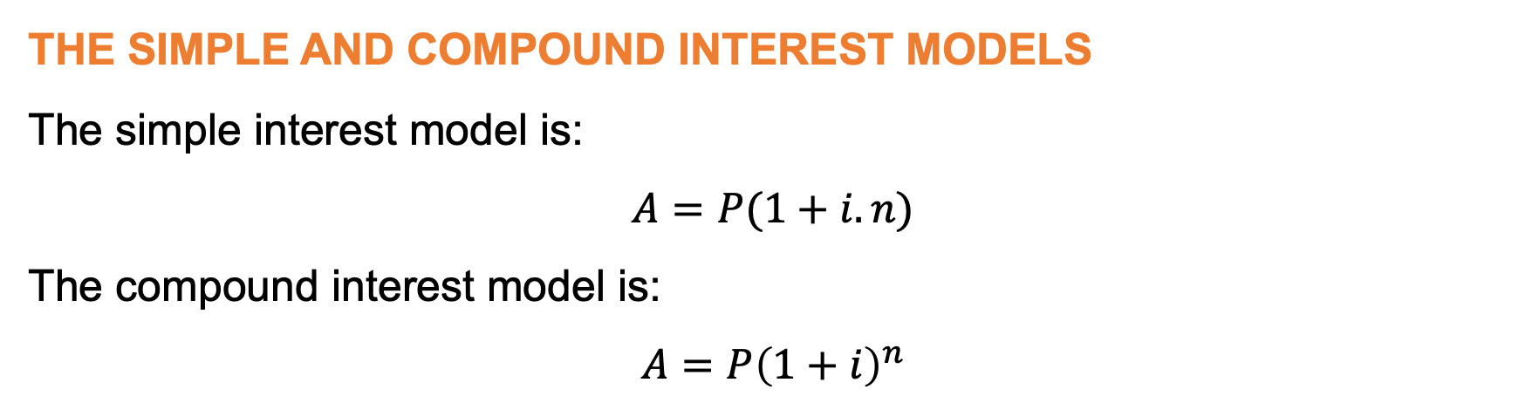
Chapter 5: Financial Mathematics (continued)
THE SIMPLE AND COMPOUND INTEREST MODELS
The simple interest model is:
$$A=P(1+i.n)$$
The compound interest model is:
$$A=P{\left(1+i\right)}^{n}$$
www.futuremanagers.com

