Slide 1
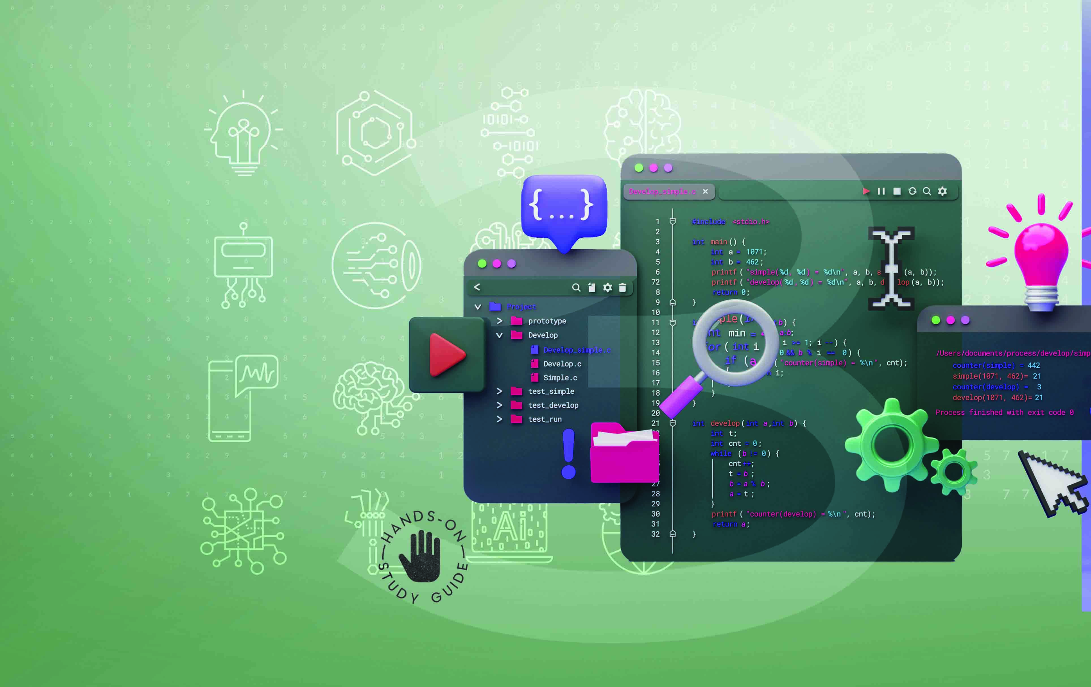

Introduction to Technical Programming
NCV3

Slide 2
Module 1: Computer hardware and software
INTRODUCTION
Our daily lives have become increasingly reliant on computers for everyday tasks. As a result, computer programming is becoming an essential skill. As a programmer you should have an understanding of how computers work because knowledge of computer architecture increases the understanding of programming concepts.
www.futuremanagers.com

Slide 3
Module 1: Computer hardware and software (continued)
DIFFERENT TYPES OF HARDWARE OF A COMMON SYSTEM
The basic functions of the computer hardware are:
Data processing;
Data storage;
Data movement; and
Control.
www.futuremanagers.com

Slide 4
Module 1: Computer hardware and software (continued)
THE PURPOSE OF SOFTWARE
Software is defined as consisting of written, machine-readable instructions or programs that tell the physical components of the computer what to do and when to execute the instructions.
www.futuremanagers.com

Slide 5
Module 1: Computer hardware and software (continued)
THE LINUX SHELL
The shell is a program that receives keyboard commands and sends them to
the operating system for processing. A program called Bash serves as the shell on most Linux computers. You can communicate with the shell by using the terminal emulator, which launches a window. Linux employs a wide range
of different terminal emulators. Among them are GNOME Terminal, Konsole,
xterm, rxvt, kvt, nxterm, and eterm. Within the terminal application on
Raspberry Pi we can run Linux commands.
www.futuremanagers.com

Slide 6
Module 2: Problem solving in
computer programming
INTRODUCTION
Solving problems is the primary objective in computer science. To solve problems, we must use a standardised, systematic approach. This is referred to as an algorithm. Programmers need to first understand how people approach problems, then they need to understand how to turn this algorithm into something that a machine can accomplish, and finally they need to understand how to represent the solution in their chosen coding language. Problem solving is a key attribute for programmers.
www.futuremanagers.com

Slide 7
Module 2: Problem solving in computer programming (continued)
PROBLEM SOLVING PROCESS AND CONCEPTS
Problem solving is the sequential process of analysing information related to a given situation and generating appropriate response options.
Computational thinking is an interrelated set of problem-solving methods that involve expressing problems and their solutions in ways that a computer can execute.
www.futuremanagers.com

Slide 8
Module 2: Problem solving in computer programming (continued)
ALGORITHMS AND SOLUTIONS TO GIVEN PROBLEMS
An algorithm can be defined as a process that performs some sequence of operations in order to solve a given problem. Algorithms are used for calculations, data processing, and in many other fields. It is the programmer’s choice to select the type of modelling tool or technique to use when solving a problem. Further, it is important to note that one problem can have different algorithms from different programmers. There is no ‘one size fits all’ in design.
www.futuremanagers.com

Slide 9
Module 3: Concepts of programming for
single-board microprocessors
or microcontrollers
INTRODUCTION TO IO ON SINGLE-BOARD COMPUTING
Raspberry Pi and Arduino are two very popular examples of single-board computing hardware commonly used in programming and electronics. Raspberry Pi serves as a learning tool for computer programming, whereas Arduino is designed for rapid programming and circuit prototyping.
www.futuremanagers.com

Slide 10
Module 3: Concepts of programming for single-board
microprocessors or microcontrollers (continued)
VISUAL PROGRAMMING AND SOLUTION DEVELOPMENT
mBlock is based on Scratch and is also graphical programming software that has a user-friendly interface and allows drag-and-drop functionality. With mBlock, users may drag and drop blocks or use C++ to program sprites, animations, games, and robots and devices like mBlock’s robots, the micro:bit, and Arduino.
www.futuremanagers.com

Slide 11
Module 4: Programming tools and utilities
INTRODUCTION
There is a wide range of tools and utilities at the developer’s disposal to help with producing applications that are not only functional but also fast, efficient and useful. Amongst these tools are software packages that can manage the different versions of programs, compilers and interpreters that can convert high-level source code into binary files for the computer to understand and debugging tools to help with error detection and fault fixing.
www.futuremanagers.com

Slide 12
Module 4: Programming tools and utilities (continued)
SOURCE CONTROL
Version control systems are software tools that help software teams
manage changes to source code over time.
www.futuremanagers.com

Slide 13
Module 4: Programming tools and utilities (continued)
BUILDING AND RUNNING C++ APPLICATIONS
Programming language translators can convert programs written in high-level languages into machine code that a computer understands. A translator in software programming terms could refer to a compiler, assembler, or interpreter. The languages C and C++ are compiled high-level languages.
www.futuremanagers.com

Slide 14
Module 4: Programming tools and utilities (continued)
C++ ON THE DESKTOP
When using C++ on a desktop, you will need to have the necessary tools to
compile and run the software you create. Your choice of tools will depend
on cost, accessibility, portability and ease of use. It will also depend on your
operating system.
www.futuremanagers.com

Slide 15
Module 4: Programming tools and utilities (continued)
C/C++ ON THE RASPBERRY PI
The GNU Compiler Collection, or GCC, is a collection of compilers and development tools that are available for a variety of operating systems. GCC was created by the Free Software Foundation (FSF) and made available as totally free (libre) software. GCC includes support primarily for C and C++ but includes the languages Objective-C, Ada, Go, Fortran, and D.
www.futuremanagers.com

Slide 16
Module 4: Programming tools and utilities (continued)
DEBUGGING C/C++ APPLICATIONS
When programmers code programs, they expect the code to work according
to their plans. However, source code often breaks or does not work as
anticipated. When this happens, we say that they have encountered a bug
or an error. Programmers need to find the problem (bug) so that the code
gives them the output they expect. Debugging tools can be used to execute the program in a controlled setting, check the code step-by-step, and identify and correct the problem.
www.futuremanagers.com

Slide 17
Module 4: Programming tools and utilities (continued)
THE GIT VERSION CONTROL SYSTEM
Version control systems (VCS) are a category of software tools that helps in
recording changes made to files by keeping track of modifications done in the code.
www.futuremanagers.com

Slide 18
Module 5: Introduction to a high-level programming language
CREATING A HELLO WORLD APPLICATION
Hello World is commonly used by programmers as the default start program.
A “Hello, World!” program is a simple program that displays the phrase
“Hello, World!” on the screen.
Writing, compiling and running this program ensures that you have the
basics of your software and utilities correctly set up and that you understand
the programming process.
www.futuremanagers.com

Slide 19
Module 5: Introduction to a high-level programming language (continued)
C++ APPLICATION STRUCTURE
By looking at one or two lines of code, it is usually not possible to definitively
determine whether a program is written in C or C++. Both languages share a similar syntax, and the code snippets might not contain language-specific features or constructs that differentiate them. To accurately identify the programming language, a broader context or more code would typically be required. This module focuses on working with C++.
www.futuremanagers.com

Slide 20
Module 6: Data types, variables and output
INTRODUCTION
When working with computer programs, data must be stored in the
computer’s memory so that we can refer to it for future use and allocate it
appropriate space. The data that our programs deal with differs depending on what we want to store.
www.futuremanagers.com

Slide 21
Module 6: Data types, variables and output (continued)
DATA TYPES IN C/C++
In programming, a data type is a categorisation that determines what type of
value a variable has and what mathematical, relational, or logical operations
can be performed on it without creating an error. For example, an integer
(int) is a data type that is used to categorise whole numbers.
www.futuremanagers.com

Slide 22
Module 6: Data types, variables and output (continued)
ARITHMETIC OPERATIONS
Operators, just like variables, form the foundation of any programming language. For example, + is an operator used for addition, while – is an operator used for subtraction. We evaluate expressions by including one or more operators. Expressions can have many operators, depending on the complexity of the problem.
www.futuremanagers.com

Slide 23
Module 6: Data types, variables and output (continued)
MULTIPLE DECLARATIONS
We seldom write programs that use only one variable. There are most often multiple variables used and often many of them will be of the same data type and even have the same initial value.
www.futuremanagers.com

Slide 24
Module 6: Data types, variables and output (continued)
ESCAPE CHARACTERS AND NEW LINES
In programming certain characters have meanings that are peculiar to the programming language. For instance, quotes and less than or greater than symbols indicate something in the code. We use an escape character to tell the program that we are going to use a character in a different way to what it would expect.
www.futuremanagers.com

Slide 25
Module 6: Data types, variables and output (continued)
FORMATTED OUTPUT
Clean output is always needed by programmers to enhance user interfaces and make debugging messages easier to understand.
www.futuremanagers.com

Slide 26
Module 7: Math, interactive input, constants
and errors
INTRODUCTION
We continue to look at different aspects of programming in
C++, such as accepting interactive input, identifying errors, using
pre-programmed maths functions, validating user input and using symbolic
constants.
www.futuremanagers.com

Slide 27
Module 7: Math, interactive input, constants and errors (continued)
C++ KEYBOARD INPUT
Programs communicate with users via input and output and computers require user interaction in order to function. Users must enter data using the keyboard or other input devices such as barcode readers. When the program receives input, it acts on it to complete the process and offer results to the users.
www.futuremanagers.com

Slide 28
Module 7: Math, interactive input, constants and errors (continued)
C++ ERRORS
A program error is a problem or fault that occurs in the program, which makes the program behave in an abnormal or unexpected manner. Programming errors frequently go unnoticed until the program is compiled or run.
All developers encounter errors, even experienced developers. In programming, errors are known as bugs and faults, and debugging is the process of identifying and fixing errors.
www.futuremanagers.com

Slide 29
Module 7: Math, interactive input, constants and errors (continued)
PRACTICAL ROBOTICS PROJECTS
Getting to know the tools and practicalities of assembling a robot from instructions is the focus here. Finding guides and instructions online is a great way to practise building well-designed systems and see different types of technology in action.
www.futuremanagers.com

Slide 30
Module 7: Math, interactive input, constants and errors (continued)
MATH LIBRARY
C++ has many functions that allows users to perform mathematical tasks on numbers.
www.futuremanagers.com

Slide 31
Module 7: Math, interactive input, constants and errors (continued)
VALIDATION
When working with data it is important to ensure that the data is accurate and complete before we allow it to enter a computer system.
www.futuremanagers.com

Slide 32
Module 7: Math, interactive input, constants and errors (continued)
SYMBOLIC CONSTANTS
Constants refer to fixed values that the program may not alter, and they are called literals. Unlike variables, constants never change in value. You must initialise a constant when it is created. C++ has two types of constants: literal and symbolic.
www.futuremanagers.com

Slide 33
Module 8: Selection control structure
INTRODUCTION
Programming involves more than just calculations and expressions. It is often necessary to include decision and control statements, which specify when statements should be executed.
www.futuremanagers.com

Slide 34
Module 8: Selection control structure (continued)
RELATIONAL EXPRESSIONS
One of the core functions in programming is to evaluate relational expressions. We will use logic operators, relational operators, and selection statements to accomplish this. Selection is a programming construct that deals with the execution of statements based on conditions.
www.futuremanagers.com

Slide 35
Module 8: Selection control structure (continued)
SELECTION STATEMENTS
The term selection statement is also referred to as branching statements, conditional statements, or decision-making statements in C++. We use selection statements to select parts of a program to be executed if a certain condition is met.
www.futuremanagers.com

Slide 36
Module 8: Selection control structure (continued)
LOGICAL OPERATORS
Logical operators are used to check whether an expression is true or false. Logical operators are frequently used when writing test expressions that govern program execution. These expressions are also known as Boolean expressions since they produce a boolean value or answer when evaluated, and the result is stored in a flag variable.
www.futuremanagers.com

Slide 37
Module 8: Selection control structure (continued)
SELECTION STATEMENTS
When we have complex assertions to examine, one of them must meet a specified condition before the second condition is evaluated. In such situations, the nested if statement is used.
www.futuremanagers.com

Slide 38
Module 9: Repetition control structure
INTRODUCTION
Repetition or looping is also known as iteration. This construct is used when a programmer needs to have a specific action repeated several times. Instead of writing the statements for that action several times over, the programmer can instruct the code to repeat those statements or action. This creates a looping or repetition construct. Loops are useful because they save time, reduce errors, and improve code readability.
www.futuremanagers.com

Slide 39
Module 9: Repetition control structure (continued)
WHILE REPETITION CONTROL
In simple terms, a while loop results in an action being performed for as long as a condition is true.
This construct is very common in programming.
www.futuremanagers.com

Slide 40
Module 9: Repetition control structure (continued)
LOGIC OPERATORS IN THE WHILE LOOP
While loops allow the use of logic operators when testing the condition which then determines whether or not statements inside the loop will be executed.
www.futuremanagers.com

Slide 41
Module 9: Repetition control structure (continued)
DO…WHILE LOOP
The do...while loop is another one of the repetition structures used in programming. Just as in every other programming language, the concept is the same, just the syntax is different. The idea of the do…while loop in C++ is similar to the while loop, but this loop will always be executed at least once.
www.futuremanagers.com

Slide 42
Module 9: Repetition control structure (continued)
THE FOR LOOP
The for loop can also be considered as a another construct implemented in repetition structures. For loops are used when you know exactly how many times you want to repeat a block of code.
www.futuremanagers.com

Slide 43
Module 9: Repetition control structure (continued)
NESTED LOOPS
Sometimes, there are situations where we want to display multidimensional data, and this is easily achieved using nested loops. Using nested loop statements, we can iterate several times with more than one condition and return different values depending on the results. Nested loops can be confusing at times but the fundamental aspect is the execution flow of inner and outer loops.
www.futuremanagers.com

Slide 44
Module 9: Repetition control structure (continued)
PROGRAM FLOW AND CONTROL
There are two statements which we can use to control the flow of the program when running a loop. These are break and continue. These statements can all work together to create a programming solution. It is important to understand and maintain control of the flow of the program.
www.futuremanagers.com

Slide 45
Module 10: Modularisation and functions
INTRODUCTION
It is important to keep in mind that there will be problems, mistakes and
setbacks when building a robot.
www.futuremanagers.com

Slide 46
Module 10: Modularisation and functions (continued)
FUNCTIONS
Programmers use functions to break down problems into smaller chunks, each performing a specific job or task. By now you will have noticed that since we started learning C++, we have been using the default function, main ( ). The concept of functions is integral to the language.
www.futuremanagers.com

Slide 47
Module 10: Modularisation and functions (continued)
RANDOM NUMBERS
In general, the random function provides a random number between any two defined values. You need to be able to demonstrate how to generate random numbers and use them in programs where there is a need for random values.
www.futuremanagers.com

Slide 48
Module 11: Arrays and lists
INTRODUCTION
In C++ programming, arrays are one of the most common data structures. With arrays, multiple values can be stored under a single name in a simple and fast way. This module discusses one dimensional arrays in C++, their advantages and disadvantages, array declarations, definitions and initialisations.
www.futuremanagers.com

Slide 49
Module 11: Arrays and lists (continued)
ONE-DIMENSIONAL ARRAYS
An array is a collection of a fixed number of components (also called elements) all of the same data type and in contiguous memory space (adjacent).it.
www.futuremanagers.com

Slide 50
Module 12: Concepts of object orientation
INTRODUCTION
One of the fundamental developments from C programming to C++ is the concept of object-oriented programming (frequently referred to as OOP).
www.futuremanagers.com

Slide 51
Module 12: Concepts of object orientation (continued)
FUNDAMENTALS OF OOP
Programming has several paradigms used in solving problems, which can be categorised into these two major groups:
Imperative: has an explicit sequence of commands that update state.
Declarative: uses a programming technique that puts the emphasis on output rather than the method of getting output.
www.futuremanagers.com

Slide 52
Module 12: Concepts of object orientation (continued)
THE STRING CLASS
In C++, a string is an object of std::string class provided in the standard C++ library representing a sequence of characters that can be accessed as singlebyte characters. There are many operations we can perform on strings, such as concatenation, comparison, and conversion. In the case of strings, memory is allocated dynamically. More RAM can be allocated on the fly. Because no memory is pre-allocated, no memory is wasted.
www.futuremanagers.com

Slide 53
Module 12: Concepts of object orientation (continued)
STRING PROCESSING
In C++, string processing is the manipulation of string objects to accomplish actions such as searching, parsing, concatenation, conversion, and formatting.
www.futuremanagers.com

