Slide 1
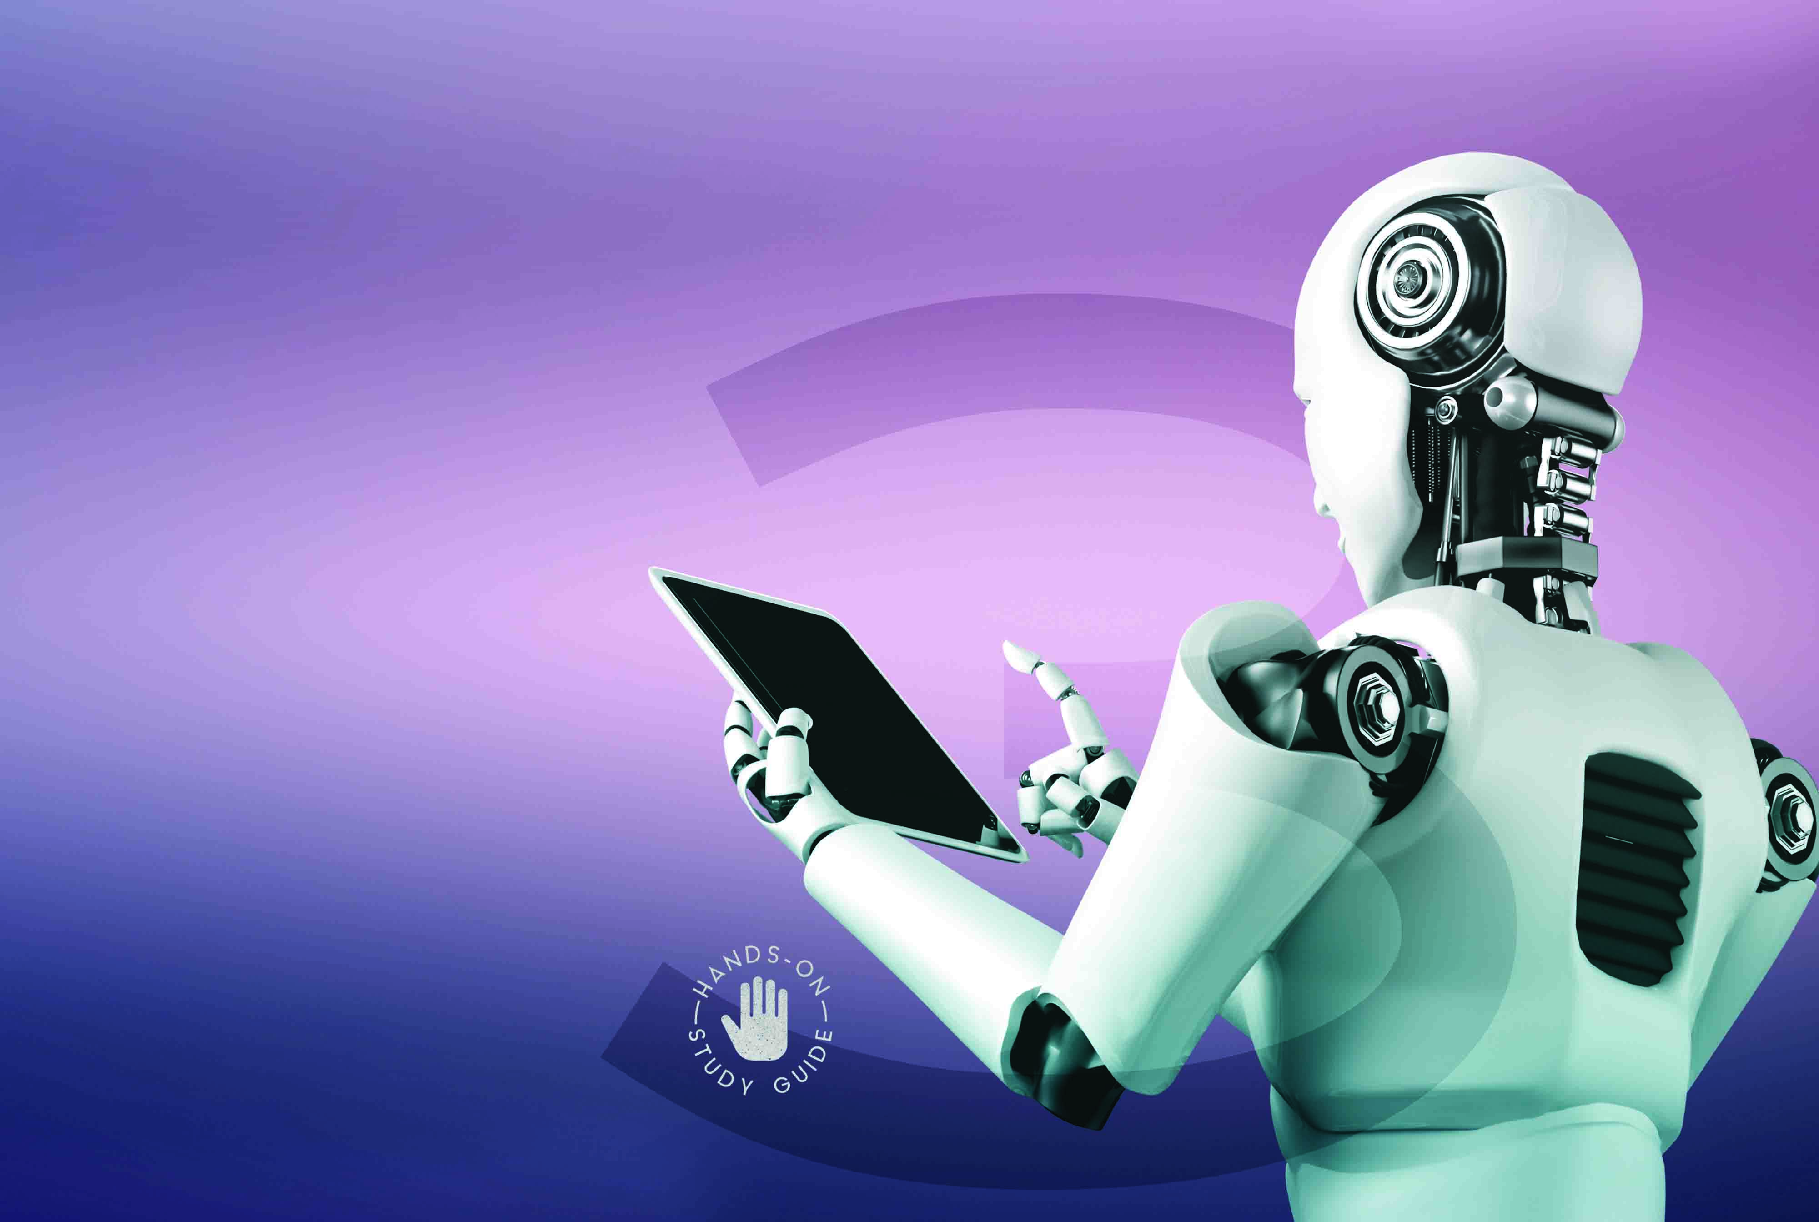

Introduction to Robotics
NCV3

Slide 2
Module 1: Robots and our lives
INTRODUCTION
Robotics is a mixed discipline that combines elements of mechanical engineering, electronics, and computer science to design and build intelligent systems.
www.futuremanagers.com

Slide 3
Module 1: Robots and our lives (continued)
ROBOTICS AS A MIXED DISCIPLINE
The fundamentals of robotics is that it’s a mixed discipline, covering topics such as mechatronics, embedded systems, signal processing, and autonomy. Robotics is referred to as an interdisciplinary field because it involves the integration of different scientific and engineering disciplines to design, develop, and operate robots.
www.futuremanagers.com

Slide 4
Module 1: Robots and our lives (continued)
MOBILE ROBOTICS
Mobile robotics is a subfield of robotics that focuses on the development of
robots that are capable of moving around in their environment. This includes
robots that move on wheels, legs, or even fly. Mobile robots can be used in a
wide range of applications, from exploring remote locations to assisting with
tasks in industrial or healthcare settings.
www.futuremanagers.com

Slide 5
Module 1: Robots and our lives (continued)
ROBOTICS AND THE INTERNET OF THINGS
The Internet of Things (IoT) has been around since 1999, but in recent years
has grown tremendously. Originally thought of as a way to help upload and
track data without needing human input, the IoT has become a key element of smart spaces and connected devices. IoT is a network of physical devices equipped with sensors that collect and exchange data over the internet.
www.futuremanagers.com

Slide 6
Module 2: 3D printing
INTRODUCTION
3D printing provides a way to turn digital designs quickly and accurately into
physical objects, in a wide range of materials and sizes. However, it is not
without its own set of difficulties and drawbacks that need to be overcome.
You need to understand the practicality of producing your own 3D printed parts and artefacts.
www.futuremanagers.com

Slide 7
Module 2: 3D printing (continued)
3D PRINTING
3D printing, also known as additive manufacturing, is a process of creating physical objects, also known as artefacts. The basic concept behind 3D printing is to build up material one layer at a time to slowly create a physical artefact from a digital model. The process of 3D printing an artefact typically begins with the creation of a digital 3D model using CAD (computer assisted design) software.
www.futuremanagers.com

Slide 8
Module 2: 3D printing (continued)
THE 3D PRINTING PROCESS AND CHALLENGES
As new methods and materials are developed it is easy to start seeing 3D printing as a one-stop-shop for making anything you can imagine, but that is not yet the case. Some challenges are that 3D printing is expensive, and the materials are weak compared to wood, glass, metals and other plastics.
www.futuremanagers.com

Slide 9
Module 2: 3D printing (continued)
PRINT A 3D OBJECT/ARTEFACT
3D printing is a deeply complex skill, with many variables that need to be accounted for to produce a satisfactory print. There are so many settings to adjust, pitfalls to avoid, and ways to optimise prints that a newcomer won’t even be aware of. It takes a long time before you will be able to “just print something” and the only way to get there is through practice. Prints will fail, printers will break down or malfunction, and it is important to view these moments as opportunities to learn and improve.
www.futuremanagers.com

Slide 10
Module 3: Electronics for robotics
INTRODUCTION
Robots are made up of electronic components, and a basic understanding of electricity is essential to understanding how electronics works.
www.futuremanagers.com

Slide 11
Module 3: Electronics for robotics (continued)
ELECTRICAL POWER
Electrical power refers to the rate at which electrical energy is transferred or consumed in an electrical circuit or device. Power takes into account both the amount of potential energy (voltage) of the electrons, as well as the number of electrons that flow through the circuit. The unit of measurement used to represent electrical power is Watts (W). Electrical power can be calculated by multiplying the voltage (V) applied to a circuit by the current (I) flowing through it.
www.futuremanagers.com

Slide 12
Module 4: Components of a robot
INTRODUCTION
In order to build an effective and efficient robot, it is important to have a
comprehensive mental catalogue of the different components one can use.
You can’t make a cake without choosing the right ingredients, and you cannot make a capable robot without knowing what tools you have at your disposal.
Selecting the correct parts is an easily overlooked part of designing a robotic
solution to a problem.
www.futuremanagers.com

Slide 13
Module 4: Components of a robot (continued)
MICROCONTROLLERS
Robots are a mix of many engineering disciplines, joined together by a central brain that is programmed to make everything work together to achieve a specific goal. The most common type of brain in robotics, by a large margin, is the microcontroller. These small devices allow programmers a huge amount of flexibility and control over a system, and selecting the right microcontroller is an important step in the design of any automated system.
www.futuremanagers.com

Slide 14
Module 4: Components of a robot (continued)
ACTUATORS AND MOTOR CONTROLLERS
An actuator is a mechanical or electromechanical device that is able to convert stored energy into movement. The energy can come in a variety of different forms.
www.futuremanagers.com

Slide 15
Module 4: Components of a robot (continued)
SENSORS
A robot that cannot sense its environment cannot react to its environment
or make intelligent choices in unpredictable situations. Sensors give devices
a way to detect and measure physical phenomena, and combined with the
processing power of a logic controller they can lead to some highly capable
and independent machines. The accuracy and range of specialised sensors
far outpace human ability, allowing reliable measurements that would be
otherwise impossible.
www.futuremanagers.com

Slide 16
Module 4: Components of a robot (continued)
DISPLAYS
It is important to know what an autonomous system is doing while it is
operating, and displays are a great way to get visual feedback. There are
many different types of information that a system can communicate, and a
range of displays to match. A display component refers to a device or module that is responsible for presenting visual information or output to a user.
www.futuremanagers.com

Slide 17
Module 4: Components of a robot (continued)
WIRELESS COMMUNICATION
Wireless communication provides the ability for devices to communicate with other devices and networks without having to worry about issues like wiring, space limitations and obstacles. The value of being able to set up a device, connect it to battery and have it connect to nearby devices cannot be overstated.
www.futuremanagers.com

Slide 18
Module 5: Programming
INTRODUCTION
Microcontrollers are embedded devices designed to execute specific tasks, and their widespread use in various applications has revolutionised the field of electronics. Understanding the basics of microcontroller programming is essential for harnessing their power and unleashing their potential. Whether you are a beginner or have prior experience in programming, you will get to know the essential concepts, from the structure of a microcontroller program to the manipulation of registers, memory, and I/O ports.
www.futuremanagers.com

Slide 19
Module 5: Programming (continued)
BASIC CONCEPTS OF MICROCONTROLLER PROGRAMMING
Microcontrollers, like all processors and controllers, are quite ineffective
if they are not instructed to perform tasks. The basic concept of using a
microcontroller is to program the IO pins to control either inputs or outputs
(or sometimes both) in the input-process-output cycle.
www.futuremanagers.com

Slide 20
Module 5: Programming (continued)
MICROCONTROLLER PROGRAMMING AND PROGRAMMING LANGUAGE INTERFACE INSTRUCTIONS
Microcontrollers combine programming with physical and electrical components, which adds even more layers on top of that. The Arduino UNO is a versatile and affordable microcontroller perfectly suited to projects and prototypes.
www.futuremanagers.com

Slide 21
Module 5: Programming (continued)
MICROCONTROLLER PROGRAMMING, PRACTICAL PROJECTS AND PHYSICAL COMPUTING
Automated systems have to exist in the real world, where faulty parts and environmental conditions add variables that cannot be predicted. The best way to learn how to program is to explore, experiment, and learn from your mistakes. The internet is an incredible resource, and there is no shortage of freely available learning materials at your disposal.
www.futuremanagers.com

Slide 22
Module 6: Practical robotics
INTRODUCTION
The best way to gain experience of building robots is not just by reading about them but rather by building, testing, debugging and programming your own robots.
www.futuremanagers.com

Slide 23
Module 6: Practical robotics (continued)
PRACTICAL ROBOTICS PROJECTS GUIDE
The internet is filled with excellent how-to guides, instruction videos and project showcases, so it is important to know the best way to translate those resources into a working prototype.
www.futuremanagers.com

Slide 24
Module 6: Practical robotics (continued)
DESIGN AND DEVELOPMENT OF AN AUTOMATED
ARTEFACT OR PROTOTYPE
Analysis of the problem, design components, presenting decomposition of components, designing applicable circuit schematics, applicable software prototyping and design tools, composing code, developing and debugging source code, moving the applicable code to the controller, device testing, finishing the design and artefact and creating a user manual are important to understand when designing and developing an artefact.
www.futuremanagers.com

