Slide 1


Office Practice
NCV2

Slide 2
Module 1: Maintaining the reception area
VISITORS AND SECURITY
Security measures are designed to ensure the safety of all personnel as well as the safety of any visitors to the company. Generally, depending on its size, a business will appoint either a security company or a security guard to be in control of this important function. In most companies, visitors are required to sign in and out of the premises in a visitor’s register.
www.futuremanagers.com

Slide 3
Module 1: Maintaining the reception area (continued)
MAINTAIN A CLEAN AND SAFE RECEPTION AREA
The reception area is a visitor’s introduction to the company. It is important that the area, whether large or small, project the desired corporate image. Good housekeeping practices are essential to maintain an agreeable and welcoming reception area.
www.futuremanagers.com

Slide 4
Module 1: Maintaining the reception area (continued)
CREATE A PRESENTABLE RECEPTION AREA
The reception area is the company presentation area. It is important that the reception area correctly reflects the identity and personality of the company. The visitor entering will immediately be aware of the identity, work ethic and the kind of customer the company is targeting.
www.futuremanagers.com

Slide 5
Module 2: Customer enquiries in an office setting
GREETING THE CUSTOMER AND IDENTIFYING THEIR NEED
Good customer service depends mostly on effective communication, especially good listening skills. Every time a customer visits or calls and you concentrate on delivering the best service to them, you will be improving the client’s perception of the company, making sure that they will be eager to do business with you again.
www.futuremanagers.com

Slide 6
Module 2: Customer enquiries in an office setting (continued)
ATTEND TO CUSTOMER TELEPHONE AND ELECTRONIC REQUESTS
Answering customer queries effectively is one of the most important functions at reception. When customer queries are answered effectively and promptly, you have a happy customer who is very likely to return to your company for more business.
www.futuremanagers.com

Slide 7
Module 2: Customer enquiries in an office setting (continued)
REFER A CUSTOMER’S REQUEST
When it comes to referring or delaying a request, be honest and explain the situation. Your company will have guidelines of what to do in difficult situations. Be sure you know these guidelines. You must also know who to ask when you need advice or if you do not know how to proceed. With unpredictable, unusual requests, don’t dismiss the enquiry out of hand. It is better to look for an opportunity within the request.
www.futuremanagers.com

Slide 8
Module 2: Customer enquiries in an office setting (continued)
RESPOND TO CUSTOMERS FACE-TO-FACE AND ON THE TELEPHONE
As always with customers, a positive, professional and friendly attitude is well received and appreciated – whether this is in person or on the phone. Acknowledge the customer – greet them in a calm, friendly manner and listen carefully and patiently to the query or complaint so that you get all the relevant details.
www.futuremanagers.com

Slide 9
Module 3: Receive, consult and direct visitors in a reception area
RECEIVING VISITORS IN A RECEPTION AREA
The most important function of the person at reception is receiving and welcoming visitors to the company. Setting high standards for the reception area will contribute to the visitor’s overall impression of dealing with a professional organisation. The reception desk can never be left unattended. Make sure another person always takes over, even if only for a few minutes. Visitors should not be kept waiting unnecessarily.
www.futuremanagers.com

Slide 10
Module 3: Receive, consult and direct visitors in a reception area (continued)
PROCESS VISITOR’S REQUIREMENTS ACCORDING TO ORGANISATIONAL REQUIREMENTS
To assist a visitor, it is important to find out what the reason for their visit is and then help them complete their business with as little trouble as possible. Your approach must be professional, and your purpose with each person must be to satisfy and help each one to the best of your abilities.
www.futuremanagers.com

Slide 11
Module 3: Receive, consult and direct visitors in a reception area (continued)
DIRECT VISITORS
Visitors come to a company for a specific reason and when they leave would like to feel that they have achieved what they set out to do. It is up to you to help them achieve their goals while at the same time making their experience as pleasant as possible. One way is to give them clear, simple directions to the office or department they must go to.
www.futuremanagers.com

Slide 12
Module 4: Employ effective telephone etiquette
USE EFFECTIVE TELEPHONE ETIQUETTE
Answer the telephone promptly on the third or fourth ring.
For an outgoing call or incoming call, greet, identify the company according to organisational guidelines and introduce yourself.
Speak slowly and clearly so that callers can verify that they have reached the right company.
Speak in a pleasant tone of voice – the caller will appreciate it.
Be sincere and helpful.
www.futuremanagers.com

Slide 13
Module 4: Employ effective telephone etiquette (continued)
USE EFFECTIVE TELEPHONE ETIQUETTE (CONT)
Listen attentively, do not interrupt.
Don’t use slang and do not eat or drink when talking on the telephone.
Only speak to someone else while busy with a customer if it concerns the call you are on.
Use the mute or hold button, rather than covering the mouthpiece with your hand if you have to speak to someone else. Make sure you are on mute during conference calls.
www.futuremanagers.com

Slide 14
Module 4: Employ effective telephone etiquette (continued)
USE EFFECTIVE TELEPHONE ETIQUETTE (CONT)
Do not touch the microphone on a headset while speaking.
Always mute yourself on a conference call. Unmute yourself only when you are speaking.
If the caller has reached a wrong number, be courteous and try to help them get the right extension.
Allow the caller to end the call first at the end of the conversation.
Replace the handheld receiver gently when you have completed the call.
www.futuremanagers.com

Slide 15
Module 4: Employ effective telephone etiquette (continued)
INCOMING CALLS
Always keep the golden rule in mind: Make sure that the first call the client makes is not their last, but the beginning of a long client relationship.
www.futuremanagers.com

Slide 16
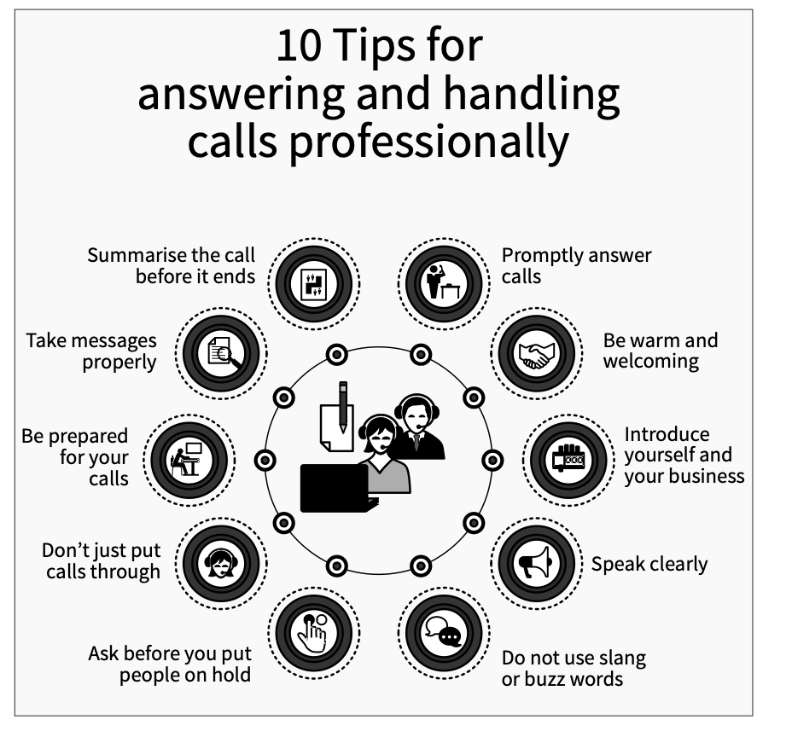
Module 4: Employ effective telephone etiquette (continued)
CORRECTLY PROCESS INCOMING CALLS
www.futuremanagers.com

Slide 17
Module 4: Employ effective telephone etiquette (continued)
CORRECTLY PROCESS OUTGOING CALLS
Making outgoing calls correctly is just as important as answering incoming calls correctly. As always, you are a representative of the company from which you are calling – be professional and efficient. Take control of your outgoing calls by preparing for the call. If you are well prepared, you will come across as a professional and you will be self-assured and assertive during the call.
www.futuremanagers.com

Slide 18
Module 5: Operate and take care of equipment
THE PC
Computers are multifunctional machines that can produce almost any printed text required for a business – letters, reports, memos, spreadsheets, newsletters, etc. Operating a PC is a basic skill required of every employee in an office today.
www.futuremanagers.com

Slide 19
Module 5: Operate and take care of equipment (continued)
THE FAX MACHINE
A fax machine transmits original documents quickly and clearly to another user over a telephone line. Text documents, handwritten pages, graphics, etc. can be transmitted in their original form. No special preparations, like typing or coding, are required. The document received at the fax terminal looks like a photocopy of the original document.
www.futuremanagers.com

Slide 20
Module 5: Operate and take care of equipment (continued)
THE PHOTOCOPIER
Photocopying is the most efficient way to produce high quality copies quickly. The machines are easy to operate, although the more complex ones may require training. Many offices now install all-in- one copiers, printers and collators, which also have scanning and faxing capabilities.
www.futuremanagers.com

Slide 21
Module 5: Operate and take care of equipment (continued)
MAINTAINING EQUIPMENT IN A CLEAN AND WORKING ENVIRONMENT
A clean work area helps maintain the professional image of the company and contributes to the general health and well-being of those who work there. Always disconnect your computer, screen or any other electronic device you want to clean, from its power source before you start cleaning it.
www.futuremanagers.com

Slide 22
Module 5: Operate and take care of equipment (continued)
MONITOR AND REQUEST EQUIPMENT CONSUMABLES
To operate efficiently, all organisations and businesses need stocks of consumables for daily administrative tasks. Items like pens, pencils, paper products, paperclips, staples, post-it notes, printer consumables, etc. must be kept in stock for daily use. In smaller businesses, the secretary or receptionist will be responsible for ordering supplies. In larger organisations it would be the purchasing department.
www.futuremanagers.com

Slide 23
Module 5: Operate and take care of equipment (continued)
IDENTIFY AND MINIMISE SAFETY RISKS WHEN OPERATING EQUIPMENT IN AN OFFICE ENVIRONMENT
Make sure you know how to operate equipment by reading the user manual or asking an experienced co- worker to show you how to operate the machine. User manuals also have details of possible hazards regarding the machine and give details of how to avoid and minimise dangerous situations.
www.futuremanagers.com

Slide 24
Module 6: Receive, distribute and dispatch mail
RECEIVE AND SORT MAIL
Mail arrives at the company from correspondents outside the organisation and is delivered by a postal agency. Once the postal items have been delivered to the addressee, the postal agency is no longer responsible. After delivery, it becomes the responsibility of the mailroom function of that specific organisation. Each company determines for itself how the mailroom function will be dealt with.
www.futuremanagers.com

Slide 25
Module 6: Receive, distribute and dispatch mail (continued)
DISTRIBUTE AND DISPATCH MAIL
Internal: Once mail has been sorted, date-and-time stamped and the required items logged in the mail register, the mail must be delivered to the different departments and addressees as soon as possible.
External: Outgoing mail includes all the post that goes out of the organisation. The mailroom is the central mail distribution centre, therefore, the various departments send post to the mailroom at regular intervals for dispatch.
www.futuremanagers.com

Slide 26
Module 6: Receive, distribute and dispatch mail (continued)
THE IMPORTANCE OF MAINTAINING MAILROOM PROCEDURES
Documents of all kinds are continuously moving through the mailroom. These documents are all important to maintain and improve the efficient, effective running of the organisation. Therefore, it is very important that organisational procedures and set timeframes be strictly adhered to. Following prescribed procedures ensures that mail will be delivered within agreed timeframes, with no unnecessary costs involving insurance claims, lost goods, or legal action against the organisation.
www.futuremanagers.com

Slide 27
Module 7: Create evidence and maintain confidentiality
CREATE EVIDENCE AND MAINTAIN CONFIDENTIALITY
Keeping accurate records of company information is one of an organisation’s most important assets. Record keeping is one of the integral parts of any business and provides historic proof of how the business is run. Evidence of all transactions – sales, purchases, advertising, correspondence – must be recorded and saved.
www.futuremanagers.com

Slide 28
Module 7: Create evidence and maintain confidentiality (continued)
THE TYPES OF CONTRACTS SEEN IN A BUSINESS
There are many different types of contracts:
Contracts between a company and a client.
Contracts between two companies.
Contracts between a company and a supplier.
www.futuremanagers.com

Slide 29
Module 7: Create evidence and maintain confidentiality (continued)
LOCATE AND PROVIDE RECORDS TO USERS ON REQUEST
A combination of paper-based and electronic systems are used in most offices. Once the records have been created, they have to be stored in a system that will allow them to be easily found and retrieved. The filing system that is used must be systematic, but simple enough for anyone to understand.
www.futuremanagers.com

Slide 30
Module 7: Create evidence and maintain confidentiality (continued)
MAINTAIN CONFIDENTIALITY OF CUSTOMER AND COMPANY INFORMATION
The company has a legal obligation to protect information concerning its personnel, its clients and the company. To do this effectively, the company must have a comprehensive security policy statement, which everyone working for the company must know and understand. This document must be readily available in the office.
www.futuremanagers.com

Slide 31
Module 8: File a variety of documents in existing systems
FILE A VARIETY OF DOCUMENTS IN EXISTING SYSTEMS
Most businesses keep track of all office documents and records with a combination of electronic and paper-based filing systems. Maintaining the integrity of the system must be a priority and must therefore be well managed, organised and easily accessible if it is to be useful. The only way to achieve this is to develop a proper filing and indexing system, that effectively integrates a paper and digital filing system, so that all records are easily accessible.
www.futuremanagers.com

Slide 32
Module 8: File a variety of documents in existing systems (continued)
RETRIEVE INFORMATION FROM AN EXISTING STORAGE SYSTEM
Authorised personnel will have access to the required electronic files. This means that most of the time-consuming file finding, and dispatching is no longer required. This saves time and improves productivity in the workplace. When members of staff require information that they are not authorised to access or do not have permission to work on, a quick email, phone call or message to a supervisor could grant permission for access or, a read-only copy can be sent as requested.
www.futuremanagers.com

Slide 33
Module 8: File a variety of documents in existing systems (continued)
STORE VALUABLE DOCUMENTATION AND REFERENCE MATERIALS SECURELY
The security policy of an organisation must protect the (1) confidentiality, (2) integrity and (3) accessibility of its information. According to the International Standard on Information Security Management, these 3 areas are the standard of security companies must strive for. The standards are achieved by introducing and enforcing effective security policies and procedures.
www.futuremanagers.com

