Slide 1

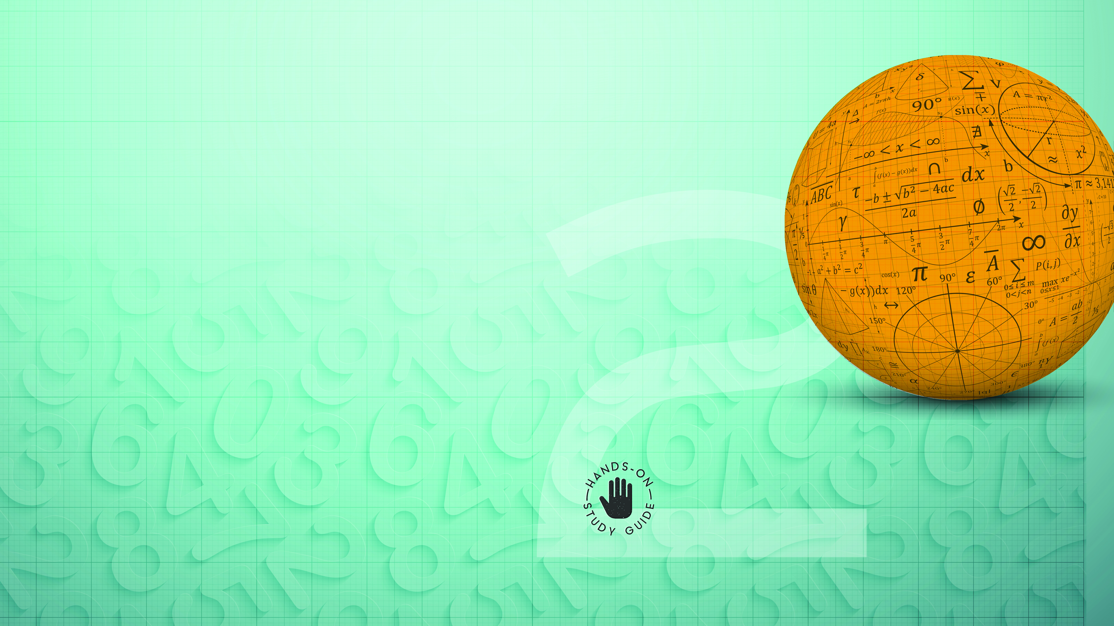
Mathematics
NCV2

Slide 2
Chapter 1: Numbers
SCIENTIFIC TOOLS
If a calculation has more than one operation we use BODMAS/BIDMAS to perform the calculation in a fixed order. The scientific calculator is programmed to follow this order automatically. Scientists and engineers use a vast range of instruments to perform their measurements. These instruments may range from simple objects such as rulers to more advanced instruments such as electronic microscopes.
www.futuremanagers.com

Slide 3
Chapter 1: Numbers (continued)
ESTIMATES AND APPROXIMATIONS
An approximation (≈) is a stated value of a number that is close to (but not equal to) the true value of that number.
An estimation is an approximation of a quantity which has been decided by judgement rather than carrying out the process needed to produce a more accurate answer.
www.futuremanagers.com

Slide 4
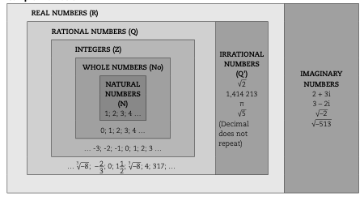
Chapter 1: Numbers (continued)
NUMBERS AND RELATIONSHIPS AMONG NUMBERS
www.futuremanagers.com

Slide 5
Chapter 1: Numbers (continued)
DECIMALS
Decimals are used for example to measure distance, length and amounts of money. A fraction can be converted to a decimal by dividing the numerator by the denominator. The answer will either be a terminating decimal or a recurring decimal.
www.futuremanagers.com

Slide 6
Chapter 1: Numbers (continued)
TERMINATING DECIMALS
A terminating decimal can be described in everyday language as a decimal fraction that does not go on forever. It has a fixed number of decimal places.
www.futuremanagers.com

Slide 7
Chapter 1: Numbers (continued)
RECURRING DECIMALS
Recurring decimals go on forever and are much too long to work with. You have to round them off. Recurring decimals can not be written as fractions with a denominator that has a base of 10.
www.futuremanagers.com

Slide 8
Chapter 1: Numbers (continued)
EXPONENTS
An exponent (index) is a mathematical way of representing a very large number or a very small number in a format that is user friendly.
www.futuremanagers.com

Slide 9
Chapter 1: Numbers (continued)
ARITHMETIC SEQUENCES AND SERIES
An arithmetic sequence or arithmetic progression is a sequence where each new term after the first is calculated by adding a constant amount to the previous term. It’s also known as a pattern or a progression sequence.
www.futuremanagers.com

Slide 10
Chapter 2: Functions and algebra
INFORMATION FROM GRAPHS
Information can be represented in the form of graphs. We often use graphs to assist in finding the algebraic relationship or formula between two variables. A relationship in Mathematics refers to two things that are related to each other.
www.futuremanagers.com

Slide 11
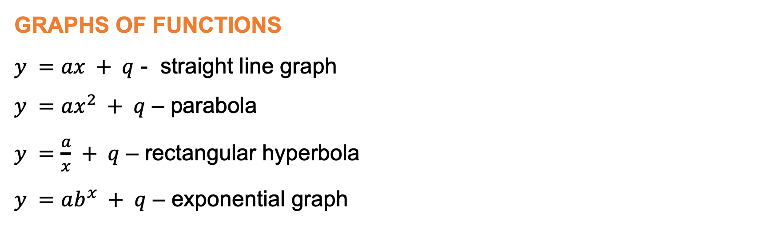
Chapter 2: Functions and algebra (continued)
GRAPHS OF FUNCTIONS
$y =ax + q$ - straight line graph
$y =ax^{2} + q$ – parabola
$y =\frac{a}{x} + q$ – rectangular hyperbola
$y =ab^{x} + q$ – exponential graph
www.futuremanagers.com

Slide 12
Chapter 2: Functions and algebra (continued)
CHARACTERISTICS OF FUNCTIONS
Domain represents the (x-values)
Range represents the (y-values)
When x-intercepts: y = 0
When y-intercepts: x=0
A turning point on any graph is the point where the gradient changes from increasing to decreasing or vice versa.
www.futuremanagers.com

Slide 13
Chapter 2: Functions and algebra (continued)
CHARACTERISTICS OF FUNCTIONS (CONT)
An asymptote to a curve is a straight line to which the curve continuously draws nearer without ever touching it.
The amplitude is the distance from the midpoint to the highest or lowest point on the function or it is the maximum distance above or below the
x-axis (maximum y-value).
The period is the distance between any two repeating points on the function or it is the smallest interval after which a graph repeats itself.
www.futuremanagers.com

Slide 14
Chapter 2: Functions and algebra (continued)
CHARACTERISTICS OF FUNCTIONS (CONT)
A function is a relationship between two variables x and y which means that for each x-value (independent variable) there is only ONE y-value (dependent variable).
www.futuremanagers.com

Slide 15
Chapter 2: Functions and algebra (continued)
LINES AND EXPRESSIONS
Parallel lines have the same gradients (m)
The product of the gradients of perpendicular lines is equal to -1
A monomial: Expression that has only ONE term
A binomial: Expression that has only TWO terms
A trinomial: Expression that has only THREE terms
www.futuremanagers.com

Slide 16
Chapter 3: Space, shape and measurement
PHYSICAL QUANTITIES
The length of a line, the perimeter, the area of a particular shape and the volume of an object can be represented by various symbols.
Quantity | Symbol | Dimension
Length | l; b; r; h; H; P; C | One dimensional
Area | A | Two dimensional
Volume | V | Three dimensional
www.futuremanagers.com

Slide 17
Chapter 3: Space, shape and measurement (continued)
PERIMETER, SURFACE AREA AND VOLUME
The perimeter is defined as the distance around the edge of a shape, whereas the surface area is defined as the space occupied by a two dimensional shape. The volume is defined as the amount of solid occupied by a three-dimensional geometrical object. A net is defined as a two-dimensional representation of a three-dimensional object.
www.futuremanagers.com

Slide 18
Chapter 3: Space, shape and measurement (continued)
THE CARTESIAN COORDINATE SYSTEM
The Cartesian coordinate system consists of a horizontal axis (x-axis) and a vertical axis (y-axis). A point on the Cartesian coordinate system is represented as (x; y), referred to as an ordered number pair. The x-coordinate is called the abscissa, the perpendicular distance from the y-axis. Similarly, the y-coordinate is called the ordinate, the perpendicular distance from the x-axis.
www.futuremanagers.com

Slide 19
Chapter 3: Space, shape and measurement (continued)
PLOTTING POINTS ON THE CARTESIAN COORDINATE SYSTEM
A point in the Cartesian coordinate system is represented by an ordered number pair, (x; y). The ordered number pair (x; 0) represents a point on the x-axis and (0;y) represents a point on the y-axis.
www.futuremanagers.com

Slide 20
Chapter 3: Space, shape and measurement (continued)
POLYGONS
A polygon is defined as a geometrical figure with three or more sides. Polygons can be represented on a Cartesian coordinate system by plotting various ordered numbered pairs which form the vertices (points on a geometrical figure) of the polygon and joining the lines between these ordered number pairs to represent the sides of the polygon.
www.futuremanagers.com

Slide 21
Chapter 3: Space, shape and measurement (continued)
TRANSFORMATIONS
The translation of a point (x; y) on a Cartesian system can be defined as the movement of the x-coordinate by p units horizontally, that is left or right and the y-coordinate by q units vertically, that is up or down on the Cartesian system.
www.futuremanagers.com

Slide 22
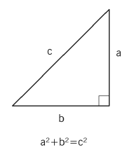
Chapter 3: Space, shape and measurement (continued)
PYTHAGORAS THEOREM
Pythagoras Theorem can be used in right-angle triangles to calculate an unknown side.
www.futuremanagers.com

Slide 23
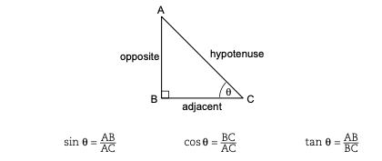
Chapter 3: Space, shape and measurement (continued)
TRIGONEMETRIC MODELS
www.futuremanagers.com

Slide 24
Chapter 4: Data handling
STATISTICS AND DATA
Statistics involves the collection, display and analysis of information. Statistics comprises of all the techniques which enables us to make sense out of data. Data is a complete set of individual pieces of information which is being used in any of the processes connected with statistics. It is the information collected from observations, interviews, internet, archives, books or experiments.
www.futuremanagers.com

Slide 25
Chapter 4: Data handling (continued)
CENTRAL TENDENCY
Measures of central tendency include
The mean (the average),
The mode (most frequent occurring), and
The median (the middle-most value).
www.futuremanagers.com

Slide 26
Chapter 4: Data handling (continued)
MEASURES OF DISPERSION
Measures of dispersion include:
Range = largest value – smallest value
Lower quartile: 25th percentile.
Upper quartile: 75th percentile.
Inter-quartile; and
Semi-IQR.
www.futuremanagers.com

Slide 27
Chapter 4: Data handling (continued)
REPRESENT DATA EFFECTIVELY AND APPROPRIATELY
Data can be represented in several ways, such as:
A frequency table to represent the number of times a specific incident occurred.
A bar graph used to display data in categories;
Compound bar graphs;
Stem and leaf plot;
Histograms;
Frequency polygons;
Pie charts; and
Broken line graphs,
www.futuremanagers.com

Slide 28
Chapter 5: Financial mathematics
PERSONAL AND HOUSEHOLD FINANCES
Money that is received is referred to as income and money that is paid out is expenditure. When income is greater than expenditure, the difference is referred to as a surplus. When expenditure is greater than income, the difference is referred to as a deficit. Families in which there is a surplus are said to have disposable income.
www.futuremanagers.com

Slide 29
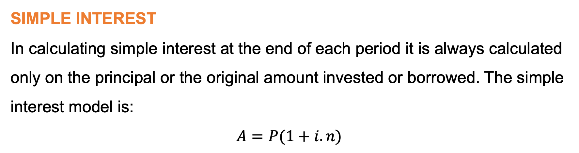
Chapter 5: Financial mathematics (continued)
SIMPLE INTEREST
In calculating simple interest at the end of each period it is always calculated only on the principal or the original amount invested or borrowed. The simple interest model is:
$$A=P(1+i.n)$$
www.futuremanagers.com

Slide 30
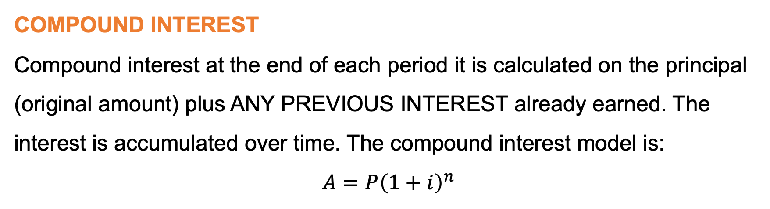
Chapter 5: Financial mathematics (continued)
COMPOUND INTEREST
Compound interest at the end of each period it is calculated on the principal (original amount) plus ANY PREVIOUS INTEREST already earned. The interest is accumulated over time. The compound interest model is:
$$A=P{\left(1+i\right)}^{n}$$
www.futuremanagers.com

