Slide 1

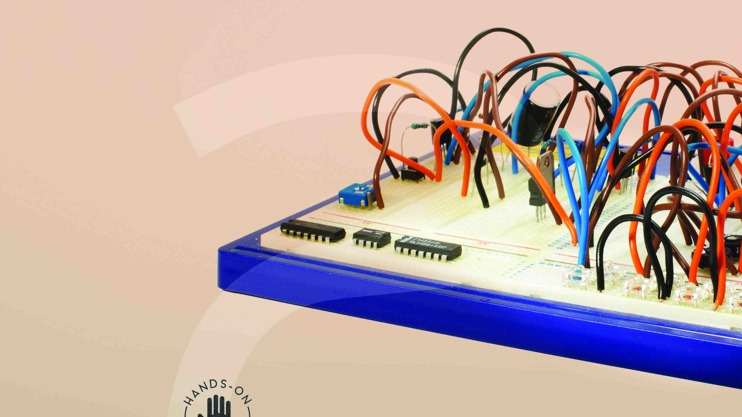
NCV2 Fundamentals of Electronic and
Digital Concepts for Robotics

Slide 2
Module 1: SI units and introduction to atomic theory
INTRODUCTION
Accurate measurement is a fundamental component of good science, engineering and technology as well as many other areas of work. Regardless the field in which one specialises, there is a need to speak a common language when it comes to measurements. An international unit of standards, the International System of Units, has been adopted across all fields of engineering.
www.futuremanagers.com

Slide 3
Module 1: SI units and introduction to atomic theory (continued)
BASIC SI UNITS OF MEASUREMENT
The International System of Units (known by the international abbreviation SI units and sometimes called the SI system) is the modern form of the metric system.
www.futuremanagers.com

Slide 4
Module 1: SI units and introduction to atomic theory (continued)
BASIC SI UNITS OF MEASUREMENT UNITS
The base quantities and base units used in SI units are:
Length – metre;
Time – second;
Mass – kilogram;
Temperature – kelvin;
Electrical current – ampere;
Luminous intensity – candela;
Amount of substance – mole.
www.futuremanagers.com

Slide 5
Module 1: SI units and introduction to atomic theory (continued)
BASIC ATOMIC THEORY
An atom is the smallest particle into which a substance can be divided without changing its properties. An atom cannot be broken apart using any chemical means.
Everything in the world around us (called matter) is composed of atoms, each with a nucleus and one or more electrons that orbit around it, like satellites around the earth.
www.futuremanagers.com

Slide 6
Module 2: Electrical supply systems, Ohm’s law, Joule’s law and related theoretical aspects
INTRODUCTION
The electrical field is very vast and includes many electrical concepts, definitions and laws. Without a good understanding of the basic concepts, definitions and laws, you will find it difficult to master any electrical subject.
www.futuremanagers.com

Slide 7
Module 2: Electrical supply systems, Ohm’s law, Joule’s law and related theoretical aspects (continued)
OHM’S LAW
This relationship between voltage, current and resistance can be expressed as Ohm’s law. It can be defined as follows: The current flowing through a circuit is directly proportional to the voltage and inversely proportional to the resistance, provided the temperature remains constant.
www.futuremanagers.com

Slide 8
Module 2: Electrical supply systems, Ohm’s law, Joule’s law and related theoretical aspects (continued)
JOULE’S LAW
Joule’s law can be defined as the amount of heat (H) generated in a conductor with a given resistance (R) when a current (I) flows through it for a specific time (t) is directly proportional to the square of the current, the resistance of the conductor and the time for which the current flows.
www.futuremanagers.com

Slide 9
Module 2: Electrical supply systems, Ohm’s law, Joule’s law and related theoretical aspects (continued)
COMPARING DIFFERENT ELECTRICAL SUPPLY SYSTEMS
Direct current: DC can be described as an electric charge or current that flows in one direction. The voltage and the current are always constant (fixed).
Alternative current: The electric charge in an AC source, on the other hand, changes direction periodically. We can therefore say the voltage in an AC circuit also periodically reverses polarity, because the current changes direction.
www.futuremanagers.com

Slide 10
Module 2: Electrical supply systems, Ohm’s law, Joule’s law and related theoretical aspects (continued)
ELECTRICAL CELLS
An electrical cell is a device that converts chemical energy directly into electrical energy. In this cell, an electrolyte reacts chemically with two electrodes, making one positive and the other negative. Several cells grouped together will form a battery. Only similar cells can be connected to form a battery.
www.futuremanagers.com

Slide 11
Module 3: Basic electronic components and semiconductors
INTRODUCTION
The field of electronics is growing more powerful and becoming more versatile day by day. However, to understand and work in this field, one must be able to identify, rate and explain the function of the basic components. Together, these components perform from the simplest to the most complex functions.
www.futuremanagers.com

Slide 12
Module 3: Basic electronic components and semiconductors (continued)
BASIC ELECTRONIC COMPONENTS
The following are basic components in electronics:
Resistors;
Potentiometers;
Capacitors (polarised and non-polarised);
Inductors;
Transistors;
Relays; and
Transformers.
www.futuremanagers.com

Slide 13
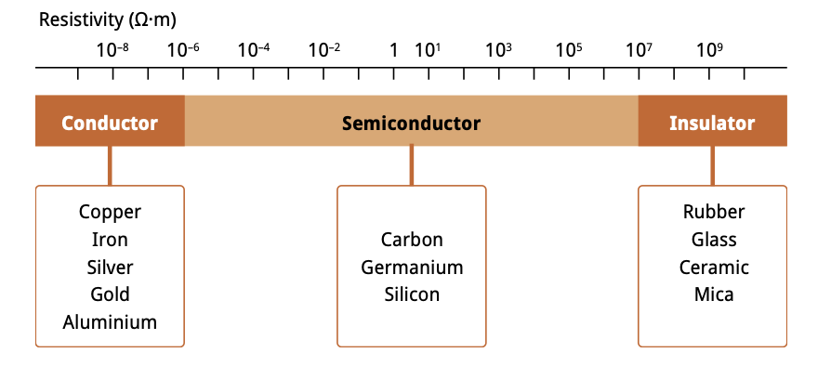
Module 3: Basic electronic components and semiconductors (continued)
SEMICONDUCTORS
Semiconductors have specific electrical properties. Materials that conduct electricity are called conductors and materials that do not conduct electricity are called insulators.
www.futuremanagers.com

Slide 14
Module 3: Basic electronic components and semiconductors (continued)
FORMATION OF P- AND N-TYPE JUNCTIONS (PN-JUNCTIONS)
A PN-junction is formed by joining two equally doped P-type and N-type semiconductors. When they are joined, the holes of the P-type and electrons of the N-type semiconductors combine to form covalent bonds. This joined P- and N-material is called a diode.
www.futuremanagers.com

Slide 15
Module 3: Basic electronic components and semiconductors (continued)
DIFFERENT TYPES OF DIODES
A Zener diode is a special kind of diode that will allow the forward and reverse flow of current.
A light-emitting diode (LED) is manufactured to emit light if current flows through it when forward biased.
www.futuremanagers.com

Slide 16
Module 3: Basic electronic components and semiconductors (continued)
THE USE AND IMPLEMENTATIONS OF TRANSISTORS
A transistor is a solid-state electronic device used to amplify or control the flow of electricity in electronic equipment. This small, three-terminal semiconductor device has revolutionised the electronic industry. The design of a transistor allows it to function as an amplifier or a switch.
www.futuremanagers.com

Slide 17
Module 3: Basic electronic components and semiconductors (continued)
INTEGRATED CIRCUITS
An integrated circuit is an assembly of electronic components, manufactured as a single unit, in which minute devices (transistors, diodes, capacitors and resistors) and their interconnections are built up on a thin piece of silicon or germanium.
www.futuremanagers.com

Slide 18
Module 3: Basic electronic components and semiconductors (continued)
TRANSDUCERS AND SENSORS
A transducer is an electronic device that converts energy from one form to another.
A sensor is a device that detects a physical parameter of interest (e.g. heat, light, sound).
www.futuremanagers.com

Slide 19
Module 4: Electrical components, symbols, and circuit drawings, prototyping and design
CONSTRUCTING SIMPLE CIRCUITS ON BREADBOARDS
The breadboard helps you to test a circuit before it is assembled. Points to remember when using a breadboard:
Only use single-stranded wire or male-to-male jumper wires as connecting wires for the circuits.
Use the top two or the bottom two rows to connect the power (+ and –).
ICs must always be connected across the centre open piece – one row of IC pins on one side and the other row on the other side.
www.futuremanagers.com

Slide 20
Module 4: Electrical components, symbols, and circuit drawings, prototyping and design (continued)
CONSTRUCTING SIMPLE CIRCUITS ON VEROBOARD
A Veroboard is a special type of insulated board. It has parallel strips of copper track on the underside and a clear, resin-bonded plastic or fibreglass board at the top. The preformed holes can be seen in the figures on the next page. A Veroboard is used to make up permanent, soldered circuits. It is perfect for small circuits. However, due to the large number of holes, it is very easy to connect a component in the wrong place. All components are placed on top of the board.
www.futuremanagers.com

Slide 21
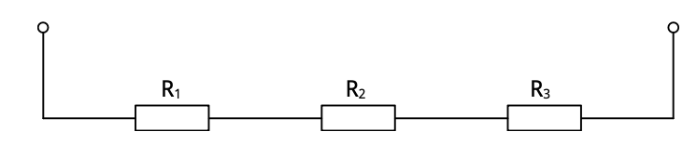
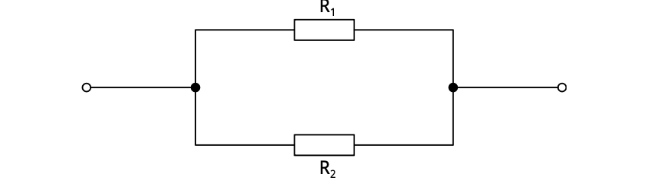
Module 4: Electrical components, symbols, and circuit drawings, prototyping and design (continued)
THE COMPOSITION AND DESIGN OF ELECTRICAL CIRCUITS
Resistors in series are connected head to tail, i.e. the output of one resistor is fed to the input of the next resistor:
Resistors are connected in parallel when one end of all the resistors are connected by a continuous wire and the other end of all the same resistors are also connected to one another through a continuous wire:
www.futuremanagers.com

Slide 22
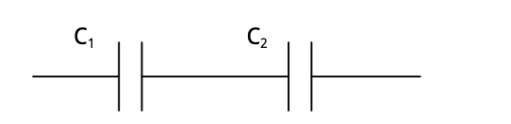
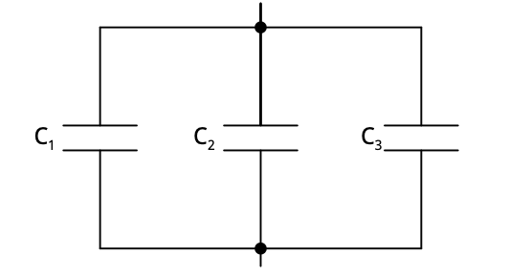
Module 4: Electrical components, symbols, and circuit drawings, prototyping and design (continued)
THE COMPOSITION AND DESIGN OF ELECTRICAL CIRCUITS (CONT)
When capacitors are connected in series, they are connected head to tail:
Capacitors are connected in parallel when one end of all the capacitors is connected together and the other end of all the capacitors is connected together to another point:
www.futuremanagers.com

Slide 23
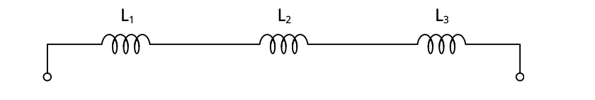
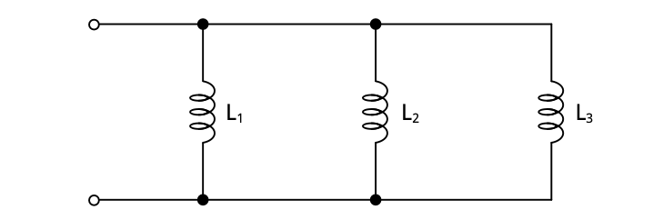
Module 4: Electrical components, symbols, and circuit drawings, prototyping and design (continued)
THE COMPOSITION AND DESIGN OF ELECTRICAL CIRCUITS (CONT)
Inductors in series are connected in exactly the same way as resistors in series:
When connecting inductors in parallel, one end of all the inductors is connected to one point and the other end of all the inductors is connected to another point:
www.futuremanagers.com

Slide 24
Module 5: Electrical tools and equipment
INTRODUCTION
When you work in an electrical or electronic field, you will use instruments to test, calculate or measure the value of electrical quantities such as current, voltage, resistance and power. You must be familiar with measurements and measuring instruments. Measurement refers to the unit value that is used to measure specific quantities. Measuring instruments can be used to measure or compare components as well as to check whether they are functioning properly.
www.futuremanagers.com

Slide 25
Module 5: Electrical tools and equipment (continued)
THE LAYOUT OF A BREADBOARD
The electronic breadboard allows you to build circuits of any size without having to solder a single component into place. It also allows you to experiment with the circuit and easily replace a component with one of different value.
www.futuremanagers.com

Slide 26
Module 5: Electrical tools and equipment (continued)
TESTING ELECTRONIC COMPONENTS
Modern multimeters can be used to test most components. Keep the following in mind when using a multimeter to test components:
The supply to the circuit must be switched off. (This is to protect the user from electric shocks and to prevent damage to the meter.)
Use the correct settings on the meter.
Know what readings to expect and interpret as acceptable.
www.futuremanagers.com

Slide 27
Module 6: Digital systems and principles
INTRODUCTION
Understanding basic digital and logic concepts is important, because they are the building blocks used in all digital equipment such as computers, banking and communication systems, cars and many other everyday applications. Knowing digital systems allows us to better understand the working principles of such systems and it will also help us in repairing digital devices.
www.futuremanagers.com

Slide 28
Module 6: Digital systems and principles (continued)
BASIC DIGITAL CONCEPTS: DIGITAL WAVES
Digital signals are represented as square waves. Because the values in a digital signal must be either 0 or 1, the signal can easily be corrected to eliminate noise. They can also be received clearly even after travelling very long distances.
Analogue signals are made up of a continuous range of values, where each point can have a slightly different value as time varies.
www.futuremanagers.com

Slide 29
Module 6: Digital systems and principles (continued)
LOGIC DESIGN: BOOLEAN LOGIC
Boolean logic can be defined as a form of algebra where all values are either true or false. These values of true and false are used to test the conditions on which selection and repetition are based.
www.futuremanagers.com

Slide 30
Module 6: Digital systems and principles (continued)
USING LOGIC GATES
Logic gates are the building blocks of all information technology systems in use today. They perform basic logic (processing) functions. Logic gates are constructed using discrete components (elementary electronic devices that are constructed as single units) within an IC. Most logic gates have two inputs and one output. Only the NOT gate has one input and one output; all the other gates will have two or more inputs, but only one output.
www.futuremanagers.com

Slide 31
Module 7: Workshop ethics, safe use of equipment and operational health and safety
INTRODUCTION
Safety is the most important consideration in a workshop and in industry. If the workplace is unsafe, the consequences can be serious, even deadly. The Occupational Health and Safety Act 85 of 1993 (generally referred to as the OHS Act) is the law that aims to protect the well-being of workers.
www.futuremanagers.com

Slide 32
Module 7: Workshop ethics, safe use of equipment and operational health and safety (continued)
UNDERSTANDING OCCUPATIONAL HEALTH AND SAFETY CONCEPTS
The aims of safety regulations are to:
protect workers from injuries and illness;
protect visitors to the workplace from hazards arising from the activities of workers; and
prevent accidents by ensuring that people apply general rules regarding health and safety.
www.futuremanagers.com

