Slide 1


N5 Power Machines

Slide 2
Module 1: Thermodynamics
INTRODUCTION
“Thermodynamics” is the study of forces due to heat or heat due to forces. Thermodynamics is a branch of physics that studies the relationship between heat, work, and energy.
www.futuremanagers.com

Slide 3
Module 1: Thermodynamics (continued)
THERMODYNAMICS OF GASES: JOULE’S LAW
The first law of thermodynamics is a basic principle of physics that describes
the relationship between energy and heat. It states that energy cannot be created or destroyed, it can only be transferred or converted from one form to another.
www.futuremanagers.com

Slide 4
Module 1: Thermodynamics (continued)
THERMODYNAMICS OF GASES: CLAUSIUS’S LAW
The second law of thermodynamics is a basic principle of physics that describes the behaviour of heat and the direction in which heat will flow. It states that heat will always flow from a hotter object to a colder one, and that this process is irreversible.
www.futuremanagers.com

Slide 5
Module 1: Thermodynamics (continued)
ABSOLUTE TEMPERATURE
Absolute temperature is measured in Kelvin and not degrees Celsius. If the
temperature of a gas is given in degrees Celsius, use the following conversion: K = °C + 273
www.futuremanagers.com

Slide 6
Module 1: Thermodynamics (continued)
SPECIFIC HEAT CAPACITY AND GAS CONSTANTS
Specific heat capacity is the amount of heat required to raise or lower the
temperature of a unit mass by one degree. Solids and liquids have only one
specific heat capacity, but gases have two specific heat capacities.
www.futuremanagers.com

Slide 7
Module 1: Thermodynamics (continued)
HEATING AND THE EXPANSION AND COMPRESSION OF GASES
The enlarging of the volume of a system is called expansion, while the reduction in the volume of a system is called compression. The gas expands when the pressure on the gas is removed and compresses when the pressure is imposed on the gas.
www.futuremanagers.com

Slide 8
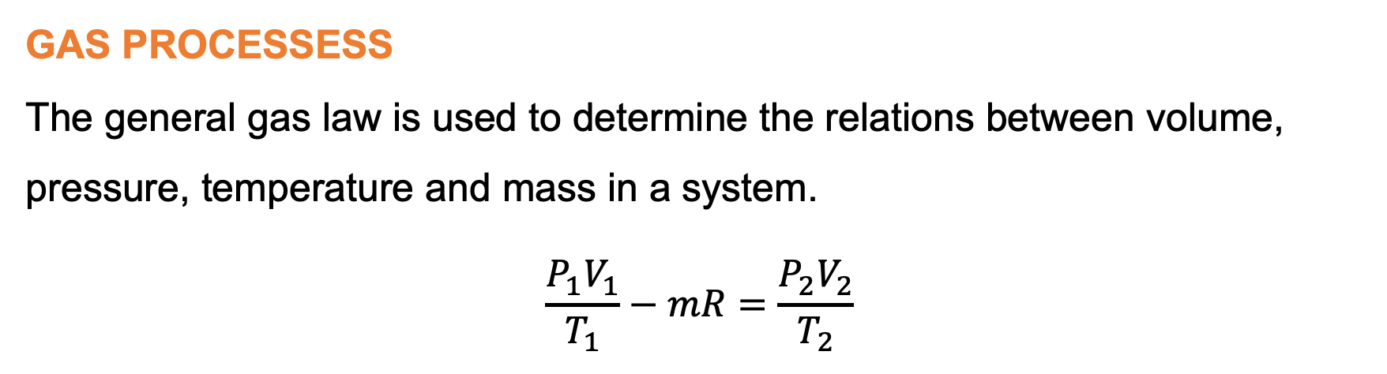
Module 1: Thermodynamics (continued)
GAS PROCESSESS
The general gas law is used to determine the relations between volume, pressure, temperature and mass in a system.
$$\frac{P_{1}V_{1}}{T_{1}}−mR=\frac{P_{2}V_{2}}{T_{2}}$$
www.futuremanagers.com

Slide 9
Module 2: Air compressors
INTRODUCTION
Air compressors are mechanical devices that convert mechanical energy into
compressed air, which is stored in reservoirs for various applications. They work by drawing in atmospheric air and then compressing it to a higher pressure, increasing its density and potential energy. A variety of compressors are used in the industry to provide functions such as powering air tools, paint sprayers and pumping refrigeration and air conditioning refrigerants.
www.futuremanagers.com

Slide 10
Module 2: Air compressors (continued)
AIR COMPRESSORS
The most common air compressors are:
Reciprocating air compressors (low mass rate, high pressure);
Rotary screw compressors (high mass rate, low pressure);
Axial compressors (high mass rate, low pressure); and
Centrifugal compressors (high mass rate, low pressure).
www.futuremanagers.com

Slide 11

Module 2: Air compressors (continued)
CALCULATIONS ON WORK DONE AND POWER: CYLINDER VOLUME
The volume of a cylinder without clearance and the stroke volume are the same at inlet conditions and it depends on its diameter and stroke length if the clearance volume is neglected.
$$V_{1}=V_{s}=lA$$
$$V_{1}=\frac{mRT_{1}}{P_{1}}$$
www.futuremanagers.com

Slide 12
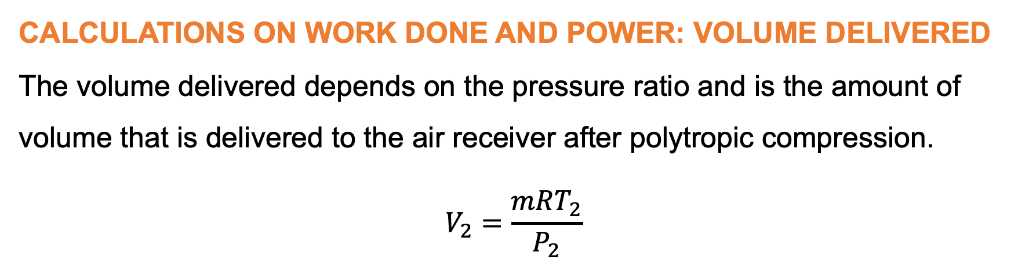
Module 2: Air compressors (continued)
CALCULATIONS ON WORK DONE AND POWER: VOLUME DELIVERED
The volume delivered depends on the pressure ratio and is the amount of
volume that is delivered to the air receiver after polytropic compression.
$$V_{2}=\frac{mRT_{2}}{P_{2}}$$
www.futuremanagers.com

Slide 13
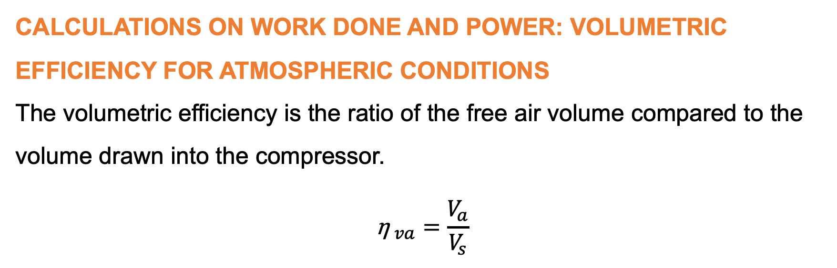
Module 2: Air compressors (continued)
CALCULATIONS ON WORK DONE AND POWER: VOLUMETRIC EFFICIENCY FOR ATMOSPHERIC CONDITIONS
The volumetric efficiency is the ratio of the free air volume compared to the
volume drawn into the compressor.
$${\text{η} }_{va}=\frac{V_{a}}{V_{s}}$$
www.futuremanagers.com

Slide 14
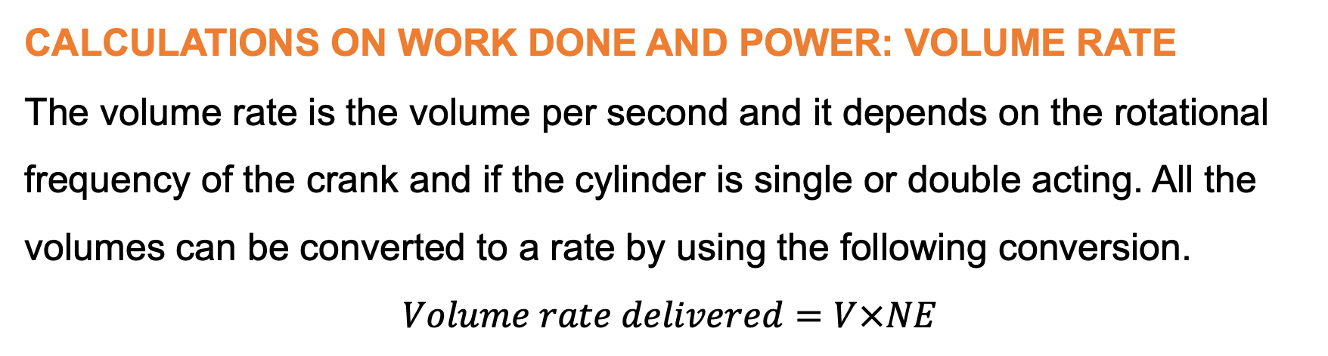
Module 2: Air compressors (continued)
CALCULATIONS ON WORK DONE AND POWER: VOLUME RATE
The volume rate is the volume per second and it depends on the rotational
frequency of the crank and if the cylinder is single or double acting. All the
volumes can be converted to a rate by using the following conversion.
$$Volume rate delivered=V×NE$$
www.futuremanagers.com

Slide 15
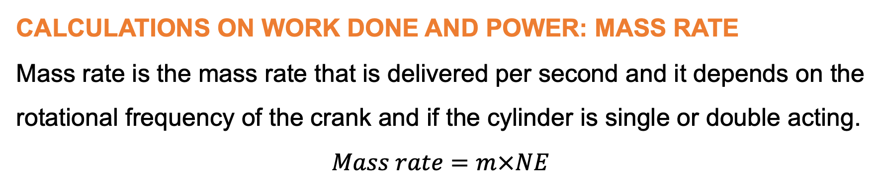
Module 2: Air compressors (continued)
CALCULATIONS ON WORK DONE AND POWER: MASS RATE
Mass rate is the mass rate that is delivered per second and it depends on the
rotational frequency of the crank and if the cylinder is single or double acting.
$$Mass rate=m×NE$$
www.futuremanagers.com

Slide 16
Module 2: Air compressors (continued)
CALCULATIONS ON WORK DONE AND POWER: WORK DONE BY THE COMPRESSOR
The cycle work done (work done by the compressor) is the sum of all the areas under the curves (bc) for polytropic compression (+), (cd) for constant pressure delivery stroke (+) and (ab) constant pressure suction stroke (–) from the PV-diagram.
www.futuremanagers.com

Slide 17
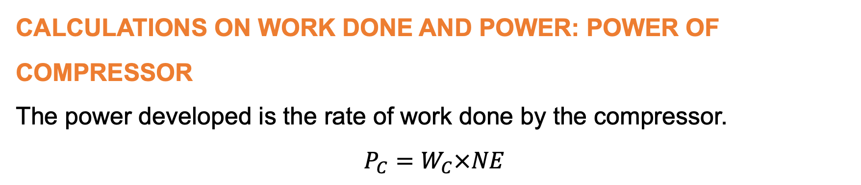
Module 2: Air compressors (continued)
CALCULATIONS ON WORK DONE AND POWER: POWER OF COMPRESSOR
The power developed is the rate of work done by the compressor.
$$P_{C}=W_{C}×NE$$
www.futuremanagers.com

Slide 18
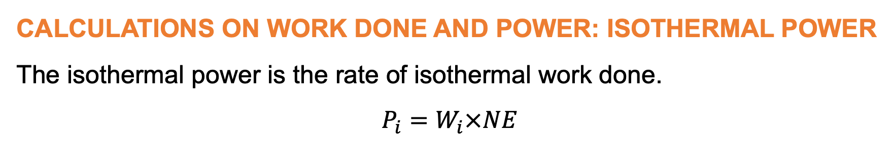
Module 2: Air compressors (continued)
CALCULATIONS ON WORK DONE AND POWER: ISOTHERMAL POWER
The isothermal power is the rate of isothermal work done.
$$P_{i}=W_{i}×NE$$
www.futuremanagers.com

Slide 19
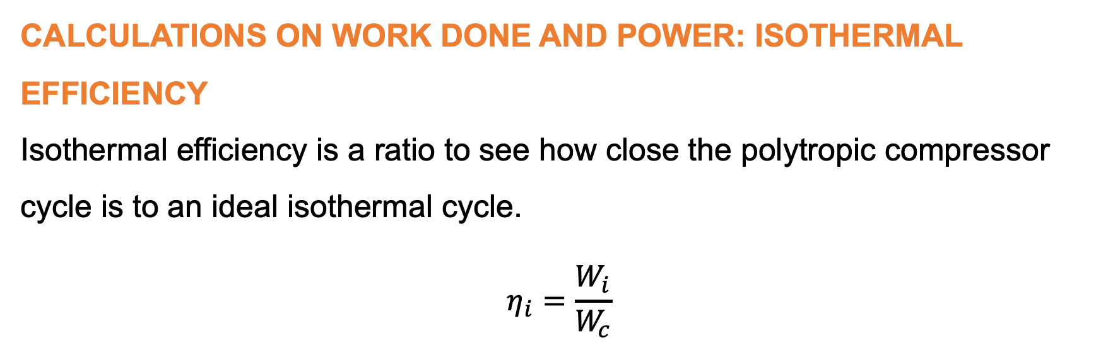
Module 2: Air compressors (continued)
CALCULATIONS ON WORK DONE AND POWER: ISOTHERMAL EFFICIENCY
Isothermal efficiency is a ratio to see how close the polytropic compressor cycle is to an ideal isothermal cycle.
$$η_{i}=\frac{W_{i}}{W_{c}}$$
www.futuremanagers.com

Slide 20
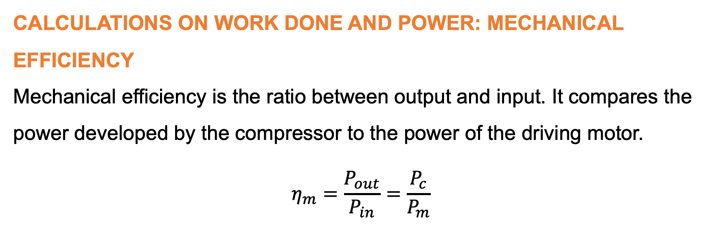
Module 2: Air compressors (continued)
CALCULATIONS ON WORK DONE AND POWER: MECHANICAL EFFICIENCY
Mechanical efficiency is the ratio between output and input. It compares the
power developed by the compressor to the power of the driving motor.
$$η_{m}=\frac{P_{out}}{P_{in}}=\frac{P_{c}}{P_{m}}$$
www.futuremanagers.com

Slide 21
Module 3: Steam generation and nuclear power plant
INTRODUCTION
The process of steam generation involves boiling water to produce steam, which undergoes a phase change from liquid to gas due to applied heat. This heat must be consistently supplied for the conversion to occur. A basic steam generation setup includes a kettle type boiler that heats a specific amount of water. As heat is applied, the water temperature rises until it reaches the boiling (saturation) point, leading to the formation of steam bubbles.
www.futuremanagers.com

Slide 22
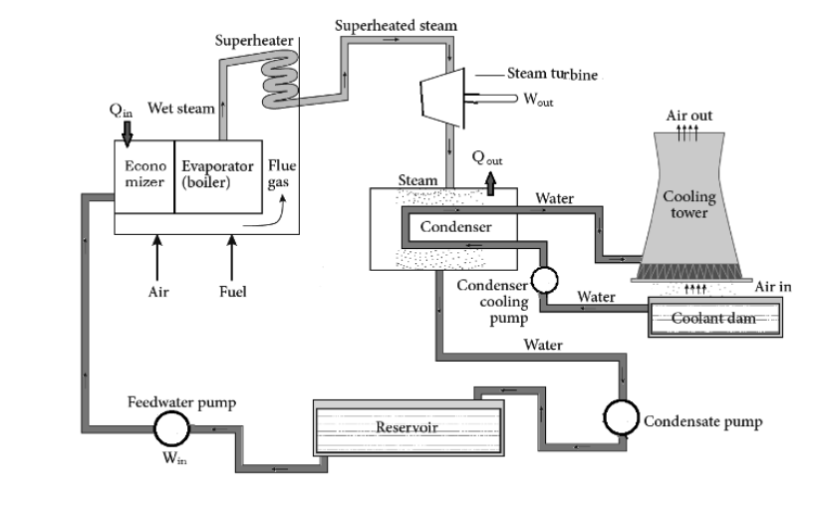
Module 3: Steam generation and nuclear power plant (continued)
BASIC ELEMENTS OF STEAM PLANTS
The typical arrangement of the basic elements of a steam plant is illustrated:
www.futuremanagers.com

Slide 23
Module 3: Steam generation and nuclear power plant (continued)
STEAM GENERATION (IDEAL RANKINE CYCLE)
The Rankine cycle is the process widely used by power plants such as coal-fired power plants or nuclear reactors. A fuel is used to produce heat within a boiler, converting water into steam which then expands through a turbine producing useful work.
www.futuremanagers.com

Slide 24
Module 3: Steam generation and nuclear power plant (continued)
INTERNAL ENERGY
The actual energy stored in the steam is called internal energy. It is defined
as the difference between the enthalpy of the steam and the external work of
evaporation.
www.futuremanagers.com

Slide 25
Module 3: Steam generation and nuclear power plant (continued)
QUALITY OF STEAM
Steam quality is a measure of moisture in the steam expressed as the percentage of steam vapour in the steam/water mixture. For example, 90% steam quality contains 10% liquid water.
www.futuremanagers.com

Slide 26
Module 3: Steam generation and nuclear power plant (continued)
BARREL CALORIMETER
Calorimeter is a device that measures the amount of heat involved in a
chemical reaction or process. A barrel calorimeter is used to determine the approximate dryness fraction of steam.
www.futuremanagers.com

Slide 27
Module 3: Steam generation and nuclear power plant (continued)
SEPERATING CALORIMETER
It is used to determine the dryness fraction of steam with a high moisture content.
www.futuremanagers.com

Slide 28
Module 3: Steam generation and nuclear power plant (continued)
THROTTLING CALORIMETER
It is used to determine the dryness fraction of steam with a low water content.
www.futuremanagers.com

Slide 29
Module 3: Steam generation and nuclear power plant (continued)
COMBINED SEPERATING AND THROTTLING CALORIMETER
If a separating calorimeter is connected in series with a throttling calorimeter, even very wet steam can theoretically be handled. The separating calorimeter will nearly dry the steam and the throttling calorimeter can handle this nearly dry steam in order to ensure superheated steam after throttling. A condenser is provided after the passage through the throttling calorimeter in order to condense the steam and record its mass.
www.futuremanagers.com

Slide 30
Module 3: Steam generation and nuclear power plant (continued)
STEAM PLANT CONCEPTS
The main types of steam power plants are thermal power plant, gas turbine
power plant and nuclear power plant. Thermal power plant or coal fired thermal power plant is the most conventional plant for generating electric power by means of steam driving a turbine which in turn then drives a generator to produce electrical energy.
www.futuremanagers.com

Slide 31
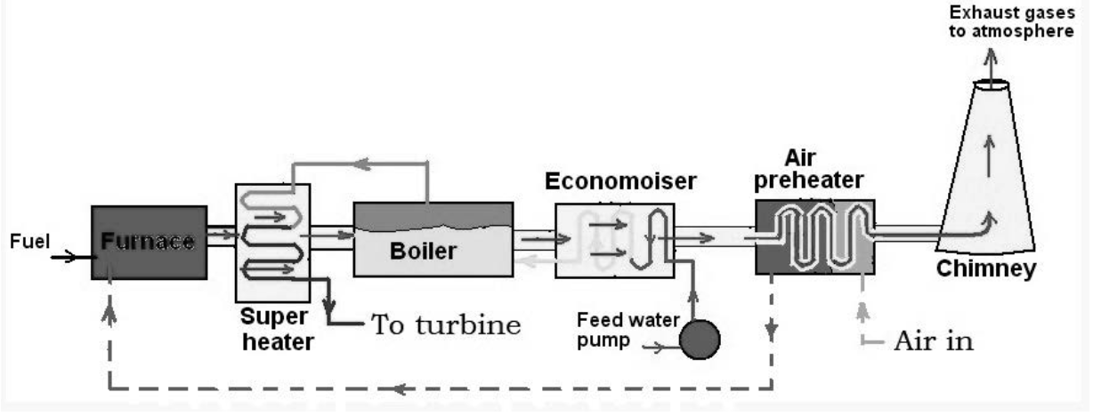
Module 3: Steam generation and nuclear power plant (continued)
MAIN COMPONENTS
The main components that has to do with the steam generation process are:
www.futuremanagers.com

Slide 32
Module 3: Steam generation and nuclear power plant (continued)
HEAT ABSORBED BY EACH COMPONENT
In order to calculate the heat absorbed by the four main components in the steam plant it needs to be understood that the heat that is absorbed by each component is assumed to be the same as the heat that is rejected by the flue gas flowing over each component.
www.futuremanagers.com

Slide 33
Module 3: Steam generation and nuclear power plant (continued)
EFFICIENCY AND EQUIVALENT EVAPORATION
Boiler efficiency (η) is a measure of how well a boiler converts combustion heat from the fuel into useful heat in the steam delivered to the turbine. It is calculated by dividing the useful heat output of the steam by the energy input of the fuel.
www.futuremanagers.com

Slide 34
Module 3: Steam generation and nuclear power plant (continued)
NUCLEAR POWER PLANTS
A nuclear power plant works to a large extent like a conventional thermal power plant. The only difference is that the heat, which converts water into steam, is produced by nuclear fission and not by burning coal, natural gas or liquid fuel.
www.futuremanagers.com

Slide 35
Module 3: Steam generation and nuclear power plant (continued)
ENVIRONMENTAL IMPACT: ADVANTAGES
Cleaner than burning fossil fuels;
High energy supply;
Reliability
Resists climate change;
Long life; and
Low fuel cost.
www.futuremanagers.com

Slide 36
Module 3: Steam generation and nuclear power plant (continued)
ENVIRONMENTAL IMPACT: DISADVANTAGES
Unethical use of power;
Radioactive waste;
Accidents;
Thermal pollution;
Slow production; and
Building and safety cost.
www.futuremanagers.com

Slide 37
Module 3: Steam generation and nuclear power plant (continued)
NUCLEAR REACTOR SAFETY SYSTEMS
Each nuclear power plant has multiple, robust safety systems designed to prevent accidents, and reduce its effects should one occur. These are:
Controlling the reactor;
Cooling the fuel; and
Containing radiation.
www.futuremanagers.com

Slide 38
Module 4: Condensers
INTRODUCTION
The steam condenser in a power plant is a device used to convert the low-
pressure exhaust steam from the turbine into water in order to be reused in the generation of steam.
www.futuremanagers.com

Slide 39
Module 4: Condensers (continued)
CONDENSER FUNCTIONS
The main function of a condenser is to maintain a low pressure (below atmospheric pressure) at the outlet of the turbine to obtain maximum possible energy. It is typically a large heat exchanger that uses cooling water to condense the steam back into water.
www.futuremanagers.com

Slide 40
Module 4: Condensers (continued)
TYPES OF STEAM CONDENSERS
Jet condenser: It is known as a direct contact condenser because the exhaust steam from the turbine and the cooling water supplied are in direct contact when condensation takes place.
Surface condenser: It is known as an indirect contact condenser because the condensate does not mix with the cooling water.
www.futuremanagers.com

Slide 41
Module 4: Condensers (continued)
AIR PUMPS
During the condensation process, the fluid changes from a gas to a liquid
(condenses). Since liquids take up less volume as the same mass of a vapour, the volume is drastically reduced, depending on the pressure in the condenser. This big reduction in volume creates the vacuum inside the condenser. In other words, the specific volume of water at a given pressure is many times lower than that of steam (can be read from a steam table).
www.futuremanagers.com

Slide 42
Module 4: Condensers (continued)
TYPES OF AIR PUMPS
Edwards air pump: This pump can remove condensate and air and is known as a wet air pump. It is a reciprocating pump.
Leblanc rotary air pump: This pump mainly removes vapour and air only and is known as a dry air pump.
Air ejector: The air ejector is used to remove air when a wet pump is used to extract the condensate from the condenser. It is not a pump and consists of a convergent-divergent nozzle and a diffuser.
www.futuremanagers.com

Slide 43
Module 4: Condensers (continued)
DALTON’S LAW OF PARTIAL PRESSURE
Law 1: The total pressure exerted by a mixture of gases or vapours is equal to the sum of the partial pressures of each of the individual gases or vapours.
Law 2: The mass of a vapour or gas that is required to saturate a given
volume is the same, whether or not other gases or vapours are present.
www.futuremanagers.com

Slide 44
Module 5: Gas turbines and governors
INTRODUCTION
The close connection between governors and steam turbines is vital. It helps power plants adjust smoothly to changes in demand in order to keep the plant running reliably and efficiently. This is important in today’s energy world where we face various challenges that need smart solutions.
www.futuremanagers.com

Slide 45
Module 5: Gas turbines and governors (continued)
GOVERNORS
A governor is a device generally used to determine and regulate the speed of
an engine, turbine or generator to the desired level. It is a particular feedback
system used where there is a need to control the load variation in the system.
www.futuremanagers.com

Slide 46
Module 5: Gas turbines and governors (continued)
TYPES OF GOVERNORS
The governor can be classified in various ways depending on how they operate. Governors can be divided into two basic groups:
Mechanical control: Older equipment use these control systems. The fuel
system is controlled by mechanical governor.
Electronic control: Newer equipment use an electronic control system.
This system interfaces and controls engine and generator control functions
to provide a constant, reliable power source.
www.futuremanagers.com

Slide 47
Module 5: Gas turbines and governors (continued)
GAS AND STEAM TURBINES
A steam turbine is powered by the energy in hot, gaseous steam and works like a cross between a wind turbine and a water turbine. It resembles a wind turbine because it has spinning blades that turn when steam blows past them; and it is like a water turbine because the blades fit snugly inside a sealed outer container so the steam is constrained and forced past them at speed.
www.futuremanagers.com

Slide 48
Module 5: Gas turbines and governors (continued)
TYPES OF STEAM TURBINES
Steam turbines may be classified into different categories depending on their
construction, working pressures, size and many other elements. But there
are two basic types of steam turbines which are called impulse and reaction
turbines. There are other types of steam turbines that are actually derivatives of these two main types.
www.futuremanagers.com

Slide 49
Module 5: Gas turbines and governors (continued)
VELOCITY DIAGRAMS
The velocity diagram of a turbine consists mainly out of the following three
velocity vectors:
Blade velocity;
Steam velocity; and
Relative velocity.
www.futuremanagers.com

Slide 50
Module 6: Renewable energy systems
INTRODUCTION
Renewable energy systems harness natural and renewable resources such as sunlight, wind, rain, tides, waves, and geothermal heat to generate power. These systems aim to provide sustainable, clean, and eco-friendly alternatives to traditional energy sources, which rely on limited fossil fuels and have harmful environmental impacts.
www.futuremanagers.com

Slide 51
Module 6: Renewable energy systems (continued)
ENVIRONMENTAL IMPACT
Renewable energy generally has less impact on the environment than traditional fossil fuels, but it is not completely without environmental consequences. The environmental impact of renewable energy varies depending on the specific technology used, its scale, location, and the entire life cycle of the energy system.
www.futuremanagers.com

Slide 52
Module 6: Renewable energy systems (continued)
SOLAR PHOTOVOLTAIC CELLS AND SOLAR THERMAL ELECTRICITY GENERATION
Solar energy can be harnessed through two main technologies:
Solar thermal electricity generation: Uses mirrors or lenses to concentrate sunlight onto a small area, typically a receiver.
Solar photovoltaic (PV) cells: Solar PV cells convert sunlight directly into electricity using the photovoltaic effect.
www.futuremanagers.com

Slide 53
Module 6: Renewable energy systems (continued)
OPERATION AND ANALYSIS OF CSP SYSTEMS
Concentrating solar power (CSP) systems are an innovative technology that
utilises mirrors or lenses to concentrate sunlight onto a small area, generating heat that can be converted into electricity.
www.futuremanagers.com

Slide 54
Module 6: Renewable energy systems (continued)
COMPONENTS OF A PV POWER PLANT
A solar photovoltaic (PV) power plant consists of various components that work together to capture sunlight and convert it into electricity.
www.futuremanagers.com

Slide 55
Module 6: Renewable energy systems (continued)
WORKING PRINCIPLE OF SOLAR THERMAL SYSTEMS
Solar thermal systems harness the sun’s energy to produce heat, which can be used for various applications including electricity generation, water heating, and space heating. There are several types of solar thermal systems, but the basic working principle involves concentrating sunlight to generate high temperatures.
www.futuremanagers.com

Slide 56
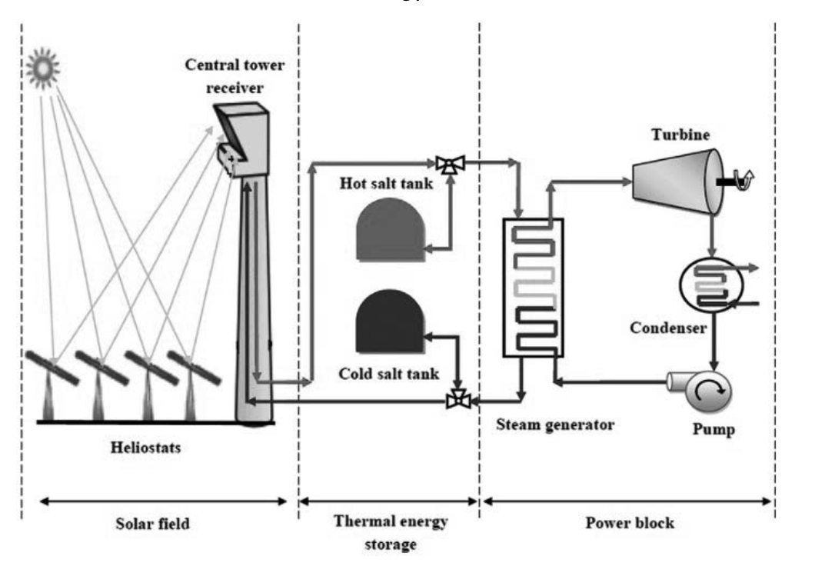
Module 6: Renewable energy systems (continued)
LAYOUT OF A SIMPLIFIED SOLAR POWER PLANT WITH DIRECT STEAM AND RANKINE CYCLE
www.futuremanagers.com

