Slide 1

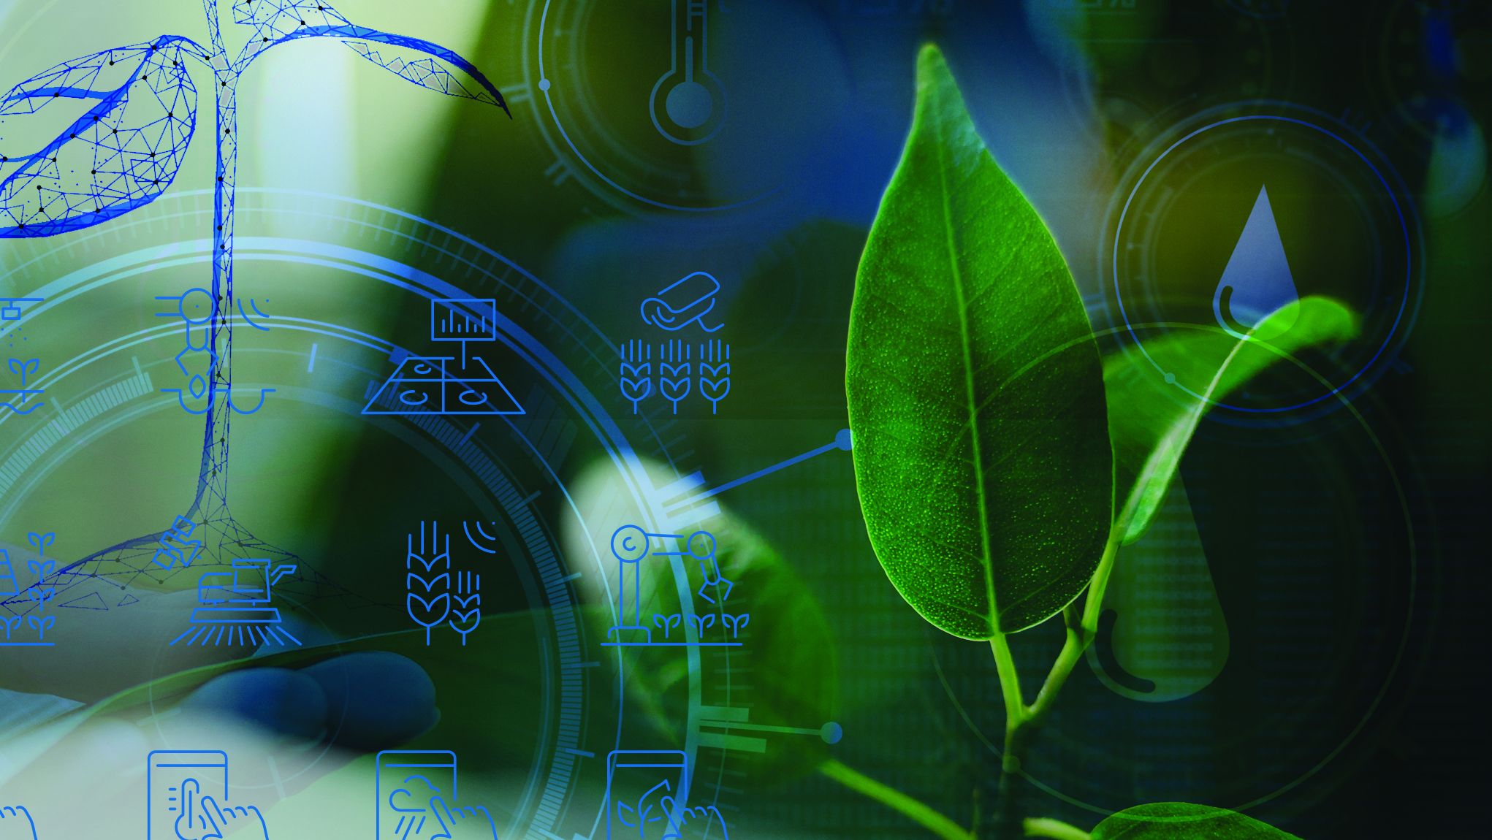
Computer Practice: Farming
N5

Slide 2
Module 1: Introduction to computers
ICT IN FARMING
Modern agriculture is completely transformed by new advancements in Information and Communication Technologies (ICTs), ranging from robotics and drones to computer vision software. Farmers now have access to tools that will help them meet the demands of our world’s ever- increasing population.
www.futuremanagers.com

Slide 3
Module 1: Introduction to computers (continued)
SMART FARMING
Smart farming is a management concept focused on providing the agricultural industry with the infrastructure to leverage advanced technology – including big data, the cloud, and the Internet of Things (IoT) – for tracking, monitoring, automating, and analysing operations.
www.futuremanagers.com

Slide 4
Module 1: Introduction to computers (continued)
A PERSONAL COMPUTER (PC)
PCs are used in various fields such as education, finance, business, healthcare, government, agriculture, manufacturing, and many more. Application software such as word processing programs, spreadsheets, database programs, accounting programs, and many more, is proof of the versatility of a PC.
www.futuremanagers.com

Slide 5
Module 1: Introduction to computers (continued)
MOBILE COMPUTING
Mobile computing is the use of a portable or easily transported computer by using wireless Internet connection or Wi-Fi hotspots in the home, office, or public places such as coffee shops and airports. Mobile computing devices are generally modern-day handheld devices that have the hardware and software required to execute typical desktop and Web applications. They have similar hardware and software components as those used in personal computers.
www.futuremanagers.com

Slide 6
Module 2: Networking concepts
NETWORKS AND ARCHITECTURES
A network is a collection of devices connected through data communication links. The nodes are computers, servers, mainframes, network devices, peripherals, terminals, telephones, printers, or any other device capable of sending and receiving data. The purpose of a network is to allow the sharing of data and resources such as printers.
www.futuremanagers.com

Slide 7
Module 2: Networking concepts (continued)
USE OF NETWORKS TO ENABLE THE INFORMATION AGE
An immense quantity of information is available on the Internet – a large group of networks. Growing up in the information age is beneficial to education. Technology and networks in an interactive classroom are far more exciting for students. Physical or time constraints are unrestricted and students can work interactively.
www.futuremanagers.com

Slide 8
Module 3: Word processing
USE THE MAIL MERGE FEATURE IN A DOCUMENT
Mail Merge is used for regular correspondence with the same people. A main document (e.g. letter, labels, or envelopes) is prepared each time, but the same data source (names, addresses, etc.) is used several times. When the primary or main document is merged with the data source, a number of personalised documents are generated. Use mail merge when you want to create a set of documents that are basically the same but each document contains unique elements.
www.futuremanagers.com

Slide 9
Module 4: Spreadsheet
WORKSHEETS, ROWS, COLUMNS, AND CELLS
A worksheet consists of rows, columns and cells:
Rows are arranged horizontally and are labelled with numbers.
Columns are arranged vertically and are labelled with letters.
Each block is called a cell. A cell is the position where a row and column intersect.
www.futuremanagers.com

Slide 10
Module 4: Spreadsheet (continued)
CHARTS WITHIN A SPREADSHEET
Selecting the most appropriate chart type will make your data more effective and informative. There are different types of charts, including:
A column chart,
A stacked column chart,
A line chart, and
A pie chart.
www.futuremanagers.com

Slide 11
Module 5: Presentation application skills
PURPOSE OF USING PRESENTATION SOFTWARE
A presentation program is a software package used to display information that addresses a certain topic, in the form of a slide show. The slide show is used to give a visual presentation. It can provide information, report progress, sell a product or service, help in decision-making, and help solve a problem.
www.futuremanagers.com

Slide 12
Module 5: Presentation application skills (continued)
THE BENEFITS OF USING PRESENTATION APPLICATIONS
It informs, persuades, motivates, or teaches the audience,
It is a useful aid for a speaker,
It gives an outline or a brief summary for the audience to easily follow the trend of the topic,
Animation and sound effects will ensure an interested and alert audience, and
High-impact visuals keep the audience engaged.
www.futuremanagers.com

Slide 13
Module 5: Presentation application skills (continued)
CHARACTERISTICS OF A GOOD PRESENTATION DOCUMENT
A good presentation is:
Brief
Presentable,
Accurate,
Logical, and
Interesting.
www.futuremanagers.com

