Slide 1

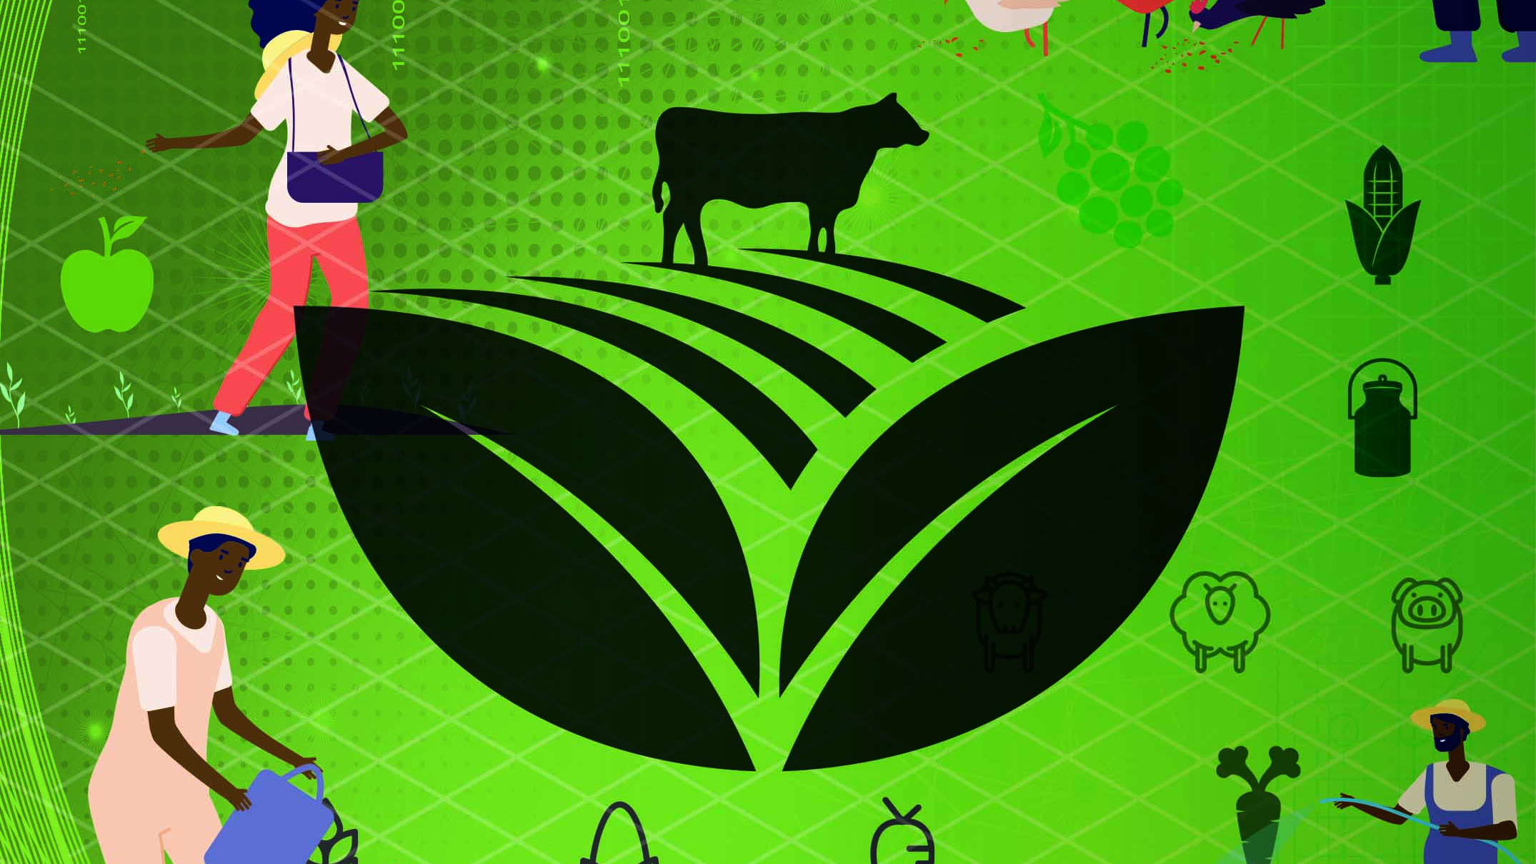
Plant and Animal Production
N4

Slide 2
Module 1: Soil and their components
INTRODUCTION
When we study agriculture we need to study soil and soil components because both plant and animal life depend on it. Plants grow in soil, and domesticated farm animals eat plants, so if there’s no soil, and no plant growth, then there will be nothing for those animals to eat. Soil is also one of the greatest assets of a country because the amount of soil that a country has is finite and cannot be increased.
www.futuremanagers.com

Slide 3
Module 1: Soil and their components (continued)
THE IMPORTANCE OF SOIL SCIENCE
The study of soil as a natural resource includes the study of soil formation and classification, as well as the physical, chemical, biological, and fertility aspects of the soil and how these properties relate to how soils are used and managed. In order for soil to yield the best crop for the farmer, it is important for the farmer to be aware of every aspect of the soil and how to address soil shortcomings.
www.futuremanagers.com

Slide 4
Module 1: Soil and their components (continued)
DEFINING SOIL
Soil is the loose material on the surface of the earth that covers most of the land. The four main components of soil are inorganic materials (or minerals), organic matter, air and water. Inorganic materials make up the bulk of soil. These are small particles of rock and sand that are formed when rock breaks down into many smaller pieces.
www.futuremanagers.com

Slide 5
Module 1: Soil and their components (continued)
ESSENTIAL NUTRIENTS
Most plants need different amounts of nutrients for normal and healthy growth, each of which serves a different purpose. It is therefore extremely important to ensure that the correct amount of each of the nutrients is available to plants in a form that they can absorb. Macro- and micronutrients are absorbed by plants as ions and are usually available as salts underground.
www.futuremanagers.com

Slide 6
Module 1: Soil and their components (continued)
SOIL PH
pH is the abbreviation for potential hydrogen. Soil pH is a unit of measurement of the acidity or alkalinity of soil and is used to analyse the characteristics of a sample of soil. Natural soil pH is dependent on the type of rock that broke down to create the soil, as well as the process that caused the rock to break down.
www.futuremanagers.com

Slide 7
Module 1: Soil and their components (continued)
SOIL SAMPLING
Soil sampling is a very important step for any agricultural enterprise. The process gives farmers information about which nutrients are present, and in which amounts, as well as which nutrients are missing from the soil.
www.futuremanagers.com

Slide 8
Module 1: Soil and their components (continued)
SOIL SAMPLING STEPS
Look closely at the entire plot of land you want to test and note any visible differences in soil structure.
If there are obvious differences, then samples should be collected from each of the different soils.
If there aren’t major differences, then samples can be taken from the entire plot of land.
Ensure that the surface area is clear of rubble or organic material.
www.futuremanagers.com

Slide 9
Module 1: Soil and their components (continued)
THE EFFECTS OF NITROGEN ON THE GROWTH OF PLANTS
Nitrogen is a primary macronutrient. Plants need nitrogen to produce proteins and chlorophyll. During photosynthesis, plants use energy from sunlight to convert carbon dioxide and other nutrients into elements that are further synthesised into amino acids that form proteins when they join.
www.futuremanagers.com

Slide 10
Module 1: Soil and their components (continued)
THE EFFECTS OF PHOSPHOROUS ON THE GROWTH OF PLANTS
Phosphorous is required for plant respiration, photosynthesis and healthy growth. Plants also use phosphorous to produce flowers, fruit and seeds and it forms an important part of proteins, DNA and efficient water use.
www.futuremanagers.com

Slide 11
Module 1: Soil and their components (continued)
THE EFFECTS OF POTASSIUM ON THE GROWTH OF PLANTS
Potassium is required for photosynthesis and the transportation and storage of food. It also plays a part in the formation of cell walls, together with calcium and boron. Plants need potassium for fruit to ripen properly, seeds to fill, stems to lengthen, and resistance to pests and diseases.
www.futuremanagers.com

Slide 12
Module 1: Soil and their components (continued)
THE EFFECTS OF MAGNESIUM ON THE GROWTH OF PLANTS
Plants require magnesium for photosynthesis, to move phosphorous as needed throughout the plant, and to consume iron.
www.futuremanagers.com

Slide 13
Module 1: Soil and their components (continued)
WATER AND MINERAL UPTAKE FROM SOIL
Water is one of the most important elements in the life of plants. The macro- and micronutrients that plants need to thrive are dissolved in water in the soil, which the plants absorb via their root systems. They do this through a process called osmosis.
www.futuremanagers.com

Slide 14

Module 2: Plant production
INTRODUCTION
Plant production is the growing of crops for food and for use as inputs in the production of other products. It is important to understand the external and internal structure of plants in order to optimise crop yield by applying the right amount of organic and chemical fertilisers, water, weed and pest control, and to know the proper way of harvesting and storing crops.
www.futuremanagers.com

Slide 15
Module 2: Plant production (continued)
PLANT MORPHOLOGY AND PLANT PHYSIOLOGY
Plant morphology, also known as phytomorphology, is the study of the external structure of plants and is useful when visually identifying plants. Plant physiology is the study of the way plants function, including all the processes involved in growth, metabolism, reproduction, defence and communication.
www.futuremanagers.com

Slide 16
Module 2: Plant production (continued)
PLANT REPRODUCTION AND CROP YIELD
Plants, like all living organisms, pass on their genes to the next generation by reproducing. Plants that use their flowers for reproduction are said to reproduce sexually, while plants that do not use their flowers for reproduction reproduce asexually (also called vegetative reproduction).
Crop yield is a measurement of the amount of a crop that can be grown per unit area of land.
www.futuremanagers.com

Slide 17
Module 2: Plant production (continued)
CULTIVATION OF VEGETABLES
The main objective of vegetable production is to achieve the best yield from crops in the least amount of time while keeping labour costs to a minimum. To achieve this objective, farmers need to understand the principles that govern vegetable production and how to control the optimum growing environment for specific vegetables.
www.futuremanagers.com

Slide 18
Module 2: Plant production (continued)
SCHEDULE AND OPERATE IRRIGATION
Irrigation is simply the process of supplying controlled amounts of water to land or crops to assist in crop production. There are various types of irrigation, with differences in the way the plants are given water. In order to ensure that each plant receives the correct amount of water, the water must be applied to the plants as consistently as possible.
www.futuremanagers.com

Slide 19
Module 2: Plant production (continued)
WEEDS AND WEED CONTROL
Weed control for farmers is very important as it will influence the crop yield, increase costs and affect the quality of the product. Severe weed infestation will affect irrigation and water flow to crops as well as interfere with the application of any pesticides. Weeds can also have diseases that will affect the crop.
www.futuremanagers.com

Slide 20
Module 2: Plant production (continued)
HERBICIDES
Herbicides have been the most common method of weed eradication since the 1950s. Herbicides work on impacting the specific growth phases of a particular weed by affecting the ability to germinate, controlling the spread of young plants and attacking more mature plants. One of the major disadvantages of the use of herbicides is that weeds can develop a resistance to the herbicide or the active ingredients in the herbicide.
www.futuremanagers.com

Slide 21
Module 2: Plant production (continued)
PESTS AND DISEASES AFFECTING CROPS
Pests and diseases will present on crops with nibbling on the leaves and stems, wilting leaves, falling leaves as well as mould or marks on the leaves. Plant diseases change the appearance of plants.
www.futuremanagers.com

Slide 22
Module 2: Plant production (continued)
HARVESTING AND STORAGE
Every vegetable has a different harvesting and storage technique that ensures optimum flavour, freshness and nutrition. Some vegetables are harvested at a certain maturity, while others are harvested for size. Many vegetables should be harvested often to induce the plant to produce more fruit.
www.futuremanagers.com

Slide 23
Module 3: Animal production
THE DIGESTIVE SYSTEMS OF FARM ANIMALS
Digestion is the consumption of food and water; chewing, chemical reaction of saliva, and swallowing of food; digestion of food and absorption of nutrients; maintaining hydration and electrolytes as well as the evacuation of waste.
www.futuremanagers.com

Slide 24
Module 3: Animal production (continued)
POULTRY PRODUCTION
The growth of the poultry industry in South Africa has seen a rapid increase due to the quick turnaround time and the ability to have a number of diverse products from poultry farming, e.g., meat and eggs.
www.futuremanagers.com

Slide 25
Module 3: Animal production (continued)
SHEEP AND GOAT PRODUCTION
Goat breeds in South Africa are farmed for meat, milk or fibre (i.e., produced for hair). Different breeds are better suited for specific needs.
Sheep production takes place to supply communities with meat and wool. Many sheep are kept in the semi-desert areas of the Karoo regions. Meat producing sheep are concentrated in the Karoo and Northern Cape areas.
www.futuremanagers.com

