Slide 1

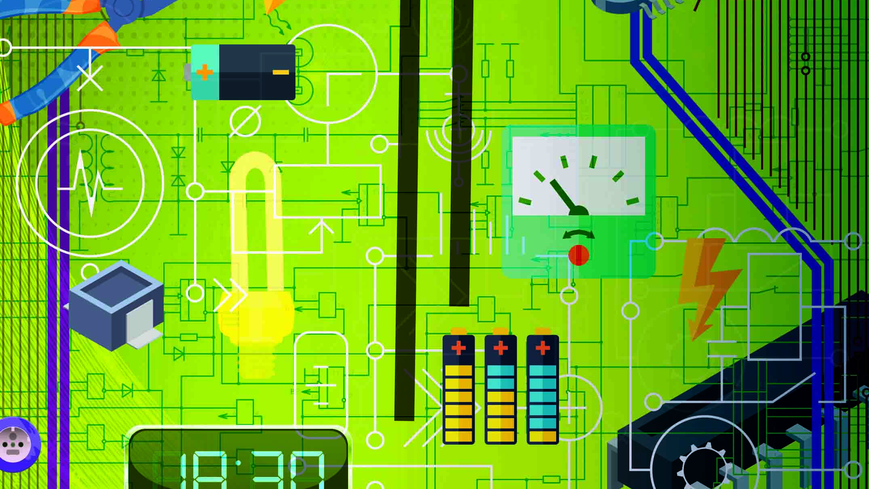
Promotional version
Additional changes may apply
N4 Industrial Electronics

Slide 2
Module 1: Network theorems
INTRODUCTION
The following theorems are important to know:
Kirchhoff ’s laws;
Superposition Theorem;
Thevenin’s Theorem;
Norton’s Theorem; and
Maximum power transfer.
www.futuremanagers.com

Slide 3
Module 1: Network theorems (continued)
KIRCHOFF’S LAWS
Kirchhoff ’s Current Law states that the algebraic sum of currents entering a point will be equal to the algebraic sum of the currents leaving that point.
Kirchhoff ’s Voltage Law states that the algebraic sum of the individual voltage drops in a closed network is equal to the algebraic sum of the applied voltage.
www.futuremanagers.com

Slide 4
Module 1: Network theorems (continued)
SUPERPOSITION THEOREM
The Superposition Theorem states that all current magnitudes and directions may be determined by considering each supply on its own.
www.futuremanagers.com

Slide 5
Module 1: Network theorems (continued)
THEVENIN’S THEOREM
Thevenin’s Theorem is a method for simplifying a two-terminal linear circuit to an equivalent circuit with only a voltage source in series with a resistance or impedance. The theorem specifies that a complex network consisting of impedances and voltage sources may be replaced by a constant voltage source with a series impedance.
www.futuremanagers.com

Slide 6
Module 1: Network theorems (continued)
NORTON’S THEOREM
Norton’s Theorem specifies that a complex network consisting of impedances and voltage sources may be replaced by a constant current source with a parallel resistance. It is a method for simplifying a two-terminal linear circuit to an equivalent circuit with only a current source in parallel with a resistance or impedance.
www.futuremanagers.com

Slide 7
Module 1: Network theorems (continued)
MAXIMUM POWER TRANSFER THEOREM
The maximum power transfer states that, in order to obtain maximum external power from a source with a finite internal resistance, the resistance of the load must be equal to the resistance of the source as viewed from its output terminals.
www.futuremanagers.com

Slide 8
Module 2: Alternating current theory
INTRODUCTION
Every electrical fault situation is unique and demands its own approach. Only with experience will the electrician learn to conduct the best fault-finding process possible for a given situation. Approaches to and methods for fault finding are intended to guide the electrician in finding and fixing the fault in a malfunctioning electrical circuit as safely and efficiently as possible.
www.futuremanagers.com

Slide 9
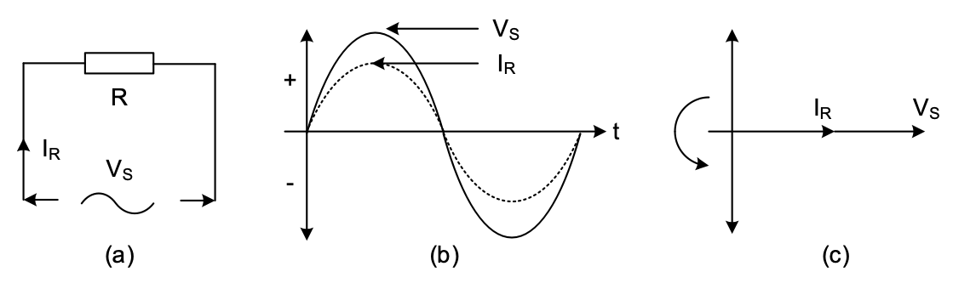
Module 2: Alternating current theory (continued)
RLC CONNECTIONS
The figure below illustrates a resistor connected across an alternating current supply (a) and (b) illustrates a graphical representation of the phase relationship between the current and the supply voltage whereas (c) illustrates a phasor diagram.
www.futuremanagers.com

Slide 10
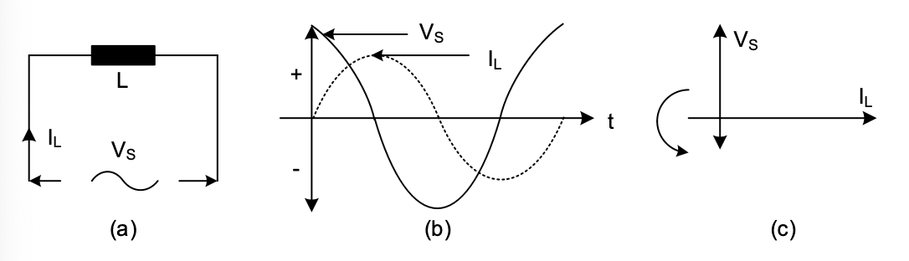
Module 2: Alternating current theory (continued)
THE EFFECT OF AN ALTERNATING QUANTITY ON AN INDUCTOR
The figure below illustrates an inductor connected across an alternating current supply (a) and (b) illustrates a graphical representation of the phase relationship between the current and the supply voltage whereas (c) illustrates a phasor diagram.
www.futuremanagers.com

Slide 11
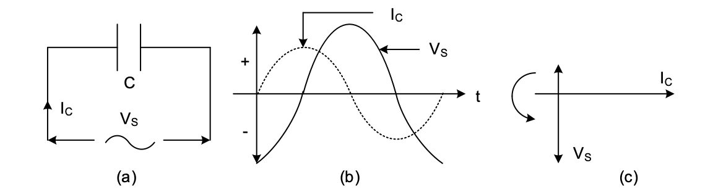
Module 2: Alternating current theory (continued)
THE EFFECT OF AN ALTERNATING QUANTITY ON A CAPACITOR
The figure below illustrates a capacitor connected across an alternating current supply (a) and (b) illustrates a graphical representation of the phase relationship between the current and the supply voltage whereas (c) illustrates a phasor diagram.
www.futuremanagers.com

Slide 12
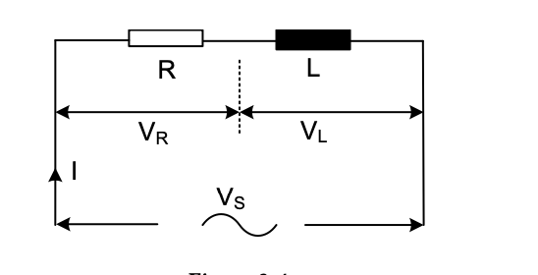
Module 2: Alternating current theory (continued)
THE SERIES RL-NETWORK
A network consisting of an inductor and resistor connected in series is illustrated below.
www.futuremanagers.com

Slide 13
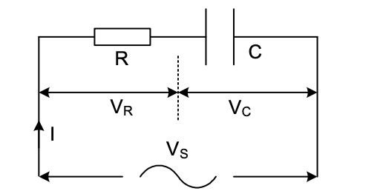
Module 2: Alternating current theory (continued)
THE SERIES RC-NETWORK
A network consisting of a capacitor and resistor connected in series is illustrated below.
www.futuremanagers.com

Slide 14
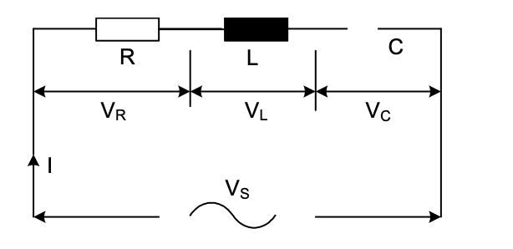
Module 2: Alternating current theory (continued)
THE SERIES RLC-NETWORK
A network consisting of a resistor, capacitor and inductor connected in series is illustrated below.
www.futuremanagers.com

Slide 15
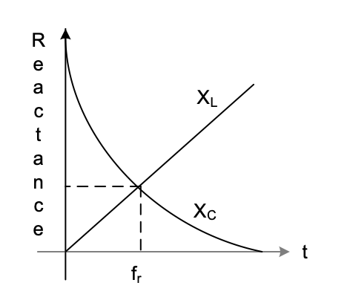
Module 2: Alternating current theory (continued)
RESONANCE
Resonance is a condition that will occur in a series- or parallel RLC-network when the inductive reactance equals the capacitive reactance. The graph representing resonance is below.
www.futuremanagers.com

Slide 16
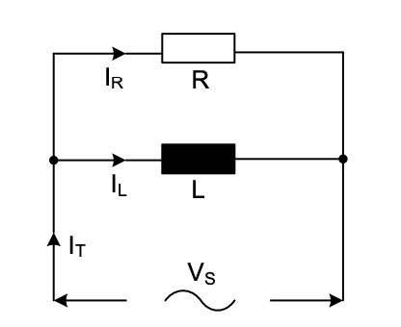
Module 2: Alternating current theory (continued)
THE PARALLEL RL- NETWORKS
A parallel network consisting of an inductor and resistor connected in parallel is illustrated below.
www.futuremanagers.com

Slide 17
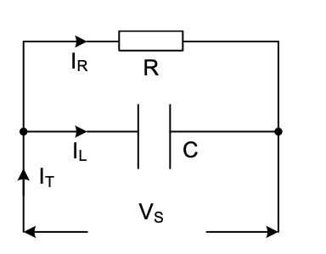
Module 2: Alternating current theory (continued)
THE PARALLEL RC- NETWORKS
A parallel network consisting of a capacitor and resistor connected in parallel is illustrated below.
www.futuremanagers.com

Slide 18
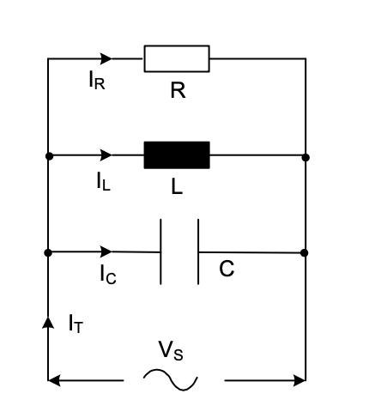
Module 2: Alternating current theory (continued)
THE PARALLEL RLC- NETWORKS
A parallel network consisting of a capacitor, inductor and resistor connected in parallel is illustrated below.
www.futuremanagers.com

Slide 19
Module 2: Alternating current theory (continued)
Q-FACTOR, BANDWIDTH AND COMPLEX NOTATION
Quality factor is the ratio of true power to reactive power in a resonant circuit or the ratio of inductive reactance to winding resistance in an inductor.
Bandwidth is the range of frequencies between f1 and f2 where the power has fallen or dropped to half its value; also known as the half-power point.
Complex notation is a method used to calculate different quantities in alternating current networks in modulus and angle form.
www.futuremanagers.com

Slide 20
Module 3: Electronic power control
INTRODUCTION
In the field of electronics there are two main elements that are used in the manufacture of semi-conductor devices or components, namely silicon and germanium. These elements do not have the same atomic weight or number of orbiting electrons, they do however have one aspect in common: there are four valence electrons in its valence shell although the orbital designation is different.
www.futuremanagers.com

Slide 21
Module 3: Electronic power control (continued)
SEMI-CONDUCTOR DIODES
A semi-conductor is a material that has a conductance value between that of a conductor and an insulator, such as silicon and germanium.
A diode is a two-terminal electronic device that conducts currents in one direction.
www.futuremanagers.com

Slide 22
Module 3: Electronic power control (continued)
PN-JUNCTIONS
A PN-junction is formed when a P-type material and an N-type material is joined together. This joining together is not an electrical junction but is a junction which is achieved through a manufacturing process.
www.futuremanagers.com

Slide 23
Module 3: Electronic power control (continued)
REVERSE-BIASED PN-JUNCTIONS
Reverse bias happens when the voltage across a diode permits current flow in the opposite direction.
www.futuremanagers.com

Slide 24
Module 3: Electronic power control (continued)
FORWARD-BIASED PN-JUNCTIONS
Under forward-bias conditions electrons from the N-type material will be repelled from the negative terminal of the voltage source and at the same time holes from the P-type material are repelled from the positive terminal of the voltage source and are driven toward the junction.
www.futuremanagers.com

Slide 25
Module 3: Electronic power control (continued)
ELECTRICAL CHARACTERISTICS OF A DIODE
The electrical characteristics of a diode are based on the absolute maximum rating system and provide information pertaining to the maximum values that may not be exceeded for a given diode.
www.futuremanagers.com

Slide 26
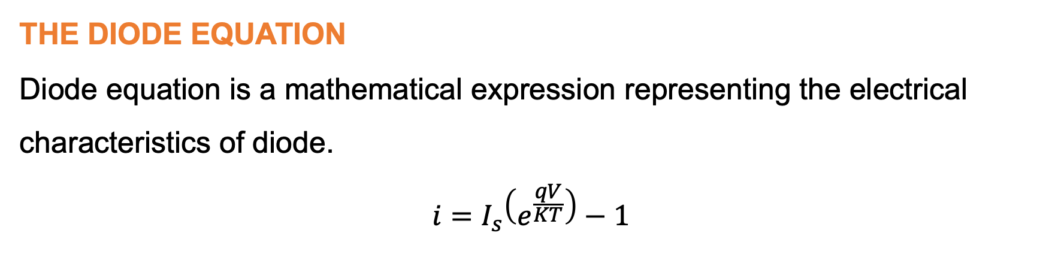
Module 3: Electronic power control (continued)
THE DIODE EQUATION
Diode equation is a mathematical expression representing the electrical characteristics of diode.
$$i=I_{s}\left(e^{\frac{qV}{KT}}\right)−1$$
www.futuremanagers.com

Slide 27
Module 3: Electronic power control (continued)
DIODE LOADLINES
The loadline for a diode is obtained by considering the maximum values of forward current and the maximum value of the forward bias for a particular rectifier diode.
www.futuremanagers.com

Slide 28
Module 3: Electronic power control (continued)
POWER CONTROL SYSTEMS (PCS)
A process control system (PCS) is a system that will handle process control and monitoring of a facility or piece of equipment.
www.futuremanagers.com

Slide 29
Module 4: Power supplies
TRANSFORMERS
A transformer is a device that transfers electrical energy in the form of alternating current.
www.futuremanagers.com

Slide 30
Module 4: Power supplies (continued)
TYPES OF TRANSFORMERS
Different types of transformers include:
Step-down transformers;
Step-up transformers;
Centre-tap transformers;
Multi-tap transformers;
Autotransformers;
Isolation transformers;
Power transformers;
Instrument transformers;
Current transformers;
Potential transformers; and
Audio frequency transformers.
www.futuremanagers.com

Slide 31
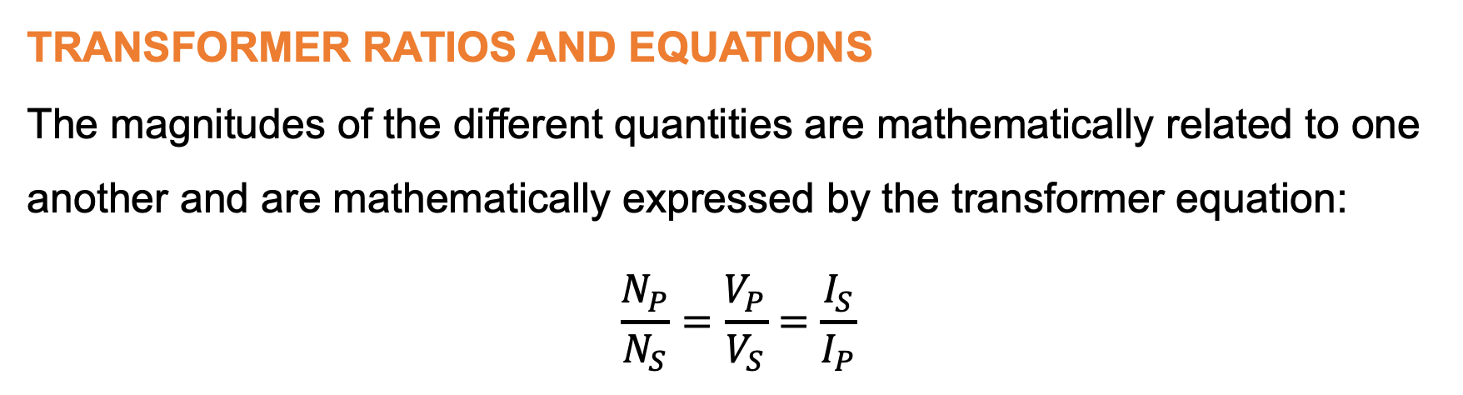
Module 4: Power supplies (continued)
TRANSFORMER RATIOS AND EQUATIONS
The magnitudes of the different quantities are mathematically related to one another and are mathematically expressed by the transformer equation:
$$\frac{N_{P}}{N_{S}}=\frac{V_{P}}{V_{S}}=\frac{I_{S}}{I_{P}}$$
www.futuremanagers.com

Slide 32
Module 4: Power supplies (continued)
TRANSFORMER RATINGS
Transformers are rated in volt-amperes (VA) or kilovolt-amperes (kVA). This means that the primary and the secondary winding are designed to withstand the VA or kVA rating of the transformer. The primary- and secondary full-load currents must be calculated using the transformer equation.
www.futuremanagers.com

Slide 33
Module 4: Power supplies (continued)
RECTIFICATION
Rectification refers to the conversion of alternating current to direct current using a rectifier.
www.futuremanagers.com

Slide 34
Module 5: Amplifiers
TRANSISTORS
A transistor is a three-terminal two junction component and is commonly referred to as a junction transistor.
www.futuremanagers.com

Slide 35

Module 5: Amplifiers (continued)
OPERATIONAL AMPLIFIERS
These operational amplifier IC-packages are cheap to manufacture and have the following characteristics:
High input impedance
Low output impedance 6
A high voltage gain in the region of ${10}^{6}$
Wide bandwidth
The ability to handle both AC- and DC-signals.
www.futuremanagers.com

Slide 36
Module 6: Transducers and liquid crystal display
TRANSDUCERS
A transducer is a device that will convert one form of energy into another form of energy. Transducers are normally associated with measuring instruments in the instrumentation field in that it will enable us to measure quantities such as liquid level, pressure, temperature and light intensity.
www.futuremanagers.com

Slide 37
Module 6: Transducers and liquid crystal display (continued)
INTRODUCTION TO LCD
LCD is short for liquid crystal display, which is a device that uses the properties of liquid crystals controlled by an electrical field for visual display. Liquid crystal displays are super-thin technology display screens that are generally used in laptop computer screens, TVs, cell phones, and portable video games.
www.futuremanagers.com

