Slide 1

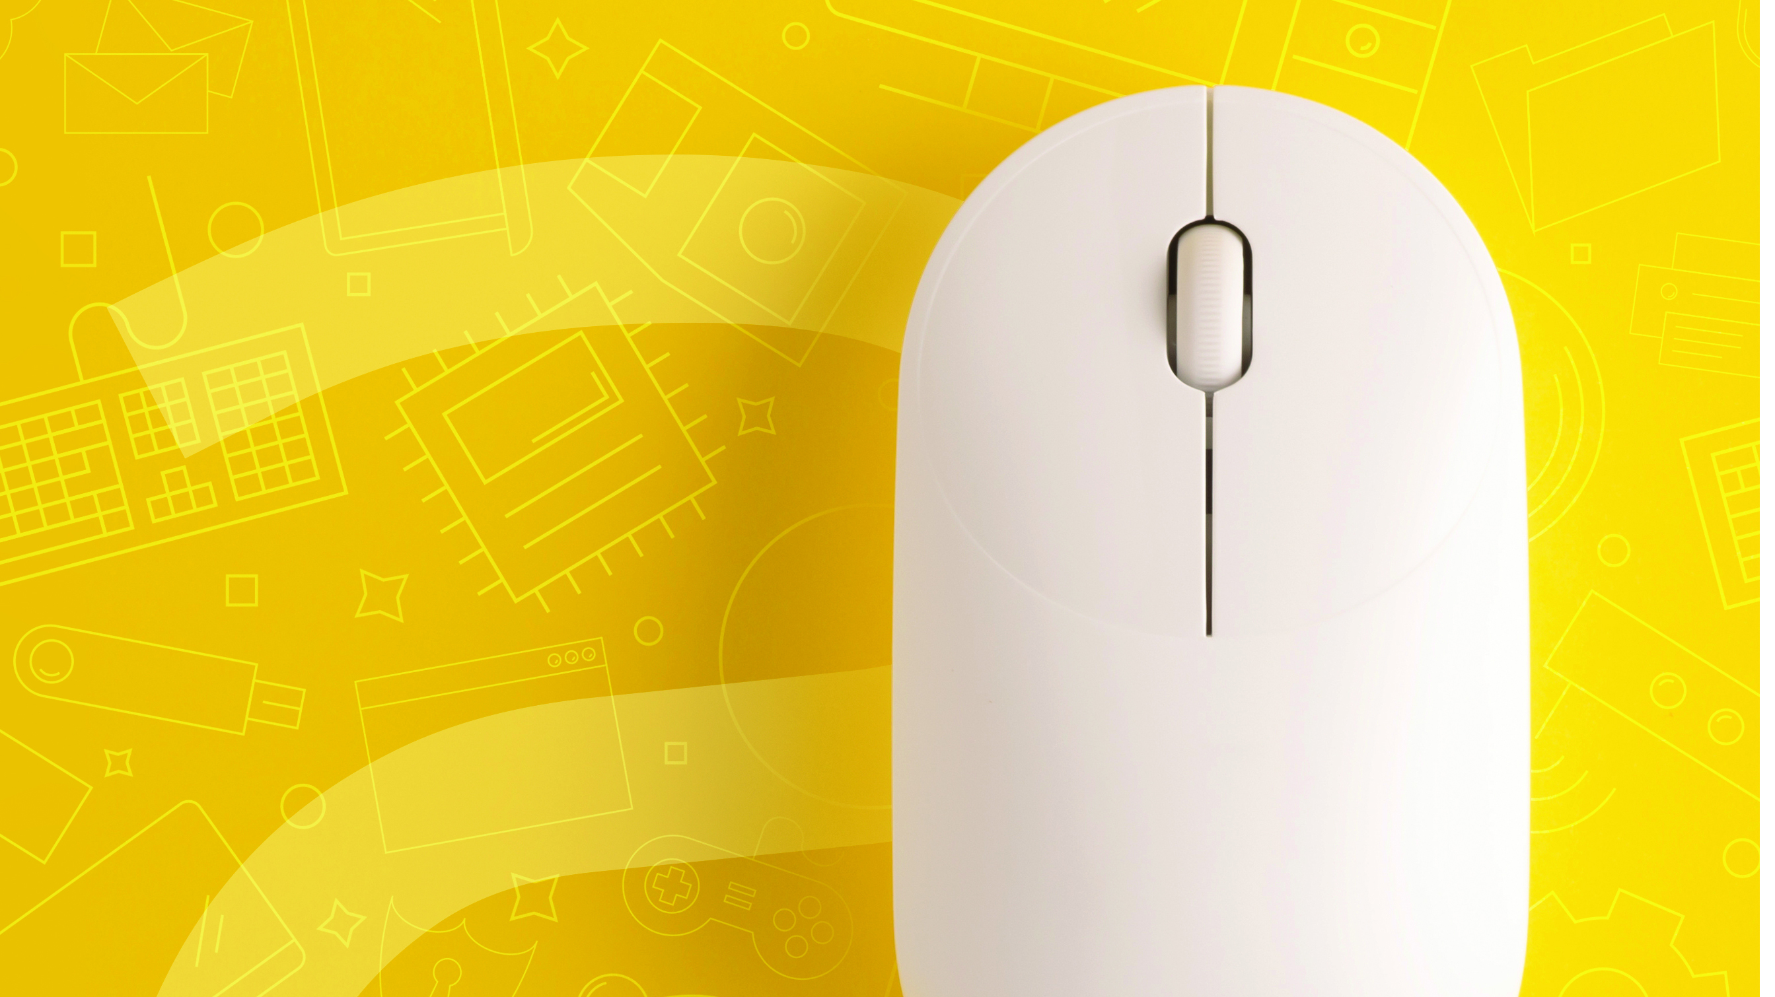
Life Orientation: Computer Skills
NCV2

Slide 2
Module 1 – Concepts of Information and Communication Technology (ICT)
EXPLAIN THE PERSONAL COMPUTER
A computer is an electronic, programmable machine, which is capable of processing data to produce a desired result (information). It is composed of hardware (visible devices, peripherals) and software (programs). Computers are available in a variety of sizes and configurations. Personal computers are any general-purpose computers such as desktop models, laptops, notebooks and tablet PCs – some designed for mobile use.
www.futuremanagers.com

Slide 3
Module 1 – Concepts of Information and Communication Technology (ICT) (continued)
INPUT DEVICES
Input devices are used to send data to the computer CPU. These include:
The keyboard;
The mouse;
Digitisers;
Scanners;
Webcams;
Memory card readers.
www.futuremanagers.com

Slide 4
Module 1 – Concepts of Information and Communication Technology (ICT) (continued)
THE CPU
The CPU can be considered as the brain (and the heart) of the computer. The CPU is a chip on the motherboard and this is where all the data is kept and processed.
www.futuremanagers.com

Slide 5
Module 1 – Concepts of Information and Communication Technology (ICT) (continued)
OUTPUT DEVICES
Output devices are used to convert machine-readable information into people-readable form, either on the screen (monitor/VDU) or on a printer, when a hard copy is produced. These include:
The Visual Display Unit (VDU);
Printers;
Plotters;
Projectors.
www.futuremanagers.com

Slide 6
Module 1 – Concepts of Information and Communication Technology (ICT) (continued)
EXPLORE AND USE THE WINDOWS OPERATING SYSTEM
The operating system:
Activates and controls the computer;
Enables the computer to run application programs;
Allows communication with the computer;
Organises files and controls the space allocation on a variety of storage media; and
Manages hardware errors and the loss of data.
www.futuremanagers.com

Slide 7
Module 1 – Concepts of Information and Communication Technology (ICT) (continued)
OPENING DIFFERENT WINDOWS
More than one file can be opened at the same time. If several files are opened in the same program, e.g. MS Word, Windows automatically groups the open windows into a single taskbar button.
www.futuremanagers.com

Slide 8
Module 1 – Concepts of Information and Communication Technology (ICT) (continued)
SWITCH BETWEEN PROGRAMS
More than one program can be opened at the same time.
www.futuremanagers.com

Slide 9
Module 1 – Concepts of Information and Communication Technology (ICT) (continued)
FILE EXPLORER
File Explorer displays the hierarchical structure of files, folders, and drives on your computer. Using File Explorer, you can identify the content of storage devices and copy, move, rename, and search for files and folders.
www.futuremanagers.com

Slide 10
Module 1 – Concepts of Information and Communication Technology (ICT) (continued)
IDENTIFY FILE TYPES
A file name consists of a unique name, followed by a full stop, followed by an extension. The extension is an indicator of the program in which the file is created.
www.futuremanagers.com

Slide 11
Module 1 – Concepts of Information and Communication Technology (ICT) (continued)
CREATE FOLDERS
Folders are created to help organise computer files into specific categories.
Folders can be created within other folders on the computer system. Files can be moved from one folder to another.
Folders can hold any number of individual files.
When saving a document that has been created, choose the folder in which to store the file.
Folders can be copied, moved, renamed, and deleted.
www.futuremanagers.com

Slide 12
Module 1 – Concepts of Information and Communication Technology (ICT) (continued)
THE HELP FUNCTION
In Windows 10 there is a Get Help function, which acts as a virtual agent. Here you can get quick answers to common questions, suggestions for troubleshooting, and instructions for how to do things. You can type your question to the virtual agent.
www.futuremanagers.com

Slide 13
Module 2 – Basic features of Microsoft Word
KEYBOARD PROFICIENCY IN AN MS WORD DOC
When working in a word processing program, it is necessary to key in text, therefore keyboarding is of vital importance. Keyboard proficiency is an essential skill nowadays and is needed in almost every working environment.
www.futuremanagers.com

Slide 14
Module 3 – Basic features of Microsoft Excel (Spreadsheet program)
WHAT IS A SPREADSHEET?
A spreadsheet is a computer program that is used to do calculations with, or to manipulate numbers. You can do quick calculations, and also draw a graph, which is a very helpful tool in financial decision-making.
www.futuremanagers.com

Slide 15
Module 3 – Basic features of Microsoft Excel (Spreadsheet program) (continued)
WHEN IS A SPREADSHEET USED?
A spreadsheet is used to make calculations from which conclusions can be drawn. Applications of spreadsheets include the following:
Budgets;
Statistical analyses;
Clock cards and wage sheets;
Projections;
Financial statements; and
Company reports, and many more.
www.futuremanagers.com

Slide 16
Module 3 – Basic features of Microsoft Excel (Spreadsheet program) (continued)
USE FORMULAS TO PERFORM BASIC CALCULATIONS IN A SPREADSHEET
Formulas are used to do calculations. These include:
Calculations in brackets;
Percent;
Exponential function;
Multiplication and division (from left to right); and
Addition and subtraction (from left to right).
www.futuremanagers.com

Slide 17
Module 4 – Basic features of PowerPoint presentations
CREATING PRESENTATIONS
A new presentation can be created in several ways. Either begin with a blank presentation that has neither suggested content nor design, or create a presentation by selecting a template (pre-designed themes and layouts) that determines the presentation’s design. You can also begin with an outline imported from another application.
www.futuremanagers.com

Slide 18
Module 5 – Introduction to email and the Internet
EXPLORE THE WORLD WIDE WEB
The Internet is a global computer network – a worldwide network of computers. It enables people to communicate electronically throughout the world. Telecommunication is a general term for the transmission of information over a telephone line, which is often used to access the Internet.
www.futuremanagers.com

Slide 19
Module 5 – Introduction to email and the Internet (continued)
USE THE INTERNET TO COMMUNICATE VIA EMAIL
Electronic mail (email) is the most common reason to connect to the Internet.
Electronic mail, or email as it is commonly known, is one of the most widely used facilities available on the Internet. Mail programs, such as Microsoft Outlook and Outlook Express, allow you to send and receive messages locally or internationally for the price of a local telephone call, or for free if you have full-time Internet access.
www.futuremanagers.com

