Slide 1

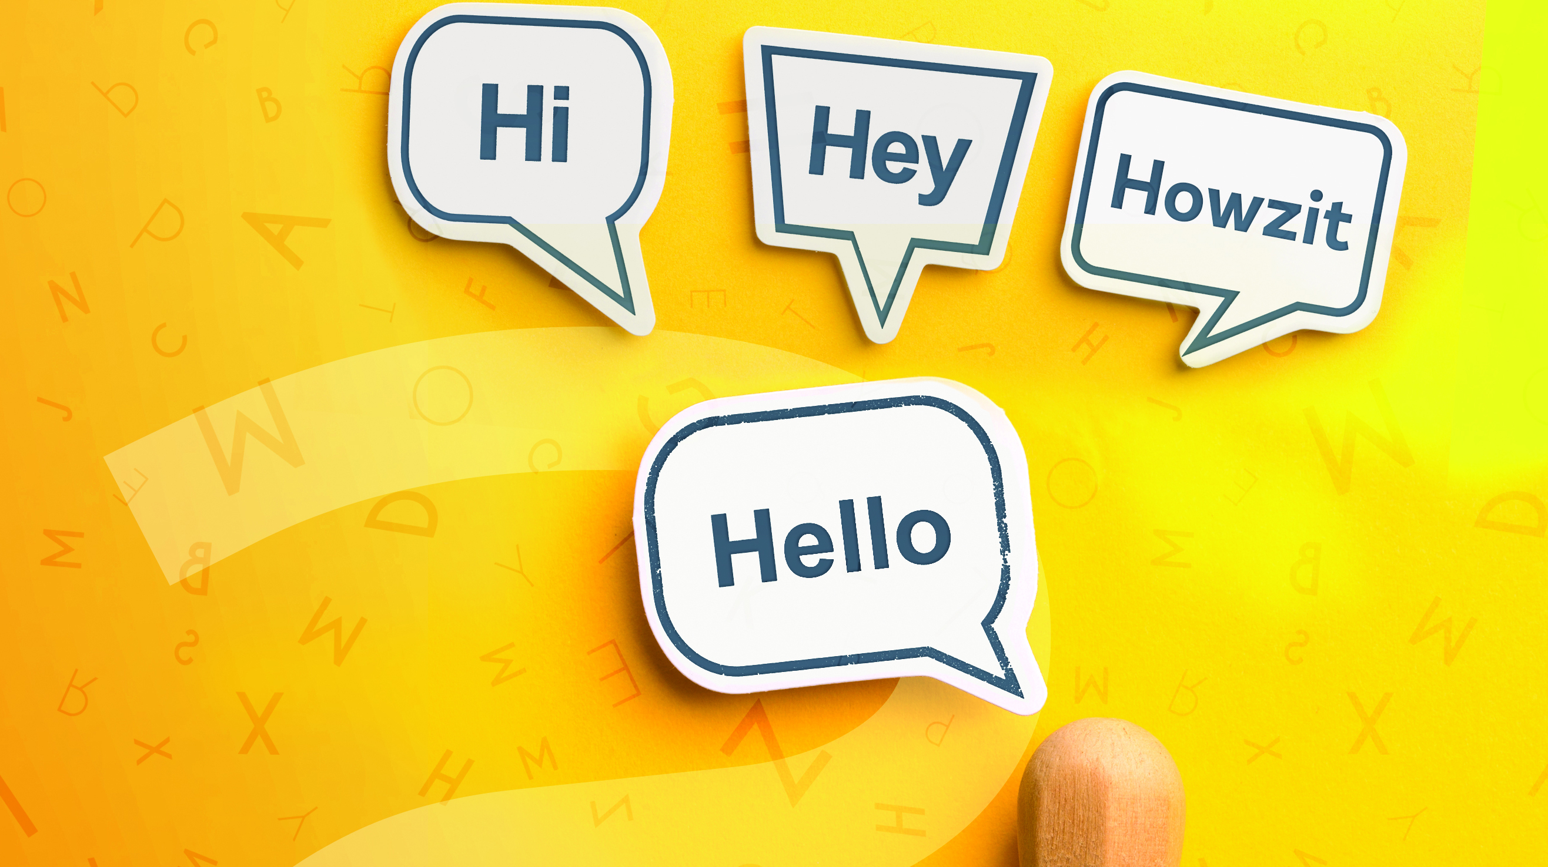
Language
NCV2

Slide 2
Module 1 – Communication
PRINCIPLES OF EFFECTIVE COMMUNICATION
The principles of effective communication are:
Audience: Suit your communication to the intended audience.
Purpose: Make your communication fulfil its purpose.
Clarity: Express yourself clearly when speaking and writing – be concise, correct and courteous.
Feedback: Listen to, view and read information in such a way that you can show you have understood it.
www.futuremanagers.com

Slide 3
Module 1 – Communication (continued)
ELEMENTS OF THE COMMUNICATION PROCESS
The elements of communication are:
Sender;
Message;
Receiver;
Feedback;
Barrier; and
Medium.
www.futuremanagers.com

Slide 4
Module 1 – Communication (continued)
BARRIERS TO COMMUNICATION
There are many different types of communication barriers, including:
Physical barriers;
Bias;
Physiological barriers;
Semantic barriers; and
Psychological barriers.
www.futuremanagers.com

Slide 5
Module 1 – Communication (continued)
CATEGORIES OF COMMUNICATION
Communication is generally classified under the following headings:
Interpersonal communication;
Intrapersonal communication; and
Mass communication.
www.futuremanagers.com

Slide 6
Module 1 – Communication (continued)
CHANNELS OF COMMUNICATION
The communication that takes place inside an organisation amongst its staff members is called internal communication. Internal communication may move through various channels. Vertical communication occurs from top to bottom (from an authority figure to a subordinate) while horizontal communication occurs between members on the same level.
www.futuremanagers.com

Slide 7
Module 2 – Viewing and reading
VIEWING
Viewing a text is similar to reading a text, except that we concentrate on the visual aspects (that which can be seen) of the text: What it looks like; what the pictures, diagrams and illustrations tell us. In face-to-face communication, we also view the other person’s body movements and are able to understand what they are telling us. Our key strategy when viewing is the ability to scan.
www.futuremanagers.com

Slide 8
Module 2 – Viewing and reading (continued)
READING
Reading strategies can be broken down into:
Pre-reading;
Scanning;
Skim-reading;
Predicting; and
Careful reading.
www.futuremanagers.com

Slide 9
Module 3 – Information texts
FEATURES OF INFORMATION TEXTS
Common features of information texts include the following:
Present tense;
Print features;
Sections in the text;
Visuals; and
Types of content.
www.futuremanagers.com

Slide 10
Module 3 – Information texts (continued)
EXAMPLES
Examples of informational texts include:
Textbooks; and
Reference texts such as a dictionary.
www.futuremanagers.com

Slide 11
Module 3 – Information texts (continued)
READING AN INFORMATION TEXT
We approach such a text in the same way as any other: we apply our reading strategies, namely:
Pre-reading;
Skimming;
Predicting; and
Careful reading.
www.futuremanagers.com

Slide 12
Module 3 – Information texts (continued)
LISTENING TO INFORMATION TEXTS
Listening is not simply hearing. Listening means to concentrate and co operate with the speaker. Many of us are bad listeners because our attention is easily distracted, we are not interested, or we do not understand the speaker. These are all barriers to communication which creep in very easily if we are not careful. To improve our listening skills, we should learn to be active listeners.
www.futuremanagers.com

Slide 13
Module 3 – Information texts (continued)
WRITING INFORMATION TEXTS
When we want to give factual information on a subject, we need to write it as an information text.
www.futuremanagers.com

Slide 14
Module 4 – Instructions, directions and short descriptive reports
INSTRUCTIONS
Instructions are step-by-step explanations of how to do something: how to build, how to fix or how to make something. They are given in the order in which they must be done and break the process into a series of small, easy to-follow steps. Good instructions are clear, simple and specific.
www.futuremanagers.com

Slide 15
Module 4 – Instructions, directions and short descriptive reports (continued)
TECHNICAL PROCESSES
To describe a technical process, we need detailed description. So we use:
Sequence words;
Specialised vocabulary;
Diagrams, like flow charts;
Strong ‘bossy’ verbs;
Adjectives and adverbs (descriptive words); and
Visuals.
www.futuremanagers.com

Slide 16
Module 4 – Instructions, directions and short descriptive reports (continued)
DIRECTIONS
Directions are instructions that tell us how to get to where we want to be. We are often in situations where we need to ask for or give directions. To give directions, we use a special vocabulary that includes street names and landmarks. We can also find the directions to a place by looking at a map of the area we want to visit.
www.futuremanagers.com

Slide 17
Module 4 – Instructions, directions and short descriptive reports (continued)
SHORT DESCRIPTIVE REPORTS
Descriptive reports are used in many different situations. In a descriptive report, you describe what has happened using only the facts and important details. You do not include your feelings, thoughts and opinions. Reports can become legal documents in court so it is very important that they are accurate and include specific details.
www.futuremanagers.com

Slide 18

Module 5 – Advertising texts
FEATURES OF ADVERTISING TEXTS
How to write advertising texts:
Give a title or heading;
Use eye-catching layout;
Use interesting font;
Ask an effective question or two;
Have enough white space;
Remember important detail;
Use colourful pictures/illustrations;
Use catchy phrases/words;
Give contact details; and
Use big letters.
www.futuremanagers.com

Slide 19
Module 5 – Advertising texts (continued)
AIDA PRINCIPLE
AIDA is an acronym. It stands for the following:
A – Attention
I – Interest
D – Desire
A – Action
www.futuremanagers.com

Slide 20
Module 5 – Advertising texts (continued)
LANGUAGE OF ADVERTISING
When our purpose in advertising is mainly to persuade, we use emotive language. A slogan is a short, catchy, memorable phrase that is used to promote a product or service. A logo is a symbol or design that is used to identify an organisation.
www.futuremanagers.com

Slide 21
Module 5 – Advertising texts (continued)
THE TARGET AUDIENCE
The target audience is the group of receivers that the advertisement is aimed at. It is important to think of the audience when you design an advert, because you want to influence them.
www.futuremanagers.com

Slide 22
Module 5 – Advertising texts (continued)
CLASSIFIED ADVERTISEMENTS
Classified advertisements appear mostly in newspapers although they may also appear in certain magazines. They are very popular because they are much cheaper than any other form of advertising, although you pay per word. They appear in columns under suitable headings. The headings are numbered and are arranged in alphabetical order.
www.futuremanagers.com

Slide 23
Module 5 – Advertising texts (continued)
DISPLAY ADVERTISEMENTS
Display advertisements are bigger than classified advertisements. They usually take up two or more columns in newspapers and they often take up even a whole page in a newspaper or magazine. They are very expensive.
www.futuremanagers.com

Slide 24
Module 6 – Social media and blogging
SOCIAL NETWORKING
Social media refers to a large range of computer-based websites that encourage ‘conversation’ between people, and between people and organisations.
www.futuremanagers.com

Slide 25
Module 6 – Social media and blogging (continued)
BLOGS
If people want to write longer texts for friends or the public, they can create a blog. An information blog has information and facts, but it also allows readers a space to comment. It encourages a ‘conversation’ between the writer and the readers. A personal blog is an ongoing diary, written by someone about their personal life and views.
www.futuremanagers.com

Slide 26
Module 7 – Social event communication
NOTICE
Notices on notice boards are very common. The main purpose of a notice is to draw attention to something or some event that is going to take place. A notice gives information on many different topics.
www.futuremanagers.com

Slide 27
Module 7 – Social event communication (continued)
POSTER
A poster is a large notice that often has a picture on it. We use posters to give information, but also to advertise, e.g. an event. Persuasive language is then used. Below are a few examples for the use of posters.
It is a great way to advertise films, musicians, events.
Protestors use posters to communicate a message.
Posters are also used to copy famous artwork.
www.futuremanagers.com

Slide 28
Module 7 – Social event communication (continued)
PAMPHLETS
A pamphlet is longer than a poster and notice. It is usually a single sheet of paper that is printed on both sides, and folded in half. It can also be folded to have three sides. The way a pamphlet is laid out visually is very important. Pamphlets combine information and advertising, and they are used for different reasons.
www.futuremanagers.com

Slide 29
Module 7 – Social event communication (continued)
E-MAIL
E-mail is short for electronic mail and it has become the most popular form of electronic communication. It is quick to send a message and it is inexpensive. Graphics and sound can be added to messages. E-mail can be sent and received from almost any computer in the world. It is an ideal way to communicate with a group as you can send the message to everyone in a group at the same time. You can also print copies if you need to.
www.futuremanagers.com

Slide 30
Module 7 – Social event communication (continued)
SMS
The message we send from a cellphone to another cellphone is called an SMS. SMS language and Internet-based communication, such as e-mail and instant messaging, have their own features. Slang and abbreviations are usually used.
www.futuremanagers.com

Slide 31
Module 8 – Letters (continued)
LETTER OF ENQUIRY
We write a letter of enquiry when we need information. Most of the letters in the business world can be classified as letters of enquiry. If an enquiry is handled correctly, it should lead to a sale.
www.futuremanagers.com

Slide 32
Module 8 – Letters (continued)
REPLY TO AN ENQUIRY
It is very important to reply to an enquiry as quickly as possible. If you can get into the habit of replying to any correspondence within 48 hours, you will reap the benefits! If anybody goes to the trouble to write a letter of enquiry, s/he deserves a prompt reply.
www.futuremanagers.com

Slide 33
Module 8 – Letters (continued)
LETTER OF COMPLAINT
There are many ways to complain. One of the most effective ways is to write a formal letter of complaint. A letter usually gets the required response because a phone call often ends up with the “wrong” person or “wrong” department!
www.futuremanagers.com

Slide 34
Module 8 – Letters (continued)
REPLY TO A COMPLAINT
This letter is an answer to a letter of complaint. A good organisation does not hesitate to apologise immediately for a mistake that has been made and to put it right. In this way, the organisation can build up a good name and can benefit from the complaint in the long-term.
www.futuremanagers.com

Slide 35
Module 9 – Doing research
DEFINE THE RESEARCH TOPIC
When doing research, we follow the process:
Define the research topic;
Identify research key words;
Access resources;
Reference sources;
Read/view/listen to the sources;
Interview people;
Write the report using the five writing steps; and
Get final feedback on the report.
www.futuremanagers.com

Slide 36
Module 9 – Doing research (continued)
IDENTIFY RESEARCH KEY WORDS
Brainstorm what you know already about the subject and come up with some key words for research.
www.futuremanagers.com

Slide 37
Module 9 – Doing research (continued)
ACCESS RESOURCES
In a library/resource centre, you will find many resources for your research. Whatever subject we need to research, the Internet will have something on it. If we don’t know which specific Internet website to access, we use search engines to help us find the information we need.
www.futuremanagers.com

Slide 38
Module 9 – Doing research (continued)
REFERENCE SOURCES
Write down carefully what resources you have decided to access, either from the print media or the Internet. If, in the end, you use that information, you will have to acknowledge the sources. This will prevent you from committing plagiarism.
www.futuremanagers.com

Slide 39
Module 9 – Doing research (continued)
READ/REVIEW/LISTEN TO THE SOURCES
Apply further reading strategies to the reading texts you have decided on.
Read again carefully, looking for points to underline and then put down as key words under sub-headings.
Do not write out whole sentences.
www.futuremanagers.com

Slide 40
Module 9 – Doing research (continued)
WRITE THE REPORT USING THE FIVE WRITING STEPS
Plan and organise the information;
Write the first draft;
Receive feedback and edit;
Write the final draft;
Proofread, write neatly and submit.
www.futuremanagers.com

Slide 41
Module 10 – Short stories
ELEMENTS OF A SHORT STORY
The elements of a short story are:
Character;
Conflict;
Plot;
Setting; and
Theme.
www.futuremanagers.com

Slide 42
Module 10 – Short stories (continued)
FIGURES OF SPEECH (STYLISTIC DEVICES)
Most short stories make use of figures of speech to create some effect. These include:
Similes;
Metaphors;
Personification; and
Irony.
www.futuremanagers.com

Slide 43
Module 11 – Oral presentation
INTRODUCTION
If you have a clear verbal message and, most important, the right body language and an expressive voice, people will want to listen to you and will believe your message.
www.futuremanagers.com

Slide 44
Module 11 – Oral presentation (continued)
VOICE
Our voice is very important. It can do so many things. We can speak fast or slowly. We can make our voice sound high or low, loud or soft, or allow it to rise and fall gently. The elements of our voice are like crayons just waiting to “colour in” our spoken words. We’ll show you how we can use our voices well, by applying inflection, pitch, tempo, volume and tone.
www.futuremanagers.com

Slide 45
Module 11 – Oral presentation (continued)
READING ALOUD
When we read an information text aloud, our main purpose is to share information. When we read a story aloud, our purpose is to entertain, so we can be more dramatic. We use our voice and body skills to put across the plot, the different characters, the mood, the conflict, etc. to a listening audience.
www.futuremanagers.com

Slide 46
Module 11 – Oral presentation (continued)
PRESENTING AN ORAL REPORT
Presenting a report as a speech is NOT simply reading the report aloud. A good oral presentation works on many levels. It combines information with special “live presentation language”, voice, body language, visual aids and the opportunity to react to feedback from the audience.
www.futuremanagers.com

